Slide 1
Design by Contract
David Talby

Slide 2
Software Correctness
When is a class correct?
  It’s a relative concept; what is required?
  But it’s the correct question: the class is the basic independent, reusable unit of software
Theory flashback: class = Abstract Data Type
  Commands (push, pop, empty, full)
  Axioms (count == 0 iff empty)
  Preconditions (pop requires not empty)
Why isn’t this reflected in programming?

Slide 3
Approaches to Correctness
Testing
  Tests only cover specific cases
  Tests don’t affect extensions (inheritance)
  If something doesn’t work, where is the problem?
  It is difficult to (unit-) test individual classes
Formal Verification
  Requires math & logic background
  Successful in hardware, not in software
The assert() macro
  Introduced to Java only in JDK 1.4

Slide 4
Design by Contract
Created by Bertrand Meyer, in Eiffel
Each class defines a contract, by placing assertions inside the code
Assertions are just Boolean expressions
  Eiffel: identified by language keywords
  iContract: identified by javadoc attributes
Assertions have no effect on execution
Assertions can be checked or ignored

Slide 5
Methods
Each feature is equipped with a precondition and a postcondition
double sqrt (double x)
require
x >= 0
do
…
ensure
result * result == x
end

Slide 6
Methods II
The same in iContract syntax:
//** return Square root of x
@pre x >= 0
@post return * return == x */
double sqrt (double x) { … }
Assertions are just Boolean expressions
  Except result and old in postconditions
  Function calls are allowed, but…
  Don’t modify data: ++i, inc(x), a = b

Slide 7
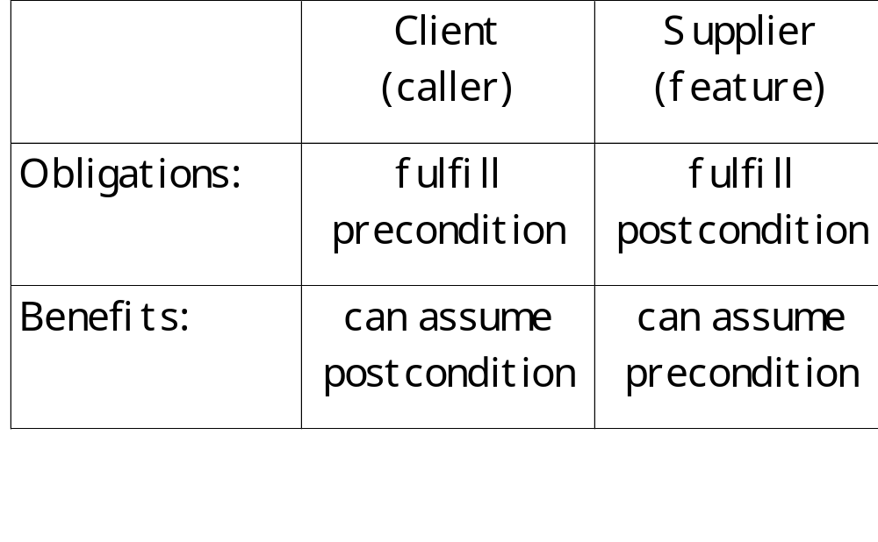
The Contract

Slide 8
Class Invariants
Each class has an explicit invariant
class Stack[G]
private
int count;
boolean isEmpty() { … }
… other things …
invariant
isEmpty() == (count == 0)
end

Slide 9
Theory: Hoare Clauses
Hoare’s Notation for discussing correctness:
{ P } code { Q }
For example:
{ x >= 10 } x = x + 2 { x >= 12 }
Partial Correctness: If a program starts from a state satisfying P, runs the code and completes, then Q will be true.
Full Correctness: If a program start from a state satisfying Q and runs the code, then eventually it will complete with Q being true.

Slide 10
When is a Class Correct?
For every constructor:
{ Pre } code { Post /\ Inv }
For every public method call:
{ Pre /\ Inv } code { Post /\ Inv }
Origin is Abstract Data Type theory
Private methods are not in the contract
Undecidable at compile time

Slide 11
Common Mistakes
Not an input-checking mechanism
  Use if to test human or machine output
  Assertions are always true
Not a control structure
  Assertion monitoring can be turned off
  They are applicative, not imperative, and must not include any side effects
  Besides, exceptions are inefficient
An assertion violation is always a bug
  In precondition: client bug
  In postcondition or invariant: supplier bug

Slide 12
Common Mistakes II
Don’t use defensive programming
  The body of a routine must never check its pre- or post-conditions.
  This is inefficient, and raises complexity.
Don’t hide the contract from clients
  All the queries in a method’s precondition must be at least as exported as the method
  Doesn’t have to be so in postconditions

Slide 13
Inheritance and DbC
The LSP Principle
  Functions that use references to base classes must also work with objects of derived classes without knowing it.
  Or: Derived classes inherit obligations as well
How to break it
  Derived method has a stronger precondition
  Derived method has a weaker postcondition
  Derived class does not obey parent’s invariant

Slide 14
Inheritance and DbC II
class Parent {
void f() {
require PPre
ensure PPost
…
}
invariant PInv
}
class Child extends Parent{
void f() {
require CPre
ensure CPost
…
}
invariant CInv
}
Derivation is only legal if:
  PPre → CPre
  CPost → PPost
  CInv → PInv

Slide 15
Inheritance and DbC III
The Eiffel way
  Child method’s precondition is PPre ∨ CPre
  Child method’s postcondition is PPost ∧ CPost
  Child’s invariant is PInv ∧ CInv
  This is how the runtime monitors assertions
Abstract Specifications
  Interfaces and Abstract methods can define preconditions, postconditions and invariants
  A very powerful technique for frameworks

Slide 16
Loop Correctness
Loops are hard to get right
  Off-by-one errors
  Bad handling of borderline cases
  Failure to terminate
There are two kinds of loops
  Approximation (while and recursion)
  Traversal (traditional for)

Slide 17
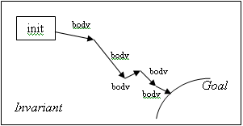
Approximation Loops
Prove that progress is made each step
State the invariant context of progress

Slide 18
Approximation Loops II
The loop is correct if:
  Variant is a decreasing positive integer
  Invariant is true before each iteration
int gcd(int a, int b) {
int x = a, y = b;
while (x != y)
variant max(x, y)
invariant x > 0 && y > 0 // && gcd(x,y)=gcd(a,b)
do if (x > y) x = x – y; else y = y – x;
return x;
}

Slide 19
Traversal Loops
Traverse a known collection or sequence
  for (int i=0; i < 10; i++)
  for (iterator<x> i = xlist.iterator(); ...)
Invariant: Total number of elements
Variant: Number of elements left
Estimator: Number of elements left
Can be imitated by approximation loops
  Use for only when variant = estimator

Slide 20
Why use Design by Contract?
Speed – find bugs faster
Testing – per class, including privates
Reliability – runtime monitoring
Documentation – part of the interface
Reusability – see Ariane 5 crash
Improving programming languages
  Finding more bugs at compile time
  Removing redundant language features

Slide 21
An Example: Null Pointers
The #1 Java runtime error: NullPointerException
How do we know that a call’s target is not null?
{? x != null} x.use {use postconditions}
Out of context:
x := new C; x.use;
Because we checked:
if (x != null) x.use;
while (x != null) { x.use; foo(x); }
But this is not enough!

Slide 22
The Missing Ingredient
Sometimes no checks should be done:
A method’s caller must ensure x != null
x is never null “by nature”
We must document it as well
We must be able to state that ensuring
a property is someone else’s responsibility

Slide 23
Letting the Compiler Check
Rule: x.use does not compile if x != null can’t can’t be proved right before it
Computation Assertions:
  x = new C
  x = y, assuming y != null
  if (x != null) …
  while (x != null) ...

Slide 24
Letting the Compiler Check II
ADT Assertions:
  precondition when feature begins
  postcondition of called feature
  the class invariant
Incremental, per-feature check
Test can be optional per class
All compile-time, yet fully flexible

Slide 25
Sample Caught Bugs
Infinite recursion:
  int count() { return 1 + left.count() + right.count(); }
Forgotten initialization:
  Socket s = new BufferedSocket();
  s.getBuffer().write(“x”); // s.connect() not yet called
Neglecting the empty collection:
  do tok.getToken().print() while (!tok.done());
Using uncertain results:
  f = filemgr.find(filename); f.delete();

Slide 26
The Big Picture
Contracts complement what is learnt from code
Identifying a simple kind of assertions is enough
  But syntax is strict: not (x == null) won’t work
This works even though:
  Assertions aren’t trusted to be correct
  They have no runtime cost, unless requested
The same principle is used for language features
  x.foo(); y.foo(); can run in parallel iff x != y
  x.foo() can bind statically if x exact_instanceof C

Slide 27
DbC in Real Life: C/C++
In C, the assert macro expands to an if statement and calls abort if it’s false
  assert(strlen(filename) > 0);
Assertion checking can be turned off:
  #define NDEBUG
In C++, redefine Assert to throw instead of terminating the program
Every class should have an invariant
Never use if() when assert() is required

Slide 28
DbC in Real Life: UML
UML supports pre- and post-conditions as part of each method’s properties
Invariants are supported at class level
Object Constraint Language is used
  Formal language - not code
  Readable, compared to its competitors
  Supports forall and exists conditions

Slide 29
DbC in Real Life: Java
Assertions that can be turned on and off are only supported from JDK 1.4
  assert interval > 0 && interval <= 1 : interval;
The most popular tool is iContract
  Assertions are Javadoc-style comments
  Instruments source code, handles inheritance
Based on the OCL
  @invariant forall IEmployee e in getEmployees() |
  getRooms().contains(e.getOffice())
  @post exists IRoom r in getRooms() | r.isAvailable()

Slide 30
Exceptions
Definition: a method succeeds if it terminates in a state satisfying its contract. It fails if it does not succeed.
Definition: An exception is a runtime event that may cause a routine to fail.
Exception cases
  An assertion violation (pre-, post-, invariant, loop)
  A hardware or operating system problem
  Intentional call to throw
  A failure in a method causes an exception in its caller

Slide 31
Disciplined Exception Handling
Mistake 1: Handler doesn’t restore stable state
Mistake 2: Handler silently fails its own contract
There are two correct approaches
  Resumption: Change conditions, and retry method
  Termination: Clean up and fail (re-throw exception)
Correctness of a catch clause
  Resumption: { True } Catch { Inv ∧ Pre }
  Termination: { True } Catch { Inv }

Slide 32
Improper Flow of Control
Mistake 3: Using exceptions for control flow
  try { value = hashtable.find(key); }
  catch ( NotFoundException e ) { value = null; }
It’s bad design
  The contract should never include exceptions
It’s extremely inefficient
  Global per-class data is initialized and stored
  Each try, catch, or exception specification cost time
  Throwing an exception is orders of magnitude slower than returning from a function call

Slide 33
Case Study: Genericity
It’s very difficult to write generic, reusable classes that handle exceptions well
  Genericity requires considering exceptions from the template parameters as well
  Both default and copy constructors may throw
  Assignment and equality operators may throw
  In Java: constructors, equals() and clone() may throw
“A False Sense of Security”
  Tom Cargill paper’s on code for class Stack<T>
  Affected design of STL, as well as Java containers
  Among the conclusions: Exceptions affect class design

Slide 34
Goals
Exception Neutrality
  Exceptions raised from inner code (called functions or class T) are propagated well
Weak Exception Safety
  Exceptions (either from class itself or from inner code) do not cause resource leaks
Strong Exception Safety
  If a method terminates due to an exception, the object’s state remains unchanged

Slide 35
Summary
Software Correctness & Fault Tolerance
Design by Contract
  When is a class correct?
  Speed, Testing, Reliability, Documentation, Reusability, Improving Prog. Languages
Exceptions
  What happens when the contract is broken?
  Neutrality, Weak Safety, Strong Safety

