Slide 1
Programming Tools
David Rabinowitz

Slide 2
This Lecture
Personal Productivity Tools
  And how to use them
Refactoring
Static Analysis & Metrics
Profiling

Slide 3
Refactoring
Improving the design of existing code, without changing its observable behavior
Here’s the Extract Method refactoring:
Before:
void f(int[] a) {
…
// compute score
score = initial_score;
for (int i=0; i<a.length; i++)
score += a[i] * delta;
}
After:
void f() {
…
computeScore();
}
computeScore(int[] a) {
// code cut & pasted here
}

Slide 4
Why?
Why Refactor?
  Improve software design
  Make software easier to understand
  Help find bugs
  Help program faster
Preconditions
  Working code
  Good set of unit tests

Slide 5
When?
When to refactor
  Before adding functionality
  Before fixing a bug
  During code review
When not to refactor
  During adding functionality
  During fixing a bug
  No good set of unit tests
  Small programs (usually)

Slide 6
Code Smells
“If it stinks, change it”
  Duplicate code
  Switch statements
  Long method
  Data class
  Long parameter list
  Primitive obsession
  Temporary field
  …

Slide 7
Documented Refactorings
There’s a catalog
  Fowler’s book
  www.refactoring.com/catalog
There are many others
Way to learn good OOD principles
Pay attention to the mechanics

Slide 8
Automated Refactorings
Eclipse’s ‘Refactor’ menu automates thing
  Undo & Redo
  Physical Structure
  Class Level Structure
  Structure Inside a Class
Wizards & Preview Windows Included
Other tools exist: see refactorit.com

Slide 9
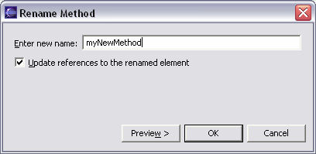
Automated Refactoring Example
The ‘Rename’ Refactoring renames any Java element, and references to it:

Slide 10
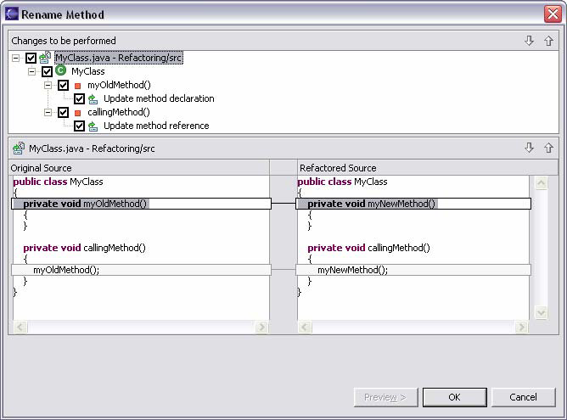
Automated Refactoring Example II
You can preview your changes:

Slide 11
Encapsulate Field
Before:
public String name;
After:
private String name;
public String getName() {
return name;
}
public void setName(String n) {
name = n;
}

Slide 12
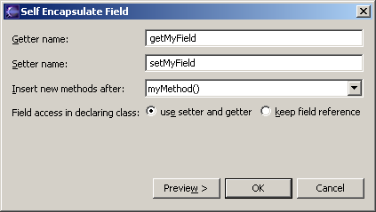
Encapsulate Field in Eclipse

Slide 13
Introduce Null Object
Before:
if (project == null)
plan = Plan.default();
else
plan = project.getPlan();
After:
class NullProject
implements Project {
public Plan getPlan() {
return Plan.default();
}
// other Project methods
}
This is the Null Object Pattern

Slide 14
Parameterize Method
Before:
class Server {
handleGet(…)
handlePut(…)
handleSet(…)
}
After:
class Server {
handle(EventType et, …)
}

Slide 15
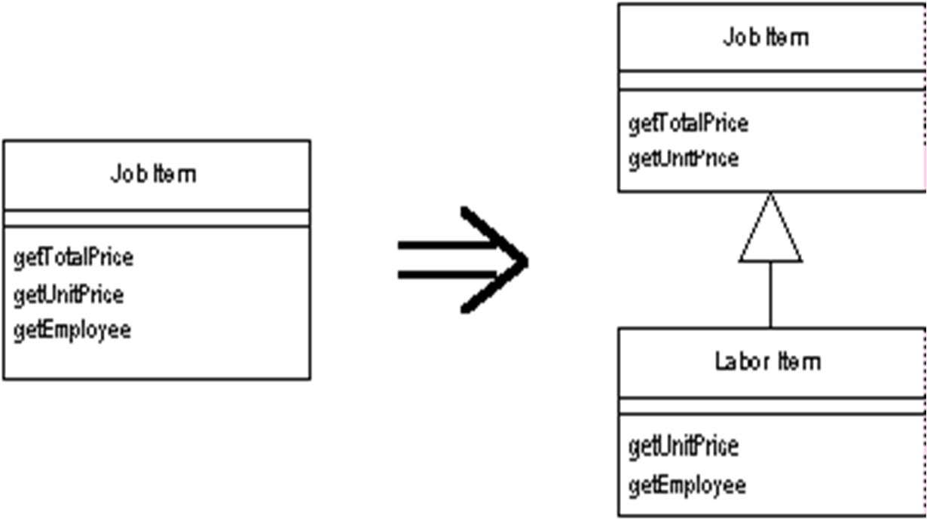
Extract Subclass

Slide 16
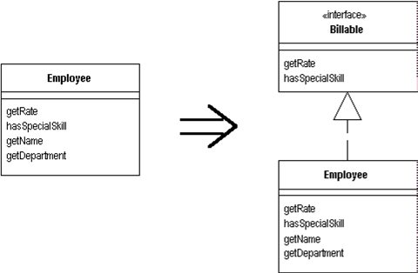
Extract Interface

Slide 17
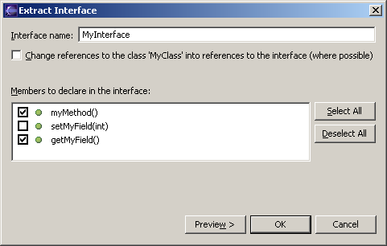
Extract Interface in Eclipse

Slide 18
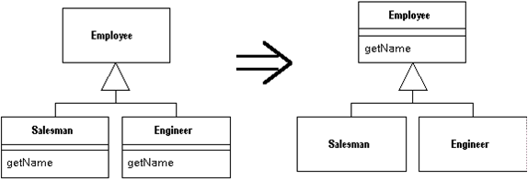
Pull Up Method

Slide 19
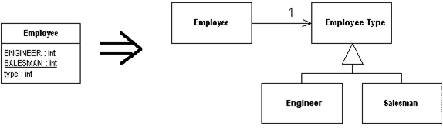
Replace Type Code with State/Strategy

Slide 20
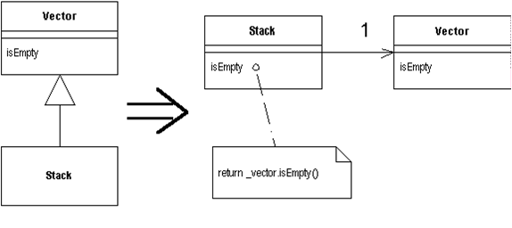
Replace Inheritance with Delegation

Slide 21
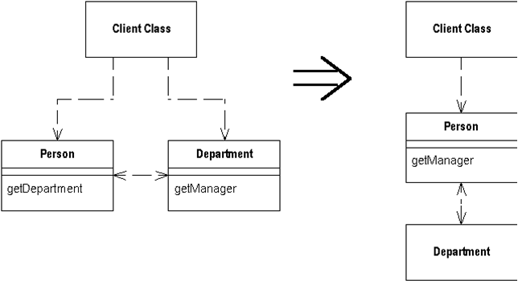
Hide Delegate
Obeys the Law of Demeter

Slide 22
Separate Query from Modifier
Database
Database
getNextResultAndAdvanceIndex
getNextResult
AdvanceIndex
Obeys Command-Query Separation

Slide 23
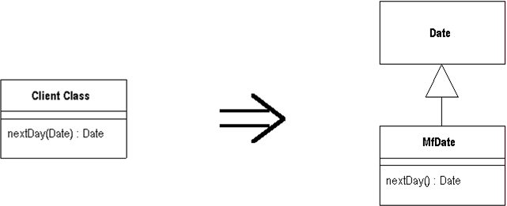
Introduce Local Extension
Alternative: Introduce Foreign Method

Slide 24
The opposites are there too
Inline method (extract method)
Replace Parameter with Explicit Methods (Parameterize Method)
Collapse Hierarchy (Extract subclass)
Remove middle man (Hide delegate)
Push down method (pull up method)
Replace delegation with inheritance

Slide 25
More useful Refactorings in Eclipse
Rename
Move
Change Method Signature
Use Supertype where possible
Extract Constant
Introduce Factory
…

Slide 26
How to Refactor
Recognize the smells
Refactor in small discrete steps
Test after each step
Refactor in pairs
Use documented refactorings
Don’t mix with adding functionality or fixing a bug

Slide 27
Static Code Analysis
Programs that help gain understanding of your code
Find areas in the code with
  Possible Bugs
  “Fishy” Design
  Inconsistent Style
It’s no replacement for testing
  Finding (non-trivial) bugs is undecidable

Slide 28
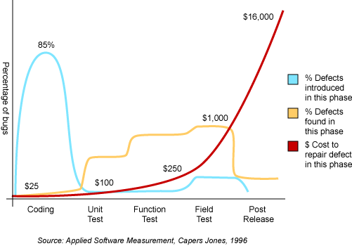
Why is it so important?

Slide 29
Available Tools
Commercial
  Lint for C and C++ (see gimpel.com)
  JTest (parasoft.com)
Free Eclipse Plugins
  JLint (artho.com)
  CPD – Copy Paste Detector
  PMD
  CheckStyle
  JDepend – Metrics

Slide 30
Lint
Looks for over 800 C/C++ Issues
Things that compilers either miss or allow
Specific C++ Errors, for example:
  Throwing from a destructor
  Not checking for NULL argument in ‘delete’
  Order of initializations / constructors
  Non-virtual over-riden methods
Macro scanning
  Incorrect parameter passing, Side effects, …

Slide 31
Lint II
Value Tracking
  Division by zero, null dereference, out-of-bounds, memory leaks, double deallocation, …
Casting & Values
  Loss of sign, truncations, Assignment in ‘if’, …
Specific C Issues
  printf() arguments, order of evaluation: a[i] = i++;
Style
  Indentation, suspicious semi-colons (a > b); , …
Hundreds of other issues

Slide 32
JTest
Checks for 380 Java & Style Issues
Can automatically correct 160 of these
Extensible by user-defined issues
Supports metrics as well
  Number of bytes, classes, lines, methods, …
  Issue = Deviation from acceptable metric range
Some issues are shared with C/C++
  Values, Casting, Unreachable code, Indentation, Comments, Initialization, Exceptions, …

Slide 33
JTest II
Other Java Specific Issues
  Portability
  Security
  Optimization
  Garbage Collection
  Threads and Synchronization
  Internationalization
  Servlets / EJBs
  Naming Conventions
  …

Slide 34
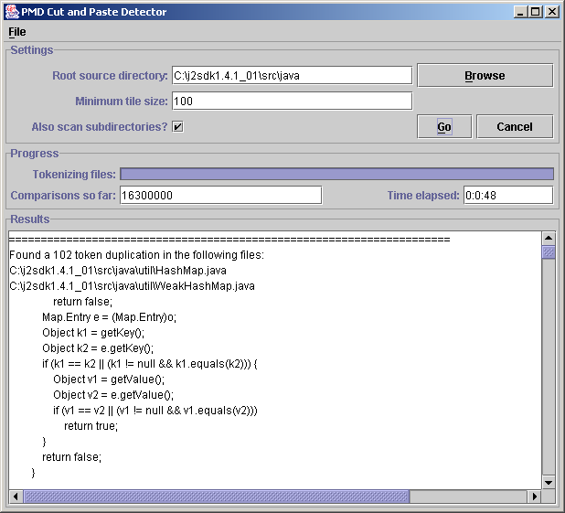
CPD – Copy Paste Detector
Works with Java, C, C++ and PHP
http://pmd. sourceforge.net/ cpd.html
From the examples:
  A 307 lines(!) of duplicated code in Apache 2

Slide 35

PMD
For Java code
Checks
  Unused local variables / parameters / private methods
  Empty catch blocks
  Empty 'if' statements
  Duplicate import statements
  Classes which could be Singletons
  Short/long variable and method names
  And many many more …

Slide 36
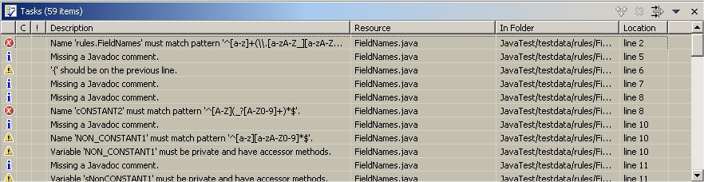
CheckStyle
Similar to PMD
Javadoc Comments, Naming Conventions, Headers, Imports, Size Violations, Whitespace, Modifiers, Blocks, Coding Problems, Class Design, Duplicate Code

Slide 37
JDepend
Calculates metrics for java packages
Calculated metrics
CC - Concrete Class Count
  The number of concrete classes in this package.
AC - Abstract Class Count
  The number of abstract classes or interfaces in this package.

Slide 38
JDepend (2)
Ca - Afferent Couplings
  The number of packages that depend on classes in this package.
  "How will changes to me impact the rest of the project?"
Ce - Efferent Couplings
  The number of other packages that classes in this package depend upon.
  "How sensitive am I to changes in other packages in the project?"

Slide 39
JDepend (3)
A - Abstractness (0-1)
  Ratio (0.0-1.0) of Abstract Classes (and interfaces) in this package.
  AC/(CC+AC)
I - Instability (0-1)
  Ratio (0.0-1.0) of Efferent Coupling to Total Coupling.
  Ce/(Ce+Ca).
D - Distance from the Main Sequence (0-1)
Cyclic - If the package contains a dependency cycle

Slide 40
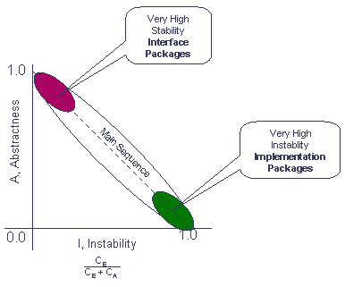
The main sequence

Slide 41
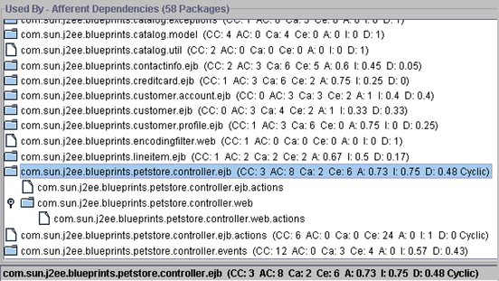
Examples – Pet Store

Slide 42
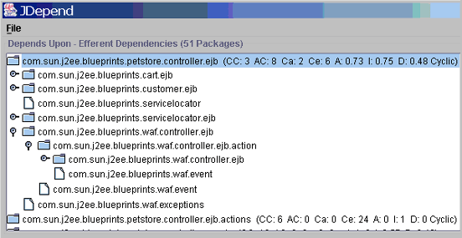
Examples – Pet Store (2)

Slide 43
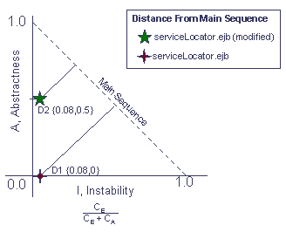
How to improve the rating?

Slide 44
Profiling
A profiler is a program that can track the performance of another program
Used to solve performance problems
  “How come a simple file viewer take 30 seconds to start, and over 2 minutes to find text in a medium text file?”
Used to solve memory problems
  “Why does my text editor take 50MB on startup, and 300MB after a hour of work?”

Slide 45
Performance Tuning
How can I make my program faster?
The 80 / 20 Principle
  80% of the time is spent in 20% of the code
  Key Issue: Find the bottlenecks
Classic Mistake: Assume the bottlenecks
  You can’t know where they’ll be
Classic Mistake II: Optimize in Advance
  Start with the right design, then optimize
Notes:
C++ ⬄ Delphi strings
Dates

Slide 46
Performance Tuning Process
Step 1: Identify the bottlenecks
  Use a profiler!
  Find & measure the bottlenecks
Step 2: Decide how to solve bottlenecks
  Make them faster (new algorithm, data str.)
  Call them less often (caching, lazy execution)
Step 3: Measure again
  Only way to make sure improvement happened

Slide 47
Eclipse Profiler Plugin
We’ll demonstrate on the (free!) Eclipse Profiler Plugin
What is tracked
  CPU
  Memory usage
  Number of objects
  Object graph
  Call graph

Slide 48
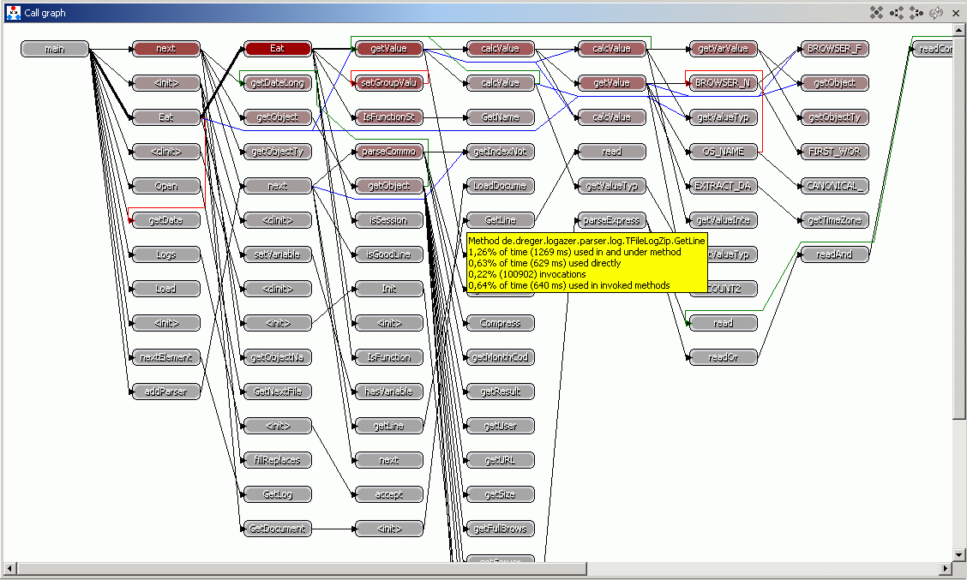
Call Graph

Slide 49
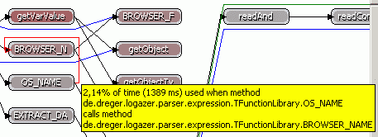
Call hint

Slide 50

Callers

Slide 51
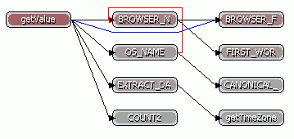
Callees

Slide 52
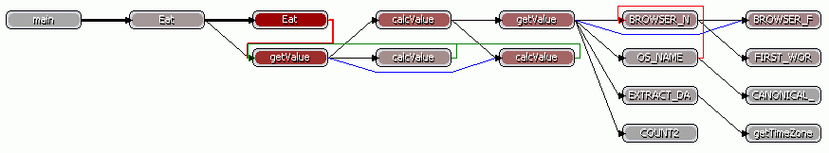
Callers and callees

Slide 53
CPU Profiling
How many invocations were?
How much time have we spent in a package / class / method?
Finds the bottlenecks
  Just sort by time or number of invocations

Slide 54
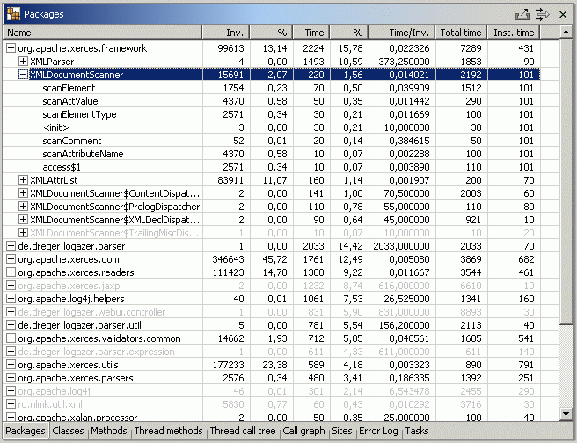
Packages

Slide 55
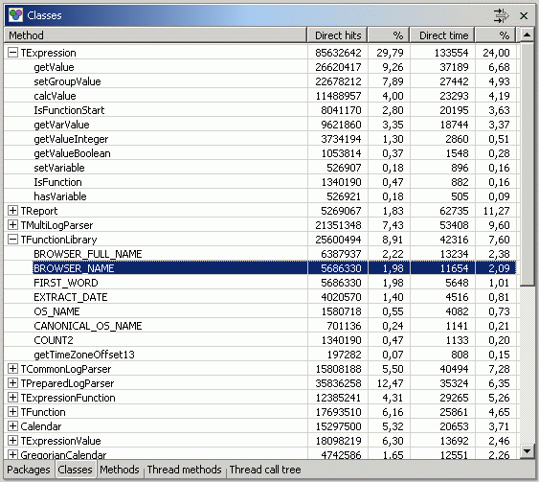
Classes

Slide 56
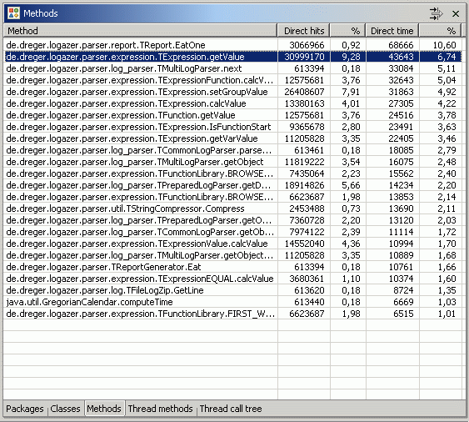
Methods

Slide 57
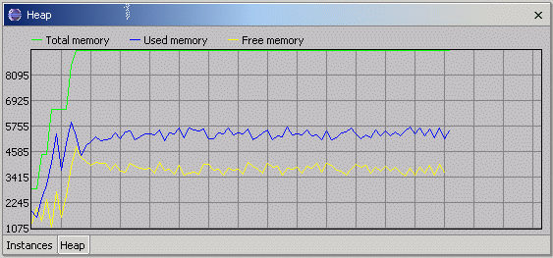
Memory
How much memory does the program take?
Are there memory leaks?

Slide 58
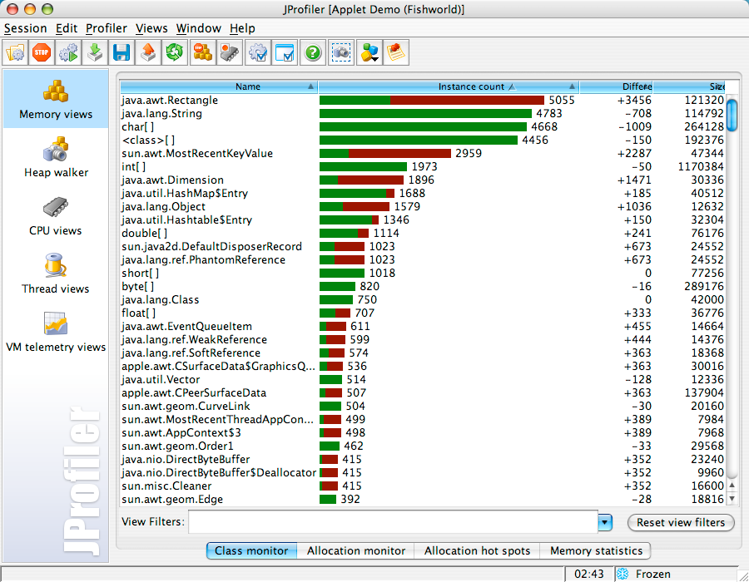
Memory Monitor

Slide 59
Profiling - summery
How does my application behave?
What are the critical paths?
Where are the bottlenecks?
Do I have memory leaks?
  Java users – you are not exempted!

Slide 60
Summary
Personal Productivity Tools
  Refactoring
  Static Analysis & Metrics
  Profilers
Use them!
There’s more – see Eclipse Plugins

