Slide 1
RTTI and Reflection
David Talby

Slide 2
Overview
Static typing
Run-Time Type Information in C++
Reflection in Java
Dynamic Proxies in Java
Syntax, uses and misuses for each

Slide 3
Typing
Static Typing, or Strong Typing:
  The type of every object and expression must be specified and checked at compile-time
  Or: All type violations are caught at compile-time
Dynamic Typing or Weak Typing:
  Type violations are only detected at run-time
What is a type violation?
  Given C x; x.foo(arg); C has no method/operator foo
  Or, arg is not an acceptable argument for it

Slide 4
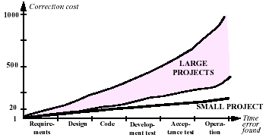
Advantages of Static Typing
Reliability
  Relative cost of error correction, from Boehm, “Software Engineering Economics”, 1981:

Slide 5
Advantages II
Readability
  Part of an interface, like Design by Contract
Efficiency
  Constant-time dynamic binding
  Static binding and inlining
  Optimized machine-code instructions
Static Typing ≠ Static Binding
  Object-oriented language usually use
  static typing with dynamic binding

Slide 6
Run-Time Type Information
David Talby

Slide 7
Run-Time Type Information
A mechanism for safely bypassing typing
Controversial: can be easily abused
Capabilities (C++):
  Testing if an object is of a given type
  Testing if two objects are of the same type
  Retrieving the name of a type
  Imposing a full order on types
C++: dynamic_cast and typeid operators
Java: casting and instanceof operator

Slide 8
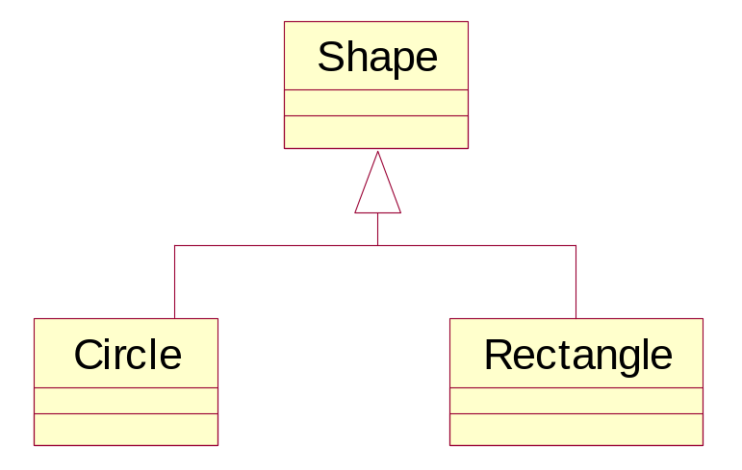
Polymorphic Collections
A list<Shape*> is polymorphic
How to count rectangles, or find max radius?
The language requires a mechanism to test whether a given object is of a given type

Slide 9
Polymorphic Collections II
double max_radius = 0.0;
for (iterator<Shape*> it = list->begin(); it != list->end(); it++)
if (Circle* c = dynamic_cast<Circle*>(*it))
max_radius = max(max_radius, c->radius());
In Java: combine instanceof and C-style cast
Cast will succeed for descendants of Circle
  Obeys Liskov Substitution Principle

Slide 10
dynamic_cast
Source type must be polymorphic
  But not the target type
  Dynamic casts aren’t useful for static types
This enables an efficient implementation: Hold a pointer to type_info in the v-table
my_circle:
vptr
vtable:
type_info
type_info:
“Circle”
(bases)
type_info:
“Shape”

Slide 11
dynamic_cast II
Can be used for pointers and references
  If cast to a pointer failed, return 0
  If cast to a referece failed, throw bad_cast
In Java
  The instanceof always returns a boolean
  All casts are dynamic (checked): ClassCastException
What about static_cast?
  Equivalent to deprecated C-style casts: (Circle*)s
  More efficient: doesn’t examine source object
  Required to cast from void*
  Best avoided – dynamic_cast is safer

Slide 12
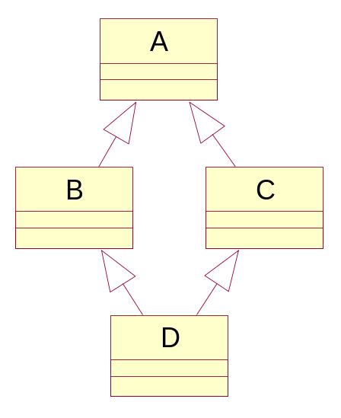
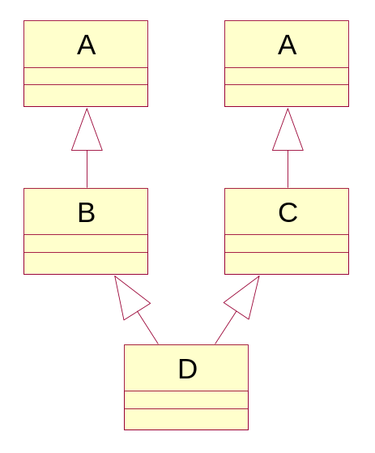
dynamic_cast III
Fails if the source object has more than one unique target base class
Virtual inheritance:
each D has one A
Ordinary inheritance:
each D has two A’s

Slide 13
The typeid operator
Returns the type_info* of an object
type_info supports comparison
  Several type_info* may exist in memory for the same type – required for DLLs
  Compare its objects, not pointers to objects
type_info has a before() order function
  Unrelated to inheritance relationships
type_info has a char* name() function
  Useful for printing debug messages
  Useful for keying more per-type data

Slide 14
More Uses for RTTI
Receiving an object of uncertain content
  Object o = myObjectStream.readObject();
  if (o instanceof Circle) c = (Circle)o;
Inability to alter ancestor classes
  Let Lineman, Boss, BigBoss inherit Worker
  Everyone gets a bonus except the Lineman
  Best solution: virtual bonus() in Worker
  If Worker can’t be changed (no source, many dependencies) – RTTI is the only solution

Slide 15
Misuses of RTTI
It’s easy to use RTTI to violate basics
  Single Choice Principle
  Open-Closed Principle
Virtual functions are required instead of:
  void rotate(Shape* s) {
  if (typeid(s) == typeid(Circle))
  // rotate circle algorithm
  else if (typeid(s) == typeid(Rectangle))
  // rotate rectangle algorithm
  else …

Slide 16
Misuses of RTTI II
Using over-generic base classes
  class List {
  void put(Object o) { … }
  Object get(int index) { … }
  Instead of:
  list<Shape*>
This poses several problems
  Forces casting in source code
  Less efficient
  Reduces compiler type-checking
This is why Java will have generics

Slide 17
Misuses of RTTI III
Casting instead of using adapters
  interface Storable { int objectId(); }
  interface Book {
  String getName() { … }
  String getAuthor() { … }
  }
  class BookImpl implements Book, Storable { … }
“Clients should only work with interfaces”
  Only some clients should know about objectId()
Accessing objectId() requires casting
Violates Liskov Substitution Principle

Slide 18
RTTI & Casting Guidelines
There are very few correct uses
  Polymorphic collections
  Validation of an received object
  Compromise, when a class can’t be changed
Usually, casting means a design error
  Excluding casting between primitive types
  Excluding the current Java collections
Static typing also tests your design

Slide 19
Reflection
David Talby

Slide 20
What is Reflection?
Library and runtime support for:
  Creating class instances and arrays
  Access and modify fields of objects, classes and elements of arrays
  Invoke methods on objects and classes
Java is the most widely used example
  The java.lang.reflect package
  In java.lang: classes Class and Object
All under the Java security model

Slide 21
Reflection API – Class
class Object has a getClass() method:
  System.out.println(obj.getClass().getName());
class Class provides:
static Class forName(String className);
Class[] getClasses(); // all inner classes
Class[] getDeclaredClasses(); // excludes inherited
ClassLoader getClassLoader();
Constructor getConstructor(Class[] parameters);
Constructor[] getConstructors();
Constructor[] getDeclaredConstructors();

Slide 22
Reflection API – Class II
class Class also provides:
Field getField(String name); // and ‘declared’ version
Field[] getFields(); // and ‘declared’ version
Class getDeclaringClass(); // for inner classes
Class[] getInterfaces();
Method getMethod(String name, Class[] params);
Method[] getMethods(); // and ‘declared’ version
String getName();
String getPackage();
int getModifiers();

Slide 23
Reflection API – Class III
class Class even provides:
Class getSuperClass();
boolean isArray();
boolean isAssignableFrom(Class c);
boolean isInstance(Class c);
boolean isInterface();
boolean isPrimitive();
Object[] getSigners(); // and other security data
String toString();
Object newInstance(); // uses default constructor

Slide 24
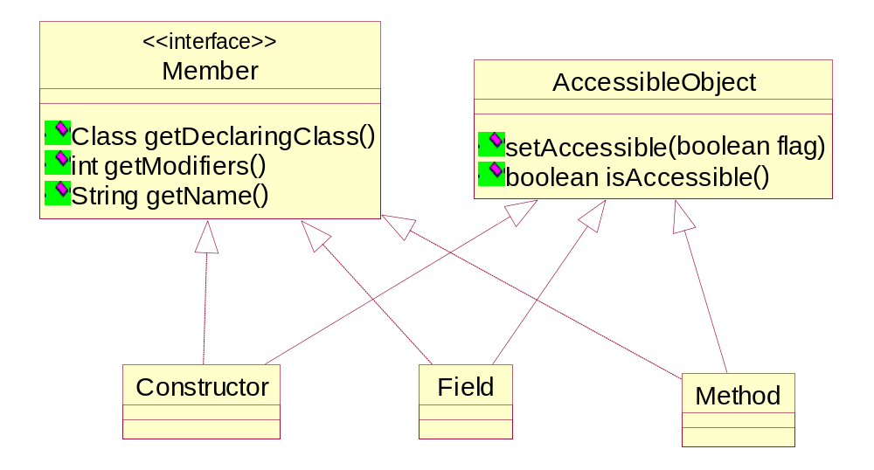
Reflection API - Members

Slide 25
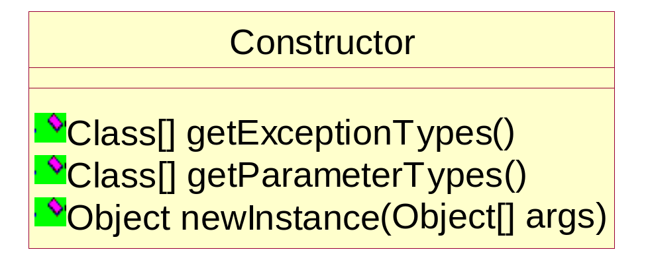
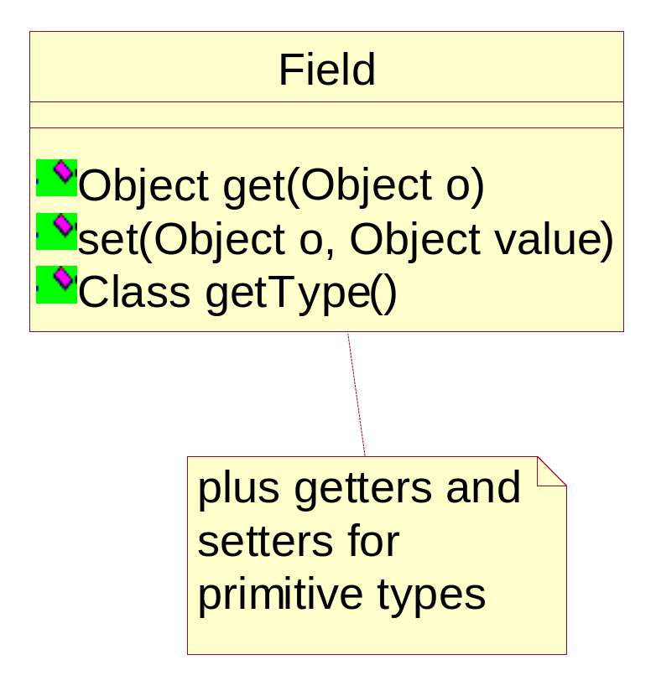
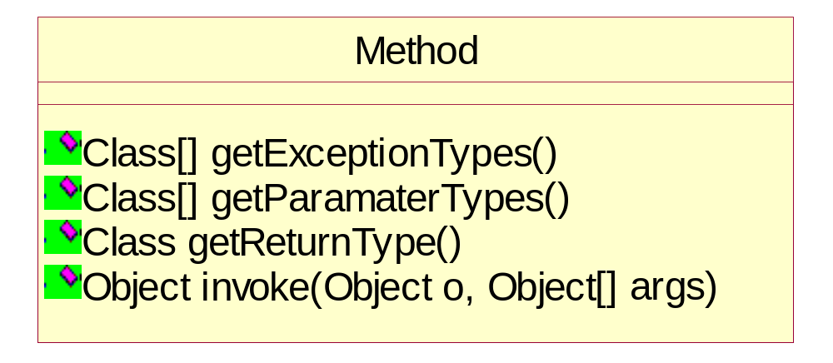
Reflection API – Members II

Slide 26
Reflection API - Others
class Array
  Getters and setters by index, getLength()
  newInstance() of single- or multi-dimensional
class Modifier
  Check return values of getModifiers()
class ReflectPermission
  Beyond normal access/modify/create checks
  Currently only supports SuppressAccessChecks
Several exception types (ignored here)

Slide 27
What is it good for?
Development Tools
  Inspectors of JavaBeans
  Debuggers, class browsers
Runtime services
  Object Serialization
  Object-relational database mapping
Frameworks
  Hooks through a class naming convention
  Plug-ins and add-ins

Slide 28
Object Inspection
Printing an object fields’ names and values
Field[] fa = obj.getClass().getFields();
for (int i=0; i < fa.length; i++)
print(fa[i].getName(); fa[i].get(obj).toString());
Changing a field’s value given its name
obj.getClass().getField(theFieldName).set(obj,newValue);
Printing an inheritance tree, given a class name
Class c = Class.forName(theClassName);
while (c != null) {
System.out.println(c.getName());
c = c.getSuperClass();
}

Slide 29
Serialization
Writing an object to XML:
Class c = obj.getClass();
StringBuffer output = new StringBuffer();
output.append(“<“ + c.getName() + “>”);
Field[] fa = c.getFields();
for (int i=0; i < fa.length; i++) {
output.append(“<“+fa[i].getName()+”>”);
output.append(fa[i].get(obj).toString());
output.append(“</“+fa[i].getName()+”>”);
}

Slide 30
Serialization II
Non-primitive reference objects must be recursively written as XML elements
  Use Class.isPrimitive() to test each field type
Fields marked as transient aren’t written
  Use Modifier.isTransient(Field.getModifiers())
Objects must be rebuilt from XML data
  Use Class.forName() to find object’s class, Class.getField() to find fields, and Field.set()
Java serialization is implemented this way
  But writes to a more efficient binary format

Slide 31
Plug-Ins
Your new game enables downloading new weapons from the web
Define an interface for Weapon
Download *.class files of new stuff into:
  A directory called c:\MyGame\weapons (or weapons.jar)
  where c:\MyGame is the home class path
When the program starts:
String[] files = findFileNames(pluginDir + “\*.class”);
Weapon[] weapons = new Weapon[files.length];
for (int i=0; i < weapons.length; i++)
weapons [i] = (Weapon)Class.forName(
“weapons.”+files[i]).newInstance();

Slide 32
Plug-Ins II
The weapons array is a list of prototypes
  Alternative: Hold Class[] array
Multiple interfaces are easy to support
  Use Class.getInterfaces() on downloaded files
All Weapon code is type-safe
  And secure, if there’s a security policy
There are better plug-in implementations
  See class ClassLoader
  Classes can be stored and used from the net

Slide 33
Reflection Guidelines
☺ Reflection is a new reuse mechanism
☹ It’s a very expensive one
Use it when field and class names as strings were necessary anyway
  Class browsers and debuggers, serialization to files or databases, plug-in class names
Use it to write very generic frameworks
  Plug-ins and hooks to be written by others
Don’t use it just to show off…

Slide 34
Dynamic Proxies
David Talby

Slide 35
Dynamic Proxies
Support for creating classes at runtime
  Each such class implements interface(s)
  Every method call to the class will be delegated to a handler, using reflection
  The created class is a proxy for its handler
Applications
  Aspect-Oriented Programming: standard error handling, log & debug for all objects
  Creating dynamic event handlers

Slide 36
Invocation Handlers
Start by defining the handler:
  interface java.lang.reflect.InvocationHandler
  With a single method:
  Object invoke( // return value of call
  Object proxy, // call’s target
  Method method, // the method called
  Object[] args) // method’s arguments
The “real” call made: proxy.method(args)
  Simplest invoke(): method.invoke(proxy,args)

Slide 37
Creating a Proxy Class
Define the proxy interface:
  interface Foo { Object bar(Object obj); }
Use java.lang.reflect.Proxy static methods to create the proxy class:
  Class proxyClass = Proxy.getProxyClass(
  Foo.class.getClassLoader(), new Class[] { Foo.class });
First argument – the new class’s class loader
2nd argument – list of implemented interfaces
The expression C.class for a class C is the static version of C_obj.getClass()

Slide 38
Creating a Proxy Instance
A proxy class has one constructor which takes one argument – the invocation handler
Given a proxy class, find and invoke this constructor:
  Foo foo = (Foo)proxyClass.
  getConstructor(new Class[] { InvocationHandler.class }).
  newInstance(new Object[] { new MyInvocationHandler() });
Class Proxy provides a shortcut:
Foo f = (Foo) Proxy.newProxyInstance(
Foo.class.getClassLoader(),
new Class[] { Foo.class },
new MyInvocationHandler());

Slide 39
A Few More Details
We ignored a bunch of exceptions
  IllegalArgumentException if proxy class can’t exist
  UndeclaredThrowableException if the handler throws an exception the interface didn’t declare
  ClassCastException if return value type is wrong
  InvocationTargetException wraps checked exceptions
A proxy class’s name is undefined
  But begins with Proxy$
Primitive types are wrapped by Integer, Boolean, and so on for argument and return values
The syntax is very unreadable!
  Right, but it can be encapsulated inside the handler

Slide 40
A Debugging Example
We’ll write an extremely generic class, that can wrap any object and print a debug message before and after every method call to it
Instead of a public constructor, it will have a static factory method to encapsulate the proxy instance creation
It will use InvocationTargetException to be exception-neutral to the debugged object

Slide 41
A Debugging Example II
The class’s definition and construction:
public class DebugProxy
implements java.lang.reflect.InvocationHandler {
private Object obj;
public static Object newInstance(Object obj) {
return java.lang.reflect.Proxy.newProxyInstance(
obj.getClass().getClassLoader(),
obj.getClass().getInterfaces(),
new DebugProxy(obj)); }
private DebugProxy(Object obj) { this.obj = obj; }

Slide 42
A Debugging Example III
The invoke() method:
public Object invoke(Object proxy, Method m,
Object[] args) throws Throwable {
Object result;
try {
System.out.println("before method " + m.getName());
result = m.invoke(obj, args);
} catch (InvocationTargetException e) {
throw e.getTargetException();
} catch (Exception e) {
throw new RuntimeException("unexpected:” + e.getMessage());
} finally {
System.out.println("after method " + m.getName()); }
return result; }

Slide 43
A Debugging Example IV
Now that the handler is written, it’s very simple to use. Just define an interface:
interface Foo { Object bar(Object o); }
class FooImpl implements Foo { … }
And wrap it with a DebugProxy:
Foo foo = (Foo)DebugProxy.newInstance(new FooImpl());
This is not much different than using any proxy or decorator
Just much, much slower

Slide 44
Dynamic Proxies: Summary
Applications similar to above example:
  Log every exception to a file and rethrow it
  Apply an additional security policy
Other kinds of applications exist as well
  Dynamic event listeners in Swing
  In general, being an observer to many different objects or interfaces at once
It’s a very new feature – from JDK 1.3
  There may be other future applications

