Slide 1
Common mistakes
Basic Design Principles
David Rabinowitz

Slide 2
Common Mistakes
Repeated often
Don’t you make them!
How to recognize the danger signals?

Slide 3
Danger Signals (1)
public class Counter {
public int howManyA(String s) {
int conut = 0;
for(int i = 0; i < s.length(); ++i)
if(s.charAt(i) == 'a')
++count;
return count;
}
}
Is this a class?

Slide 4
Danger Signals (2)
Class City extends Place { … }
Class Jerusalem extends City implements Capital { … }
Class TelAviv extends City { … }
What is wrong here?

Slide 5
Danger Signals (3)
Class Person {
  String getName(); void setName(String name);
  int getAge(); void setAge(int age);
  Car getCar(); void setCar(Car car);
}
What do we see ?

Slide 6
Basic Design Principles (abridged)
The Open Closed Principle
The Dependency Inversion Principle
The Interface Segregation Principle
The Acyclic Dependencies Principle
Notes:
Package cohesion
The Common Closure Principle
The Common Reuse Principle
The Law Of Demeter

Slide 7
The Open Closed Principle
Software entities (classes, modules, functions, etc.) should be open for extension, but closed for modification.
In the OO way:
  A class should be open for extension, but closed for modification.
Existing code should not be changed – new features can be added using inheritance or composition.

Slide 8
Example
enum ShapeType {circle, square};
struct Shape {
ShapeType _type;
};
struct Circle {
ShapeType _type;
double _radius;
Point _center;
};
struct Square {
ShapeType _type;
double _side;
Point _topLeft;
};
void DrawSquare(struct Square*)
void DrawCircle(struct Circle*);

Slide 9
Example (cont.)
void DrawAllShapes(struct Shape* list[], int n) {
int i;
for (i=0; i<n; i++) {
struct Shape* s = list[i];
switch (s->_type) {
case square:
DrawSquare((struct Square*)s);
break;
case circle:
DrawCircle((struct Circle*)s);
break;
}
}
}
Where is the violation?

Slide 10
Correct Form
class Shape {
public:
virtual void Draw() const = 0;
};
class Square : public Shape {
public:
virtual void Draw() const;
};
class Circle : public Shape {
public:
virtual void Draw() const;
};
void DrawAllShapes(Set<Shape*>& list) {
for (Iterator<Shape*>i(list); i; i++)
(*i)->Draw();

Slide 11
The Dependency Inversion Principle
High level modules should not depend upon low level modules. Both should depend upon abstractions.
Abstractions should not depend upon details. Details should depend upon abstractions.

Slide 12
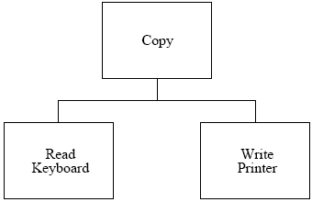
Example
Where is the violation?
void Copy() {
  int c;
  while ((c = ReadKeyboard()) != EOF)
  WritePrinter(c);
}

Slide 13
Example (cont.)
Now we have a second writing device – disk
enum OutputDevice {printer, disk};
void Copy(outputDevice dev) {
int c;
while ((c = ReadKeyboard()) != EOF)
if (dev == printer)
WritePrinter(c);
else
WriteDisk(c);
}

Slide 14
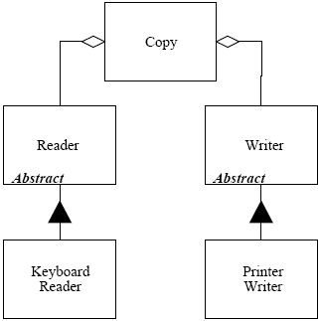
Correct form
class Reader {
public:
virtual int Read() = 0;
};
class Writer {
public:
virtual void Write(char)=0;
};
void Copy(Reader& r,
Writer& w) {
int c;
while((c=r.Read()) != EOF)
w.Write(c);
}

Slide 15
The Interface Segregation Principle
The dependency of one class to another one should depend on the smallest possible interface.
Avoid “fat” interfaces

Slide 16
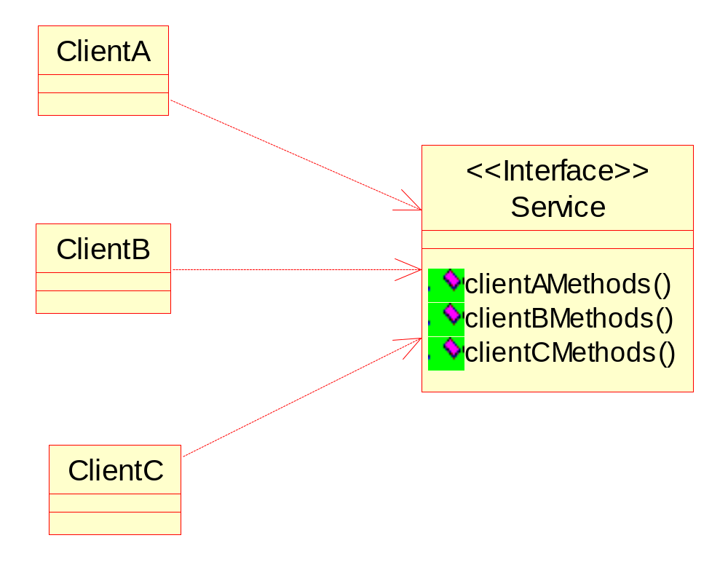
The Interface Segregation Principle

Slide 17
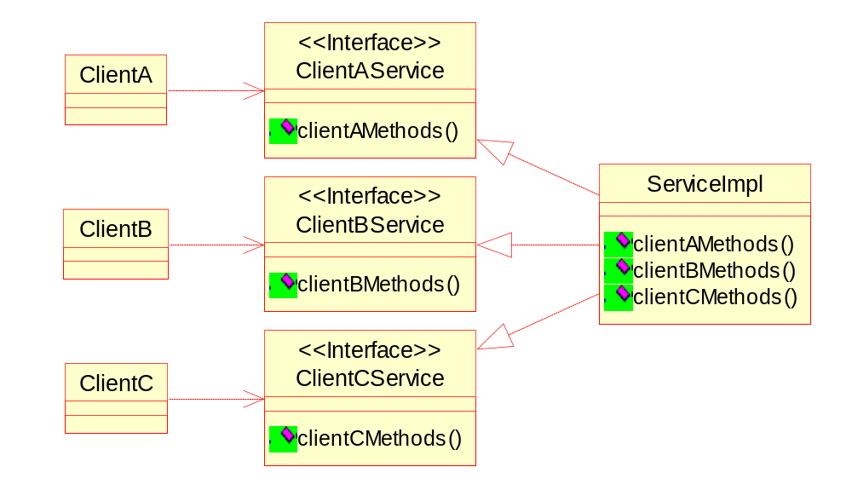
The Interface Segregation Principle

Slide 18
Example
class Timer {
public:
void Regsiter(int timeout,
TimerClient* client);
};
class TimerClient {
public:
virtual void TimeOut() = 0;
};
class Door {
public:
virtual void Lock() = 0;
virtual void Unlock() = 0;
virtual bool IsDoorOpen() = 0;
};

Slide 19
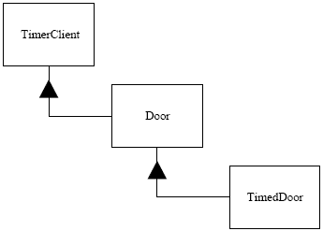
A Timed Door

Slide 20
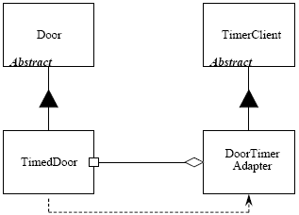
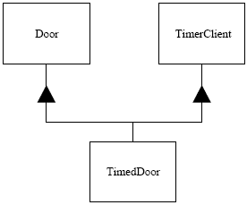
Correct Form
Two options:
Adapter
Multiple Inheritence

Slide 21
The Acyclic Dependencies Principle
The dependency structure between packages must not contain cyclic dependencies.

Slide 22
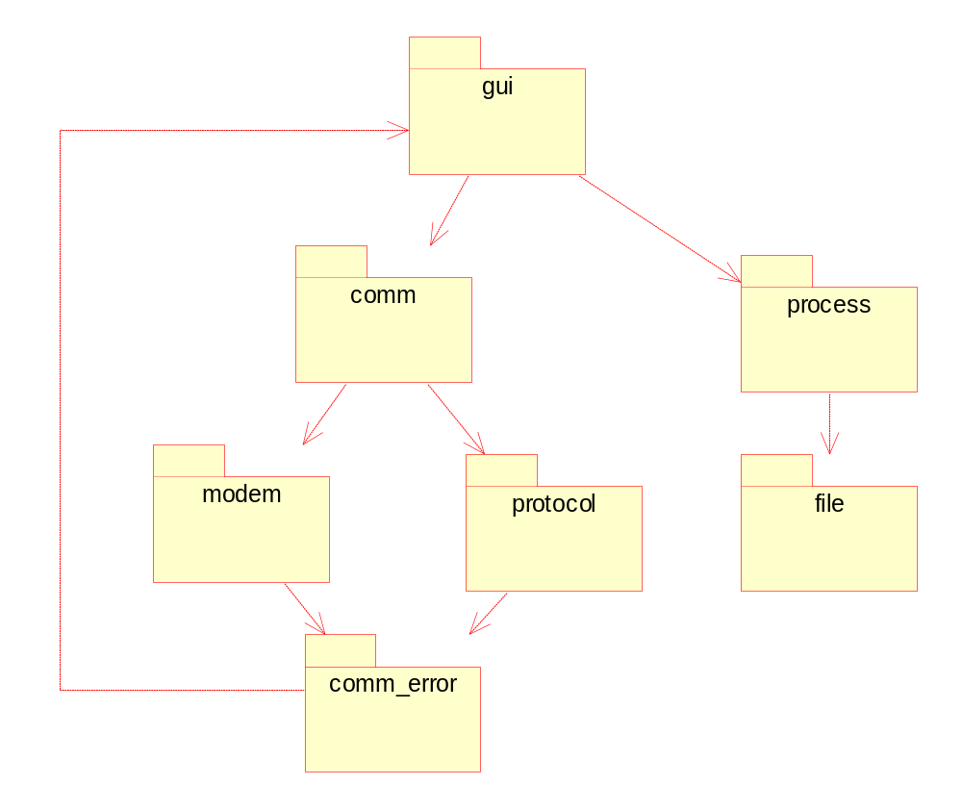
Example

Slide 23
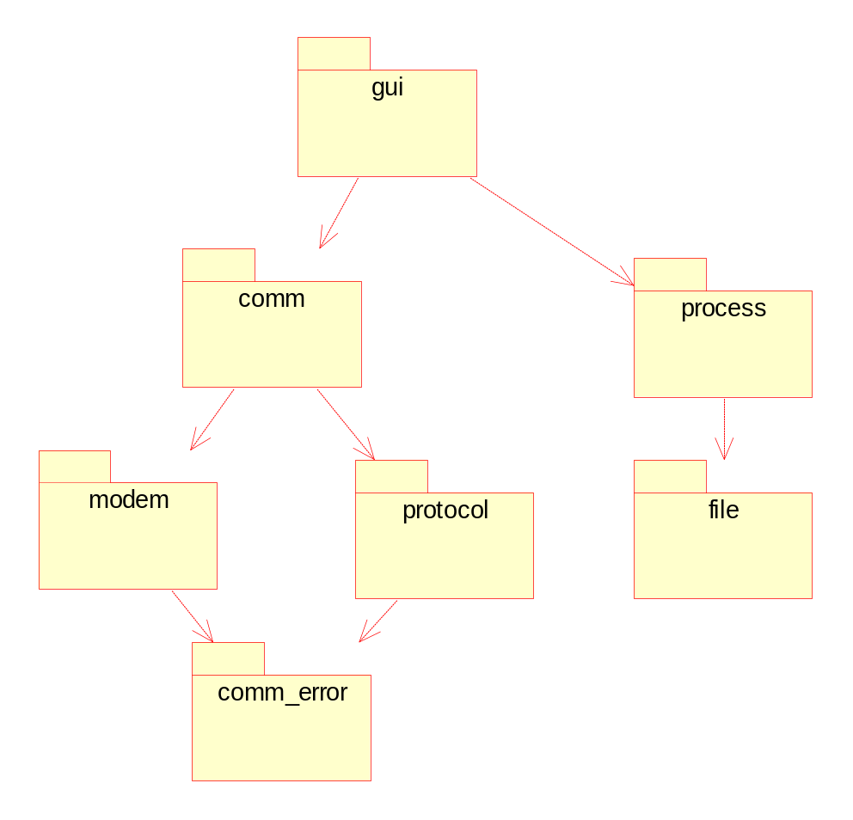
Correct Form

Slide 24
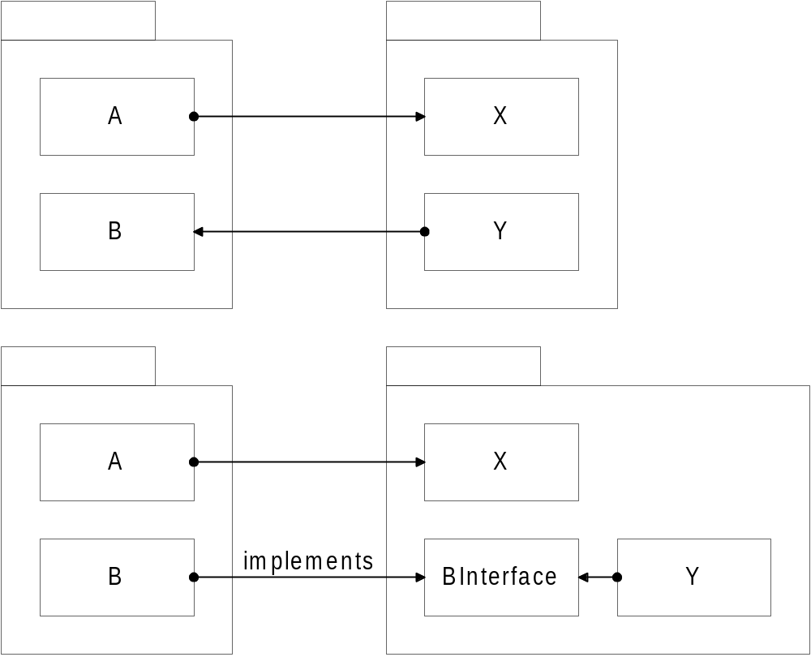
Example 2

Slide 25
The Law Of Demeter
Only talk to your immediate friends.
In other words:
  You can play with yourself. (this.method())
  You can play with your own toys (but you can't take them apart). (field.method(), field.getX())
  You can play with toys that were given to you. (arg.method())
  And you can play with toys you've made yourself. (A a = new A(); a.method())

Slide 26
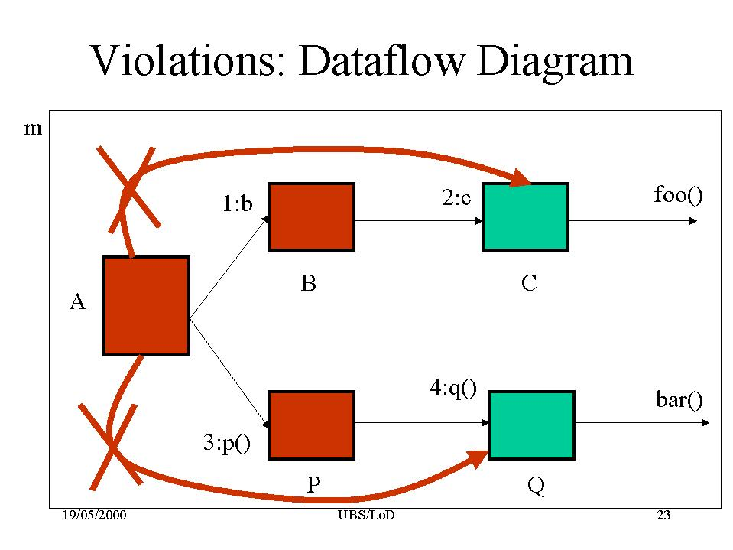
Example

Slide 27
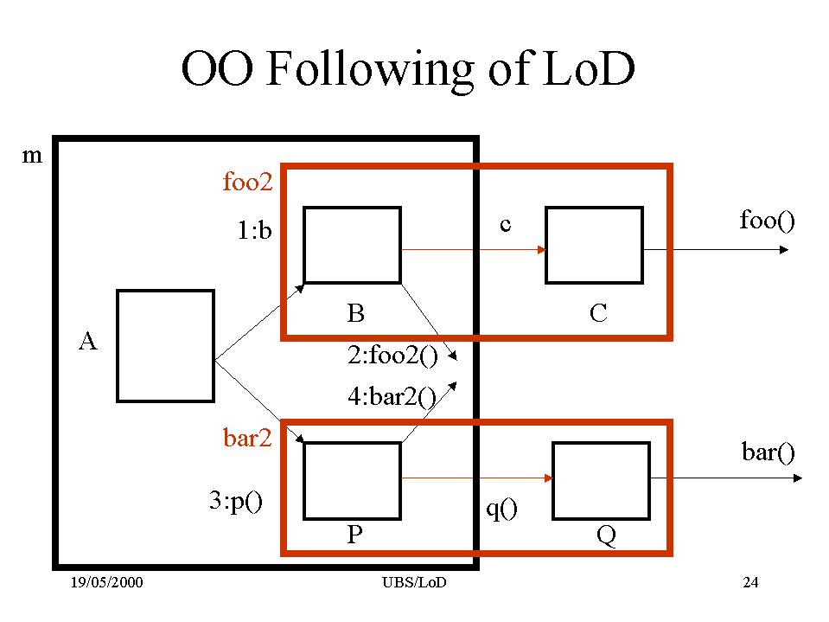
How to correct

Slide 28
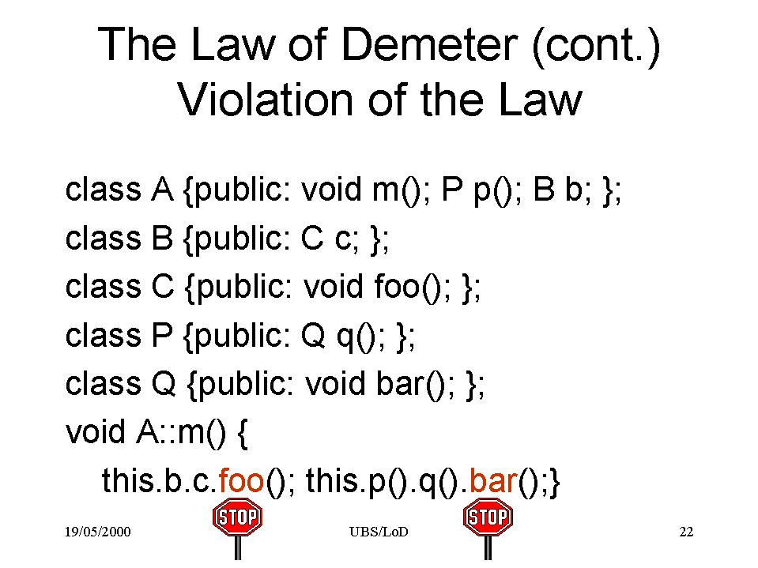
Example Code

Slide 29
Resources
Our resources page
http://www.objectmentor.com/ resources/articleIndex
  Don’t be afraid from “old” articles

Slide 30
Package cohesion
The Common Closure Principle
  Classes within a released component should share common closure. That is, if one needs to be changed, they all are likely to need to be changed.
The Common Reuse Principle
  The classes in a package are reused together. If you reuse one of the classes in a package, you reuse them all.

