Slide 1
Design Patterns
David Talby

Slide 2
This Lecture
What is it all about?
Abstract Factory
Composite
Strategy

Slide 3
Introduction
O-O Design is Hard
Errors are expensive
Reuse experts’ designs
Pattern = Documented experience

Slide 4
Expected Benefits
Finding the right classes
Finding them faster
Common design jargon
Consistent format
Coded infrastructures

Slide 5
O-O Programming
An interface is a contract to clients.
A class implements interface(s).
Objects are instances of classes.
Objects are only accessed through their public interfaces.
Only two relations between classes: Inheritance and composition

Slide 6
Object Relationships
Inheritance: Static and efficient, but exposes and couples modules
Composition: Hides more from client and can change dynamically
Gang of Four:
“Favor composition over inheritance”
Dijkstra: “Most problems in computer science can be solved by another level of indirection”.

Slide 7
Designing for Change
The Open-Closed Principle
Non-clairvoyance
Key Issue: Prepare for change!
Well, prepare for what?

Slide 8
Causes of Redesign
Dependence on hardware or software platform
Dependence on representation or implementation
Specifying a class upon creation
Algorithmic dependence
Tight coupling
Overuse of inheritance
Inability to alter classes easily

Slide 9
Pattern Categories
Creational - Replace explicit creation problems, prevent platform dependencies
Structural - Handle unchangeable classes, lower coupling and offer alternatives to inheritance
Behavioral - Hide implementation, hides algorithms, allows easy and dynamic configuration of objects

Slide 10
Pattern of Patterns
Encapsulate the varying aspect
Interfaces
Inheritance describes variants
Composition allows a dynamic choice between variants
Criteria for success:
Open-Closed Principle
Single Choice Principle

Slide 11
1. Abstract Factory
A program must be able to choose one of several families of classes
For example, a program’s GUI should run on several platforms
Each platform comes with its own set of GUI classes:
WinButton, WinScrollBar, WinWindow
MotifButton, MotifScrollBar, MotifWindow
pmButton, pmScrollBar, pmWindow

Slide 12
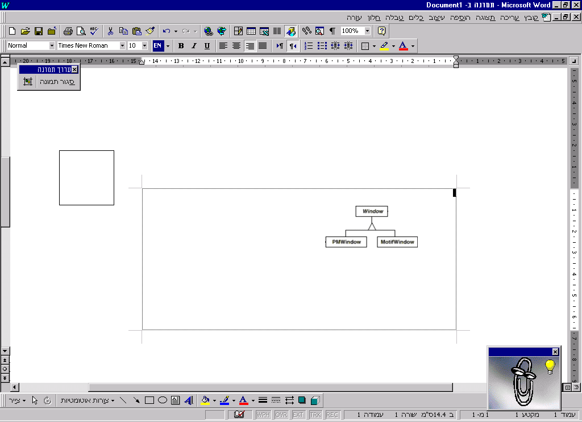
The Requirements
Uniform treatment of every button, window, etc. in the code
  Easy - Define their interfaces:
Uniform object creation
Easy to switch between families
Easy to add a family

Slide 13
The Solution
Define a Factory - a class that creates objects:
class WidgetFactory {
Button* makeButton(args) = 0;
Window* makeWindow(args) = 0;
// other widgets…
}

Slide 14
The Solution II
Define a concrete factory for each of the families:
class WinWidgetFactory {
Button* makeButton(args) {
return new WinButton(args);
}
Window* makeWindow(args) {
return new WinWindow(args);
}
}

Slide 15
The Solution III
Select once which family to use:
WidgetFactory* wf =
new WinWidgetFactory();
When creating objects in the code, don’t use ‘new’ but call:
Button* b = wf->makeButton(args);
Switch families - once in the code!
Add a family - one new factory, no effect on existing code!

Slide 16

The Big (UML) Picture

Slide 17
The Fine Print
The factory doesn’t have to be abstract, if we expect a remote possibility of having another family
Usually one factory per application, a perfect example of a singleton
Not easy to extend the abstract factory’s interface

Slide 18
Known Uses
Different operating systems
(could be Button, could be File)
Different look-and-feel standards
Different communication protocols

Slide 19
Pattern of Patterns
Encapsulate the varying aspect
Interfaces
Inheritance describes variants
Composition allows a dynamic choice between variants
Criteria for success:
Open-Closed Principle
Single Choice Principle

Slide 20
2. Composite
A program must treat simple and complex objects uniformly
For example, a painting program has simple objects (lines, circles and texts) as well as composite ones (wheel = circle + six lines).

Slide 21
The Requirements
Treat simple and complex objects uniformly in code - move, erase, rotate and set color work on all
Some composite objects are defined statically (wheels), while others dynamically (user selection)
Composite objects can be made of other composite objects
We need a smart data structure

Slide 22
The Solution
All simple objects inherit from a common interface, say Graphic:
class Graphic {
void move(int x, int y) = 0;
void setColor(Color c) = 0;
void rotate(double angle) = 0;
}
The classes Line, Circle and others inherit Graphic and add specific features (radius, length, etc.)

Slide 23
The Solution II
This new class inherits it as well:
class CompositeGraphic
: public Graphic,
public list<Graphic>
{
void rotate(double angle) {
for (int i=0; i<count(); i++)
item(i)->rotate();
}
}

Slide 24
The Solution III
Since a CompositeGraphic is a list, it had add(), remove() and count() methods
Since it is also a Graphic, it has rotate(), move() and setColor() too
Such operations on a composite object work using a ‘forall’ loop
Works even when a composite holds other composites - results in a tree-like data structure

Slide 25
The Solution IV
Example of creating a composite:
CompositeGraphic *cg;
cg = new CompositeGraphic();
cg->add(new Line(0,0,100,100));
cg->add(new Circle(50,50,100));
cg->add(t); // dynamic text graphic
cg->remove(2);
Can keep order of inserted items if the program needs it

Slide 26
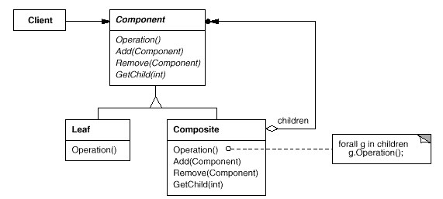
The GoF UML
Single Inheritance
Root has add(), remove() methods

Slide 27
The Fine Print
Sometimes useful to let objects hold a pointer to their parent
A composite may cache data about its children (count is an example)
Make composites responsible for deleting their children
Beware of circles in the graph!
Any data structure to hold children will do (list, array, hashtable, etc.)

Slide 28
Known Uses
In almost all O-O systems
Document editing programs
GUI (a form is a composite widget)
Compiler parse trees (a function is composed of simpler statements or function calls, same for modules)
Financial assets can be simple (stocks, options) or a composite portfolio

Slide 29
Pattern of Patterns
Encapsulate the varying aspect
Interfaces
Inheritance describes variants
Composition allows a dynamic choice between variants
Criteria for success:
Open-Closed Principle
Single Choice Principle

Slide 30
3. Strategy
A program must switch between complex algorithms dynamically
For example, a document editor has several rendering algorithms, with different time/beauty tradeoffs
Word is a common example

Slide 31
The Requirements
Algorithms are complex, would be havoc to have them inside the one Document class
Switch algorithms dynamically
Easy to add new algorithms

Slide 32
The Solution
Define an abstract class that represents an algorithm:
class Renderer {
void render(Document *d) = 0;
}
Each specific algorithm will be a descendant class
FastRenderer, TexRenderer, …

Slide 33
The Solution II
The document itself chooses the rendering algorithm:
class Document {
render() {
renderer->render(this);
}
setFastRendering() {
renderer = new FastRenderer();
}
private: Renderer *renderer;
}

Slide 34
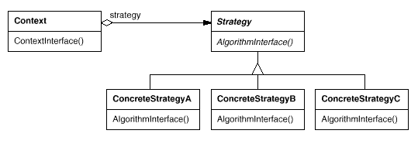
The GoF UML

Slide 35
The Fine Print
Inheriting a strategy would deny a dynamic switch
Some strategies may not use all information passed from Context
Strategies can be stateless, and then they can be shared
In some cases strategy objects are optional

Slide 36
Known Uses
Document rendering programs
Compiler code optimizations
Different heuristic algorithms (games, portfolio selection)
Different memory management schemes (Booch components)
Validation of dialog boxes (optional strategies, Borland ObjectWindows)

Slide 37
Pattern of Patterns
Encapsulate the varying aspect
Interfaces
Inheritance describes variants
Composition allows a dynamic choice between variants
Criteria for success:
Open-Closed Principle
Single Choice Principle

Slide 38
Summary
Experience is required to see these patterns when they occur in your application
It’s worth looking for them - someone else has already done a major part of your job!
Patterns are practical example of the O-O approach’s usefulness
“Catalog” of 23 patterns on Intranet

