Slide 1
Design Patterns
David Talby

Slide 2
This Lecture
The Creational Patterns
  Builder
  Prototype
  Factory Method
  (Abstract Factory)
  Singleton
Choosing Between Them

Slide 3
Creational Patterns
Easily Change:
  What gets created?
  Who creates it?
  When is it created?
Hide the concrete classes that get created from client code
Competing patterns, each with its own strengths

Slide 4
4. Builder
Separate the specification of how to construct a complex object from the representation of the object
For example, a converter reads files from one file format
It should write them to one of several output formats

Slide 5
The Requirements
Single Choice Principle
  Same reader for all output formats
  Output format chosen once in code
Open-Closed Principle
  Easy to add a new output format
  Addition does not change old code
Dynamic choice of output format

Slide 6
The Solution
We should return a different object depending on the output format:
  HTMLDocument, RTFDocument, …
Separate the building of the output from reading the input
Write an interface for such a builder
Use inheritance to write different concrete builders

Slide 7
The Solution II
Here’s the builder’s interface:
class Builder {
void writeChar(char c) { }
void setFont(Font *f) { }
void newPage() { }
}

Slide 8
The Solution III
Here’s a concrete builder:
class HTMLBuilder
: public Builder
{
private:
HTMLDocument *doc;
public:
HTMLDocument *getDocument() {
return doc;
}
// all inherited methods here
}

Slide 9
The Solution IV
The converter uses a builder:
class Converter
{
void convert(Builder *b) {
while (t = read_next_token())
switch (o.kind) {
CHAR: b->writeChar(o);
FONT: b->setFont(o);
// other kinds…
}
}
}

Slide 10
The Solution V
This is how the converter is used:
RTFBuilder *b = new RTFBuilder;
converter->convert(b);
RTFDocument *d = b->getDocument();

Slide 11
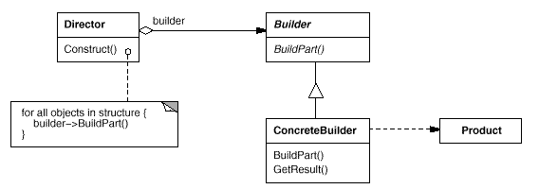
The UML

Slide 12
The Fine Print
The builder’s interface affects the ease of coding concrete builders
Kinds of documents don’t need a common base class
Methods in class Builder are empty and not abstract
getResult() is not always trivial
  Optimizations
  Lazy Creation

Slide 13
Known Uses
Converting to different formats
Building a parse tree in a compiler
Building a normalized database

Slide 14
5. Prototype
Specify the kind of object to create using a prototypical instance
For example, a photo/map editor has a palette of tools and objects that can be created
How do we have only one class for creations, and parameterize it by the class of objects it initializes?

Slide 15
The Requirements
One class for the creation tool
Easy to add new objects
Dynamic toolbox configuration

Slide 16
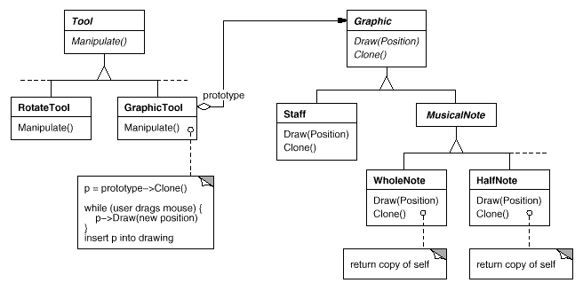
The Solution
Hold a prototype of object to create
Creation is by cloning the prototype

Slide 17
The Solution II
Less classes in the system
Can be even less: same Graphic object with different properties can be used for different tools
Tools can be chosen and configured at runtime

Slide 18
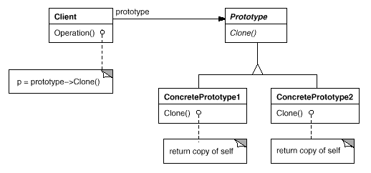
The UML

Slide 19
The Fine Print
Prototype Manager - a runtime registry of prototype can handle dynamically linked classes
Java, SmallTalk, Eiffel provide a default clone() method. C++ has copy constructors
All of these are shallow by default
When implementing deep clone, beware of circular references!

Slide 20
Known Uses
Toolboxes / Palettes
Supporting dynamically defined debuggers in a uniform GUI
EJB / COM Servers
Basically a plug-in mechanism

Slide 21
6. Factory Method
Let subclasses decide which objects to instantiate
For example, a framework for a windowing application has a class Application which must create an object of class Document
But the actual applications and documents are not written yet!

Slide 22
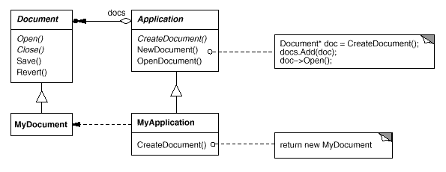
The Solution
Separate creation into a method

Slide 23
Second Variant
A remote services package has a RemoteService class that returns objects of class Proxy to client
A few clients wish to write a more potent CachedProxy
How do we support this without much hassle?

Slide 24
Second Variant Solution
Separate creation into a method
RemoteService will have a virtual method called CreateProxy()
Write CachedProxy, then write:
class CachedRemoteService
: public RemoteService
{
Proxy* createProxy(...) {
return new CachedProxy(...);
}
}

Slide 25
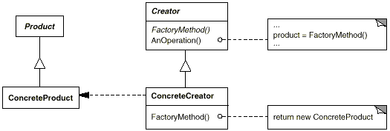
The UML

Slide 26
The Fine Print
Two Variants: Is the factory method abstract or not?
Good style to use factory methods even for a slight chance of need
Parameterized factory methods make it easy to add created products without affecting old code
Product* createProduct(int id) {
switch (id) { ... }
}

Slide 27
The Fine Print II
C++ warning: You can’t call a factory method from a constructor!
  Use lazy initialization instead
Product* getProduct() {
if (_product == NULL)
_product = createProduct();
return _product;
}
Use templates to avoid subclassing
  Application<ExcelDocument>
  complex<float>, complex<double>

Slide 28
Known Uses
A very common pattern
Framework classes
  Application, Document, View, ...
Changing default implementations
  Proxy, Parser, MemoryManager, …

Slide 29
Pattern of Patterns
Encapsulate the varying aspect
Interfaces
Inheritance describes variants
Composition allows a dynamic choice between variants
Criteria for success:
Open-Closed Principle
Single Choice Principle

Slide 30
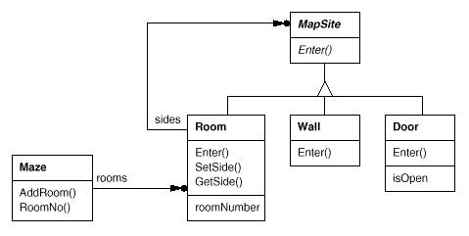
A Comparative Example

Slide 31
The Example Problem
Maze* MazeGame::CreateMaze () {
Maze* aMaze = new Maze;
Room* r1 = new Room(1);
Room* r2 = new Room(2);
Door* theDoor = new Door(r1, r2);
aMaze->AddRoom(r1);
aMaze->AddRoom(r2);
r1->SetSide(North, new Wall);
r1->SetSide(East, theDoor);
// set other sides, also for r2
return aMaze;
}

Slide 32
Enchanted Mazes
How do we reuse the same maze with EnchantedRoom, TrapDoor?
  Pass createMaze an object that can create different maze parts
  Pass createMaze an object that can build a maze and then return it
  Pass createMaze initialized samples of each kind of maze part
  Move creation with new to other methods that descendants redefine

Slide 33
1. Abstract Factory
Define a set of interfaces
  Door, Wall, Room, ...
Write families of classes
  SimpleDoor, SimpleRoom, …
  EnchantedDoor, EnchantedRoom,...
Define an abstract MazeFactory, and a concrete class for each family
  SimpleFactory, EnchantedFactory, …
Pass createMaze a factory

Slide 34
Abstract Factory II
Maze* MazeGame::CreateMaze (MazeFactory* mf) {
Maze* aMaze = mf->createMaze();
Room* r1 = mf->createRoom(1);
Room* r2 = mf->createRoom(2);
Door* d = mf->createDoor(r1,r2);
// rest is same as before
Families don’t have to be disjoint
Same factory can return variants of the same class

Slide 35
Abstract Factory Cons
Requires a new factory class for every family
Families are defined statically
Parts of the complex maze are returned right after creation
The client of the factory builds the connections between maze parts
Maze stands for any complex object

Slide 36
Builder Pros & Cons
Pros
  Each builder can create a totally different kind of object
  Object returned only at the end of construction - enables optimization
  Especially if object is on network
Cons
  Complex Interface to builder

Slide 37
Prototype Pros & Cons
Pros
  Less Classes
  Prototype can be customized between different creations
Cons
  Requires memory to hold prototype
  Many prototypes must be passed
  Clone() may be hard to implement

Slide 38
Factory Method P&C
Pros
  The simplest design
Cons
  Requires a new class for every change in creation
  Compile-time choice only

Slide 39
The Verdict
Use Factory Methods when there is little (but possible) chance of change
Use Abstract Factory when different families of classes are given anyway
Use Prototype when many small objects must be created similarly
Use Builder when different output representations are necessary

Slide 40
Some Easy Cases
Dynamic loading of classes whose objects must be created
  only Prototype
Creation can be highly optimized once entire structure is known
  only Builder

Slide 41
7. Singleton
Ensure that only one instance of a class exists, and provide a global access point to it
For example, ensure that there’s one WindowManager, FileManager or PrintSpooler object in the system
Desirable to encapsulate the instance and responsibility for its creation in the class

Slide 42
The Solution
O-O languages support methods shared by all objects of a class
  static in C++ and Java
  class methods in SmallTalk, Delphi
The singleton class has a reference to its single instance
The instance has a getter method which initializes it on the first request
The class’s constructor is protected to prevent creating other instances

Slide 43
The Solution
class Spooler {
public:
static Spooler* instance() {
if (_instance == NULL)
_instance = new Spooler();
return _instance;
}
protected:
Spooler() { ... }
private:
static Spooler* _instance = 0;
}

Slide 44
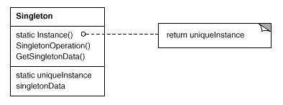
The UML

Slide 45
The Fine Print
Passing arguments for creation can be done with a create(...) method
Making the constructor public makes it possible to create other instance except the “main” one
  Not a recommended style
instance() can manage concurrent access or manage a list of instances
Access to singletons is often a bottleneck in concurrent systems

Slide 46
Known Uses
Every system has singletons!
WindowManager, PrinterManager, FileManager, SecurityManager, ...
Class Application in a framework
Log and error reporting classes
With other design patterns

Slide 47
Summary: Connections
“Abstract Factories are usually implemented using Factory Methods but can also use Prototypes”
“Builders and Abstract Factories are often Singletons”
“Builders can use Abstract Factories to enjoy best of both worlds”

