Slide 1
Design Patterns
David Talby

Slide 2
This Lecture
Patterns for a User Interface
  Representing a Document
    Composite, Flyweight, Decorator
  Writing Portable Code
    Abstract Factory, Singleton, Bridge
  Undo, Macros and Versions
    Command

Slide 3
A Word Processor
Pages, Columns, Lines, Letters, Symbols, Tables, Images, ...
Font and style settings per letter
Frames, Shadows, Background, Hyperlink attached to anything
Unlimited hierarchy: Tables with several Paragraphs containing hyper-linked images inside tables
Should be open for additions...

Slide 4
A Data Structure
First, a uniform interface for simple things that live in a document:
class Glyph
{
void draw(Window *w) = 0;
void move(double x, double y) = 0;
bool intersects(Point *p) = 0;
void insert(Glyph *g, int i) = 0;
void remove(int i) = 0;
Glyph* child(int i) = 0;
Glyph* parent() = 0;
}

Slide 5
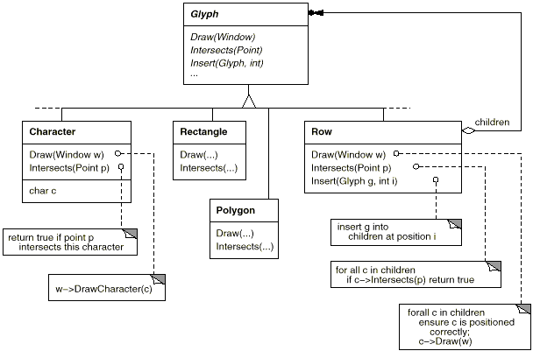
Composite Documents

Slide 6
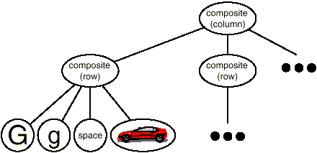
At Runtime
Unlimited Hierarchy problem solved
Dynamic selection of composites
Open for additions

Slide 7
8. Flyweight
Use sharing to support a large number of small objects efficiently
For example, if every character holds font and style data, a long letter will require huge memory
Even though most letters use the same font and style
How do we make it practical to keep each character as an object?

Slide 8
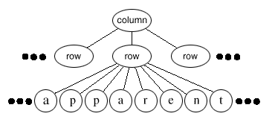
The Requirements
Reduce the memory demands of having an object per character
Keep the flexibility to customize each character differently

Slide 9
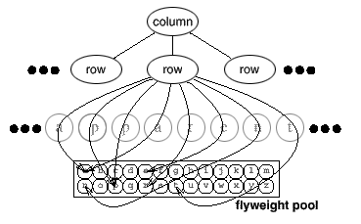
The Solution
Extrinsic state = worth sharing
Intrinsic state = not worth sharing

Slide 10
The Solution II
Put extrinsic state in a class:
class CharacterContext {
Font* font;
bool isItalic, isBold, ...;
int size;
int asciiCode;
// many others…
draw(int x, int y) { ... }
// other operational methods
}

Slide 11
The Solution III
Original class holds rest of state:
class Character : public Glyph {
CharacterContext *cc;
int x, y;
draw() {
cc->draw(x,y);
}
}

Slide 12
The Solution IV
A factory manages the shared pool
It adds the object to the pool if it doesn’t exists, and returns it
Here’s Character’s constructor:
Character(int x, int y, Font *f, …) {
this->x = x;
this->y = y;
this->cc =
factory.createCharacter(f, …);
}

Slide 13
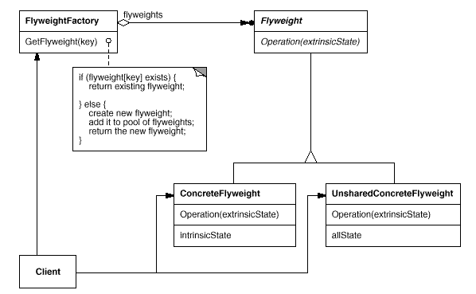
The UML

Slide 14
The Fine Print
There’s a lot of tradeoff in what is defined as “extrinsic”
Shared pool is usually a hash table
Use reference counting to collect unused flyweights
Don’t rely on object identity
  Different objects will seem equal

Slide 15
Known Uses
Word processors
  Average 1 flyweight per 400 letters
Widgets
  All data except location, value
Strategy design pattern
State design pattern

Slide 16
9. Decorator
Attach additional features to an objects dynamically
For example, many features can be added to any glyph in a document
  Background, Note, Hyperlink, Shading, Borders, …

Slide 17
The Requirements
We can freely combine features
  An image can have a background,
  a border, a hyper-link and a note
Features are added and removed dynamically
Can’t afford a class per combination
Should be easy to add new features
  Don’t put it all in Glyph

Slide 18
The Solution
Meet Decorator, a class for adding responsibilities to another glyph:
class Decorator : public Glyph
{
void draw() {
component->draw();
}
// same for other features
private:
Glyph *component;
}

Slide 19
The Solution II
Define concrete decorators:
class BackgroundDecorator
: public Decorator
{
void draw() {
drawBackground();
glyph->draw();
}
}

Slide 20
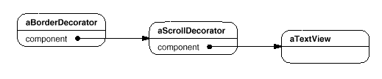
The Solution III
Many decorators can be added and removed dynamically:
Behavior can be added before and after calling the component
Efficient in space
Order of decoration can matter

Slide 21
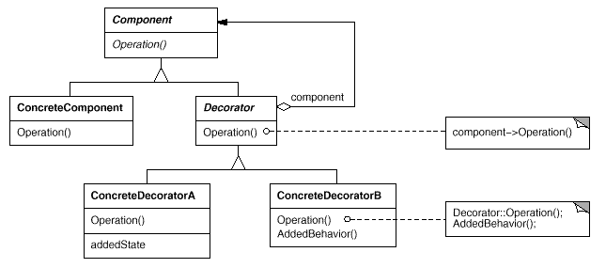
The UML

Slide 22
The Fine Print
The Decorator class can be omitted if there’s only one decorator or Glyph is very simple
The Glyph class should be lightweight and not store data

Slide 23
Known Uses
Embellishing Document
  Background, Border, Note, ...
Communication Streams
  Encrypted, Buffered, Compressed

Slide 24
Data Structure Summary
Patterns work nicely together
  Composite, Decorator, Flyweight don’t interfere
Data structures are not layered
  Instead, clients work on a Glyph interface hiding structures of unknown, dynamic complexity

Slide 25
Saving and Loading
Java has serialization
Save to disk / Send over network by simply writing the root Glyph object of a document
All optimizations saved as well!
Also works on subtrees
Very little coding
In C++ - best to code read() and write() and work the same way

Slide 26
Cut, Copy, Paste
Cut = Detach a subtree
Copy = Clone a subtree
Paste = Attach a subtree
Also works on composite glyphs
Glyphs should hold a reference to parents for the cut operations
Cloning of a flyweight should only increase its reference count!

Slide 27
10. Bridge
Separate an abstraction from its implementations
For example, a program must run on several platforms
Each platform comes with its own set of GUI classes:
WinButton, WinScrollBar, WinWindow
MotifButton, MotifScrollBar, MotifWindow
pmButton, pmScrollBar, pmWindow

Slide 28
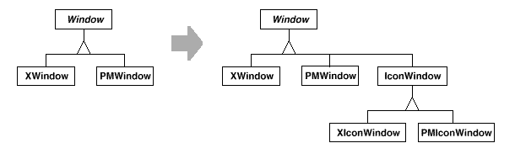
Abstract Factory, Right?
An abstract factory can be used to provide these advantages:
  Clients treat widgets uniformly
  Easy to add or switch families
However, it requires a class per platform per abstraction:

Slide 29
The Requirements
One class per abstraction,
one class per implementation
  Basically all platforms give similar functionality for a window
  If a platform doesn’t support a feature, we should code it once

Slide 30
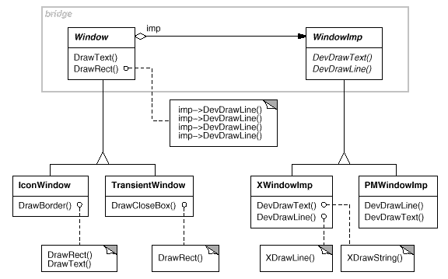
The Solution
Separate the two hierarchies:

Slide 31
The Solution II
Usually, an implementation inherits the abstraction it implements
The Bridge patterns simply replaces this by composition
This gives several advantages in cases such as the above:
  An abstraction can choose its implementation at runtime
  Even change implementations

Slide 32
The Solution III
  Both the abstractions and the implementations can be extended by subclassing
  Changing one does not force recompilation of the other
  In C++ this technique completely hides a class’s implementation (its private functions and members)
  Many abstractions can share the same implementation

Slide 33
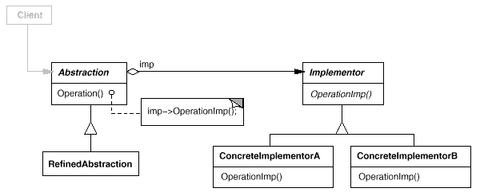
The GoF UML

Slide 34
The Fine Print
Choosing the implementor can still be done with an Abstract Factory
Stateless implementors can be shared (so the Abstract Factory becomes a Flyweight factory)

Slide 35
Known Uses
A program that must run on several platforms
A data structures library
  Abstractions: Set, List, Array, Table
  Implementations: LinkedList, HashTable, DenseArray, …
Different kinds of images versus algorithms to display them

Slide 36
11. Command
Encapsulate commands as objects
We’ll take the the uses one by one:
  Undo/Redo
  Macros
  Queues and logs
  Version control
  Crash recovery
  Message Grouping

Slide 37
The Requirements I
Undo / redo at unlimited depth
Only store relevant data for undo
Easy to add commands

Slide 38
The Solution
Repesent a command as a class:
class Command
{
public:
virtual void execute() = 0;
virtual void undo() = 0;
}

Slide 39
The Solution II
Concrete commands hold undo data:
class DeleteLine : public Command {
void execute() {
line = document->getLine();
document->removeLine();
}
void undo() {
document->addLine(line);
}
private:
Line line;
}

Slide 40
The Solution III
Keep a list of executed commands:
  Array<Command*> commands;
  int i;
When you click the ‘Undo’ button:
  commands(i)->undo();
  i--;
When you click the ‘Redo’ button:
  commands(i)->execute();
  i++;

Slide 41
The Solution IV
Whenever a command is activated:
  commands.add(new_command);
  i = commands.count();
When you save a document:
  document->save();
  commands.clear();
  i = 0;
The commands list may or may not be limited in size
Only relevant undo data is kept

Slide 42
The Requirements II
Macros are a series of commands
Any command with any of its options may be used
There are also for and while loops, if statements, calls to other macros...

Slide 43
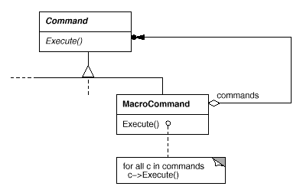
The Solution
A macro is a Composite Command
if, for, while are Decorator Commands

Slide 44
The Requirements III
Commands are accessible from menus as well as toolbars
A command may be available from more than one place
We’d like to configure the menus and toolbars at runtime

Slide 45
The Solution
Each MenuItem or ToolbarItem
refers to its command object
Just as it refers to an image
The command can be configured
  Less command classes
Macros fit in the picture as well!

Slide 46
The Requirements IV
Keep multiple versions of a document
When saving, only store the changes from the previous version

Slide 47
The Solution
The changes are exactly the list of commands since the last version was loaded
In addition, a compaction algorithm is needed for commands that cancel each other
Save = Serialize the compacted list
Load = Read early version and call
execute on command lists

Slide 48
(More!) Known Uses
Programs log commands to disk so they can be used in case of a crash
  Works, since commands are small
  Usually in a background thread
Commands can be grouped and sent as one command to a server
  Grouping for efficient communication
  Grouping to define a transaction
  Works even for user defined macros!

Slide 49
Another Summary
Interfaces rule
  As long as Command is abstract, who cares how complex it is
Composition rules
  Decorator and Bridge provide flexibility in less written code by avoiding inheritance
Serialization should rule

