Slide 1
Design Patterns
David Talby

Slide 2
This Lecture
More for a Document Editor
  Synchronizing Multiple Windows
    Observer
  Simplifying complex interactions
    Mediator
  Working on complex structures
    Iterator
    Visitor

Slide 3
12. Observer
Define a one-to-many dependency between objects, so that changing one automatically updates others
For example, a spreadsheet and several charts of it are open
Changing data in a window should be immediately reflected in all

Slide 4
The Requirements
Document and Chart classes must not know each other, for reuse
Easily add new kinds of charts or other links
A dynamic number of charts

Slide 5
The Solution
Terminology
  Subject and Observer
  Publisher and Subscriber
  Listeners
Subjects attach and detach listeners, and notify of events
Clients update themselves after receiving a notification

Slide 6
The Solution II
Here’s an abstract observer:
class Observer {
void update() = 0;
}
Concrete observers such as class Chart will inherit Observer

Slide 7
The Solution III
Here’s the (concrete!) subject:
class Subject {
void attach(Observer *o)
{ observers.add(o); }
void detach(Observer *o)
{ observers.remove(o); }
void notify() {
for i in observers do
o->update();
}
protected:
List observers;
}

Slide 8
The Solution IV
Both subject and observer will usually inherit from other classes as well
If multiple inheritance is not available, the observer must be a separate class that has a reference to the chart object and updates it
Java has a special mechanism – Inner classes – to make this easier

Slide 9
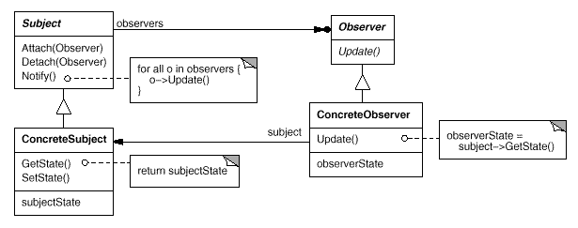
The UML

Slide 10
The Fine Print
Observing more than one subject
  Update must include an extra argument to tell who is updating
Observing only certain events
  Attach must include an extra argument to tell which events interest this observer
Observing small changes
  Update includes arguments to tell what changed, for efficiency

Slide 11
The Fine Print II
Who calls Notify?
  Greedy – the subjects, on change
  Lazy – the observers, on query
Common errors
  Forgetting to detach an object when it is destroyed
  Calling Notify in an inconsistent state
Java includes Observer as part of the standard libraries
  In package java.util

Slide 12
Known Uses
All frameworks of all kinds
  MFC, COM, Java, EJB, MVC, …
Handle user interface events
Handle asynchronous messages

Slide 13
13. Mediator
Encapsulate a complex interaction to preserve loose coupling
Prevent many inter-connections between classes, which means that changing their behavior requires subclassing all of them
For example, a dialog box includes many interactions of its widgets. How do we reuse the widgets?

Slide 14
The Requirements
A widget is a kind of colleague
Colleague don’t know about the interactions they participate in
  Can be reused for different dialogs
Colleagues don’t know about others
  Allow only O(n) connections
Easy to change interactions

Slide 15
The Solution
All colleagues talk with a mediator
The mediator knows all colleagues
Whenever a colleague changes, it notifies its mediator
The mediator codes the interaction logic, and calls operations on other colleagues

Slide 16
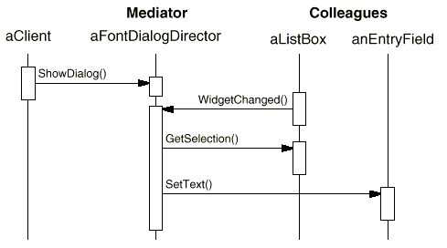
The Solution II
An example interaction:

Slide 17
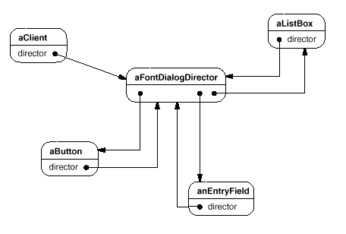
The Solution III
Only O(n) connections:

Slide 18
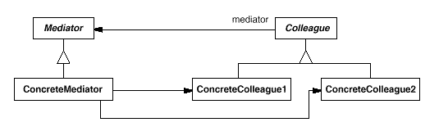
The UML

Slide 19
The Fine Print
The interaction logic (mediator) and colleagues can be reused separately and subclassed separately
Protocols are simpler since n-to-1 relations replace n-to-m relations
Abstract mediator class is unnecessary if there’s only one mediator
Observer or mediator?
  One-to-many or many-to-many?
  Should the logic be centralized?

Slide 20
Known Uses
Widgets in a user interface
  Delphi and VB “hide” this pattern
Connectivity constraints in diagrams

Slide 21
14. Iterator
without exposing its representation
An extremely common pattern
For example, a list should support forward and backward traversals
  Certainly not by exposing its internal data structure
Adding traversal methods to List’s interface is a bad idea

Slide 22
The Requirements
Traversal operations should be separate from List<G>’s interface
Allow several ongoing traversals on the same container
Reuse: it should be possible to write algorithms such as findItem that work on any kind of list

Slide 23
The Solution
Define an abstract iterator class:
class Iterator<G> {
void first() = 0;
void next() = 0;
bool isDone() = 0;
G* item() = 0;
}

Slide 24
The Solution II
Each data structure implementation will also implement an iterator class:
  ListIterator<G>
  HashTableIterator<G>
  FileIterator<G>
  StringIterator<G>
Each data structure can offer more than one iterator:
  Forward and backward iterators
  Preorder, inorder, postorder

Slide 25
The Solution III
For example:
class BackwardArrayIterator<G>
: public Iterator<G>
{
Array<G> *container;
int pos;
public:
BackwardArrayIterator(Array *a)
{ container = a; first(); }
next()
{ --pos; }
// other methods easy
}

Slide 26
The Solution IV
A data structure’s interface should return iterators on itself:
class List<G>
{
Iterator<G>* getForwardIterator()
{ return new
ListForwardIterator(this); }
Iterator<G>* getBackwardIterator()
// similarly
}
Now every LinkedList object can have many active iterators

Slide 27
The Solution V
Writing functions for containers:
void print(Iterator<int>* it)
{
for (it->first();
!it->isOver();
it->next())
cout << it->item();
}
Using them:
print(myList->getBackwardIterator());
print(myTable->getColumnItr(“Age”));
print(myTree->getPostOrderIterator());

Slide 28
The Solution VI
Generic algorithms can be written:
G* findItem(Iterator<G>* it,
G *element)
{
while (!it->isOver())
{
if (it->item() == element)
return element;
it->next();
}
return NULL;
}

Slide 29
The Requirements II
Some iterators are generic:
  Traverse every n’th item
  Traverse items that pass a filter
  Traverse only first n items
  Traverse a computed view of items
Such iterators should be coded once
It should be easy to combine such iterators and add new ones
Their use should be transparent

Slide 30
The Solution
Use the Decorator design pattern
For example, FilteredIterator<G> receives another iterator and the filtering function in its constructor
It delegates all calls to its internal iterator except first() and next():
void next() {
do it->next()
while (!filter(it->item() &&
!it->isOver());
}

Slide 31
The Solution II
It is then easy to combine such generic iterators
Print square roots of the first 100 positive elements in a list:
print(new LimitedIterator(100,
new ComputedIterator(sqrt,
new FilteredIterator(positive,
list->getForwardIterator()))));
Adding an abstract DecoratorIterator reduces code size if many exist

Slide 32
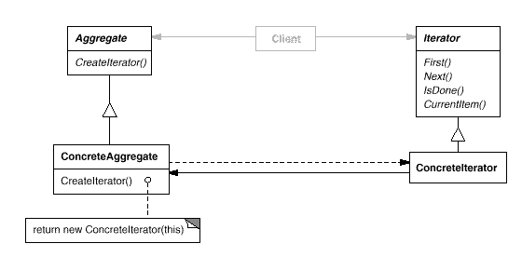
The UML

Slide 33
The Fine Print
Everything is a container
  Character strings
  Files, both text and records
  Socket streams over the net
  The result of a database query
  The bits of an integer
  Stream of random or prime numbers
This allows reusing the print, find and other algorithms for all of these

Slide 34
The Fine Print II
Iterators may have privileged access
  They can encapsulate security rights
Kinds of abstract iterators
  Direct access iterators
  Access the previous item
Robustness issues
  Is the iterator valid after insertions or removals from the container?
Iterators and the Composite pattern

Slide 35
Known Uses
All major standard libraries of popular programming languages
  STL for C++
  The new Java containers
New libraries for file, network and database access in C++ conform to STL’s iterators as well

Slide 36
15. Visitor
Separate complex algorithms on a complex data structure from the structure’s representation
For example, a document is a composite structure involved in many complex operations
  Spell check, grammar check, hyphenation, auto-format, …
How do we avoid cluttering Glyph subclasses with all this code?

Slide 37
The Requirements
Encapsulate complex algorithms and their data in one place
Outside the data structure
Easily support different behavior for every kind of Glyph
Easily add new tools

Slide 38
The Solution
Say hello to class Visitor:
class Visitor {
public:
void visitImage(Image *i) { }
void visitRow(Row *r) { }
void visitTable(Table *t) { }
// so on for every Glyph type
}
Every tool is a subclass:
  class SpellChecker : public Visitor

Slide 39
The Solution II
Add to Glyph’s interface the ability to accept visitors:
void accept(Visitor *v) = 0;
Every glyph subclass accepts a visitor by an appropriate callback:
class Image : public Glyph {
void accept(Visitor *v)
{ v->visitImage(this); }
This way the visitor is activated for the right kind of glyph, with its data

Slide 40
The Solution III
Initiating a spell check (one option):
  Create a SpellChecker object
  root->accept(sc);
Graphic non-text glyphs will just ignore the visit
  This is why Visitor includes default empty method implementations
Composite glyphs also do nothing
  They can forward the visit to all their children. This can be coded once in CompositeGlyph

Slide 41
The Solution IV
Easy to add operations
  Word count on characters
  Filters such as sharpen on images
  Page layout changes on pages
Works on any glyph
  In particular, a dynamic selection as long as it’s a composite glyph
Adding a tool does not require recompilation of Glyph hierarchy

Slide 42
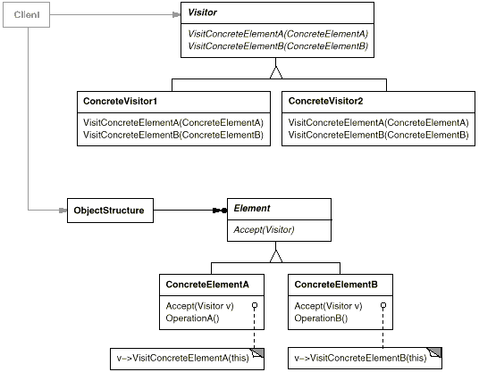
The UML

Slide 43
The Fine Print
The big problem: adding new Glyph subclasses is hard
  Requires small addition of Visitor, and recompilation of all its subclasses
How do we traverse the structure?
  Using an iterator
  From inside the accept() code
  From inside the visitxxx() code
Visitors are really just a workaround due to the lack of double dispatch

Slide 44
Known Uses
Document Editors
  Spell Check, Auto-Format, …
Photo Editors
  Filters & Effects
Compilers
  Code production, pretty printing, tests, metrics and optimizations
  on the syntax tree

Slide 45
Summary
Pattern of patterns
  Encapsulate the varying aspect
  Interfaces
  Inheritance describes variants
  Composition allows a dynamic choice between variants
Design patterns are old, well known and thoroughly tested ideas
  Over twenty years!

