Slide 1
Design Patterns
David Talby

Slide 2
This Lecture
The rest of the pack
  Working over a network
    Proxy, State, Chain of Responsibility
  Working with external libraries
    Adapter, Façade
  Coding partial algorithms
    Template Method
  Special-case patterns
    Interpreter, Momento
  Summary

Slide 3
16. Proxy
Provide a placeholder for another object, to control access to it
For example, we’d like to defer loading the images of a document until we must display it

Slide 4
The Requirements
Only load images when required
Client code must not know whether lazy load is used or not
Images may be loaded from a file, a database or a network
  Such code should be encapsulated
  Should be easy to add variations, such as security and compression

Slide 5
The Solution
Define a new graphic ImageProxy, which holds an image’s file name
Holds an uninitialized Image object
When its draw() method is called:
draw() {
if (image == NULL)
image = load(filename);
image->draw();
}

Slide 6
The Solution II
Many ways to implement load:
  Read from a file or database
  Use a complex network protocol
  Use encryption, compression, …
  Compute the returned object
Any such complex logic is well encapsulated in the proxy
The proxy can hold part of Image’s data for efficiency

Slide 7
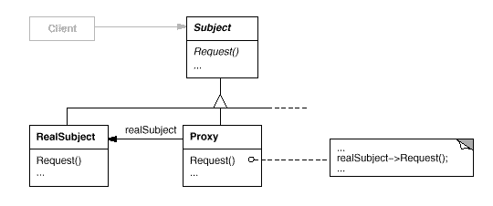
The UML

Slide 8
The Fine Print
The Proxy vocabulary
  Virtual Proxy – creates expensive objects on demand
  Remote Proxy – a local representative of an object in another address space
  Protection Proxy – controls access to the original object
  Smart Pointers – overload regular pointers with additional actions

Slide 9
The Fine Print II
Uses of smart pointers
  Reference counting
  Synchronization (lock management)
  Profiling and statistics
  Copy-on-write
  Cache coherence
  Pooling
Smart pointers are easy in C++ thanks to overloading = and –>

Slide 10
The Fine Print III
Proxy is very much like Decorator
Decorator = functional addition
Proxy = technical addition

Slide 11
Known Uses
Every programming language
Every middleware package
Every database package

Slide 12
17. State
Allow an object to alter its behavior when its internal state changes
For example, most methods of a TCPConnection object behave in different ways when the connection is closed, established or listening
How do we encapsulate the logic and data of every state?

Slide 13
The Requirements
A class has a state diagram, and many methods behave in wildly different ways in different states
When in a state, only allocate memory for data of that state
The logic of a specific state should be encapsulated

Slide 14
Pattern of Patterns
Encapsulate the varying aspect
  State of an object
Interfaces
  Let’s have a TCPState interface that has all the state-sensitive methods
Inheritance describes variants
  TCPEstablished, TCPListen and TCPClosed implement the interface
Composition allows a dynamic choice between variants

Slide 15
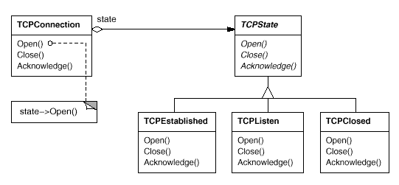
The Solution II
A TCPConnection codes state transitions and refers to a TCPState

Slide 16
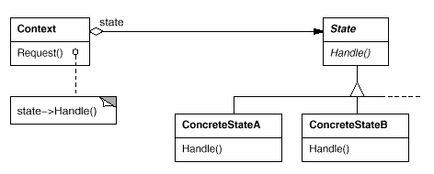
The UML

Slide 17
The Fine Print
In complex cases it is better to let states define transitions, by adding a SetState method to Context
States may be created on-demand or on Context’s creation
This pattern is really a workaround for the lack of dynamic inheritance
State is very much like Strategy
  State = Many (small) actions
  Strategy = One (complex) action

Slide 18
Known Uses
Streams and connections
Different tools on a drawing program
  Select, Erase, Crop, Rotate, Add, …

Slide 19
18. Chain of Responsibility
Decouple the sender and receiver of a message, and give more than one receiver a chance to handle it
For example, a context-sensitive help system returns help on the object currently in focus
Or its parent if it has no help
Recursively

Slide 20
The Requirements
Allow calling for context-sensitive help from any graphical object
If the object can’t handle the request (it doesn’t include help),
it knows where to forward it
The set of possible handlers is defined and changed dynamically

Slide 21
The Solution
Define a HelpHandler base class:
class HelpHandler
{
handleHelp() {
if (successor != NULL)
successor->handleHelp();
}
HelpHandler* successor = NULL;
}

Slide 22
The Solution II
Class Graphic inherits HelpHandler
Graphic descendants that have help to show redefine handleHelp:
handleHelp() {
ShowMessage(“Buy upgrade”);
}
Either the root Graphic object or HelpHandler itself can redefine handleHelp to show a default

Slide 23
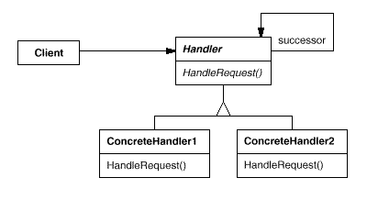
The UML

Slide 24
The Fine Print
Receipt isn’t guaranteed
Usually parents initialize the successor of an item upon creation
  To themselves or their successor
The kind of request doesn’t have to be hardcoded:
class Handler {
handle(Request* request) {
// rest as before

Slide 25
Known Uses
Context-sensitive help
Messages in a multi-protocol network service
Handling user events in a user interface framework
Updating contained objects/queries in a displayed document

Slide 26
19. Adapter
Convert the interface of a class into another that clients expect
For example, We’d like to use advanced Text and SpellCheck component that we bought
But Text doesn’t inherit Graphic or supply iterators, and SpellCheck doesn’t inherit Visitor
We don’t have their source code

Slide 27
The Requirements
Convert the interface of a class into a more convenient one
Without the class’s source code
  No compilation dependencies
The class may be a module in a non-object oriented language

Slide 28
The Solution
If you can’t reuse by inheritance, reuse by composition:
class TextGraphic
: public Graphic
{
public:
void draw() { text->paint(); }
// other methods adapted...
private:
BoughtTextComponent *text;
}

Slide 29
The Requirements II
Stacks and queues are kinds of lists, but they provide less functionality
LinkedQueue is a linked list implementation of interface Queue
We’d like to reuse LinkedList for it
Inheritance can’t be used if children offer less than their parents

Slide 30
The Solution II
Object Adapter
  Class LinkedQueue will hold a reference to a LinkedList and delegate requests to it
Class Adapter
  Class LinkedQueue will inherit from both Queue and LinkedList
  Method signatures in both classes must match
In C++ class adapters are safer thanks to private inheritance

Slide 31
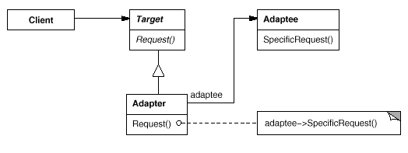
The UML
Object Adapter:

Slide 32
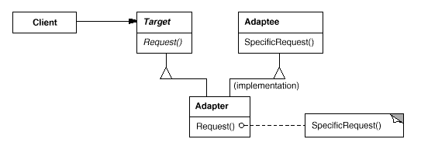
The UML II
Class Adapter:

Slide 33
Known Uses
Using external libraries
Reusing non O-O code
Limiting access to classes

Slide 34
20. Facade
Provide a unified interface to a set of interfaces of subsystems
For example, a compiler is divided into many parts
  Scanner, parser, syntax tree data structure, optimizers, generation, …
Most clients just compile files, and don’t need to access inner parts

Slide 35
The Requirements
Provide a simple, easy to use and remember interface for compilation
Keep the flexibility to tweak inner parts when needed

Slide 36
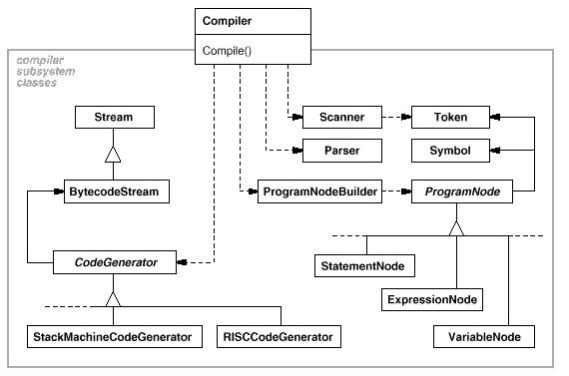
The Solution
Define a façade Compiler class as the entry point to the system

Slide 37
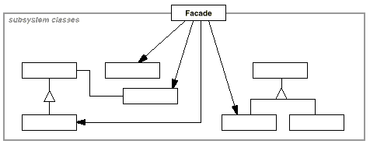
The UML

Slide 38
The Fine Print
Advantages of a façade:
  Most users will use a very simple interface for the complex system
  Clients are decoupled from the system
  Makes it easier to replace the entire system with another
Packages (Java) and namespaces (C++) are ways to define “systems” of classes and decide which classes are visible to the system’s clients

Slide 39
Known Uses
A Compiler or XML Parser
Browsing objects at runtime
The Choices O-O operating system
  The File and Memory systems

Slide 40
21. Template Method
Define the skeleton of an algorithm and let subclasses complete it
For example, a generic binary tree class or sort algorithm cannot be fully implemented until a comparison operator is defined
How do we implement everything except the missing part?

Slide 41
The Requirements
Code once all parts of an algorithm that can be reused
Let clients fill in the gaps

Slide 42
The Solution
Code the skeleton in a class where only the missing parts are abstract:
  class BinaryTree<G>
  {
  void add(G* item) {
  if (compare(item, root))
  // usual logic
  }
  int compare(G* g1, G* g2) = 0;
  }

Slide 43
The Solution II
Useful for defining comparable objects in general:
  class Comparable
  {
  operator <(Comparable x) = 0;
  operator >=(Comparable x) {
  return !(this < x);
  }
  operator >(Comparable x) {
  return !(this < x) &&
  !(this == x);
  }
  }

Slide 44
The Solution III
A very common pattern:
class HelpHandler
{
handleHelp() {
if (successor != NULL)
successor->handleHelp();
}
HelpHandler* successor = NULL;
}

Slide 45
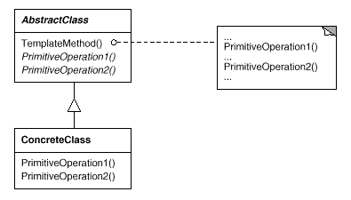
The UML

Slide 46
The Fine Print
The template method is public, but the ones it calls should be protected
The called methods can be declared with an empty implementation if this is a common default
This template can be replaced by passing the missing function as a template parameter
Java sometimes requires more coding due to single inheritance

Slide 47
Known Uses
So fundamental that it can be found almost anywhere
Factory Method is a kind of template method specialized for creation

Slide 48
22. Interpreter
Given a language, define a data structure for representing sentences along with an interpreter for it
For example, a program must interpret code or form layout, or support search with regular expression and logical criteria
Not covered here

Slide 49
23. Momento
Without violating encapsulation, store an object’s internal state so that it can be restored later
For example, a program must store a simulation’s data structures before a random or approximation action, and undo must be supported
Not covered here

Slide 50
Summary
O-O concepts are simple
  Objects, Classes, Interfaces
  Inheritance vs. Composition
Open-Closed Principle
Single Choice Principle
Pattern of patterns

Slide 51
The Benefits of Patterns
Finding the right classes
Finding them faster
Common design jargon
Consistent format
Coded infrastructures
and above all:
Pattern = Documented Experience

