Slide 1
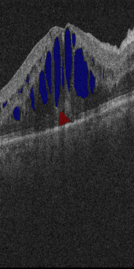

Slide 2
Notes:
Cirrus TRAIN004 057/058/059

