Slide 1

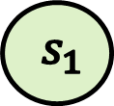

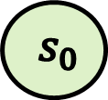

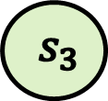
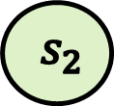
$$s_{0}$$
$$s_{1}$$
$$s_{2}$$
$$0≤n<10$$
$$n<0∨n≥10$$
$$s_{3}$$
$$s_{4}$$

Slide 2















mechanized semantics
executable semantics
$$s_{0}$$
$${\hat{s}}_{1}$$
$$s_{1}$$
$${\hat{s}}_{2}$$
$$s_{2}$$
$${\hat{s}}_{3}$$
$${\hat{s}}_{4}$$
$$s_{3}$$
$$s_{4}$$
$${\hat{s}}_{5}$$
$$s_{5}$$
$${\hat{s}}_{6}$$
$$s_{6}$$
$${\hat{s}}_{7}$$
$$s_{7}$$

