Slide 1
Stanford summer Institutes
Robot Programming
D5: Event Driven Programming:
Finite State Machine (FSM)

Slide 2


Slide 3

How Do You Feel?

Slide 4

Or …

Slide 5
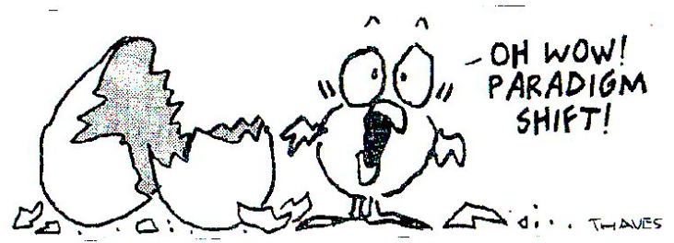
A Little Bit Of This?

Slide 6
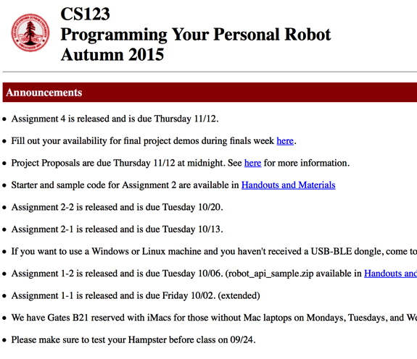
You Are Learning College Level Material
Two weeks of

Slide 7
Ask Questions and Help Each Other
Don’t Afraid To Ask Questions
By Answering Some One Else Questions, You Learn more

Slide 8
Explore !
“Robot Symphony”?
Come up with your own fun projects

Slide 9
Topics
A Week In Review
  Robot Control / Closed-Loop (PID)
  Tkinter: Build Your Own GUI
  Threads and Queues
  Dispatcher and Handler
  Review of Lab #4 Code
Finite State Machine (FSM)
  What are FSM’s
  Why / When to use FSM
Implementing of Finite State Machines
Lab Assignment

Slide 10
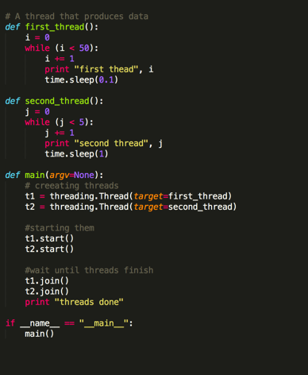
Threads: Don’t “Over Think”
Doing work in parallel

Slide 11
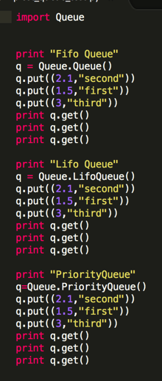
Queues:
Just like List, Array, a data structure for storing multiple items
Put: puts an item on a queue
Get: takes an item from a queue
Queues are used for communicating between threads
Queues are “thread safe”

Slide 12
Event Driven Programming Implementation
Event Dispatcher
  Monitor events and “dispatch” to handlers
Event Handlers
  Program waits for events
  When certain events happen, the program responds and does something (or decides to do nothing)
Event Sourcee1
Event Sourcee2
Event Sourcee3
Event Dispatcher
Event
Handler1
Event
Handler2
Notes:
n an event-driven application, there is generally a main loop that listens for events, and then triggers a callback function when one of those events is detected.
Creating event handlers[edit]
The first step in developing an event-driven program is to write a series of subroutines, or methods, called event-handler routines. These routines handle the events to which the main program will respond. For example, a single left-button mouse-click on a command button in a GUI program may trigger a routine that will open another window, save data to a database or exit the application. Many modern-day programming environments provide the programmer with event templates, allowing the programmer to focus on writing the event code.
The second step is to bind event handlers to events so that the correct function is called when the event takes place. Graphical editors combine the first two steps: double-click on a button, and the editor creates an (empty) event handler associated with the user clicking the button and opens a text window so you can edit the event handler.
The third step in developing an event-driven program is to write the main loop. This is a function that checks for the occurrence of events, and then calls the matching event handler to process it. Most event-driven programming environments already provide this main loop, so it need not be specifically provided by the application programmer. RPG, an early programming language from IBM, whose 1960s design concept was similar to event-driven programming discussed above, provided a built-in main I/O loop (known as the "program cycle") where the calculations responded in accordance to 'indicators' (flags) that were set earlier in the cycle.

Slide 13
How To Implement An Event Driven System
Implement “Dispatcher”: monitoring events and dispatch events to appropriate handler(s)
Implement “Handlers”: handles events
Dispatchers communicates with Handlers threads via Queues.

Slide 14
A Even-Driven System Using Queues
User Input
Draw/Display
Handler1
Dispatcher
Handler2
Queues
Sensor
data
Acting

Slide 15
Lab #4: Robot Escape
Boundary
(black tape)
Obstacles (white boxes)
2 feet
Robot
3 feet

Slide 16
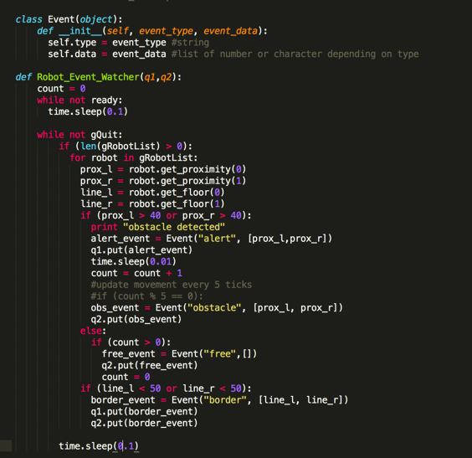
Code Review: Dispatcher

Slide 17
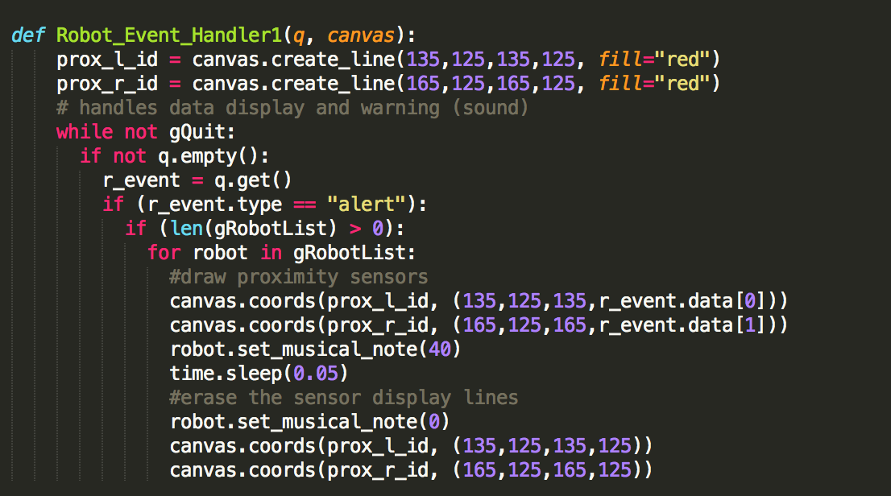
Code Review: Handler1 (Draw)

Slide 18
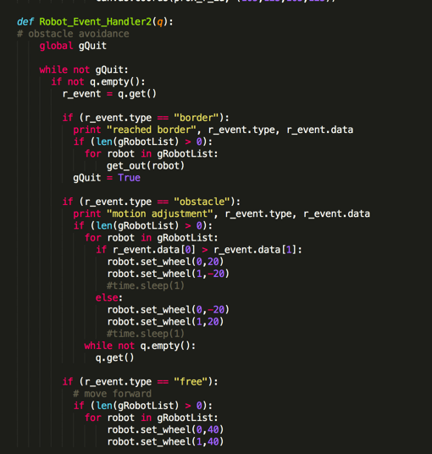
Code Review: Handler2

Slide 19
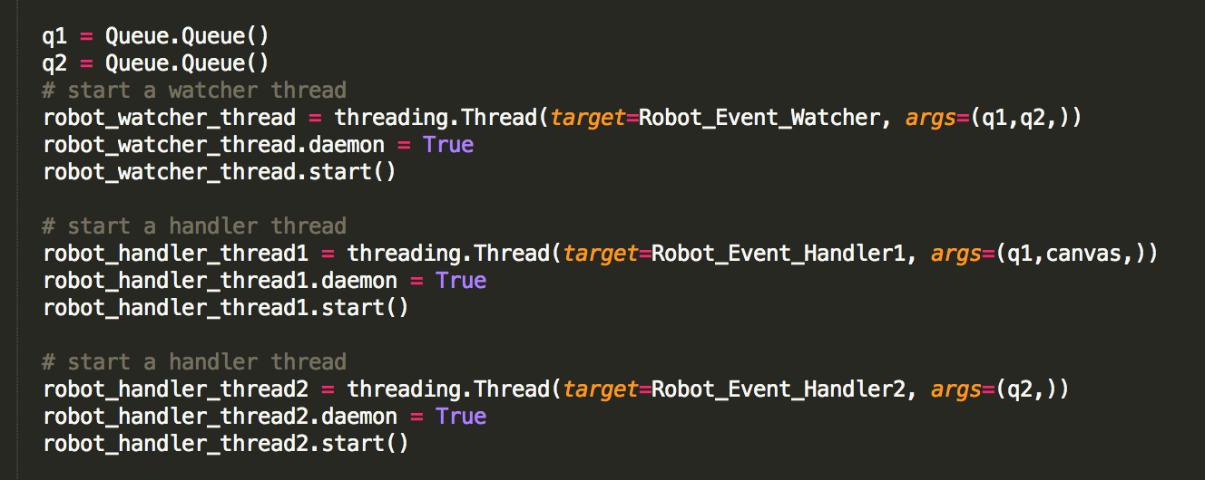
Code Review: Main

Slide 20
Finite State Machine (FSM)

Slide 21
FSM Examples in Daily Live
Vending Machines
Traffic Lights
Elevators
Alarm Clock
Microwave
Cash Registers
  Each of these devices can be thought of as a reactive system - that is because each of them work by reacting to signals or inputs from the external world.
Notes:
The behavior of state machines can be observed in many devices in modern society that perform a predetermined sequence of actions depending on a sequence of events with which they are presented. Simple examples are vending machines, which dispense products when the proper combination of coins is deposited, elevators, which drop riders off at upper floors before going down, traffic lights, which change sequence when cars are waiting, and combination locks, which require the input of combination numbers in the proper order.

Slide 22
What Is A Finite State Machine
A reactive system whose response to a particular stimulus (a signal, or a piece of input) is not the same on every occasion, depending on its current “state”.
For example, in the case of a parking ticket machine, it will not print a ticket when you press the button unless you have already inserted some money. Thus the response to the print button depends on the previous history of the use of the system.
Notes:
A finite-state machine (FSM) or finite-state automaton (plural: automata), or simply a state machine, is a mathematical model of computation used to design both computer programs and sequential logic circuits. It is conceived as an abstract machine that can be in one of a finite number of states. The machine is in only one state at a time; the state it is in at any given time is called the current state. It can change from one state to another when initiated by a triggering event or condition; this is called a transition. A particular FSM is defined by a list of its states, and the triggering condition for each transition.

Slide 23
More Precisely (Formally)
A Finite State Machine is defined by (Σ,S,s₀,δ,F), where:
  Σ is the input alphabet (a finite, non-empty set of symbols).
  S is a finite, non-empty set of states.
  s₀ is an initial state, an element of S.
  δ is the state-transition function: δ : S x Σ → S
  F is the set of final states, a (possibly empty) subset of S.
  O is the set (possibly empty) of outputs

Slide 24
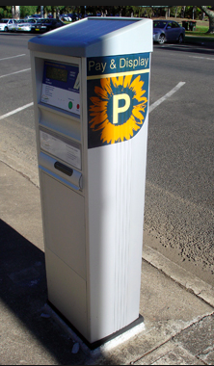
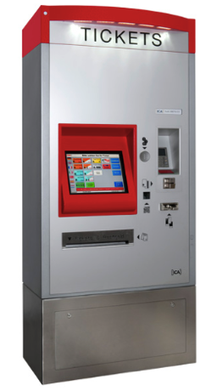
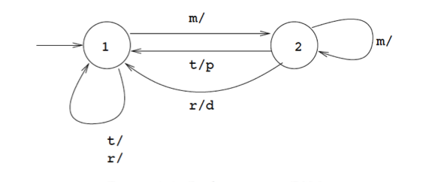
A (Simplified) Ticket Machine
  Σ (m, t, r) : inserting money, requesting ticket, requesting refund
  S (1, 2) : unpaid, paid
  s₀ (1) : an initial state, an element of S.
  δ (shown below) : transition function: δ : S x Σ → S
  F : empty
  O (p/d) : print ticket, deliver refund

Slide 25
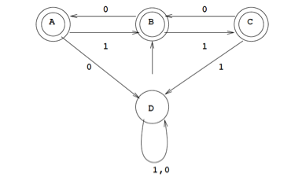
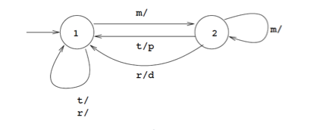
Acceptors and Transducers
Acceptors: no output, have final states
Transducers: non-empty set of output
Acceptor
Transducer

Slide 26
Deterministic and Non-Deterministic
Non-deterministic: Competing “Transitions” Leaving Same State
We only concern ourselves with Deterministic FSM in this class

Slide 27
How To Implement an FSM
The Finite State Machine class keeps track of the current state, and the list of valid state transitions.
You define each transition by specifying :
  FromState - the starting state for this transition
  ToState - the end state for this transition
  condition - a callable which when it returns True means this transition is valid
  callback - an optional callable function which is invoked when this transition is executed.
Transition is triggered by an “event”

Slide 28
Python: Dictionaries
A Python Data Structure (just like List, Queue,…)
Contains a series of key -> value mappings where the "key" is of any type (that is hashable). The "value" may be of any type and value types need not be homogeneous.

Slide 29
Python Dictionaries
{} indicates an empty dictionary
Like a list of “key: value” pairs
US_Capitals = {‘California’: ‘Sacramento’, ‘New York’: ‘Albany’, …}
US_Capitals[‘California’] returns:
  ‘Sacramento’

Slide 30
Python Dictionaries: Why?
The conceptual implementation is that of a hash table, so checks for existence are quite fast. That means we can determine if a specific key is present in the dictionary without needing to examine every element (which gets slower as the dictionary gets bigger). The Python interpreter can just go to the location key "should be" at (if it's in the dictionary) and see if key is actually there.

Slide 31
Use Dictionary For Transitions
Transition is “indexed” by the event that triggers it
  i.e. the key of the transition is the name of the event
Flexibility and Quick Access

Slide 32
Simplest FSM
Press/click “b”
Start
A
B
Press/click “a”

Slide 33
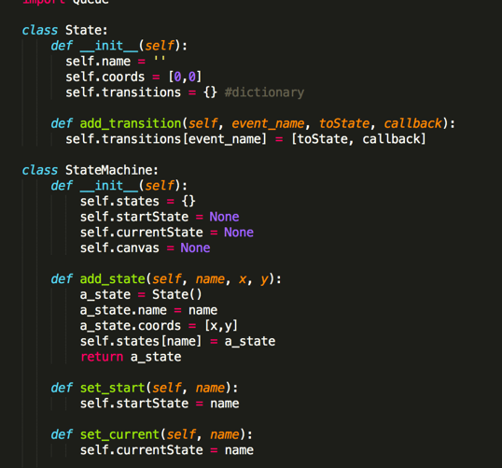
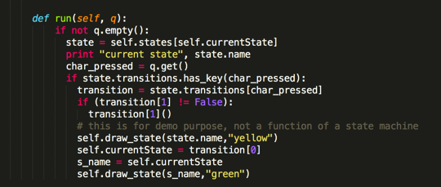
State Machine Code Example

Slide 34
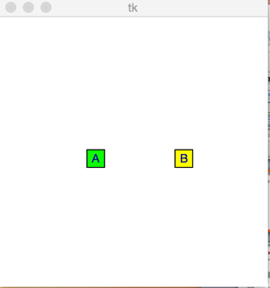
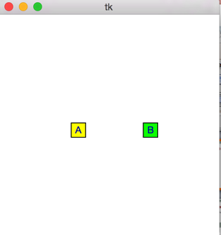
Simplest FSM
‘b’ key pressed
‘a’ key pressed

Slide 35
Simple Robot Example
Start
‘b’ key pressed
Moving
Forward
Moving
Backward
‘f’ key pressed
‘f’ key pressed
‘b’ key pressed

Slide 36
Why Finite State Machines For Robot
Need State Information
turn-left
turn-right
Turn-left, turn-right?
Oscillation problem

Slide 37
Lab #5: Obstacle Avoidance
Response to an event is dependent on the “state” of the robot
Start
Moving
Forward
M
Obs
Right
Obs
Left
free
free
Obs
Right
Or Left
L
R
Obs
Right
Or Left
Turning
Left
Turning
Right

Slide 38
Lab #5: Improving The Escape Program
Using the FSM avoidance code in the escape program

Slide 39
Lab Extra: “Cleaner” (Push Out “Trash”)
Trash: small white boxes, about same size as robot, very light
No other obstacles inside boundary except trash

Slide 40
Clean Out Trash

Slide 41
Trash Cleaner Spec
Push out trash to outside of boundary (black tape) – at least half of the “box” is outside of boundary
Indicate (with sound or light) that track has been pushed out
Quit (success condition) after pushing 3 pieces of trash out
Assumptions:
  No other object inside boundary except trash
  Trash are small white boxes about the same size as the robot

