Slide 1
CS421 Project Presentation: Haskython: Haskell-Python Conversion
David Tan Sang Tran davidtt2@illinois.edu University of Illinois at Urbana-Champaign
Detailed information can be found on the project report attached or
at https://github.com/davidtstran/haskython/blob/main/CS421/421-Project-Report-David-Tran.pdf

Slide 2
Overview of Haskython
Haskython is a Python library that can convert between Python and Haskell code. https://github.com/davidtstran/haskython
Motivation:
Design an easy way to translate between the two languages.
Allow procedural developers to learn functional programming.
Utilize the advantages of Haskell through Python code.
Goals:
Create a functioning conversion library for Haskell to Python and Python to Haskell.
Provide a public library for ease of use via a pip package.
Promote Haskython and encourage other developers to contribute to the project.

Slide 3
Implementation (Tasks and Capabilities)
Tasks:
Take in a file and create an empty file for conversion
Parse original file line-by-line
Determine function declaration, function parameters, and return type
Recognize function body and determine structure
Recognize recursion, conditionals, lists, etc.
Return the converted line back to the created file
Detailed code listing can be found in the Code Listing slide.

Slide 4
Implementation (Components)
Components:
haskell_to_python.py: File used to convert Haskell to Python
python_to_haskell.py: File used to convert Python to Haskell
Files can be read in through the command line call:
python haskell_to_python.py file.hs
python python_to_haskell.py file.py
Detailed code listing can be found in the Code Listing slide.

Slide 5
Implementation (Project Status)
Works Well:
Reading original file line-by-line
Creating a new file in the opposing language with the “_haskython” tag
Basic Haskell to Python conversion
Partially Works:
Advanced Haskell to Python conversion
Not Implemented / Future Work:
Advanced Python to Haskell conversion
Create pip package
Collaborate with other developers as an open-source project

Slide 6

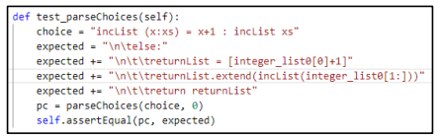
Tests (Unit Tests)
Test Parse Function Declaration
In the above code snippet, this test will retrieve the function declaration from the Haskell file and convert it into a Python function declaration using the def keyword and a counter to distinguish various parameters. The results can be seen in the function assertEqual(). With this test passing, it is proven that the library will be able to successfully convert a Haskell functional declaration into Python.
Test Parse Choices
In the above image, this test will retrieve a function body from the Haskell file and convert it into Python. For this test, we will use the incList (x:xs) body to create the Python code that will create a list with the first element incremented with recursion to create the same output as the Haskell incList function. This test shows that after a function declaration, the Python script can convert a function body from Haskell to Python.

Slide 7

Tests (Feature Tests)
Test Creating New File with _Haskython Tag
With the test, it shows that the project is able to create new file from haskell_test_empty.hs in the same directory with the correct extension of _haskython.py. The output file would be called haskell_test_empty_haskython.py. With the file being correctly created, we can ensure that the Haskell file is converted into a Python file in the same directory where the file is added. The next subsection will test the functionality of the created Python file.

Slide 8
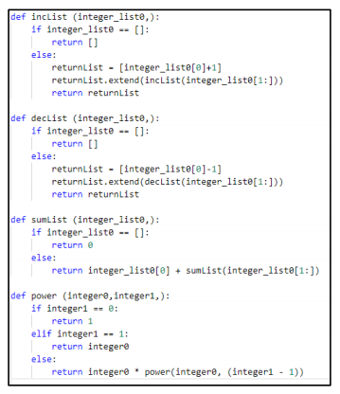
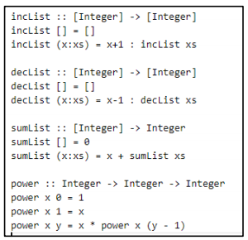
Tests (Larger Tests) – Part 1
First, Convert the haskell_test.hs to haskell_test_haskython.py
using haskell_to_python.py

Slide 9
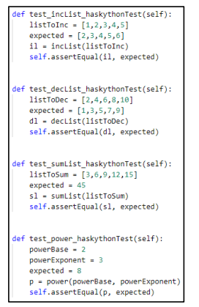
Tests (Larger Tests) – Part 2
With all of these tests passing as expected, it can be determined that the Haskell to Python is working as expected including reading a Haskell file, collecting the file information, generating the new Python file, and validating that the new functions perform successfully.

Slide 10
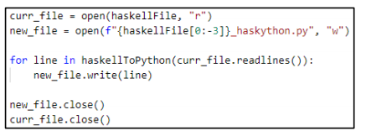
Code Listing (Central Function 1): Read Haskell File, Write to Python Conversion File
The following code is a core function that reads in a Haskell file and create a new Python file to add the translated lines.
Detailed information can be found on the project report attached or at https://github.com/davidtstran/haskython/blob/main/CS421/421-Project-Report-David-Tran.pdf

Slide 11
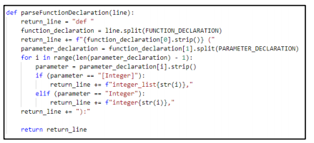
Code Listing (Central Function 2): Recognize Function Declarations, Parameters, and Types
The following code is a core function that recognizes a line in the Haskell file as a function definition and then parses the parameters and return type.
Detailed information can be found on the project report attached or at https://github.com/davidtstran/haskython/blob/main/CS421/421-Project-Report-David-Tran.pdf

Slide 12
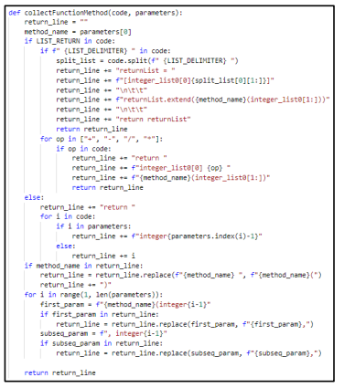
Code Listing (Central Function 3): Recognize Conditionals, Loops, Lists, and Recursion
The following code is a core function that performs inside a function body to recognize traits such as conditionals, loops, lists, recursions, etc.
Detailed information can be found on the project report attached or at https://github.com/davidtstran/haskython/blob/main/CS421/421-Project-Report-David-Tran.pdf

Slide 13
Conclusion
Detailed information can be found on the project report attached or at https://github.com/davidtstran/haskython/blob/main/CS421/421-Project-Report-David-Tran.pdf
The Haskython project provides an easy and quick way to convert back and forth between Haskell and Python.
The functions cover the majority of basic Haskell functionalities and will be continuously added upon to provide a deeper level of usage.
Haskython is created with the thought that procedural programmers can have an opportunity to slowly learn functional programming through the translation process

Slide 14
References
Tran, David T.S., “Haskython: Haskell and Python Conversion (Python Library)”. GitHub, Inc. CS421: Programming Languages Course. Summer 2021. https://github.com/davidtstran/haskython
Beckman, Mattox, “CS 421: Programming Languages” Coursera. University of Illinois at Urbana-Champaign. Summer 2021. https://www.coursera.org/learn/cs421/home/welcome
Python Wiki, “Python vs Haskell”. MoinMoin Wiki Engine. Python. https://wiki.python.org/moin/PythonVsHaskell
D. Can, V. R. Martinez, P. Papadopoulos and S. S. Narayanan, "Pykaldi: A Python Wrapper for Kaldi," 2018 IEEE International Conference on Acoustics, Speech and Signal Processing (ICASSP), 2018, pp. 5889-5893, doi: 10.1109/ICASSP.2018.8462463. https://ieeexplore.ieee.org/document/8462463
S. Behnel, R. Bradshaw, D. S. Seljebotn, G. Ewing, W. Stein, G. Gellner, et al. “Welcome to Cython’s Documentation”. Cython 3.0.0a9 Documentation. https://cython.readthedocs.io/en/latest/

