Slide 1
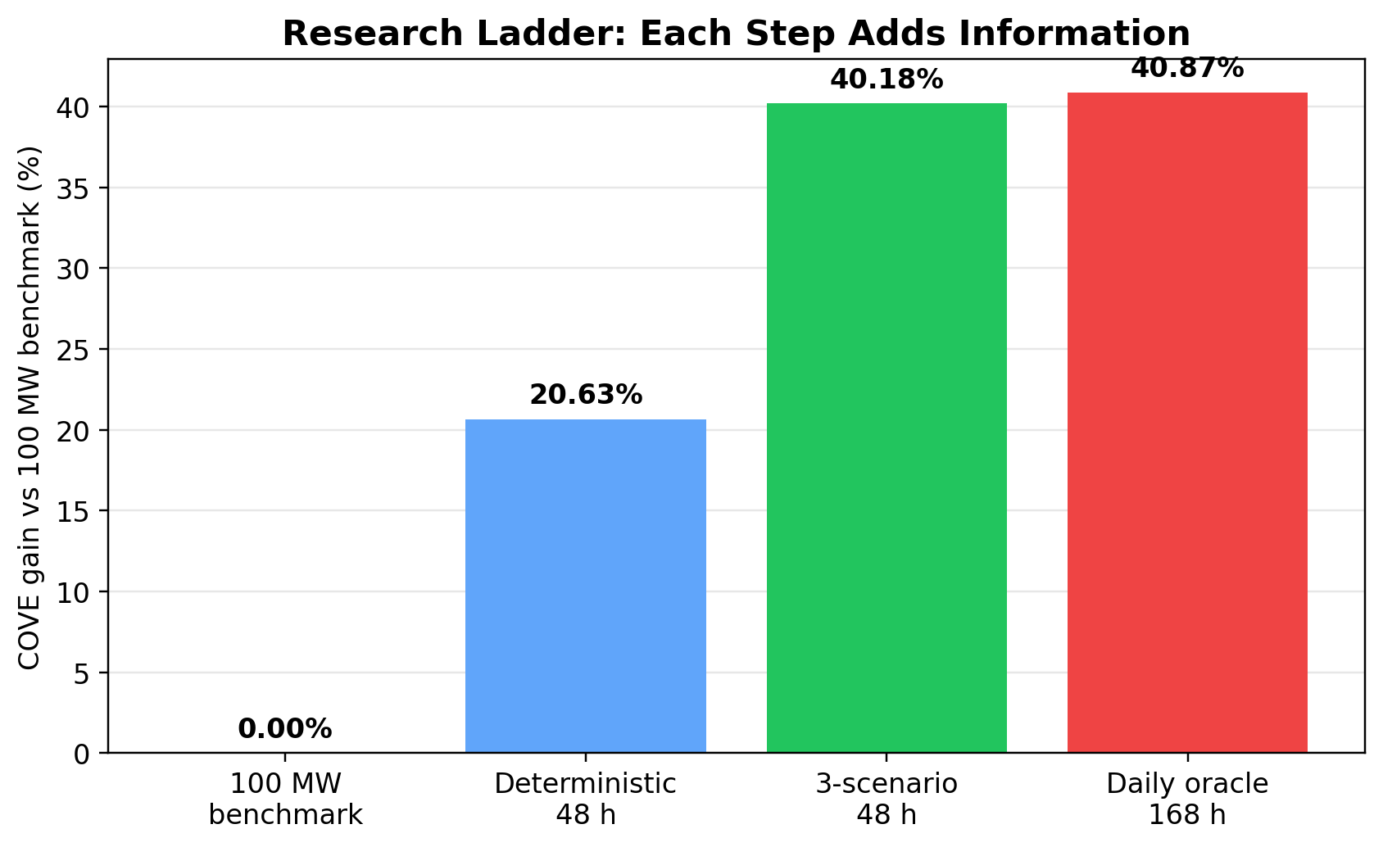
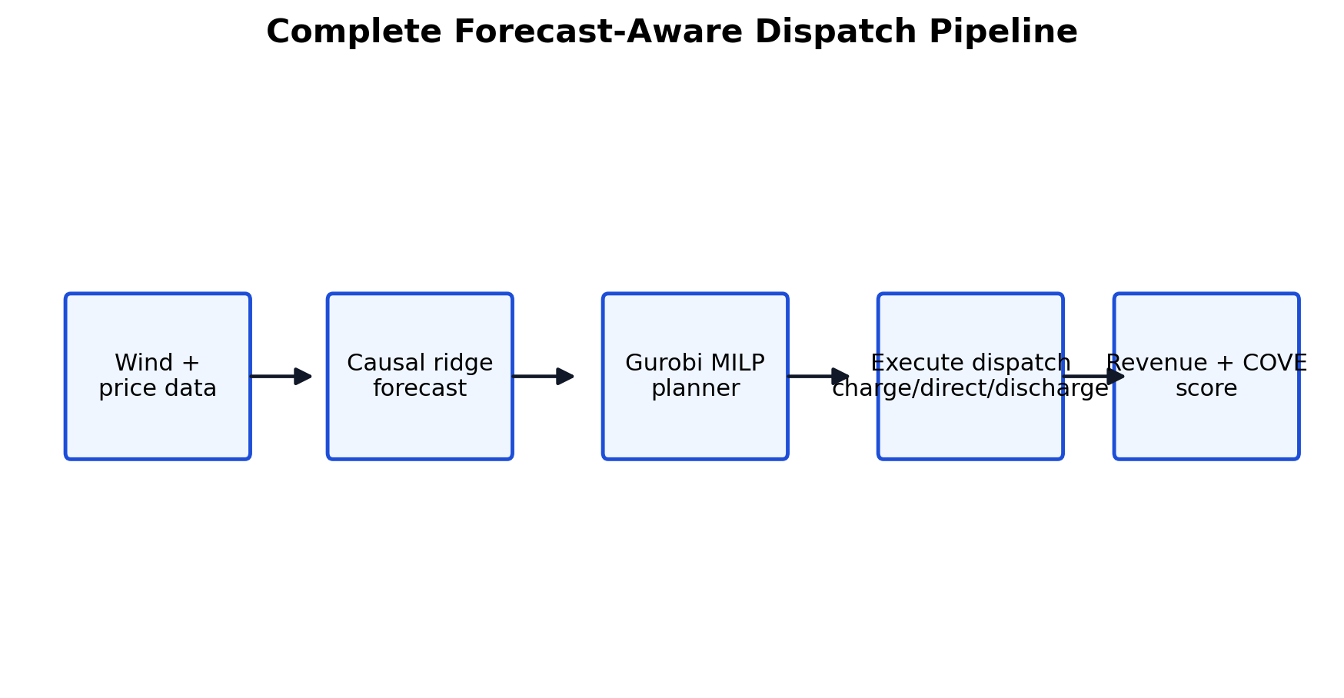
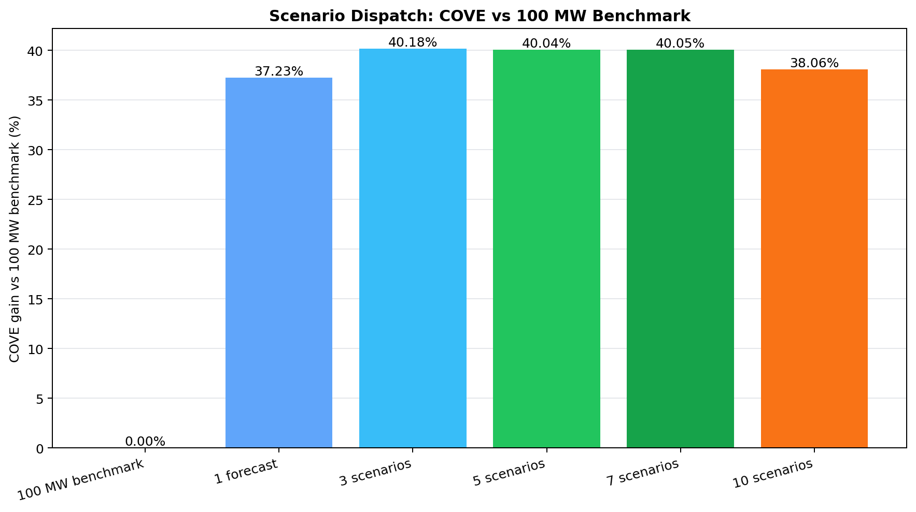
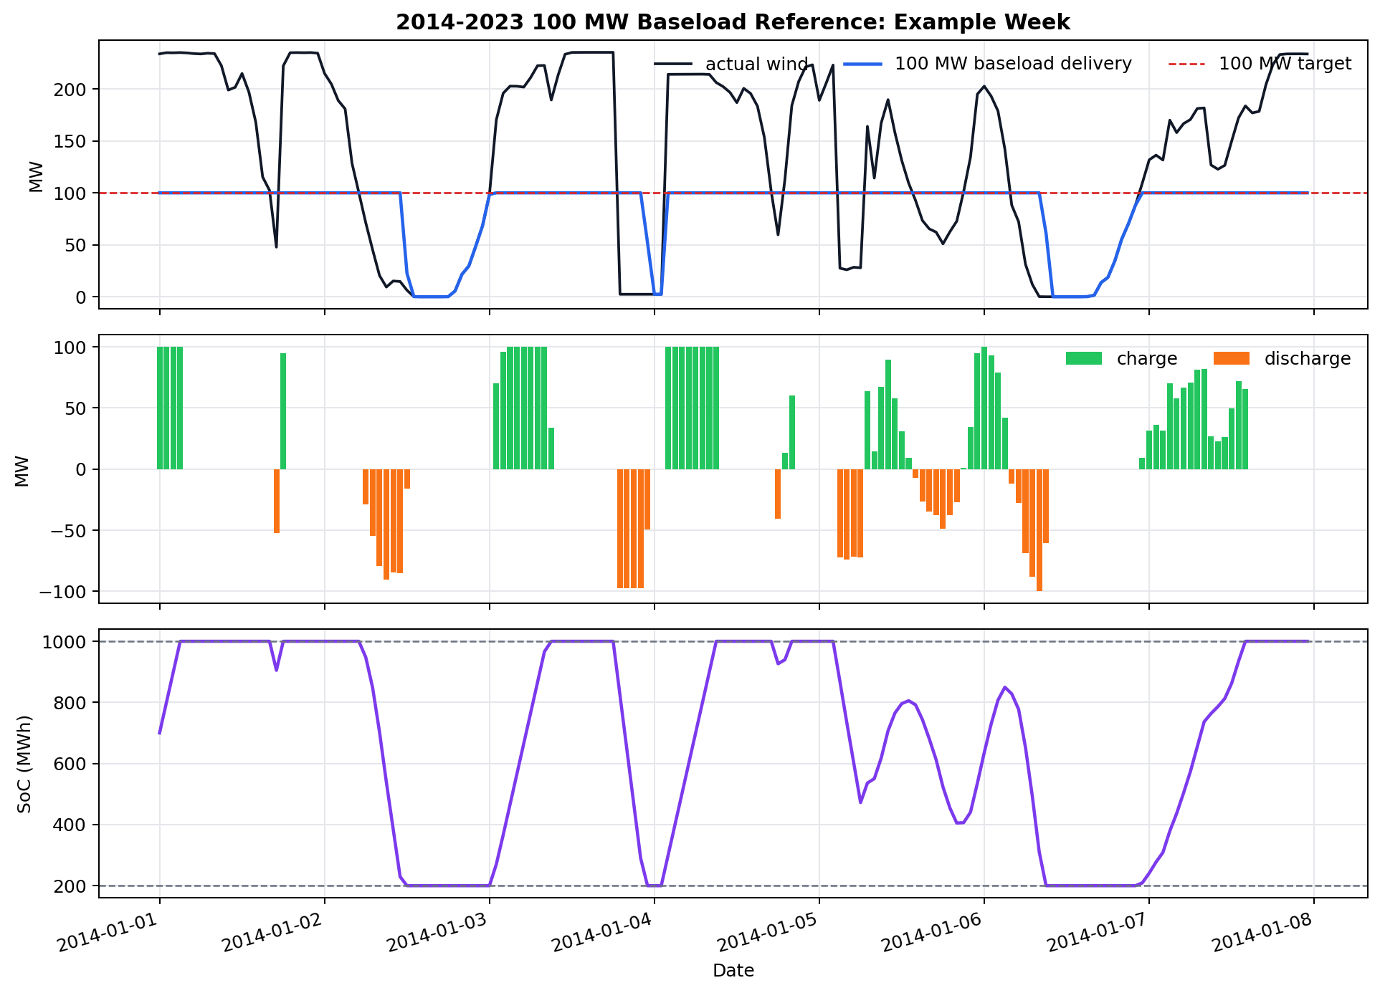
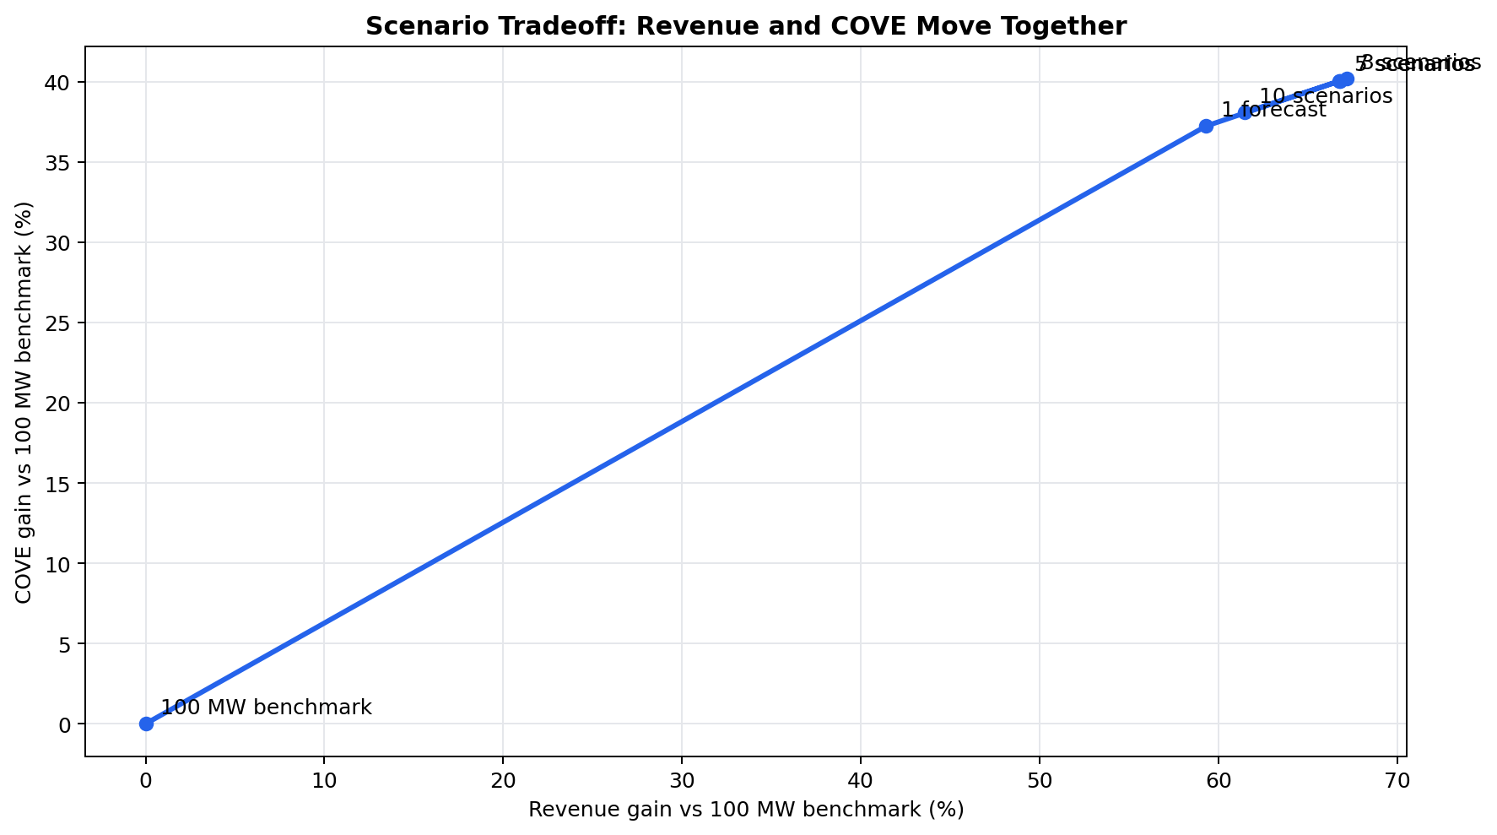
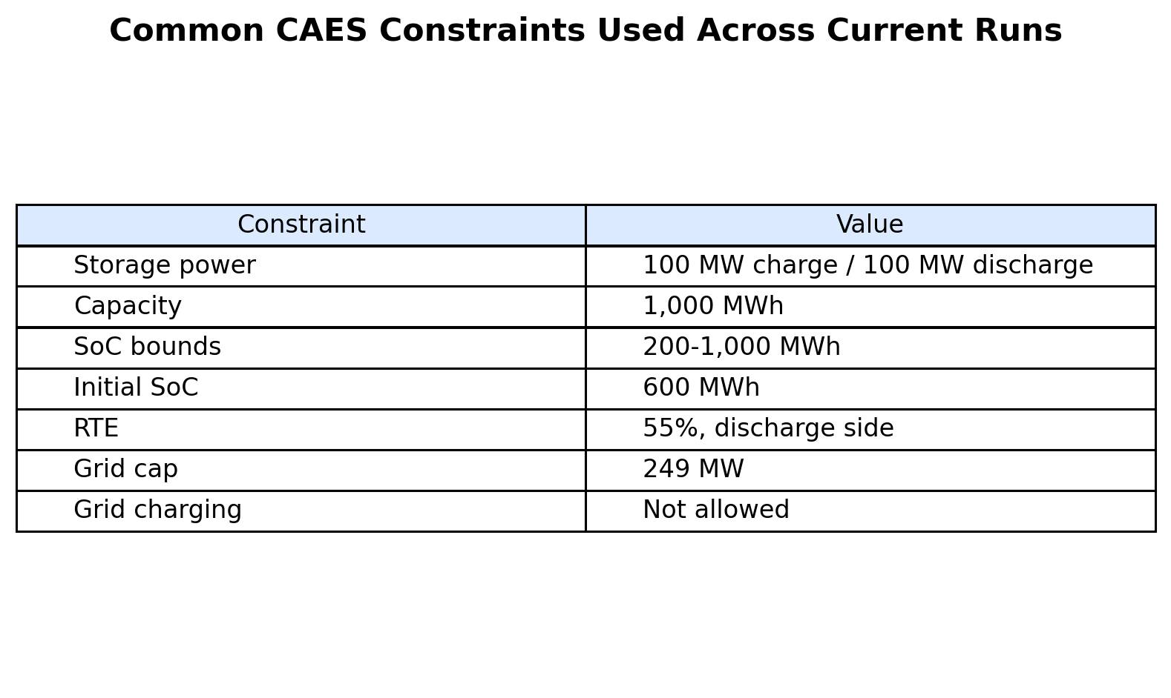
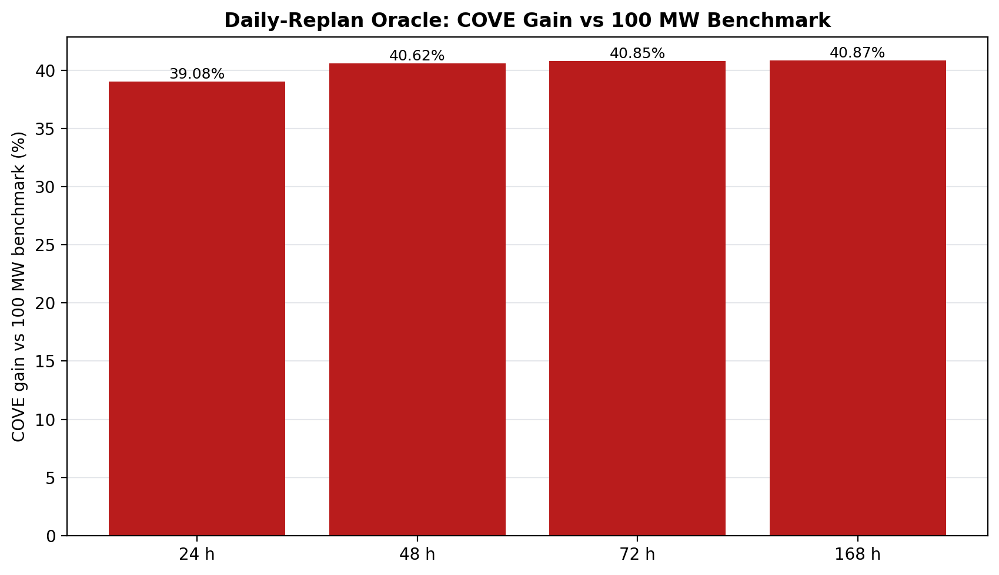
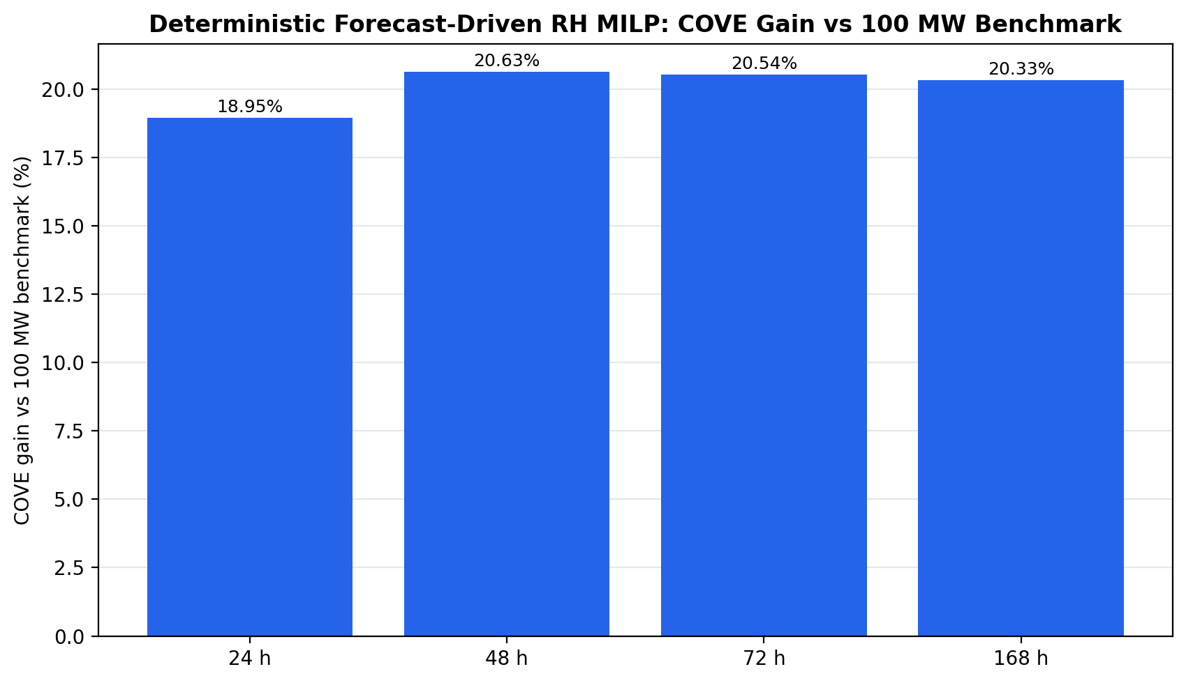
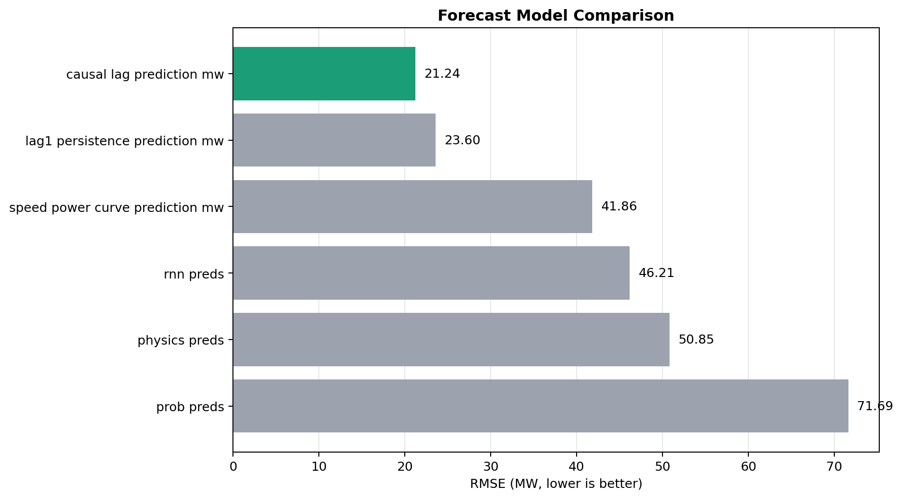
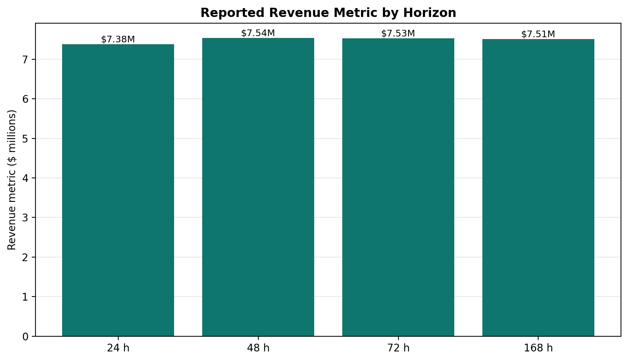
Forecast-Aware Rolling-Horizon Optimization for Hybrid Wind-Storage Dispatch
Main takeaway
David Valenta, North Carolina State University | Dr. Chris Qin, Washington State University
Hourly uncertainty-aware dispatch gave the strongest COVE reduction while respecting storage limits.
Summer 2026 REU | Pyron wind farm case study | ERCOT price data | PNNL CAES assumptions
1. Problem and Goal
5. Key Results
• Wind farms do not control when wind arrives.
• Electricity prices change hour by hour.
• Storage can hold wind energy and release it later.
• The goal is to choose direct delivery, charging, discharging, and curtailment to increase value.
• The hard part is making decisions before the future is known.
Primary comparison: 100 MW constant-output CAES benchmark. Wind-only is side context. Higher COVE gain means the storage policy makes energy more valuable per cost.
21.24 MW
20.63%
Main comparison: a 100 MW constant-output CAES benchmark. It is a realistic storage rule, while wind-only is secondary context.
Figure 4. Research ladder: start from 100 MW benchmark, add forecasting, add rolling-horizon dispatch, add scenarios, then compare to oracle.
Best forecast model
Best deterministic dispatch
causal lag/ridge RMSE
48 h COVE gain vs 100 MW
4. How the Optimizer Decides
40.18%
40.87%
Gurobi solves a mixed-integer linear program. It is the mathematical planner that chooses a feasible storage schedule under the rules below.
Best scenario controller
Oracle upper bound
• P_direct: wind sent straight to the grid.
• P_charge: wind stored in CAES.
• P_discharge: stored energy released to the grid.
• SoC: storage energy carried forward through time.
• Curtailment: wind not used because of physical limits.
3 scenarios, hourly replan
168 h perfect future
Figure 1. End-to-end pipeline: forecast wind/price, optimize dispatch with Gurobi, then score realized revenue and COVE.
2. Data and Storage Setup
Rolling horizon means: plan ahead, execute the near-term action, update the battery, then solve again. Revenue uses realized delivered power times realized price. COVE is lower when delivered energy is more valuable.
• Dataset: Pyron wind farm, 1980-2023 hourly records.
• Forecast training: historical data before 2014.
• Testing period: 2014-2023 unseen years.
• Price: ERCOT locational marginal price.
• Storage: CAES, 100 MW, 10 h, 1000 MWh capacity.
• SoC bounds: 200-1000 MWh; initial SoC: 600 MWh; RTE: 55%.
• All dispatch results carry SoC forward chronologically.
Figure 7. The hourly uncertainty-aware controller worked best with 3 scenarios; too many scenarios became conservative.
Stage
Main idea
Best result vs 100 MW
Benchmark
100 MW rule-based CAES
reference
Forecast
Causal lag/ridge predicts wind power before dispatch
RMSE 21.24 MW
Rolling horizon
Gurobi uses one predicted future and replans
48 h: 20.63% COVE gain
Scenarios
Several futures are optimized together
3 scenarios: 40.18% COVE gain
Figure 8. The best scenario case had the highest revenue and lowest COVE among scenario counts.
Oracle
Perfect future wind and price; not deployable
168 h: 40.87% COVE gain
Figure 2. Dispatch is constrained by wind-only charging, grid export, charge/discharge limits, and chronological SoC.
3. Forecasting
• Causal lag/ridge uses only past information.
• It predicts generated power directly, not wind speed.
• Best forecast RMSE: 21.24 MW.
• This forecast feeds the realistic dispatch experiments.
• Other tested methods included persistence, speed-power curve, RNN, physics, and probabilistic outputs.
Figure 9. Oracle dispatch is not realistic because it knows the future, but it shows the ceiling for the controller.
Figure 5. Deterministic dispatch found that 48 h lookahead gave the best COVE gain under the 100 MW benchmark.
6. Main Conclusion
• Forecast quality matters, but dispatch logic matters too.
• A 48-hour deterministic lookahead was best when one forecast was used.
• Hourly uncertainty-aware replanning improved the best result because it corrected mistakes quickly.
• Three scenarios were enough to capture useful uncertainty without making the optimizer overly cautious.
• The project shows forecasting and optimization must be designed as one connected control system.
Figure 6. Longer horizons do not automatically win when forecasts are imperfect; 48 h balanced planning value and forecast error.
Practical message: hybrid wind-storage control should tune the forecast horizon, replanning frequency, storage assumptions, and scenario count together, not separately.
Figure 3. Causal lag/ridge had the lowest power-prediction RMSE among tested forecast outputs.
Definitions for the reader
Acknowledgements
• 100 MW benchmark: rule-based storage case that tries to deliver 100 MW every hour.
• Wind-only: no storage; actual wind goes to the grid up to the 249 MW cap.
• Rolling horizon: solve the future, execute the near-term action, then solve again.
• Scenario dispatch: solve against several possible futures instead of one forecast.
• Oracle: perfect-future case used only as an upper bound.
• COVE: cost divided by valued delivered energy; lower is better.
• Constraint violation check: confirms storage and grid rules were not broken.
Thank you to Dr. Chris Qin, Nora Hosseiniimeni, Zach Lawrence, Jessica Yao, and the WSU Summer Research Program. Data and assumptions draw from the Pyron wind-storage dataset, ERCOT LMP records, and PNNL CAES storage references.
Contact: dvalent2@ncsu.edu
Poster size: 20 in x 30 in
All reported comparative metrics use the 100 MW constant-output benchmark as the primary reference; wind-only is secondary context.

