Slide 1
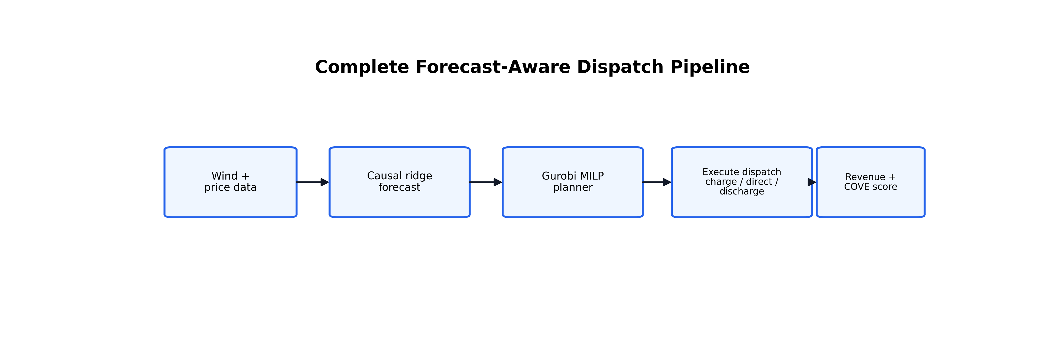
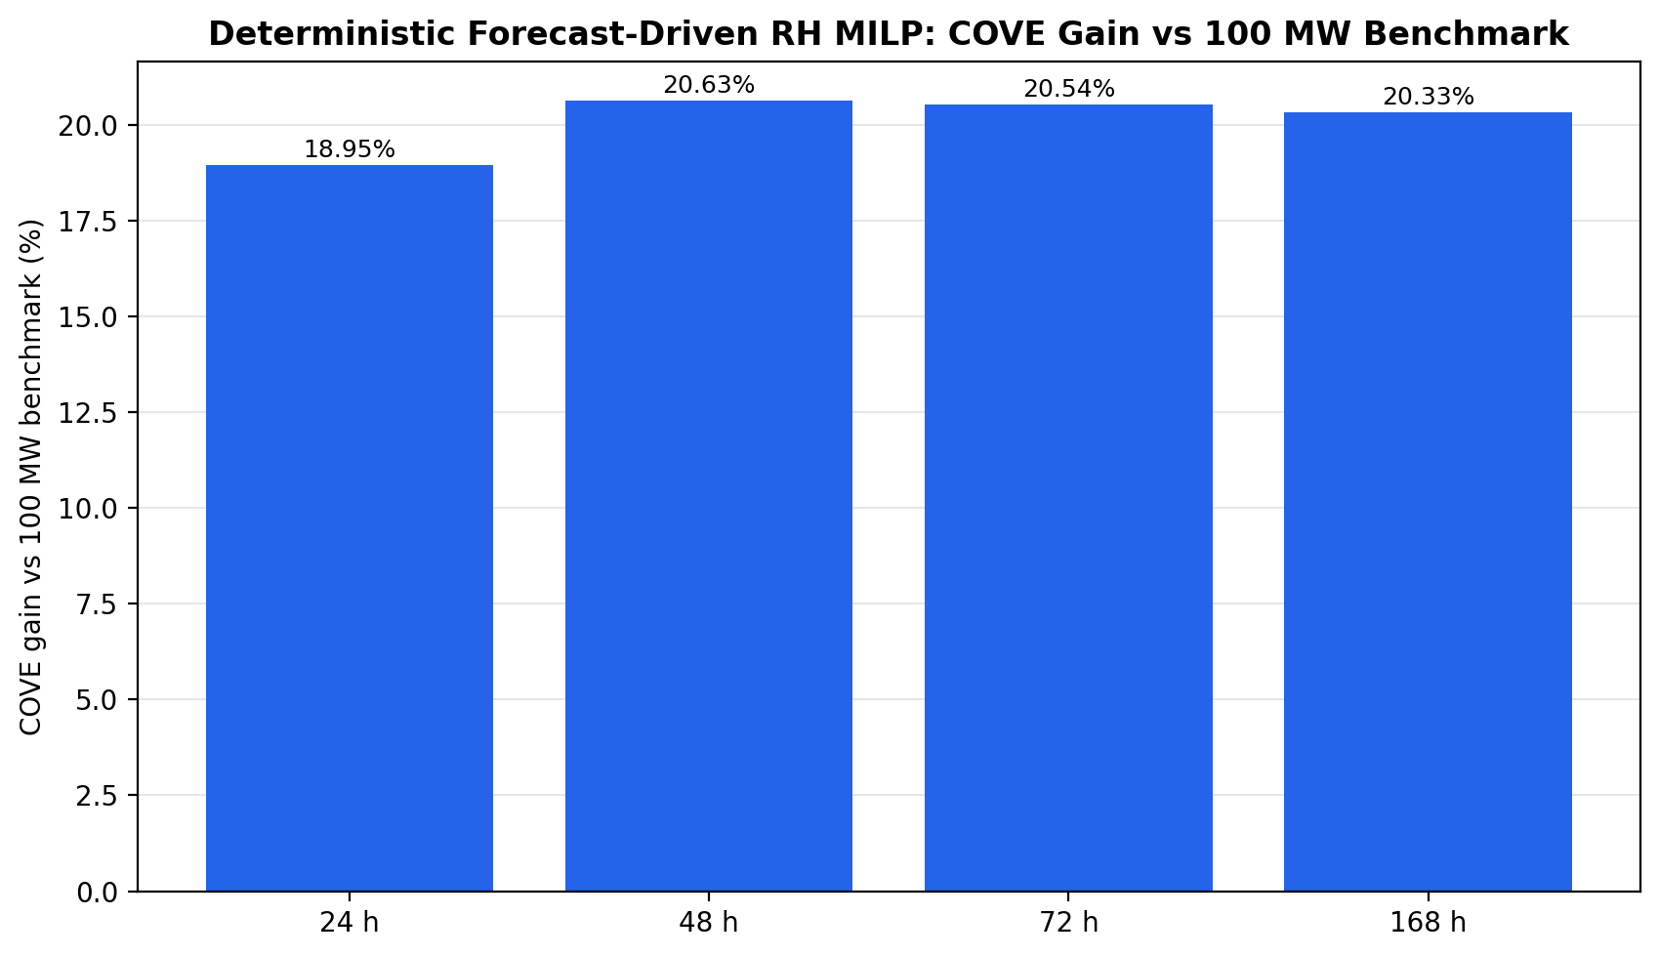
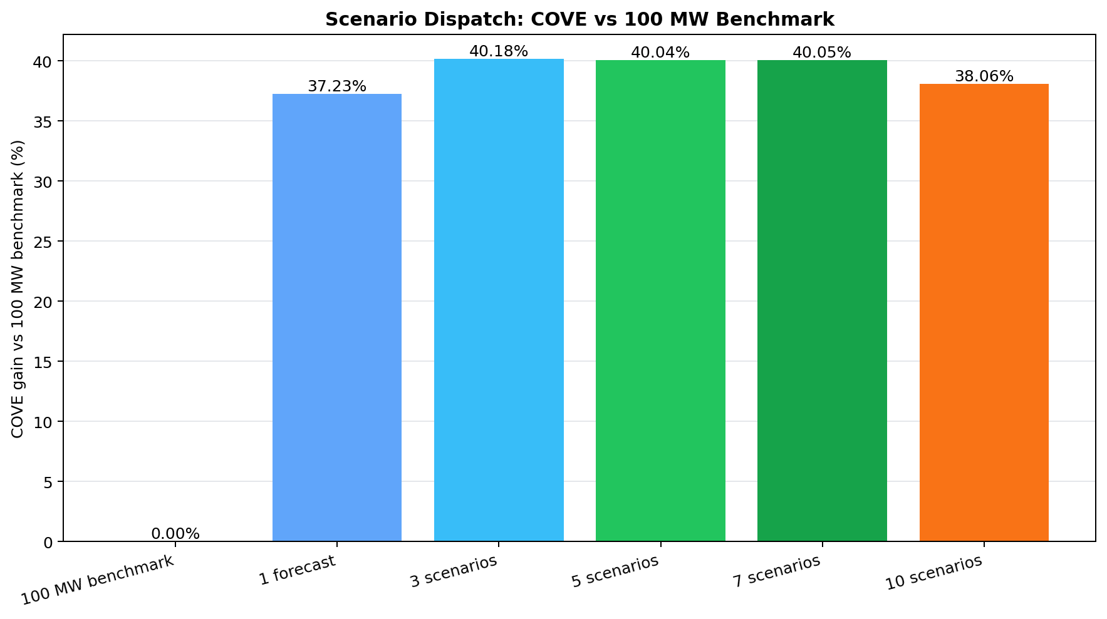
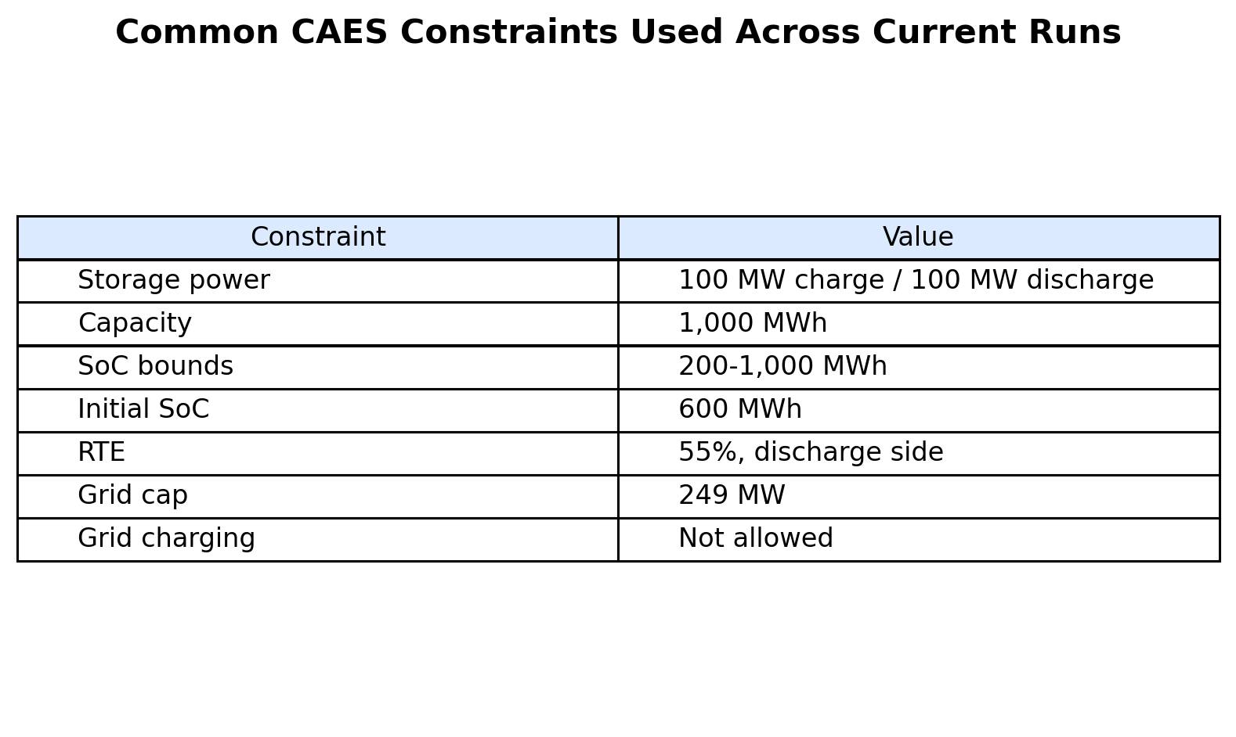
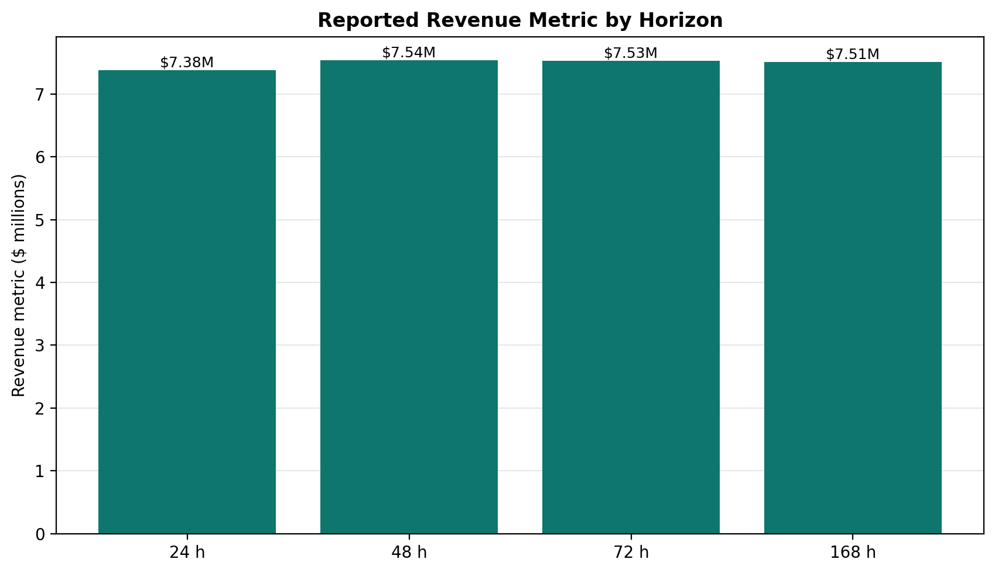
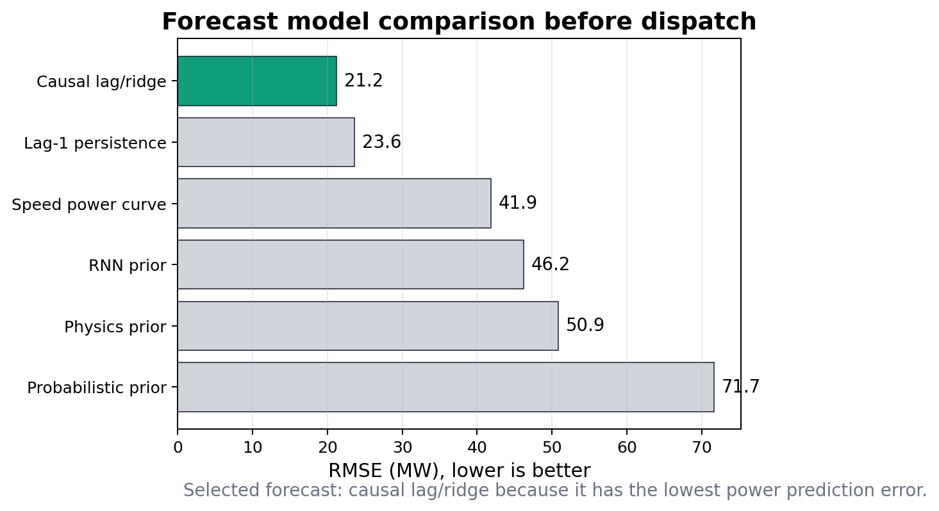
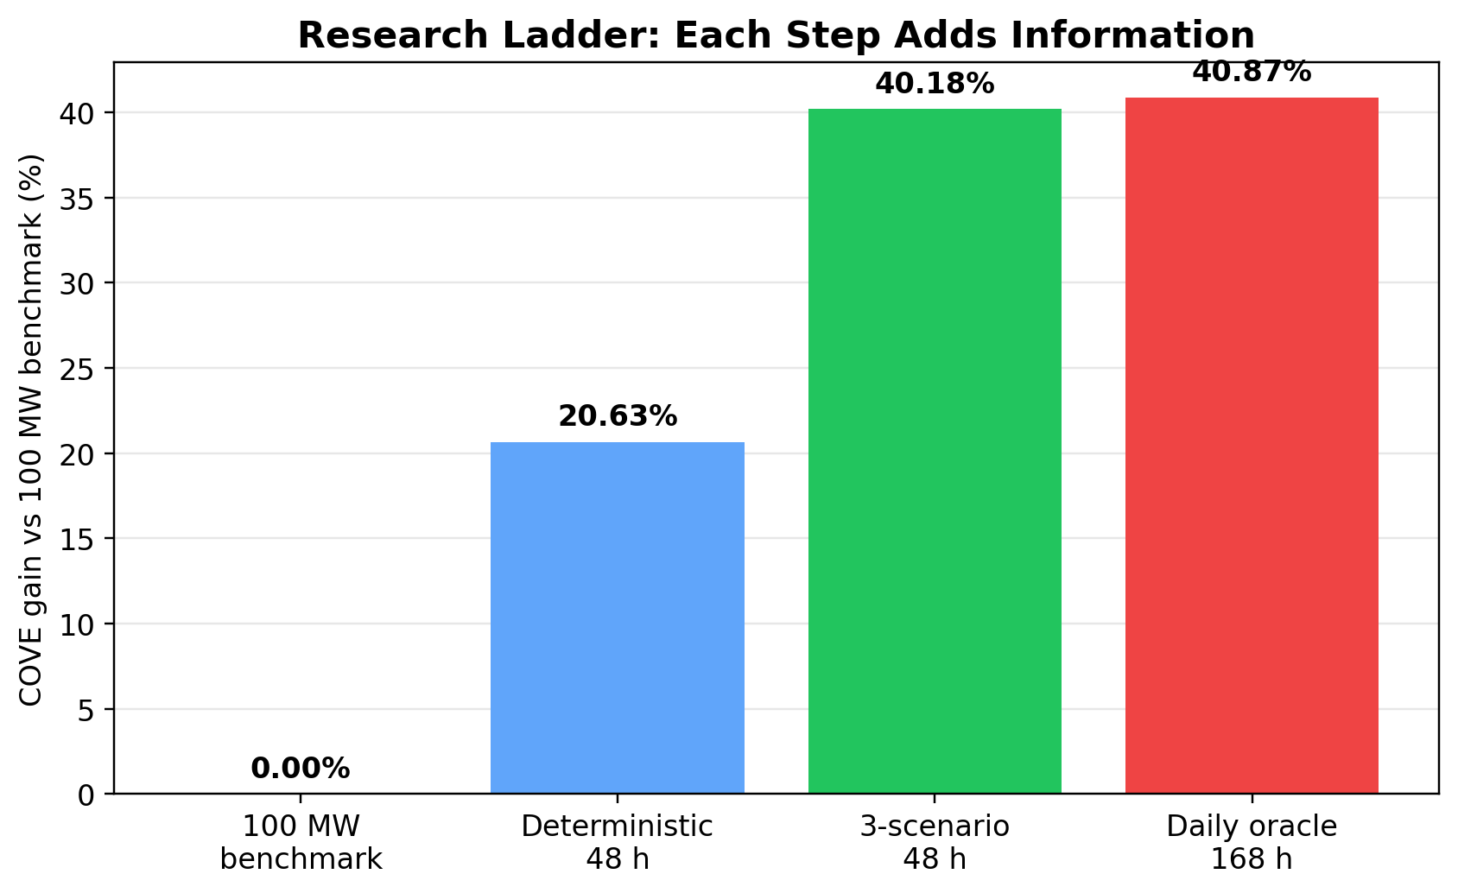
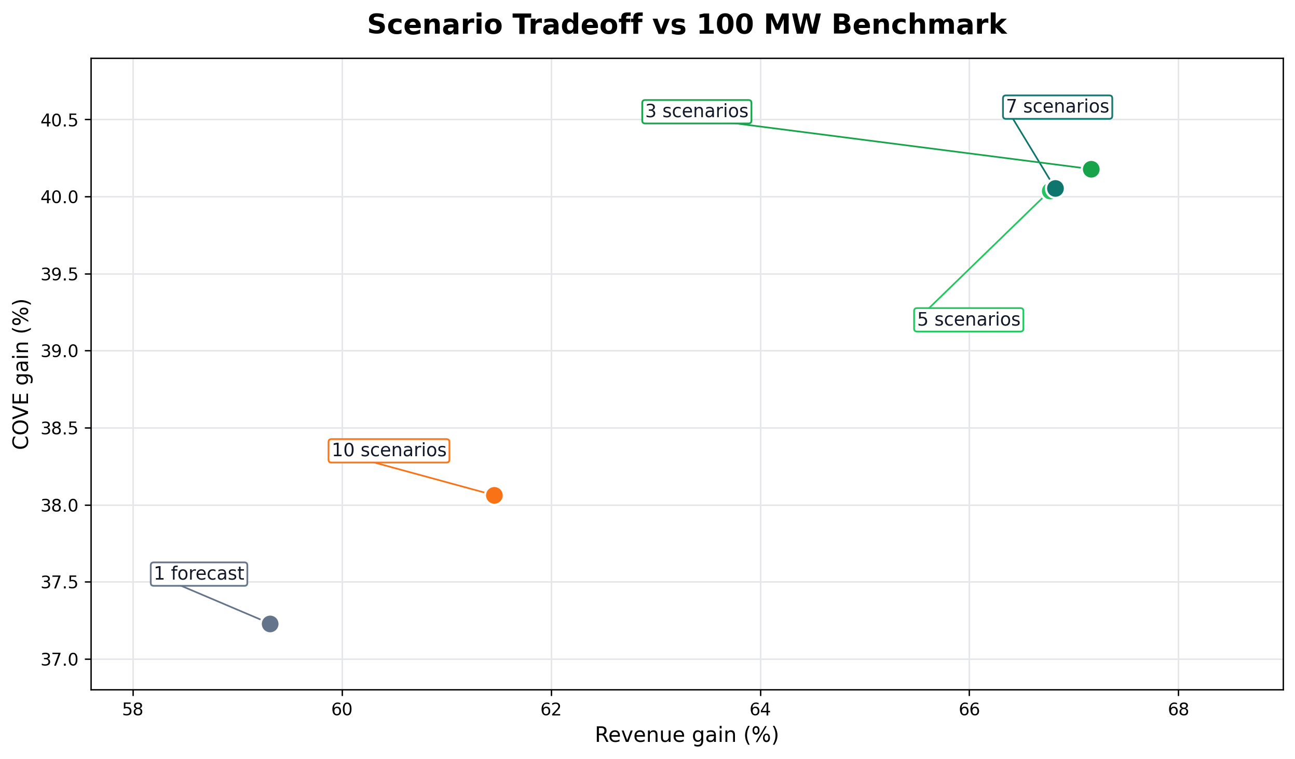
Forecast-Aware Rolling-Horizon Optimization for Hybrid Wind-Storage Dispatch
Main takeaway
David Valenta, North Carolina State University | Dr. Chris Qin, Washington State University
A forecast-aware controller must tune forecast horizon, replanning frequency, storage constraints, and scenario count together.
Summer 2026 REU | Pyron wind farm case study | ERCOT LMP data | PNNL CAES assumptions
1. Problem
Part
What changed
Best output
4. Results
• Wind and electricity price change every hour.
• A hybrid wind farm can sell wind now or store energy for later.
• The challenge is dispatching storage before the future is known.
• The main comparison is the 100 MW constant-output CAES benchmark.
• Wind-only is kept as secondary reference information.
Forecast
Predict wind power from past values
21.24 MW RMSE
Primary benchmark: 100 MW constant-output CAES. Wind-only remains secondary context.
Rolling horizon
One forecast path into Gurobi
48 h: 20.63% COVE gain
The pipeline predicts wind/price, sends those forecasts to Gurobi, executes dispatch, then scores revenue and COVE.
Scenarios
Multiple possible futures
3 scenarios: 40.18% COVE gain
21.24 MW
20.63%
Why storage helps
The important idea is separation: forecasts are guesses, Gurobi is the planner, and realized operation is the final truth used for revenue and COVE.
Oracle
Perfect future information
168 h: 40.87% COVE gain
Forecast RMSE
Deterministic
If wind arrives during a low-price hour, storage can hold part of that energy and release it when the price is higher. The dispatch problem is deciding when that trade is worth it while keeping the battery feasible.
causal lag/ridge
48 h COVE gain
3. MILP Dispatch
40.18%
40.87%
2. Data and Storage
• Gurobi chooses direct wind, charge, discharge, SoC, and curtailment.
• Charging must come from wind, not the grid.
• The battery cannot charge and discharge beyond its physical limits.
• Revenue is delivered power times realized price.
• COVE is lower when energy is delivered at higher value.
Scenario
Oracle
• Pyron wind farm hourly data, 1980-2023.
• Forecast trained before 2014; tested on unseen 2014-2023.
• ERCOT locational marginal price is used for value.
• CAES: 100 MW, 10 h, 1000 MWh.
• SoC: 200-1000 MWh, starting at 600 MWh.
• RTE: 55%, no grid charging, 249 MW grid cap.
3 scenarios, hourly replan
168 h perfect future
What the model sees
Deterministic rolling horizon: 48 hours gave the best COVE gain because it looked far enough ahead without trusting a weak long forecast too much.
The controller does not receive the true future in deployable cases. It receives forecasted wind generation and forecasted price, then the realized data is used later for scoring.
Scenario result: 3 scenarios performed best. More scenarios became more cautious and did not add enough value.
Longer horizons did not automatically improve realistic dispatch. Planning value and forecast error have to balance.
Forecast result: causal lag/ridge was the best power forecast, with 21.24 MW RMSE.
How to read these results
The ladder is not just decoration: each step adds one layer of information or control. Forecasting answers what may happen; rolling horizon decides how far to plan; scenarios add uncertainty; oracle shows the ceiling.
A higher COVE gain is better because it means the same storage system delivered energy at higher value compared with the 100 MW benchmark.
Revenue and COVE move together here: the strongest scenario case both earns more and lowers COVE against the benchmark.
5. Main Conclusion
Definitions and Acknowledgements
• The strongest realistic result came from the scenario-based controller because it planned under multiple possible futures and corrected decisions quickly.
• The deterministic 48 h case is useful because it shows the best one-forecast version of the method.
• The oracle is not realistic, but it shows the upper bound if future wind and price were known perfectly.
• The core claim is not just that Gurobi optimizes dispatch. The key result is that forecast design and dispatch design have to be tuned together.
• This matters for real wind farms because storage decisions are only useful when they respect uncertainty and physical constraints at the same time.
• 100 MW benchmark: rule-based storage case that tries to deliver 100 MW every hour.
• Rolling horizon: solve the future, execute the near-term action, update SoC, then solve again.
• Scenario dispatch: solve several possible futures instead of one forecast.
• Oracle: perfect future information, used only as a ceiling.
• COVE: cost divided by valued delivered energy; lower is better.
• All reported runs use chronological SoC and checked storage/grid constraints.
Thank you to Dr. Chris Qin, Nora Hosseiniimeni, Zach Lawrence, Jessica Yao, and the WSU Summer Research Program. Data and assumptions draw from the Pyron wind-storage dataset, ERCOT LMP records, and PNNL CAES storage references.
What I tested
Best realistic method
Why it worked
Oracle meaning
Forecast models, deterministic horizons, scenario counts, oracle ceiling, and constraint checks.
3 scenarios with hourly replanning
It reacted faster to forecast mistakes.
It is the perfect-future ceiling.
Best forecast
Best realistic
Upper bound
Contact: dvalent2@ncsu.edu
Best result: 3-scenario forecast-aware rolling-horizon dispatch improved COVE by 40.18% vs the 100 MW benchmark.
21.24 MW RMSE
3 scenarios
40.87% COVE
Poster size: 30 in x 20 in
Primary metrics compare against the 100 MW constant-output CAES benchmark; wind-only is retained only as a secondary reference.

