Slide 1
Forecast-Aware Dispatch for Hybrid Wind Storage
A clean research ladder: forecast selection -> rolling-horizon Gurobi -> uncertainty scenarios -> oracle ceiling
BASELOAD
FORECAST
ROLLING
SCENARIOS
ORACLE
0.00% COVE
21.24 MW RMSE
48 h | 6.25%
3 scen. | 23.19%
168 h | 32.83%
Current repo commit: 11b5214 | prepared for discussion with Dr. Chris Qin

Slide 2
SUMMER 2026 REU | HYBRID WIND + STORAGE
The project is now organized as a reproducible ladder
Each step changes one idea and compares against baseload or the oracle ceiling.
BASELOAD
FORECAST
ROLLING
SCENARIOS
ORACLE
0.00% COVE
21.24 MW RMSE
48 h | 6.25%
3 scen. | 23.19%
168 h | 32.83%
What stays fixed
What changes
How to read it
Wind-only charging, no grid charging, grid export cap, no simultaneous charge/discharge, chronological SoC, and realized revenue scoring.
First choose the forecast model, then choose Gurobi lookahead, then test multiple forecast futures.
Baseload is the lower reference. Oracle is the perfect-future ceiling. The proposed method lives between them.
Deep Wind Model Dispatch | current frozen ladder
02

Slide 3
SUMMER 2026 REU | HYBRID WIND + STORAGE
Baseload is the reference every dispatch result compares against
Baseload means the wind farm follows the simple reference delivery rule instead of actively optimizing storage.
Wind generated
Sold to grid
Baseline
power from the wind farm
no active lookahead strategy
0.00% gain
$271.87M
0.215746
7.273584
Scenario baseload revenue
Scenario baseload COVE
Deterministic baseload COVE
Why this slide matters: all percent improvements are measured relative to this reference. If dispatch beats baseload, storage was used in a more valuable way than the reference rule.
Deep Wind Model Dispatch | current frozen ladder
03

Slide 4
SUMMER 2026 REU | HYBRID WIND + STORAGE
Step 1 chooses the forecast before dispatch begins
This is a forecasting test only: no battery dispatch and no COVE calculation yet.
Forecast RMSE comparison (lower is better)
Causal lag / ridge
Best forecast method
21.24 MW
Best RMSE
23.60 MW
Next best baseline
Why this matters: Gurobi can only optimize the information it receives. A better forecast does not make the wind farm perfect, but it gives dispatch a stronger starting point.
Deep Wind Model Dispatch | current frozen ladder
04

Slide 5
SUMMER 2026 REU | HYBRID WIND + STORAGE
What each forecast method means
This slide explains the methods in the RMSE chart before any optimization result is discussed.
Forecast method
What it means
causal ridge
a regularized regression using only past/available inputs: wind speed terms, lagged power, and calendar features
lag-1 persistence
assumes the next hour looks like the most recent hour
speed power curve
uses wind speed to estimate power through a simple speed-to-power relationship
RNN
a neural network sequence model from the prior power-model work
physics model
a hand/physics-based power estimate from the prior model outputs
probabilistic model
a quantile/probabilistic prediction from the prior model outputs
Main takeaway: causal ridge won this comparison because it used recent measured behavior and simple wind physics without needing future information.
Deep Wind Model Dispatch | current frozen ladder
05

Slide 6
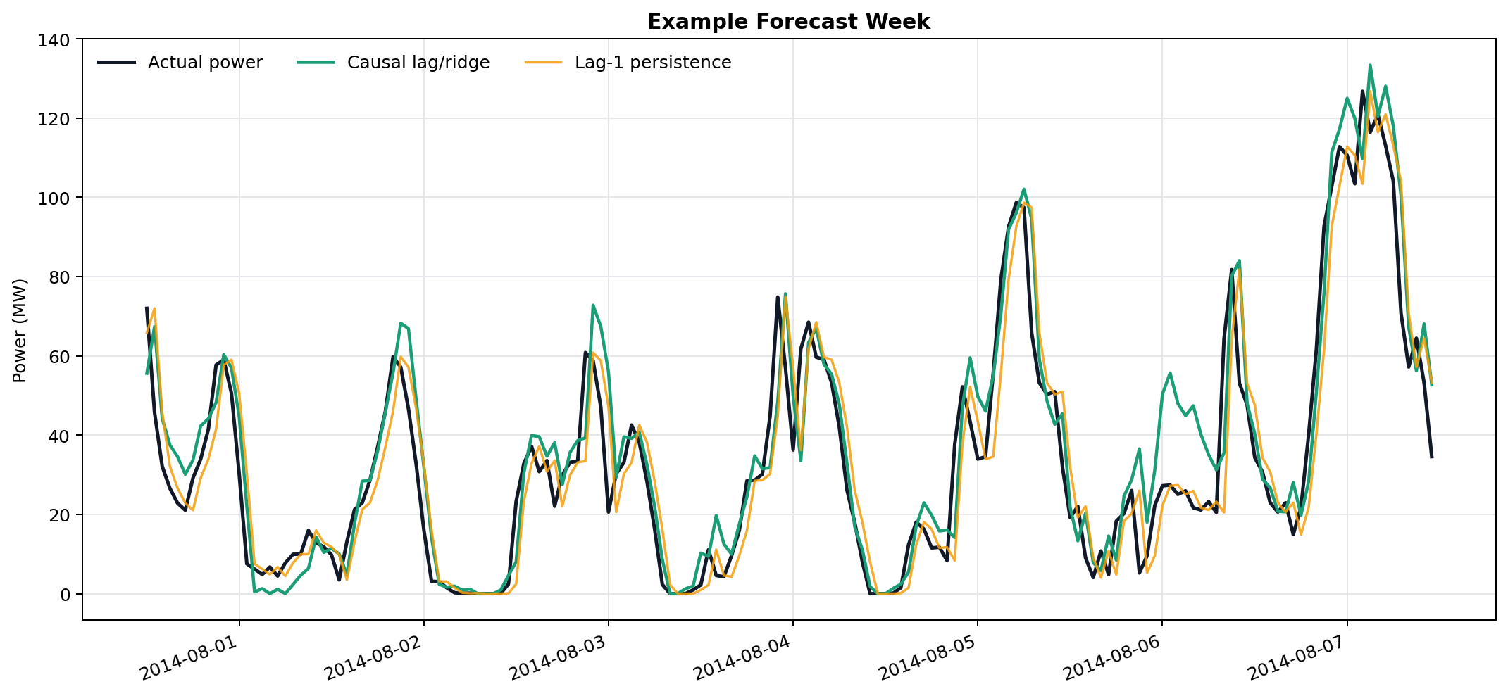
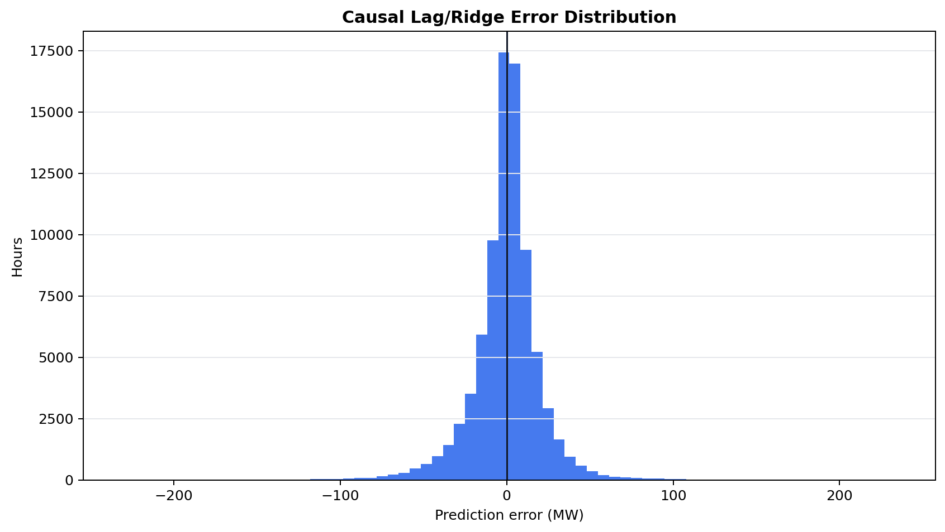
SUMMER 2026 REU | HYBRID WIND + STORAGE
The forecast model uses recent behavior plus simple wind physics
Ridge regression is the main causal forecasting method used in the paper ladder.
Inputs
Output
Reason it works
wind speed, speed squared/cubed, recent power lags, hour/day calendar signals
predicted wind power in MW for dispatch planning
it learns the power curve and repeats from recent wind-farm behavior
Deep Wind Model Dispatch | current frozen ladder
06

Slide 7
SUMMER 2026 REU | HYBRID WIND + STORAGE
Gurobi converts forecasts into feasible storage actions
The optimizer chooses direct wind, charge, discharge, curtailment, and SoC while respecting the storage constraints.
Forecasts
MILP/Gurobi
Decisions
Scoring
wind + price
maximize realized value
direct, charge, discharge
revenue + COVE
Constraint
Meaning
SoC bounds
battery cannot be empty or overfull
wind-only charging
storage charges only from wind, not the grid
249 MW grid cap
delivered power cannot exceed export capacity
no simultaneous charge/discharge
one operating mode per hour
chronological SoC
battery state carries forward hour by hour
Deep Wind Model Dispatch | current frozen ladder
07

Slide 8
SUMMER 2026 REU | HYBRID WIND + STORAGE
Step 2 finds the best deterministic rolling horizon
With the causal forecast fixed, the experiment varies how far Gurobi looks ahead; this table uses the 75 MW direct reserve run.
Horizon
24h
48h
72h
168h
COVE gain
3.31%
6.25%
6.06%
5.44%
Revenue
$7.38M
$7.61M
$7.59M
$7.54M
Main point: 48 hours was best because it sees enough future price movement to use storage, but avoids leaning too hard on poor long-range forecasts.
Deep Wind Model Dispatch | current frozen ladder
08

Slide 9
SUMMER 2026 REU | HYBRID WIND + STORAGE
Step 3 adds uncertainty instead of trusting one forecast
The scenario controller tests several possible futures and chooses an action that works well across them.
3
7
5
10
1
Case
1 forecast
3 scen.
5 scen.
7 scen.
10 scen.
COVE gain
19.40%
23.19%
23.01%
23.03%
20.47%
Revenue gain
24.07%
30.19%
29.88%
29.92%
25.74%
Deep Wind Model Dispatch | current frozen ladder
09

Slide 10
SUMMER 2026 REU | HYBRID WIND + STORAGE
Oracle dispatch gives the perfect-information ceiling
This is not a real controller; it tells us how much value is theoretically left if future wind and price were known.
Oracle horizon
24h
48h
72h
168h
COVE gain
28.30%
31.32%
32.35%
32.83%
Revenue
$9.95M
$10.39M
$10.55M
$10.62M
Deep Wind Model Dispatch | current frozen ladder
10

Slide 11
SUMMER 2026 REU | HYBRID WIND + STORAGE
The repository now matches the paper workflow
Each part has one command, one README, result files, and figures.
Folder
Command
Purpose
causal ridge regression
RUN_1_FORECAST_RMSE.py
forecast RMSE comparison
rolling horizon
RUN_2_ROLLING_HORIZON.py
deterministic Gurobi horizons
different scenarios
RUN_3_SCENARIO_COMPARISON.py
1/3/5/7/10 futures
oracle upper bound
RUN_4_ORACLE_UPPER_BOUND.py
perfect-future ceiling
b6 verification
B6_CANONICAL_RUNNER.py
separate 2020 frozen QA
What changed
Why this helps
Current commit
Restored forecast code, separated B6, added oracle folder, archived older causal-dispatch outputs.
A reviewer can now run one command per experiment instead of hunting through the old repo.
11b5214
Organize Summer REU reproduction ladder
Deep Wind Model Dispatch | current frozen ladder
11

Slide 12
SUMMER 2026 REU | HYBRID WIND + STORAGE
DAM was tested, but it should not be used in the final result
Day-Ahead Market prices sound realistic, but the current DAM version performed worse and adds a data-matching problem.
Why DAM seemed tempting
Why we cannot use it here
What happened
DAM is known ahead of real-time operation, so it looked like a realistic price input for dispatch planning.
The DAM files do not cleanly match the exact Pyron real-time LMP signal used for scoring. If the planning price and scoring price are mismatched, the comparison becomes unfair.
In the tests, DAM did worse than the frozen causal ridge setup, so it is excluded from the finished paper ladder.
Question
Answer for the meeting
Does DAM improve the current result?
No. The tested DAM setup performed worse than causal ridge.
Why can a known price perform worse?
Known does not mean matched; the DAM node/timing may not line up with realized PYR_PYRON1 LMP.
What should the paper do?
Do not use DAM in the headline result. Mention it only as an excluded sensitivity check if needed.
Deep Wind Model Dispatch | current frozen ladder
12

Slide 13
SUMMER 2026 REU | HYBRID WIND + STORAGE
The newer proxy CSV is useful only as a sanity check
We tested newer/proxy data to see whether the workflow still behaved similarly, but it is not official evidence.
What the proxy file was
What it showed
Why not trust the numbers
A reconstructed newer dataset made from available public pieces after the original Pyron file ended. It was meant to imitate the old data format.
The broad behavior looked similar: forecast-driven dispatch still needed careful horizons and constraints.
It is a proxy, not the same validated Pyron dataset. Missing pieces, source mismatch, or formatting assumptions can change revenue and COVE.
Use in final paper
Decision
Official headline numbers
Use the frozen Pyron 2014-2023 ladder, not the proxy.
Mention in discussion
Can say newer proxy data was tested as a directional robustness check.
Claim strength
Do not claim exact proxy percentages as final results.
Deep Wind Model Dispatch | current frozen ladder
13

Slide 14
SUMMER 2026 REU | HYBRID WIND + STORAGE
Main concerns are now explicit instead of hidden
This is the checklist to discuss before turning the work into the final paper.
Concern
Current status
Canonical baseline
Baseload is the reference; oracle is the upper ceiling.
Result reconciliation
Each headline number is mapped to one folder, command, CSV, and figure.
Direct/curtailment logic
B6 uses planned direct wind during realized execution instead of selling all leftover wind.
Constraints
Nora/Chris constraints are listed; B6 verifies the corrected 2020 execution logic.
Scenario maturity
Scenario result is promising but should be presented with exact assumptions.
Storage configuration
Final paper should freeze one CAES config across all headline comparisons.
DAM
Useful future extension, not part of the current frozen ladder.
Deep Wind Model Dispatch | current frozen ladder
14

Slide 15
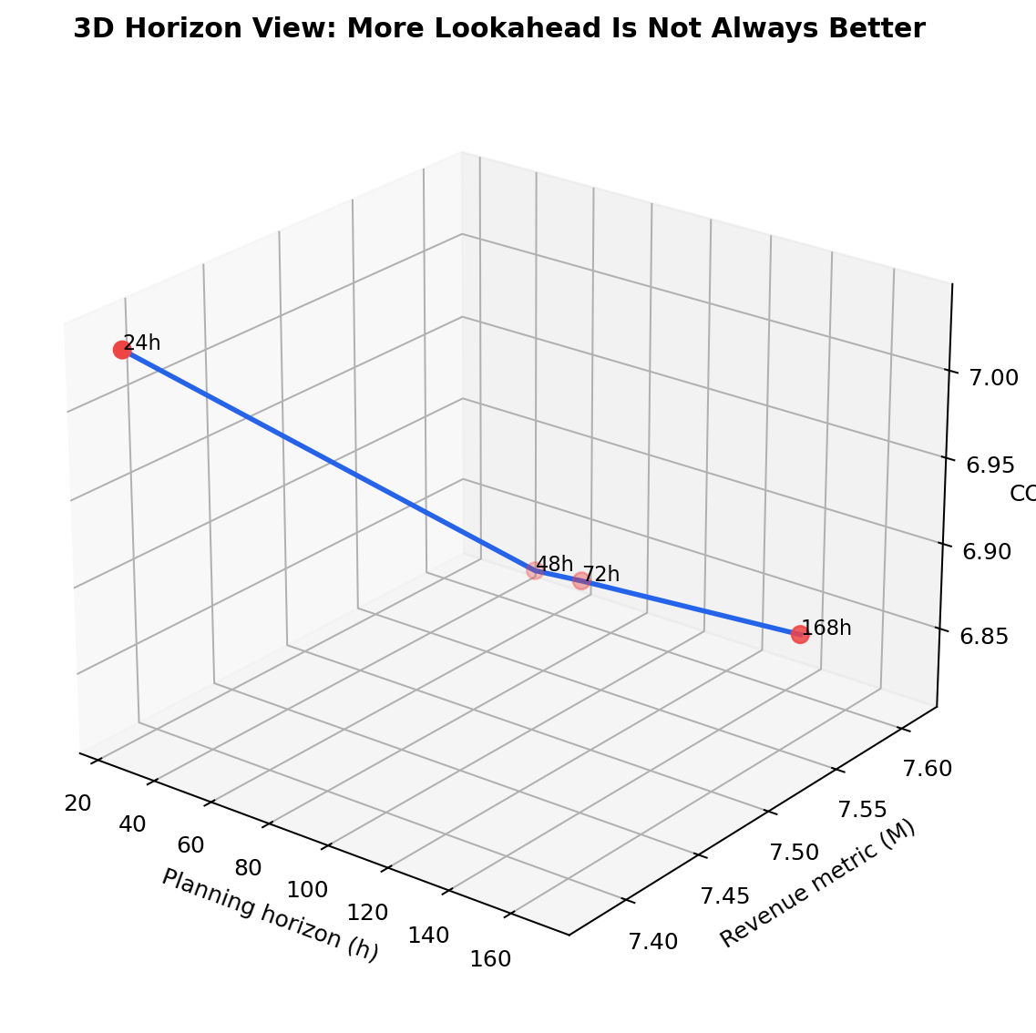
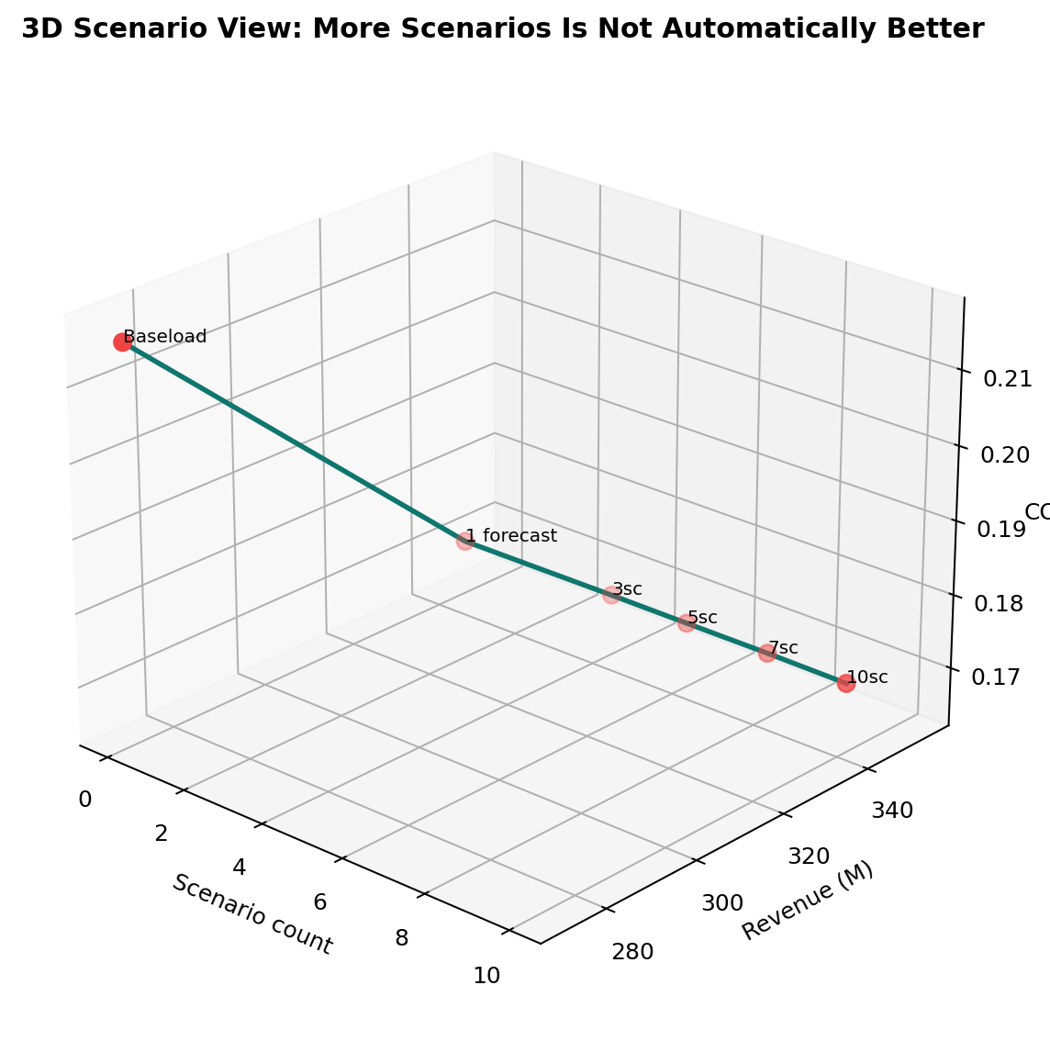
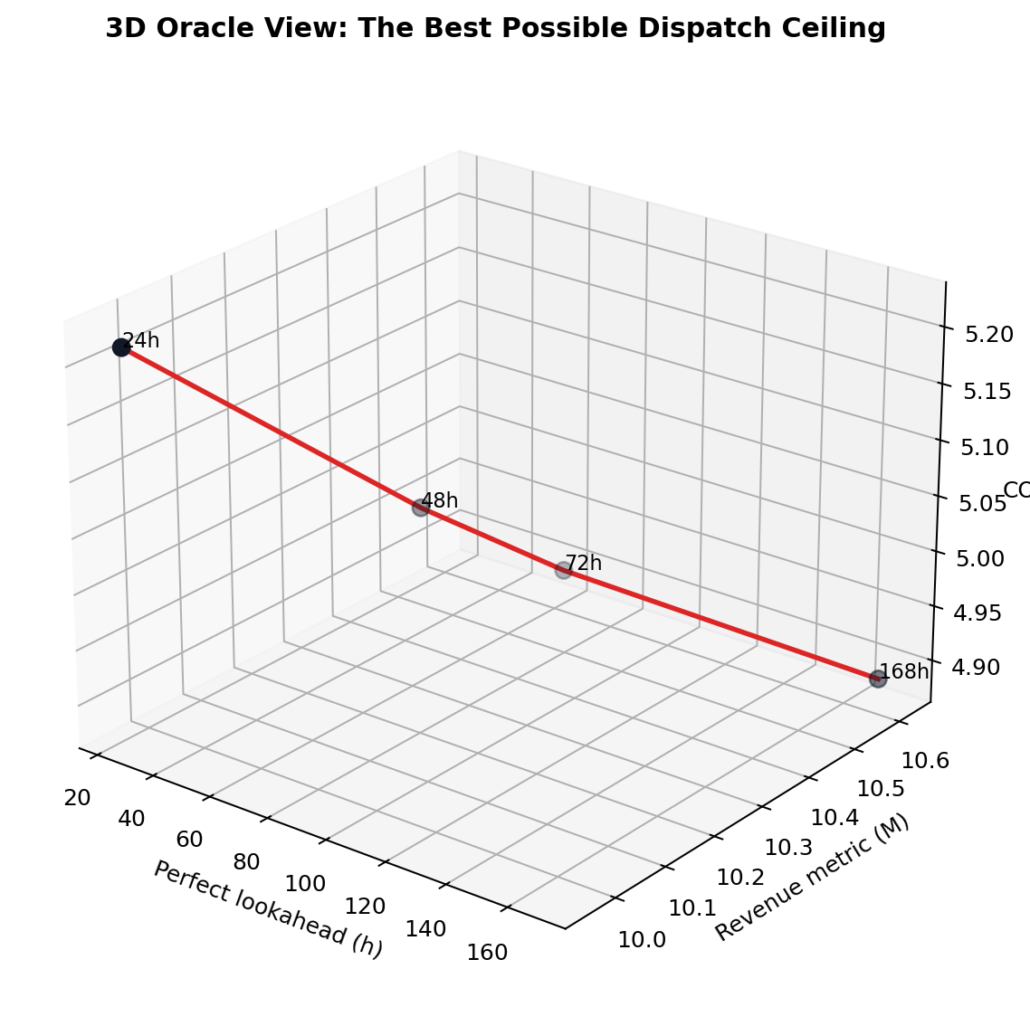
SUMMER 2026 REU | HYBRID WIND + STORAGE
These figures become the paper's visual evidence
The 3D plots are not new results; they show the same tables as value tradeoffs.
Deterministic
Scenarios
Oracle
48h is the best realistic rolling-horizon case.
3 futures had the best revenue/COVE tradeoff.
168h perfect information is the ceiling.
Deep Wind Model Dispatch | current frozen ladder
15

Slide 16
SUMMER 2026 REU | HYBRID WIND + STORAGE
Large figure: causal ridge gives the best forecast
Use this slide when explaining why the paper uses causal ridge before dispatch.
Best
21.24 MW RMSE
Lower RMSE means the forecast was closer to actual wind power.
Deep Wind Model Dispatch | current frozen ladder
16

Slide 17
SUMMER 2026 REU | HYBRID WIND + STORAGE
Large figure: 48 hours is the best realistic rolling horizon
This is the deterministic Gurobi result using causal ridge forecasts.
Winner
48 h
6.25% COVE gain
Why: enough lookahead to plan storage, but not so much that forecast error dominates.
Deep Wind Model Dispatch | current frozen ladder
17

Slide 18
SUMMER 2026 REU | HYBRID WIND + STORAGE
Large figure: three scenarios is the best uncertainty case
Multiple futures beat one forecast, but too many futures became conservative.
Winner
3 scenarios
23.19% COVE gain
Meaning: uncertainty helps when it protects against one bad forecast path.
Deep Wind Model Dispatch | current frozen ladder
18

Slide 19
SUMMER 2026 REU | HYBRID WIND + STORAGE
Large figure: oracle gives the perfect-future ceiling
This is the highest possible comparison case because Gurobi knows future wind and price.
Ceiling
168 h
32.83% COVE gain
This is not deployable. It shows the best possible target for realistic methods.
Deep Wind Model Dispatch | current frozen ladder
19

Slide 20
SUMMER 2026 REU | HYBRID WIND + STORAGE
Large figure: the final ladder in one picture
The paper story builds from reference case to realistic method to perfect-information ceiling.
BASELOAD
FORECAST
ROLLING
SCENARIOS
ORACLE
0.00% COVE
21.24 MW RMSE
48 h | 6.25%
3 scen. | 23.19%
168 h | 32.83%
No dispatch yet
Realistic method
Upper bound
Step 1 chooses the forecast by RMSE.
48h rolling + 3 scenarios is the headline controller.
Oracle is only the perfect-future comparison.
Deep Wind Model Dispatch | current frozen ladder
20

Slide 21
Finished research package
The strongest story is not just that Gurobi optimizes dispatch. It is that forecast quality, replanning horizon, uncertainty scenarios, and storage constraints must be evaluated together.
Proposed contribution
Evidence
Now the work shifts
A reproducible forecast-aware rolling-horizon dispatch pipeline for hybrid wind + CAES under explicit operational constraints.
Causal ridge wins the forecast test; 48h wins deterministic dispatch; 3 scenarios gives the best scenario result; oracle shows the remaining ceiling.
The computational package is finished enough to start writing the paper and building the poster from the frozen ladder.
Bottom line: the final paper and poster should explain the ladder, show the finished numbers, and clearly state that DAM/proxy data are not part of the headline result.

