Slide 1
Solar panel defect detection report
Quantified energy labs interview question
Position: software engineer – AI and analystics

Slide 2
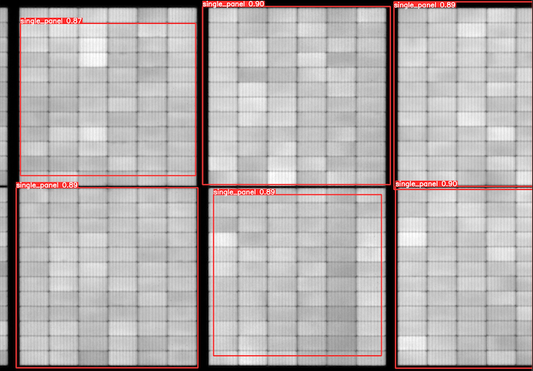
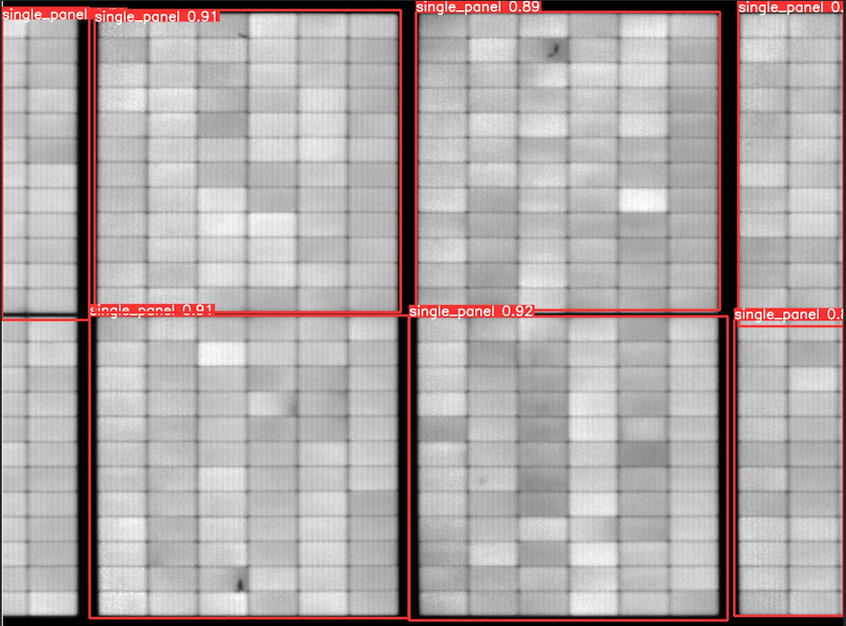
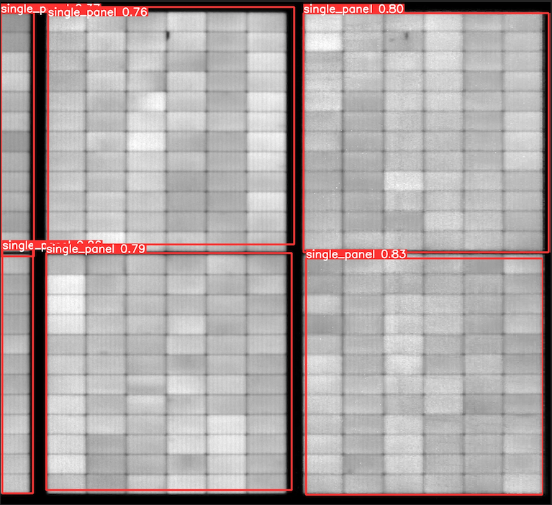
INDIVIDUAL PANEL DETECTION – Test result 99,2%
Summary
Training Epochs: ~ 200-300
mAP @ 0.5: 99.2%
Prediction includes some panels partially ‘cut’ in the image. These can be filtered by adding aspect ratio criteria
To further improve prediction
Get more data for training
Add Data Augmentation like 180deg rotation, image flipping.
Train for more epochs
The size(pixels) of the individual panel is about the same in the same string image. We can use this properties and add some code to check any abnormal size or aspect ratio, and then auto adjust it.

Slide 3
Defects DETECTION – Test result 99,2%

Slide 4
Defects DETECTION – Test result 99,2%

