Slide 1


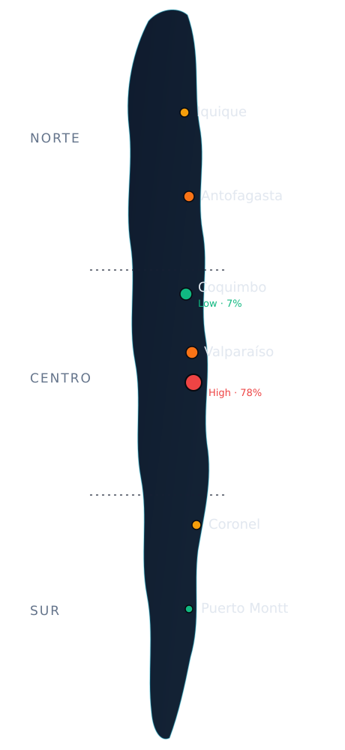
WAZE CARGO
BTS MSc AI & Data Solutions — 2026
Waze Cargo
A predictive maritime analytics solution designed to forecast shipping
disruptions and improve operational efficiency through data-driven insights.
“The ocean doesn’t wait. Now you can move before it does.”
Waze Cargo
01 / 14
Notes:
Open strong: Waze Cargo predicts Chilean port congestion before it happens. Hold on the tagline. We turn 20 years of customs data plus ocean weather into a routing decision. One line: existing tools show where your ship is; we show what happens when it arrives.

Slide 2




EXECUTIVE SUMMARY
What we're designing — and why it matters now.
Waze Cargo is a freemium SaaS platform that predicts Chilean port congestion up to 12 months ahead — combining 20 years of customs intelligence (2005–2025) with seasonal ocean-weather forecasts across Chile’s three coastal zones. We help importers and exporters pick the right port, at the right time, before delays happen.
The opportunity
The product
Chile moves $223.2B in annual trade through its ports. 98.6% of firms are SMEs. No existing tool predicts congestion before it strikes.
A live dashboard across 31 Chilean ports — ML congestion forecasts (4.03% error), commodity-level analysis, and weather-adjusted delay-risk. Dashboard 2.0 is built and running.
The model
The ask
Freemium. Free congestion labels acquire users; Pro (€100–350/mo) unlocks full forecasts and commodity routing; Enterprise (€500+/mo) adds API access and integrations.
€120,000 seed for 15% equity. Funds go to deployment, go-to-market, and a Chile-based market representative.
Waze Cargo
02 / 14
Notes:
The whole pitch in 30 seconds. Hit the four boxes in order: opportunity (223.2B, 98.6% SMEs, nobody predicts), product (live Dashboard 2.0, 31 ports, 4.03% error), model (freemium funnel), ask (120K for 15%). Then move on - detail comes later.

Slide 3

TEAM — WHO?
Five builders — and one unfair advantage.
MA
MM
DV
AK
GM
Michalis Arvanitis Katzourakis
Meliane Meledje
David Vergara Fuentes
Artemiy Klimkin
Gerson Montesinos
ML Engineer & Tech Lead
Product & GTM Strategy
Data Engineer & Market Lead
Data Scientist
Project Lead & Operations
Built the full ML pipeline, AWS cloud infrastructure, and maritime weather integration from scratch.
Led the go-to-market design and AARRR funnel strategy.
Former Chilean customs professional — the origin of our 20-year data edge.
ML modeling and forecasting pipelines.
Team coordination and product delivery.
Why this team?
David’s years inside Chilean customs give us direct access to 20 years of trade records and an insider understanding of port operations that no outside team could replicate. The rest of the team brings ML engineering, data science, product strategy, and project management — a complete stack.
Waze Cargo
03 / 14
Notes:
Spend your time on David. He was inside Chilean customs - that is why we have 20 years of data and operational insight no outsider can copy. Frame the rest as a complete stack: ML, data science, product, ops. The unfair advantage is the headline, not the resumes.

Slide 4





WHAT PROBLEM ARE YOU SOLVING — WHY?
$223.2B in trade moves blind to what’s coming.
Every Chilean importer and exporter makes routing decisions with no idea what the port will look like when their cargo arrives.
Importers
$84.3B CIF
Exporters
$138.9B FOB
98.6% are SMEs importing machinery, electronics, vehicles, pharma. A 5-day delay means empty shelves, missed deadlines, penalties. Insurance does NOT cover commercial losses from congestion.
Chile is #1 in copper; a top exporter of fruit, salmon, wine, lithium. A congested port during grape (March) or cherry (December) season means spoiled perishables and lost contracts worth millions.
Today’s tools tell you
“Your vessel is 450nm from San Antonio, ETA March 15, 14:00.” (MarineTraffic €100–150/mo · VesselFinder €40–120/mo)
What they CANNOT answer
Will the port be congested when my cargo arrives? Will my grapes compete with copper for berth space? Are swells about to close operations? Should I reroute?
Waze Cargo tells you
“San Antonio will run 40% above norm on March 15, swell risk 3.2% hours closed — route via Valparaíso (37%) or Coquimbo (7%, calmest in Chile).”
04 / 14
Notes:
Make it visceral: 223.2B moves blind. Importers face stockouts and penalties insurance won't cover; exporters face spoiled fruit during harvest. Then the three-line gap: what tools tell you / what they can't / what we tell you. End on the concrete forecast - San Antonio 40% above norm, reroute to Coquimbo at 7%. That number does not exist anywhere today.

Slide 5



MARKET AND USERS — WHO?
Three segments, one funnel.
Core — Small importers/exporters
Free tier
Persona — Maria
Highest volume of firms · limited logistics teams · most vulnerable to delays · underserved. They rely on phone calls to brokers and gut feeling. The free tier captures this market.
Runs a mid-size fruit export company in Santiago. Every December she ships cherries to China through San Antonio.
Growth — Medium importers/exporters
Pro tier
Frequent trade · structured operations · willing to pay for predictive tools. Core revenue target. One avoided delay per quarter pays for the subscription.
Last year: 6-day congestion delay → cherries past peak → $180,000 rejected.
Expansion — B2B
Enterprise
Freight forwarders, customs brokers, port authorities, carriers, mining. Enterprise & API licensing. Forwarders alone make thousands of routing decisions monthly.
With Waze Cargo: she sees the December spike 3 months out and routes via Valparaíso.
Waze Cargo
05 / 14
Notes:
Three segments map to three tiers: small=free, medium=Pro core revenue, B2B=Enterprise. Then tell Maria's story - the 180K cherry loss. That one avoided delay paying for years of subscription is the whole value argument.

Slide 6



BUSINESS MODEL — HOW?
Freemium SaaS: taste, then crave.
Free
MOST POPULAR
Pro
Enterprise
€0 /mo
€100–350 /mo
€500+ /mo
USER ACQUISITION
SME CORE
SCALE & INTEGRATE
Congestion risk labels (Low/Moderate/Elevated/High) for 1 port · monthly view · no commodity detail · weather layer blurred.
All 31 ports · 12-month horizon · commodity breakdown by HS2 · weather-adjusted delay-risk · cross-port comparison · alt-port routing · API.
Multi-user dashboards · ERP/TMS integrations · dedicated support · fleet tracking · white-label · custom HS4 analysis.
Acquisition
Conversion
Retention
Referral
Public live dashboard (no signup) for San Antonio & Valparaíso. Cold outreach using customs data — we show prospects their own import history.
“Taste then crave” — routing recs visible but paywalled, commodity table blurred, swell alerts locked. They see the value before paying.
ML alerts on congestion spikes & weather disruption + monthly trade digest. Target 60% day-30 retention, <5% monthly churn.
“Invite a logistics partner, both get 1 month Pro free.” Natural virality when an importer shares a warning with their forwarder.
Waze Cargo
06 / 14
Notes:
Freemium mechanics. The key phrase is 'taste then crave': the user SEES the routing recommendation but it is paywalled, the commodity table is blurred, swell alerts locked. Walk the AARRR row: public dashboard acquires, blurred value converts, alerts retain, partner-invite refers.

Slide 7
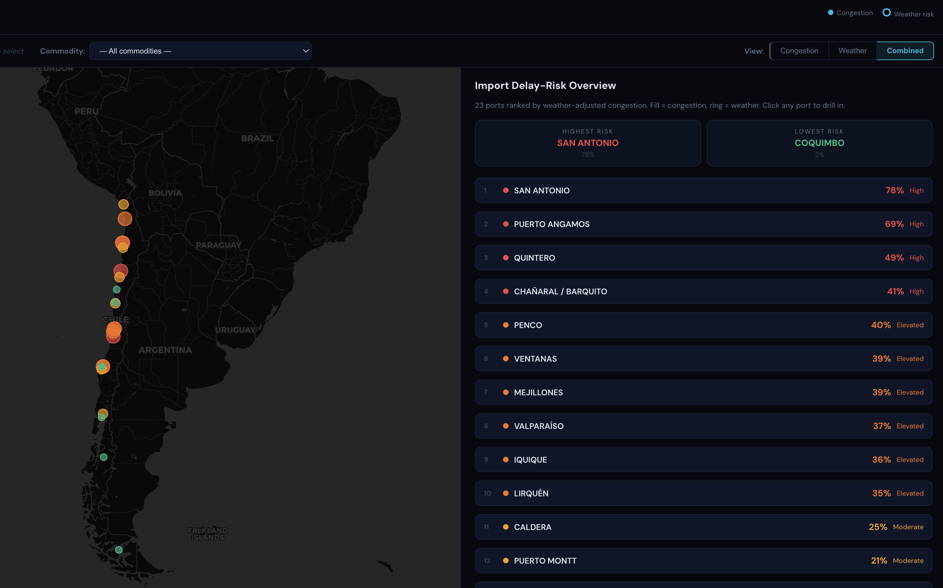

PRODUCT DEMO — WHAT?
A running product, not a mockup.
LIVE · DASHBOARD 2.0
The demo flow
1
Overview
Interactive map, all 31 ports color-coded by congestion risk.
2
Direction toggle
Import vs Export — profiles flip (Coronel busy for coal exports).
3
Port drill-in
Click San Antonio: 12-mo forecast, best vs worst month, swell vs wind driver.
4
View modes
Congestion / Weather / Combined — ring weather-exposed ports.
5
Commodity analysis
Pick HS26 copper → cross-port comparison + best-port recommendation.
6
The routing decision
“Aha”: a port they never considered is best for their commodity.
Scientific rigor: we found two data-leakage bugs that inflated accuracy (R² looked like 0.91, was honestly 0.57). We caught them via cross-model comparison, fixed them, and report only honest numbers — 4.03% wMAPE, stress-tested across 4 temporal folds including the COVID break.
Waze Cargo
07 / 14
Notes:
If live demo works, DRIVE IT - this is the moment. Walk the 6 steps on the right. Land the 'aha': a port they never considered is best for their commodity. If demo fails, this slide stands alone. Always end on the rigor box - we found two leakage bugs, R2 looked like 0.91 but was honestly 0.57, we report the honest 4.03% wMAPE. Honesty about our own numbers builds more trust than a big number would.

Slide 8


PROOF — LIVE 2026 ACCURACY
The forecast is holding up out-of-sample.
We forecast 2026 before the year happened. Five months in, here’s the model graded against actual customs data (Jan–May 2026) — fully out-of-sample.
National totals · Jan–May 2026
Accuracy by port size (wMAPE)
Imports
Exports
Total
Large ≥500/mo
11 pairs
8.3%
Actual
316,634
77,303
393,937
Medium 50–500
10 pairs
17.1%
Forecast
341,052
80,757
421,809
Small <50/mo
25.2%
33 pairs
Error
+7.7%
+4.5%
+7.1%
Overall: 8.5% wMAPE across 54 port-direction pairs.
3.4% error
1.2% error
+26.1% miss
4.03% → 8.5%
San Antonio import
San Antonio export
Valparaíso import
Honest degradation
57% of all maritime imports — excellent where it matters most.
Near-perfect on the highest-value flow.
Biggest miss, driven by a +91% May spike — a known fix target.
2025 holdout vs live 2026: expected drift for a fully out-of-sample recursive forecast.
Waze Cargo
Large ports = 98% of volume at 8.3% wMAPE — most accurate where it matters.
08 / 14
Notes:
This is the credibility kill-shot. We forecast 2026 before it happened; now we grade it on real customs data. National error 7.1%, overall 8.5% wMAPE. Drive the honesty: 2025 holdout was 4.03%, live 2026 is 8.5% - that degradation is EXPECTED for a fully out-of-sample recursive forecast, and we report it openly. Land the punchline: large ports carry 98% of volume and we hit 8.3% there - most accurate exactly where the money is. The Valparaiso miss we own as a known fix target, not hide.

Slide 9


MARKET OPPORTUNITY
A growing market with a moat competitors can’t cross.
$1.8B
$5.6B
~12%
69%
market today
by 2034
CAGR
of ports untapped
Predict
congestion
Commodity
data
Weather
risk
Chile customs
20yr
Price
MarineTraffic
€100–150
VesselFinder
€40–120
Kpler
€500+
Vizion
Custom
Sinay
Custom
Waze Cargo
€0–350
Our moat: 20 years of Chilean customs data at HS2×port granularity — unreplicable from AIS alone — plus insider domain expertise. Competitors won’t build Chile-specific models for a niche they don’t prioritize. We’re already there.
Waze Cargo
09 / 14
Notes:
Market is large AND growing: 1.8B to 5.6B, 12% CAGR, 69% untapped. Walk the table left to right - everyone is red on prediction and Chile data except us. Close on the moat: 20 years of HS2xport customs data is unreplicable from AIS; global players won't build Chile-specific models for a niche. We are already there.

Slide 10


KEY METRICS
Success, defined — and how we get there.
North Star — Weekly Active Port Checks (WAPC): unique users checking ≥1 port forecast or weather alert per week. Captures engagement and the habit that drives conversion.
40%
8–12%
<5%
60%
Activation
Free→Pro
Monthly churn
Day-30 retention
port forecast in <3 min
conversion
sticky product
habit formed
€2,400+
3:1+
15%
4.03%
LTV
LTV:CAC
Referral rate
wMAPE
per customer
ratio
K-factor > 0.3
alert at 8%
How we get there: Y1 target is 10 Pro users (€40K ARR). Acquisition via the public free dashboard (already built), cold outreach using customs intelligence, and trade-association partnerships. One avoided delay per quarter more than pays for the subscription.
Waze Cargo
10 / 14
Notes:
North star is Weekly Active Port Checks - engagement plus habit. Don't read every card; point at conversion (8-12% vs 3-5% benchmark) and LTV:CAC 3:1. Close on how-to-get-there: Y1 is just 10 Pro users / 40K ARR via a dashboard that already exists. Modest and credible.

Slide 11

3–5 YEAR FINANCIAL PROJECTIONS
From €40K to €1.2M ARR.
Year 1
€40K
10 Pro · MVP on San Antonio + Valparaíso (>60% of container traffic)
Year 2
€150K
55 Pro · conversion proven · first Enterprise · all 31 ports live
Year 3
€400K
150 Pro · ARPU → €250 on commodity upsell · first API deals
Year 4
€750K
280 Pro · LatAm expansion begins (Peru, Colombia)
Year 5
€1.2M
450 Pro · white-label port authorities · API licensing
Assumptions: 8–12% free-to-paid (SaaS benchmark 3–5%) · churn <5%/mo · ARPU €200→€250 · pipeline is country-agnostic.
Pro users: 10 → 55 → 150 → 280 → 450 across Years 1–5.
Waze Cargo
11 / 14
Notes:
Walk the ARR ladder: 40K to 1.2M over five years, Pro users on the line. Emphasize the assumptions box - conversion above benchmark because of taste-then-crave, churn under 5% because routing is recurring, pipeline is country-agnostic so Peru/Colombia are cheap. Keep it top-level, invite questions.

Slide 12


THE ASK
€120,000 seed for 15% equity.
Implied valuation €800K. This is a go-to-market bet on a working product — not an R&D bet.
40%
30%
30%
Product & Infrastructure
Sales & Marketing
Team & Operations
€48,000
€36,000
€36,000
Deploy Dashboard 2.0 (hosting, CI/CD, auth, payments) · AWS scaling · Enterprise API layer · upgrade weather to live 7-day marine forecasts.
Cold-outreach tooling · trade events (SNA, ASOEX, SOFOFA) · content & SEO · first case studies at San Antonio & Valparaíso.
Part-time Chile market rep · legal & compliance · SNA data partnership to secure continued customs access.
Return framing
TODAY
YEAR 3
YEAR 5
COMPARABLES
€800K
€2M
€6M
8–12×
implied valuation
5× ARR → 16× return
5× ARR → 50× return
Windward, Kpler revenue multiples
Waze Cargo
The core product is already built and validated — the funds deploy it, not build it.
12 / 14
Notes:
The ask: 120K for 15%, 800K valuation. Use of funds 40/30/30. The de-risk line is the closer - this is a go-to-market bet, not R&D; the product is built. Then the return math: 16x by Y3, 50x by Y5 on a conservative 5x multiple, with maritime comps trading 8-12x.

Slide 13
RISKS & MITIGATION
Backup — for Q&A.
Low SaaS adoption among Chilean SMEs
High
Competitors add prediction features
Medium
Free tier removes cost barrier · WhatsApp alerts meet users where they communicate · public dashboard needs zero signup.
Our edge is 20yr Chilean customs at HS2×port granularity — unreplicable from AIS. Global platforms won’t build Chile-specific models for a niche.
ML accuracy degrades
Medium
Weather data reliability
Low
Walk-forward CV across 4 folds (incl. COVID) · monthly auto-retrain · alert if wMAPE > 8% · hybrid ensemble auto-adapts per port.
Current system uses seasonal climatology (no API dependency). Live API upgrade planned with SHOA buoy fallback.
Customs data access
Low
Team capacity
High
Chile’s SNA has published uninterrupted since 2002. Formal data partnership underway.
Core product already built · MVP focused on Chilean ports · expand after 50 paying users.
Waze Cargo
13 / 14
Notes:
Backup only - do not present unless asked. If a juror probes risk, jump here. Each risk has a severity and a concrete mitigation. The two High risks (SME adoption, team capacity) both resolve to: free tier removes friction, product already built, focused MVP on two ports.

Slide 14
“The ocean doesn’t wait.
Now you can move
before it does.”
Waze Cargo — predictive port congestion intelligence for Chilean maritime trade.
€120K seed · 15% equity
Meliane Meledje · Michalis Arvanitis Katzourakis · Artemiy Klimkin · Gerson Montesinos · David Vergara Fuentes
BTS MSc AI & Data Solutions — 2026
Notes:
Close on the tagline - say it slowly. The ocean doesn't wait, now you can move before it does. Reinforce: this is a working product, not a concept. Restate the ask one last time: 120K, 15%. Thank the jury and open for questions.

