Slide 1
CSYE 7215: Parallel & Multithreaded Programming Textbook: Brian Goetz et al. "Java Concurrency in Practice.” Lecture 1: Intro to Testing Concurrent Programs
These slides make use of the slides developed by prof. Rance Cleaveland at the University of Maryland. I have received his permission to use these slides in this class. Please do not distribute them to anybody who is not enrolled in this class.

Slide 2
Lecture 3 Basics of Concurrent Testing

Slide 3
System Testing
Used to confirm behavior of systems
Some types of testing
Functional
Does the system deliver the required features?
Performance
Does system execute in a sufficiently timely manner?
Stress
How does the system respond to unexpected operating conditions (failures, etc.)?
Notes:
System testing: functional; performance; stress

Slide 4
Software Testing
Approaches for testing software aspects of systems
Some types of software testing
Unit
Checks individual code units (e.g. classes)
Integration
Checks collections of units (e.g. components)
Acceptance / validation
Checks entire software system
Notes:
Software testing : unit, integration; acceptance/ validation

Slide 5
How Much Testing?
“Program testing can be used to show the presence of bugs, but never to show their absence!”
Edsger Dijkstra (1970), 1972 Turing Award winner
When do you stop testing? Traditionally: when tests meet coverage criteria
“White box”: statement coverage, branch coverage, etc.
“Black box”: requirements coverage

Slide 6
Practical Aspects of Testing
High cost
Rule of thumb: 50% of software project budgets
Largely manual
Essential in safety-, business-critical settings
Often seen as “boring”
See “largely manual”
Sometimes outsourced

Slide 7
Testing and Concurrency
A general testing scenario
Devise tests (test cases)
Run tests
Use failures to identify, correct bugs
The hardest part traditionally (single-threaded applications): devising tests
Automated test running environments exist
Debuggers can be used to replay buggy tests, since applications are deterministic
Concurrency: all parts are hard, due to nondeterminism
The same test can be passed, failed
Replaying a buggy test run is difficult

Slide 8
Why the Difficulties?
Testing requires executing system
Multiple threads need processor time
Scheduler handles distribution of processing resources among threads
Scheduling is outside of testers’ control
Implication: many possible interleavings of thread actions
Testing needs to consider these, in addition to traditional coverage notions

Slide 9
Interleavings
Given sequences s₁, s₂, an interleaving of s₁, s₂ is a sequence containing all the elements of s₁, s₂ and respecting the relative orders within s₁, s₂
Example
Let s₁ = a.b, s₂ = c.d be (two-element) sequences
Then
a.b.c.d, a.c.b.d, c.a.d.b are some interleavings of s₁, s₂
b.c.a.d is not an interleaving because order between a, b in s₁ is not preserved

Slide 10
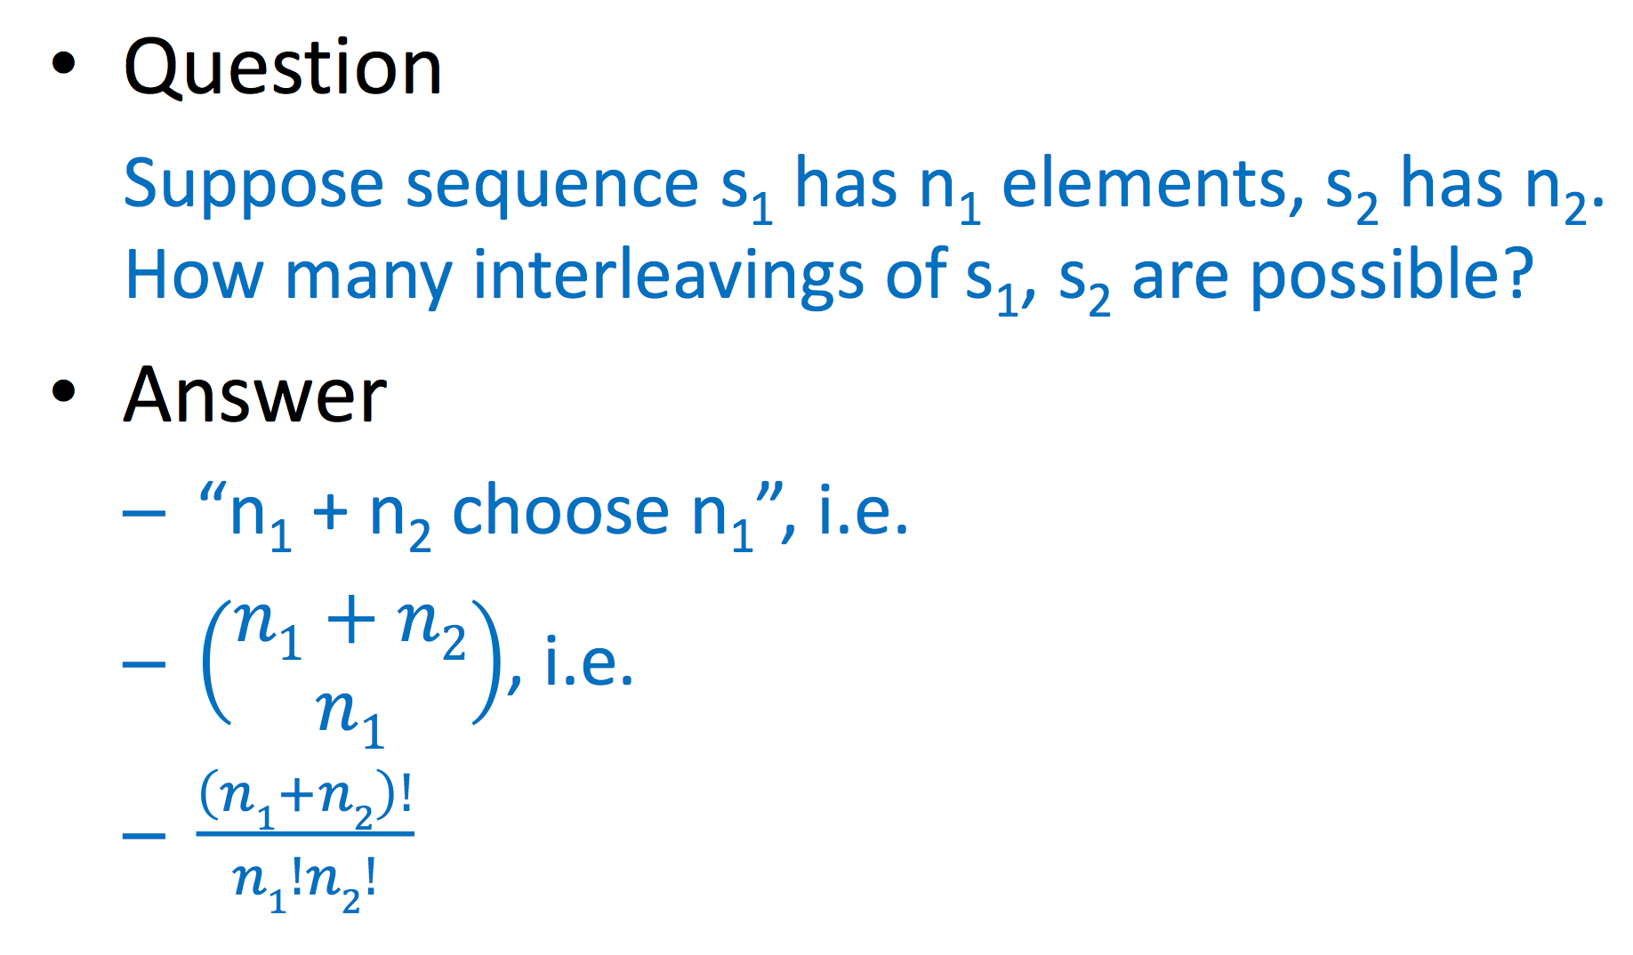
How many interleavings?

Slide 11
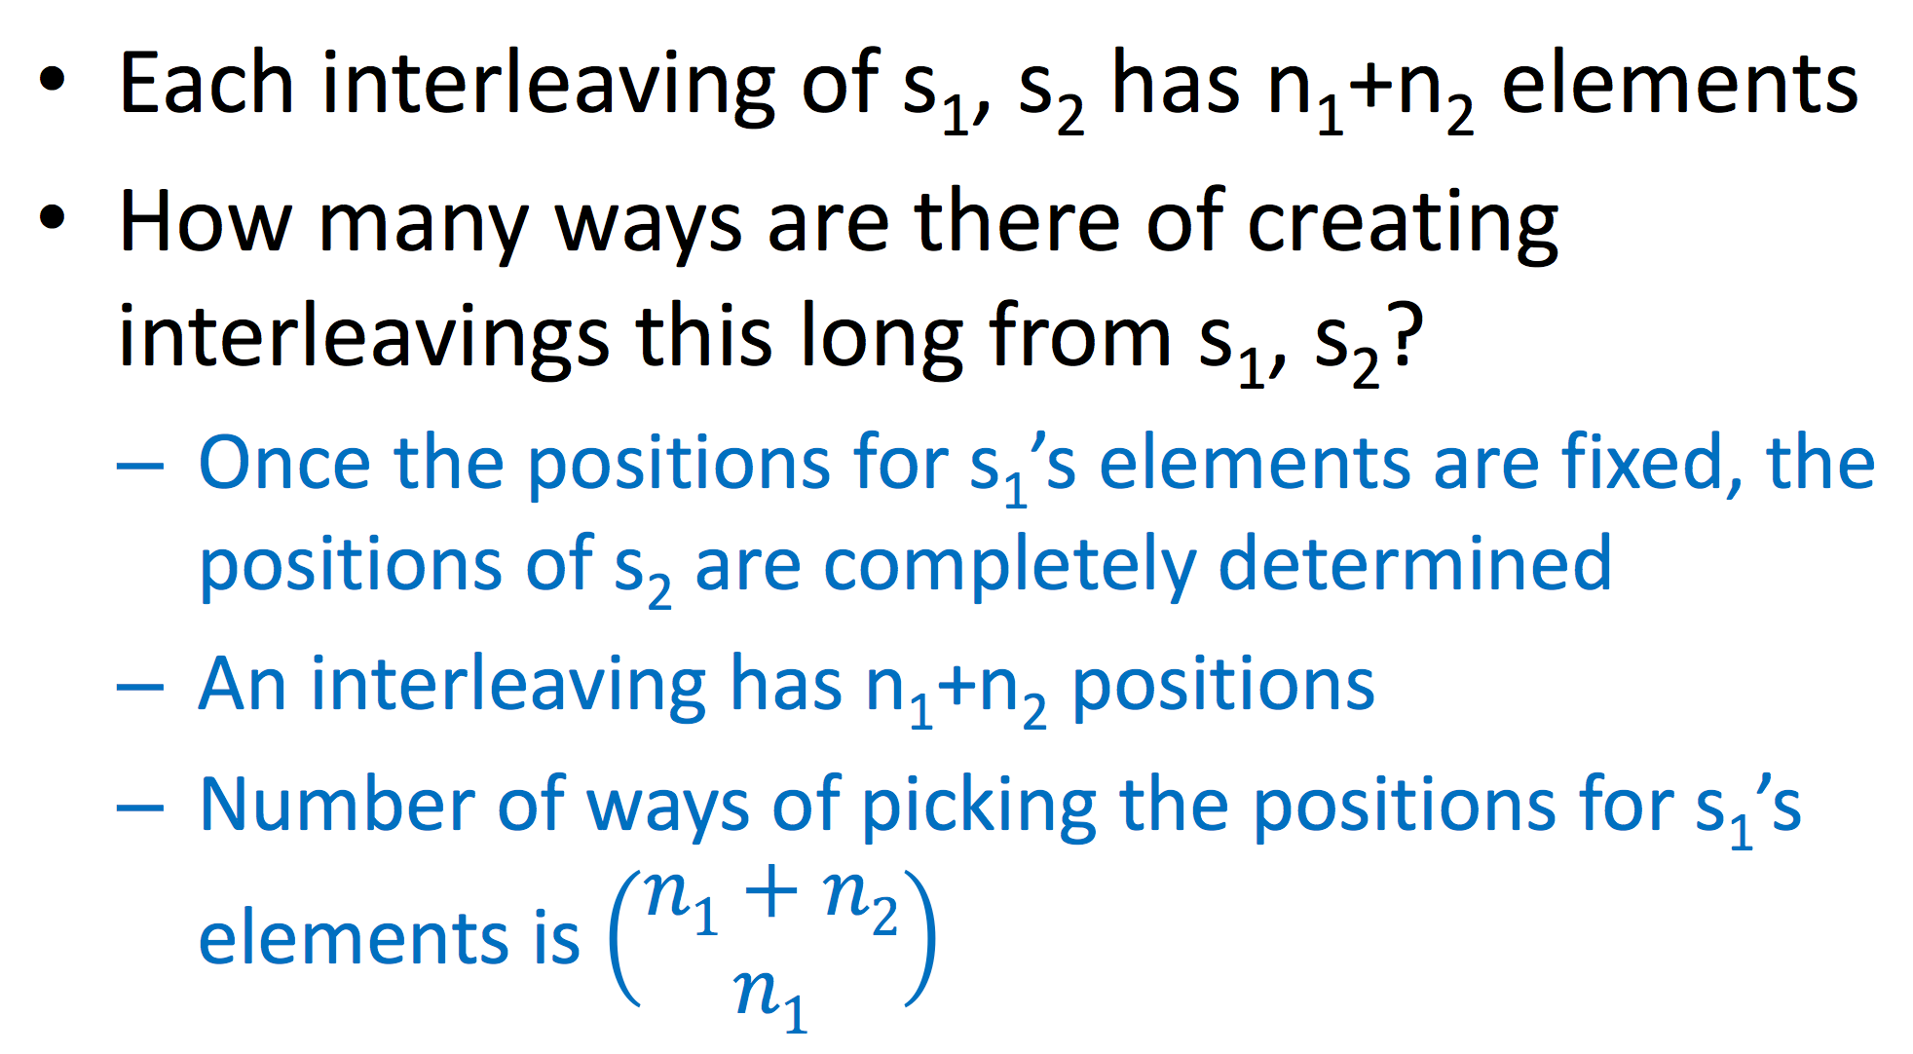
Why?

Slide 12
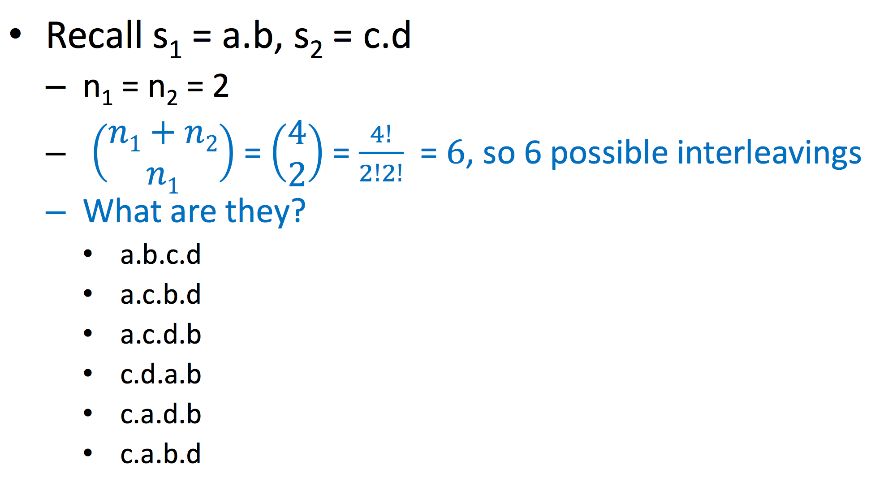
Example

Slide 13
Back to Concurrent Testing
Threads are sequences of actions
Different interleavings of actions can produce different results
So
Nondeterminism, and
From previous discussion, lots of it

Slide 14
Code examples
[IncThread.java]
[IncRace.java]
[TestRace.java]

Slide 15
TestRace: Output
Run 8
-----
t1 read shared = 0
t2 read shared = 0
t2 assigned to shared: 1
t1 assigned to shared: 1
Run 9
-----
t1 read shared = 0
t1 assigned to shared: 1
t2 read shared = 1
t2 assigned to shared: 2
------------------------------
# of runs = 10; # of passes = 5
E
Time: 0.012
There was 1 failure:
1) test(race.TestRace)
java.lang.AssertionError
at org.junit.Assert.fail(Assert.java:86)

Slide 16
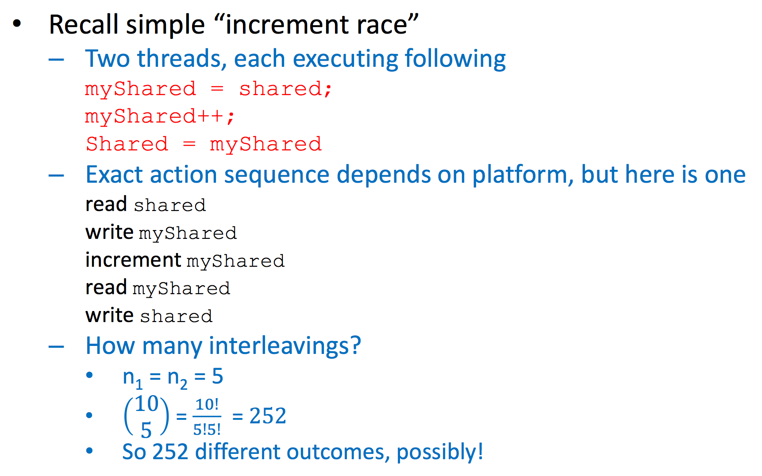
Example

Slide 17
Testing and Interleavings
The same test can yield different results, depending on interleavings
Not all interleavings yield distinct results, necessarily
During testing
Exercise multiple interleavings per test
If a bad interleaving is detected, try to recreate it using directives to scheduler

Slide 18
Multiple Interleavings?
In test cases, rerun same test inside a loop!
Number of iterations of loop is a “judgment call” based on expected complexity of program
After each iteration, determine success, keep count of failures
Be sure to reset state of program before each iteration
E.g. “TestRace.java” JUnit test from Lecture 2
private int numRuns = 10; …
public void test() throws InterruptedException {
…
for (int i=0; i < numRuns; i++) {
…
IncThread.resetShared();
Thread t1 = new Thread (new IncThread ("t1"));
Thread t2 = new Thread (new IncThread ("t2"));
…
passes = (IncThread.getShared() == 2) ? (passes + 1) : passes;
}

Slide 19
Recreating Bad Interleavings
Interleavings result from scheduling decisions
Scheduler is not under tester control
However, Java Thread class provides some methods that can influence scheduling
static void sleep (int millis)
Block for millis milliseconds
static void yield ()
“Hint” to scheduler that thread can give up processor
You can insert these statements in your code to coax threads to give up processor
Remember to remove these after done with testing!
yield() is not guaranteed to do anything, so be warned

