Slide 1





Your Kubernetes
Playbook at Your Fingertips
Advanced Troubleshooting With MCP, RAG, and K8sgpt
@yashsharma_f
@davidvonthenen

Slide 2
Yash
Sharma
TODO
TODO
TODO
TODO
TODO
@yashsharma_f

Slide 3

David
vonThenen
Are you Human or an AI?
I want 5 Kubernetes
Virtual Machines are Real
Cloudy, cloudy, cloudy…
There is storage for that!
@davidvonthenen

Slide 4
What Is k8sgpt?

Slide 5
TODO: Yash
TODO
  TODO

Slide 6
Your Customized AI Runbook
Your Organization's Best Practices via RAG and k8sgpt

Slide 7
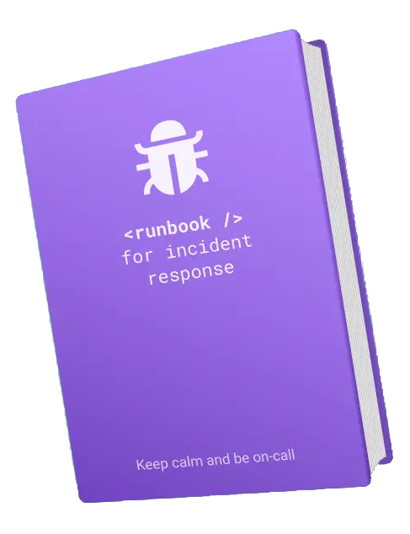
What Is An Operational Runbook?
Standardized, Step-By-Step Guide For:
  Performing IT Tasks
  Troubleshooting Issues
  Responding To Emergencies
Typical Runbook Characteristics:
  Designed to Support All Skill Levels
  Reduce Complexity To Accomplishing A Task
  Enable Consistency From Naming to Policy
Example Runbooks Uses:
  Routine Maintenance: Patching Servers, Renew Certs
  Emergency Response: Failing Over, Disaster Recovery

Slide 8
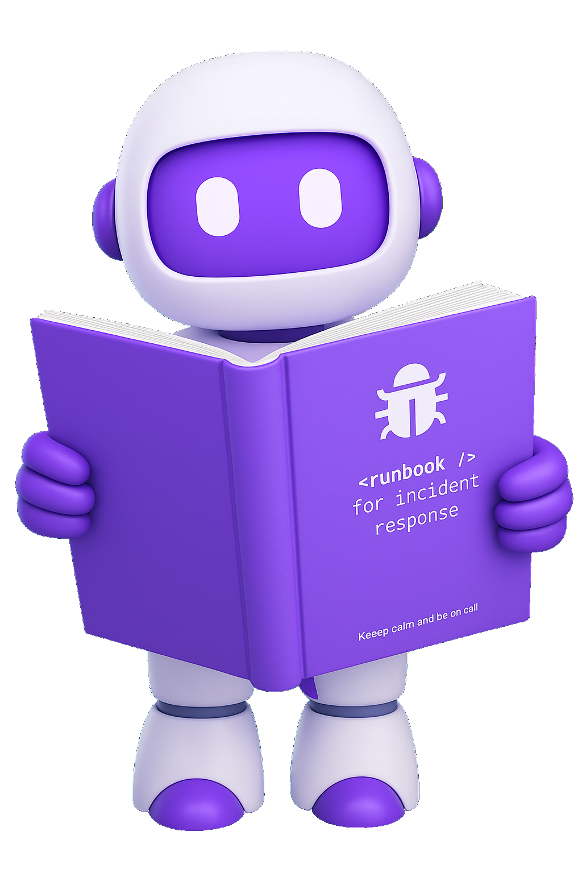
From Runbook to Reasoning: Build AI Agents
Why Build An AI Runbook Agent?
  Runbook Becomes A "Living" Document
  Bridges Human Procedures To Machine Reasoning
  Codifies Consistency, Expertise, Automation
    Generate YAML or kubectl Commands
  Agent "Thinks Like Your Organization"
Using k8sgpt and MCP, Perform Actions Where You Can:
  Retrieve Status On Aspects Of Your Cluster
  Perform "Set" Operations Based On Runbook
  Orchestrate Multi-Step Remediations With Your Agent

Slide 9
Demo: AI Agent Runbook

Slide 10
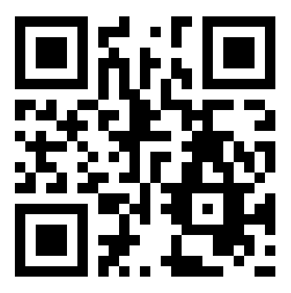
Thank You!
@yashsharma_f
@davidvonthenen

