Slide 1
Game Changer: Software-Defined Storage and Container Schedulers
David vonThenen
{code} by Dell EMC
@dvonthenen
dvonthenen.com
github.com/dvonthenen

Slide 2
Agenda
Container Schedulers
Containers In Production
Software-Defined Storage
Schedulers + SDS = Game Changing
Demo

Slide 3
Schedulers

Slide 4
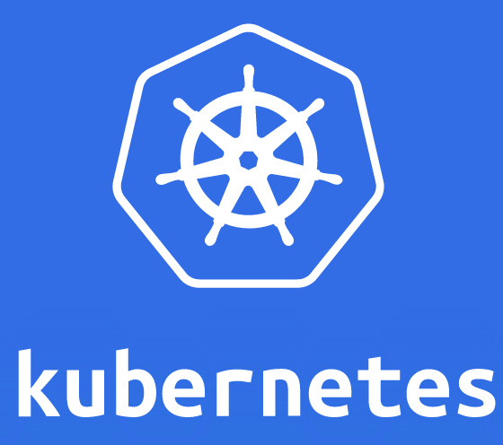

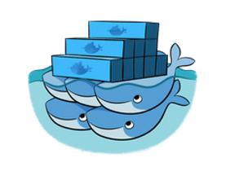

What is a Scheduler?
Fair and efficient workload placement
Adhering to a set of constraints
Quickly (and deterministically) dispatching jobs
Robust and tolerates errors

Slide 5
Let’s take a look: Apache Mesos
Is a Container Scheduler
Docker
Unified Containerizer
Cluster Manager
Task placement based on CPU, Memory, and Disk
User defined constraints
2 Layer Scheduler – Offer/Accept Model

Slide 6
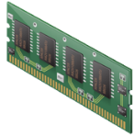
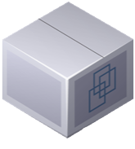
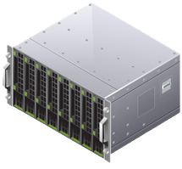
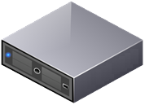
Mesos Frameworks
Ability to sub-schedule tasks based on Application needs
Framework implements a Scheduler and Executor
Scheduler – Accepts/Denies resources
Executor – Application
Multiple Frameworks run within the cluster

Slide 7
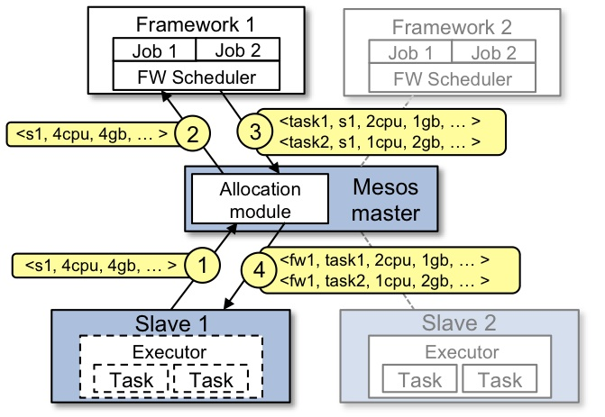
Framework / Offer Mechanism

Slide 8
Containers

Slide 9
Containers Today
Many container workloads are long running
Many have state: user data, configuration, and etc
Top 7 of 12 Apps in Docker Hub are persistent applications

Slide 10


Death of a Container
/etc /var
/bin /opt
/data
Where does my data go?
Turned to the compute node’s local disk to store data
What happens on a node failure?
Production applications require high availability
External Storage!

Slide 11

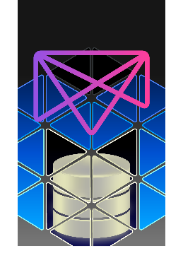
How do we achieve this?
REX-Ray
Vendor agnostic storage orchestration engine
AWS, GCE, ScaleIO, VirtualBox, many more
GitHub: https://github.com/emccode/rexray
mesos-module-dvdi
Provides hooks to Mesos agent nodes to manage external storage
GitHub: https://github.com/emccode/mesos-module-dvdi

Slide 12
Enablement is Out-Of-Band
The “glue” that combines compute to external storage is add-on to the resource manager
Obvious but easily dismissive answer: DevOps
Software upgrades? On all nodes…
Maintenance? Infrastructure, Storage Platform, etc
Changes to Container Scheduler? Behaviors, APIs, etc
Just make it happen!
Almost 100% of the way there...

Slide 13
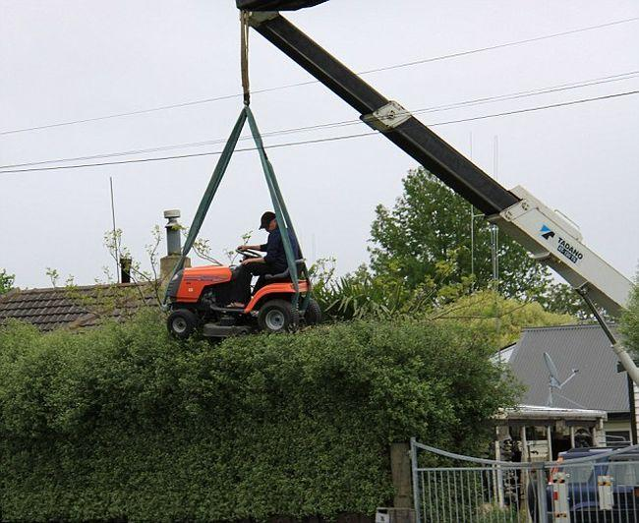
Got to be an easier way…

Slide 14
Software-Defined Storage

Slide 15
What are they?
Software-Defined Storage (SDS) serve as abstraction layer above underlying storage
Provides a (programmatic) mechanism to provision storage
Varying degrees of SDS: NFS, VMware Virtual Volumes

Slide 16
What makes them unique?
Operational - Manage provisioning and data independent of underlying hardware
Physical - Abstract consumed logical storage from underlying physical storage
Policy - Automation of policy driven SLAs both external (users) and internal (platform)

Slide 17

Let’s take a look: ScaleIO
Scale-out block storage
Linear performance
Elastic architecture
Infrastructure agnostic
Try ScaleIO as a free download:
https://www.emc.com/products-solutions/trial-software-download/scaleio.htm

Slide 18






Scale-out Block Storage
Scale from 3 nodes to 1000s of nodes
Add storage services and servers on the fly to increase capacity and performance
Storage growth always automatically aligned with application needs

Slide 19
Elastic Architecture
Add, remove, re-allocate, on the fly, without stopping IO
AUTO-REBALANCE when resources are added
AUTO-REBUILD when resources fail or removed
NO CAPACITY PLANNING OR MIGRATION!

Slide 20


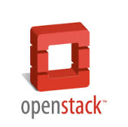






Infrastructure Agnostic
Mix and match OS, hypervisors, platforms, media in the same ScaleIO system
HDDs
SSDs
FLASH
FLASH
PCIe Flash
OPERATING SYSTEM
HYPERVISORS
CLOUD
MEDIA

Slide 21
Game Changer

Slide 22
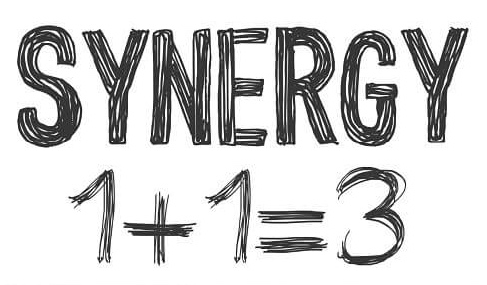
Let’s Review…
Container Schedulers:
Great platform for container management
Needs persistent storage for production Apps
Adding persistent storage out-of-band presents challenges
Software-Defined Storage:
Scale-out storage
Elastic architecture
Infrastructure agnostic

Slide 23
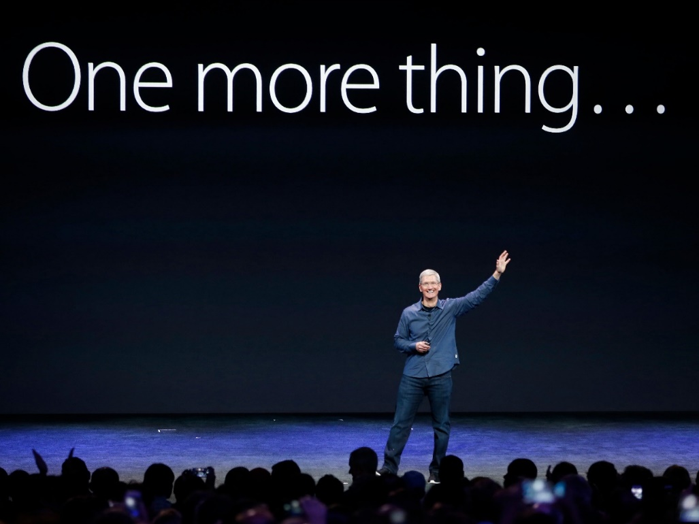
Schedulers + SDS = ????

Slide 24

Better than the Sum of Our Parts
Let’s create a Software-Defined Storage Framework
ScaleIO + Mesos Framework = Awesome Sauce!
https://github.com/codedellemc/scaleio-framework

Slide 25
SDS Framework = Mind Blown
External persistent storage native to scheduling platform
Globally accessible storage
Storage array? Reduce complexity
Reduces maintenance
Deploy Anywhere!

Slide 26

What this Means for your Apps
No data loss on infrastructure failure
Insulates changes with container scheduler (APIs, etc)
Highly Available containers and Apps!
Production ready!
Tolerates failures

Slide 27


Surprising Combination

Slide 28
Demo

Slide 29
Configuration
3 Node Mesos Cluster (Management)
2 Mesos Agent nodes (Compute)
Initially the first node online
Second node will be onboarded or introduced later
ScaleIO Cluster (Scale-out storage)
3 management nodes
180 GB local disks on each management node to comprise this storage pool

Slide 30
Configuration (Cont.)
ScaleIO Framework
GitHub: https://github.com/codedellemc/scaleio-framework
Persistent External Storage
Using REX-Ray
GitHub: https://github.com/emccode/rexray
Using mesos-module-dvdi
GitHub: https://github.com/emccode/mesos-module-dvdi

Slide 31
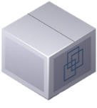


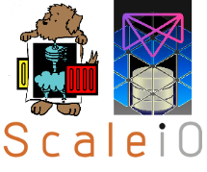




The Moving Parts
Mesos Cluster
App
Register
Scheduler
Register
App
Offer
Offer
Mesos
Agent
Mesos
Agent

