Slide 1
How Container Schedulers and
Software-based Storage will Change the Cloud
David vonThenen
{code} by Dell EMC
@dvonthenen
http://dvonthenen.com
github.com/dvonthenen
Notes:
I work on the {code} by Dell EMC team which is a group within Dell EMC that develops and contributes to various open source projects in the community. Our team is most known for working on projects enabling different container schedulers to consume various storage platforms easily. Docker (REX-Ray), Mesos (mesos-module-dvdi), Kubernetes
Past Life: Backup and Recovery Solution working on Vmware virtualized environments.

Slide 2
Agenda
Review of Software-based Storage
Container Schedulers
Schedulers + Software-based Storage = Awesome!
To the Cloud!!
Demo

Slide 3
Software-based Storage

Slide 4
What are they?
Many definitions… most agree on:
Software-Defined Storage (SDS) serve as abstraction layer above underlying storage
Provides a (programmatic) mechanism to provision storage
Varying degrees of SDS: NFS, VMware VSAN

Slide 5
What makes them unique?
Operational - Manage provisioning process and data independent of underlying hardware
Physical - Abstract consumed logical storage from underlying physical storage
Policy - Automation of policy driven both external (users) and internal (platform)
Day 2 Operations - Maintenance is inherently different

Slide 6
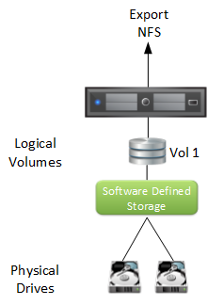
Example: NFS

Slide 7
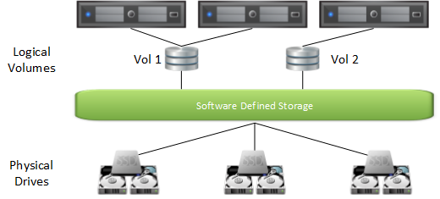
Example: VSAN

Slide 8
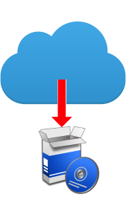
NFS & VSAN are different…
What makes NFS and VSAN special?
They are both Software-based Storage Platforms!
No special hardware, purpose built appliance, storage array, storage controller
Notes:
Other forms of Software-based Storage may need a physical appliance or require some purpose built hardware. NFS and VSAN do not. I am going to touch on this a little more later.

Slide 9
Container Schedulers

Slide 10
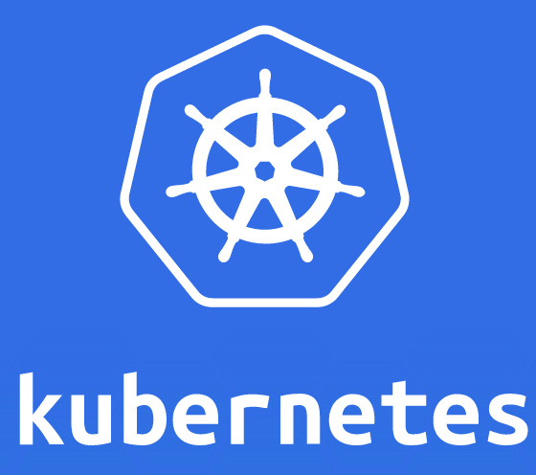
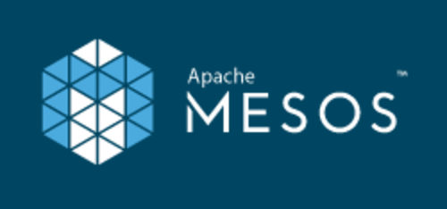
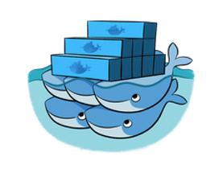
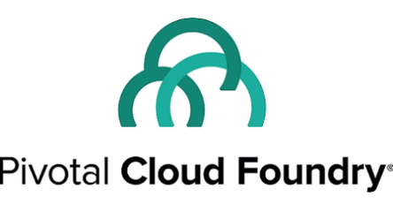
What is a Scheduler?
Fair and efficient workload placement
Adhering to a set of constraints
Quickly (and deterministically) dispatch jobs
Robust and tolerates errors
Notes:
Who here has used Mesos, Swarm, or Kubernetes?
Fair – don’t overload a particular compute node.
Constraints – Places these containers on different compute nodes.
Deterministic dispatch jobs – this allows me know how quickly I can scale my application

Slide 11
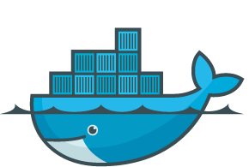

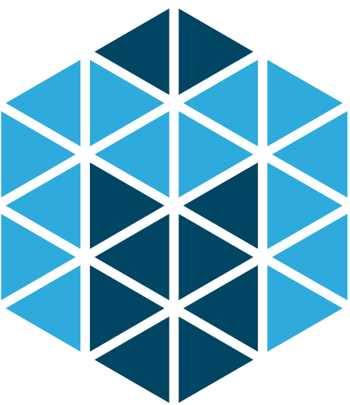
Scheduling Work
Containers like…
Docker
Mesos Unified Containerizer
rkt (CoreOS)
Cluster Manager
Task placement based on resource
Operational constraints
Notes:
Container Engines
Cluster Manager – in the sense if a compute node goes down, the scheduler will restart the tasks on other nodes.
Resource – like I need 2GB of Memory and 2 CPUs. Maybe you even need a GPU for complex mathematically computations
Constraints – when you deploy this application put each instance in a different row in my datacenter

Slide 12
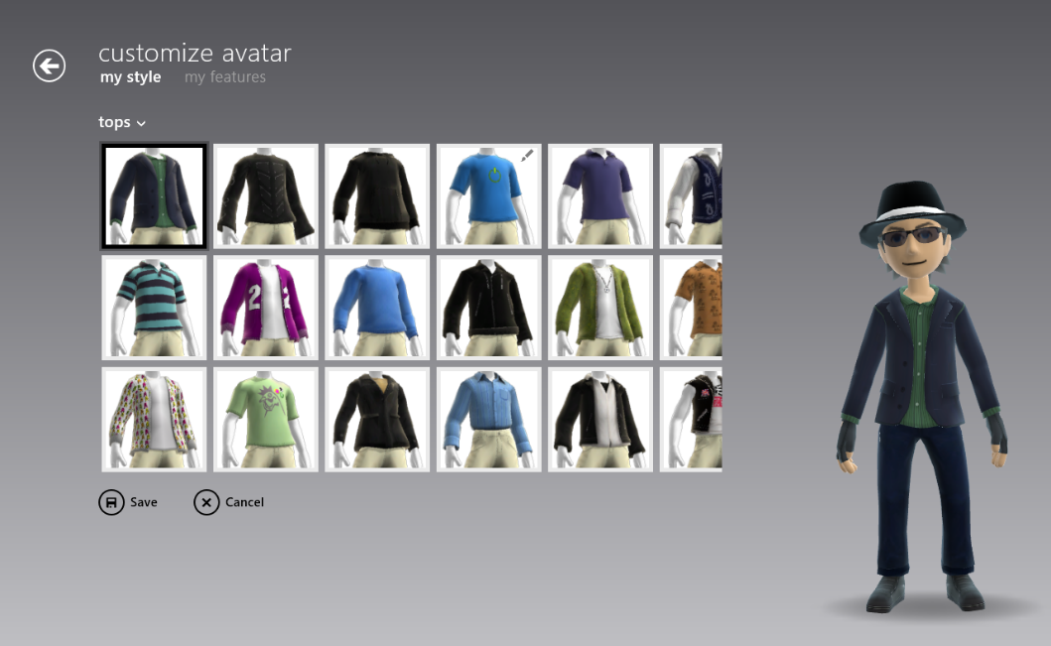
Custom Scheduling
Many allow creation of own custom Scheduler
Customization for your application:
Run-Time?
Availability?
Fault Tolerance?
Hardware Accel?
Location?
Notes:
Many Container Schedulers allow for overriding how applications get deploy…

Slide 13
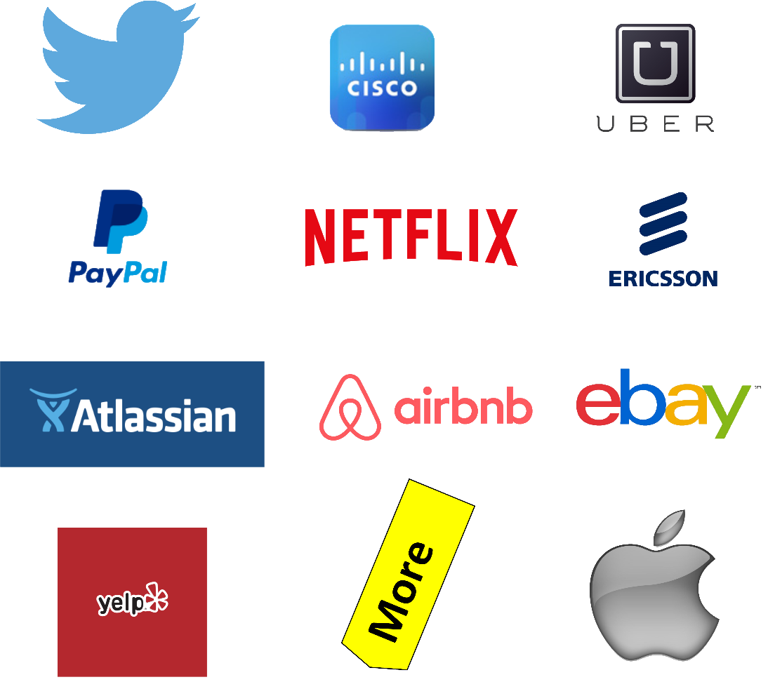
Apache Mesos
Notes:
I wanted to take a look at one Container Scheduler in particular… Apache Mesos
Is a Container Scheduler. Supports:
- Docker
- Unified Containerizer
Task placement based on CPU, Memory, and Disk
User defined constraints

Slide 14
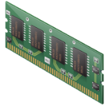
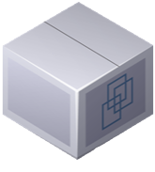
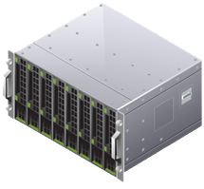
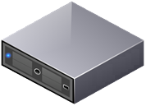
Mesos Frameworks
Ability to schedule tasks based on Application needs
Framework implements a Scheduler and Executor
Scheduler – Accepts/Denies resources
Executor – Application
Offer / Accept Mechanism
Framework tightly coupled to Application
Notes:
Dive a little deeper…
The one really cool thing about Mesos is this concept of Frameworks.
Allows you to override the behavior of how an application is placed in your cluster.
Tightly couple in the sense you can do specialized things. For example, monitor the Application’s health.

Slide 15
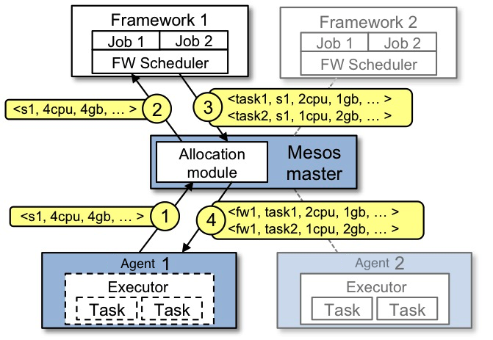
Framework / Offer Mechanism
Notes:
If we zoom into the offer/accept mechanism, we start with
#1 – the compute node offering up resource. Mesos master = control plane!
#2 - the Framework accepting those resources
#3 – the scheduler then comsumes some resource and launches N-tasks
#4 – the executor and tasks get placed on one of the compute nodes.
So we will see this exact process happening behind the scenes in the demo.

Slide 16
Schedulers and Software-based Storage

Slide 17

Better Together
Let’s create a Software-based Storage Framework
ScaleIO + Mesos Framework = Awesome Sauce!
First released in Sept 2016. Now on version 0.3.1
https://github.com/codedellemc/scaleio-framework
Notes:
Had this idea of creating a Software-based Storage Mesos Framework.
This Framework would manage the lifecycle of this Software-based Storage platform.

Slide 18

Let’s take a look: ScaleIO
Software-based Storage Platform
Scale-out block storage
Linear performance
Elastic architecture
Infrastructure agnostic
Try ScaleIO. It’s a free download!
https://www.emc.com/products-solutions/trial-software-download/scaleio.htm
Notes:
Meaning you can install this anywhere.
Elastic architecture – Add/remove nodes… automatically triggers a rebalance to keep your data protected.
IMPORTANT: What ScaleIO brings to the table is it takes Direct Attached Storage and transforms that into a Global Accessible Storage Pool across your nodes.

Slide 19
SDS Framework = Mind Blown
Framework installs and configures Storage Platform on all Mesos Agent nodes
Persistent storage native to scheduling platform
Globally accessible storage
What Storage array? Reduce complexity
Deploy Anywhere!
Notes:
Globally accessible – provision a ScaleIO volume that can be accessed anywhere in the Mesos Cluster
Reduce complexity – because the ScaleIO manages maintenance operations. Rebalancing due to a node failure.
Deploy Anywhere – because this is a Software-based Storage platform and its just simple RPMs or DEB. You can install this anywhere!

Slide 20
Containers Today
Many container workloads are long running
Many have state: user data, configuration, and etc
Top 10 of 20 Apps in Docker Hub are persistent applications
Notes:
Why is this important? Why do we care that we can deploy this anywhere?
It turns out that…

Slide 21


Death of a Container
/etc /var
/bin /opt
/data
Where does my data go?
Turned to the compute node’s local disk to store data
What happens on a node failure?
Production applications require high availability
External Storage!
Notes:
External Storage! This is where ScaleIO comes in.

Slide 22

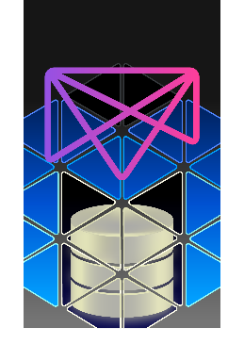
Manages the Storage Enablement
REX-Ray
Vendor agnostic storage orchestration engine
AWS, Azure, Ceph, DigitalOcean, GCE, ScaleIO, VirtualBox, many more
https://github.com/codedellemc/rexray
mesos-module-dvdi
Hook for Mesos nodes to manage external storage
https://github.com/codedellemc/mesos-module-dvdi
Contributed back to and is apart of Mesos proper
Notes:
This Framework also leverages a number of open source projects that provides the glue between the containers and ScaleIO.
ScaleIO on its own is just a storage platform. Schedulers need to provision storage for their container workloads and they do that using REX-Ray and mesos-module-dvdi

Slide 23

What this Means for your Apps
Tolerates node failures
Highly Available containers and Apps!
Insulates changes with:
container scheduler (APIs, etc)
storage platform (workflows, APIs, etc)
Production ready!
Notes:
Combined all these technologies what does this…
Insulates changes - meaning that since you have a Framework managing this Software-based Storage platform, it deals with interfacing with the container scheduler and the storage platform. NOT THE USER!

Slide 24
To the Cloud!
Notes:
Now we are getting to the crux of the talk here… what if we take this all into the cloud.

Slide 25
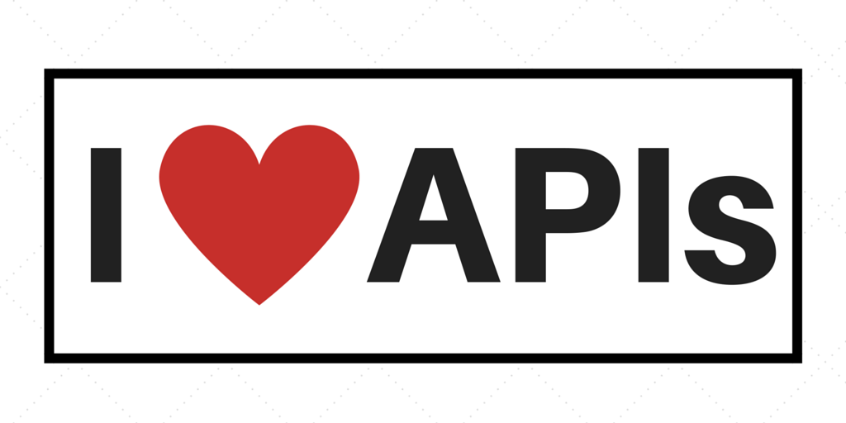
Moving towards the Cloud
DevOps and the Cloud go hand in hand
What makes these cloud accessible?
Notes:
Applications born in the cloud, Applications providing APIs, Cloud providing APIs
What does that mean if we wanted to take this Mesos Framework into the Cloud?

Slide 26

Self Monitoring Apps
Framework deploy and configure applications.
Enable application monitoring via Management APIs
Determine health and remediate!
Can fix themselves, but to what end?
Notes:
RECAP: So what I am saying is that applications can start fixing themselves?

Slide 27
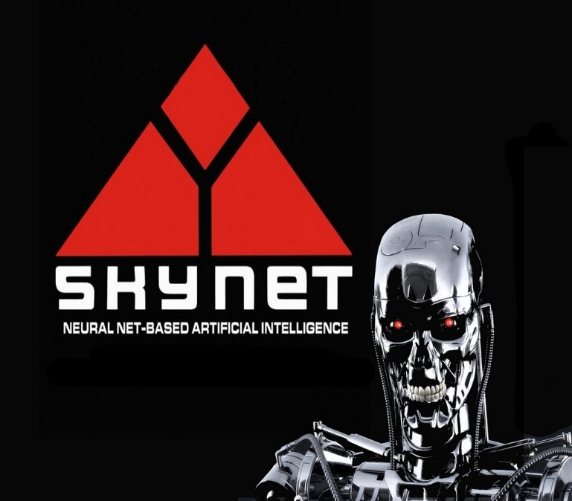
Self-aware Applications
Software-based Storage Platform with a Cloud Platform driven by APIs
AWS SDK – 10 Language bindings
Applications that change their environment
Auto-scale Instances
Dial in the IOPS for disk
Possibilities are endless!
Self-aware applications! Skynet!
Notes:
Everything to make this happen is available using…

Slide 28
Premise: Self Managing
Framework can monitor and self remediate this Software-based Storage Platform
The Scenario:
ScaleIO has a Storage Pool that is approaching full
Identifies the health check warning
Creates new EBS volumes in EC2 to expand the Storage Pool
Notes:
So I ended up building that into the Framework. Using…

Slide 29
Demo

Slide 30
Configuration
Mesos Configuration
3 Node Mesos Cluster (Management)
3 Mesos Agent nodes (Compute)
ScaleIO Cluster (Scale-out storage)
Will install on top of 3 Mesos Agent nodes
180 GB local disks on each node to make up this Storage Pool

Slide 31
Configuration (Cont.)
ScaleIO Framework
GitHub: https://github.com/codedellemc/scaleio-framework
Persistent External Storage
Using REX-Ray
GitHub: https://github.com/emccode/rexray
Using mesos-module-dvdi
GitHub: https://github.com/emccode/mesos-module-dvdi

Slide 32
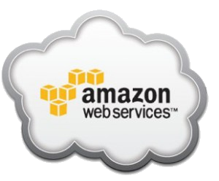


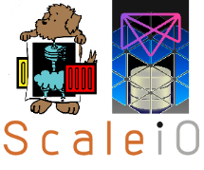
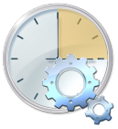


The Moving Parts
Mesos Cluster
Create EBS Vols
Scheduler
Offer
Offer
Offer
Mesos
Agent
Mesos
Agent
Mesos
Agent

