Slide 1
How Container Schedulers and
Software-based Storage will Change the Cloud
David vonThenen
{code} by Dell EMC
@dvonthenen
http://dvonthenen.com
github.com/dvonthenen

Slide 2
Agenda
Review of Software-based Storage
Container Schedulers
Schedulers + Software-based Storage = Awesome!
To the Cloud!!
Demo

Slide 3
Software-based Storage

Slide 4
What are they?
Many definitions… most agree on:
Software-Defined Storage (SDS) serve as abstraction layer above underlying storage
Provides a (programmatic) mechanism to provision storage
Varying degrees of SDS: NFS, VMware VSAN

Slide 5
What makes them unique?
Operational - Manage provisioning process and data independent of underlying hardware
Physical - Abstract consumed logical storage from underlying physical storage
Policy - Automation of policy driven both external (users) and internal (platform)
Day 2 Operations - Maintenance is inherently different

Slide 6
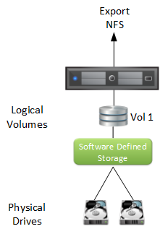
Example: NFS

Slide 7
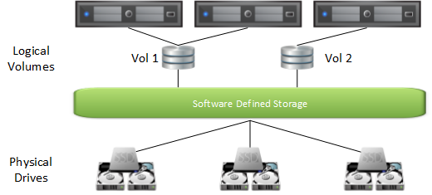
Example: VSAN

Slide 8
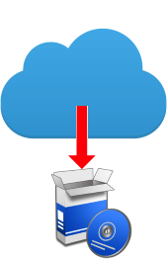
NFS & VSAN are different…
What makes NFS and VSAN special?
They are both Software-based Storage Platforms!
No special hardware, purpose built appliance, storage array, storage controller
Notes:
Other forms of Software Defined Storage may need a physical appliance or require some purpose built hardware. NFS and VSAN do not. I am going to touch on this a little more later.

Slide 9
Container Schedulers

Slide 10
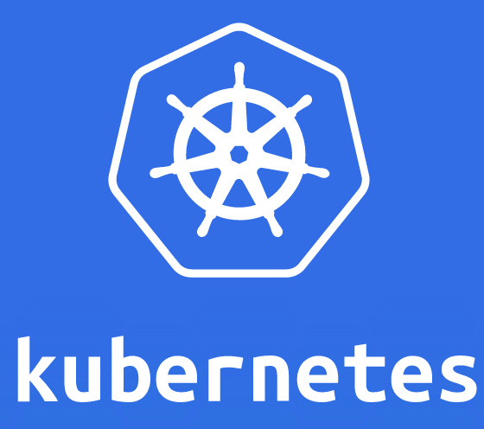

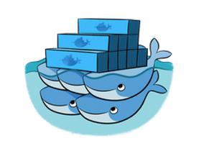
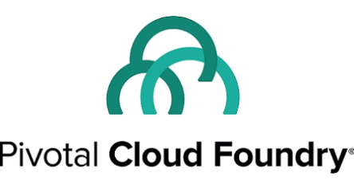
What is a Scheduler?
Fair and efficient workload placement
Adhering to a set of constraints
Quickly (and deterministically) dispatching jobs
Robust and tolerates errors

Slide 11
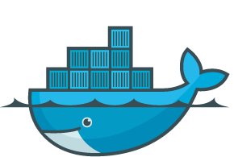

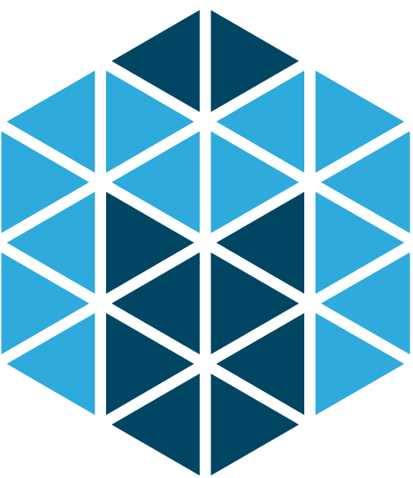
Scheduling Work
Containers like…
Docker
Mesos Unified Containerizer
rkt (CoreOS)
Cluster Manager
Task placement based on resource
Operational constraints

Slide 12
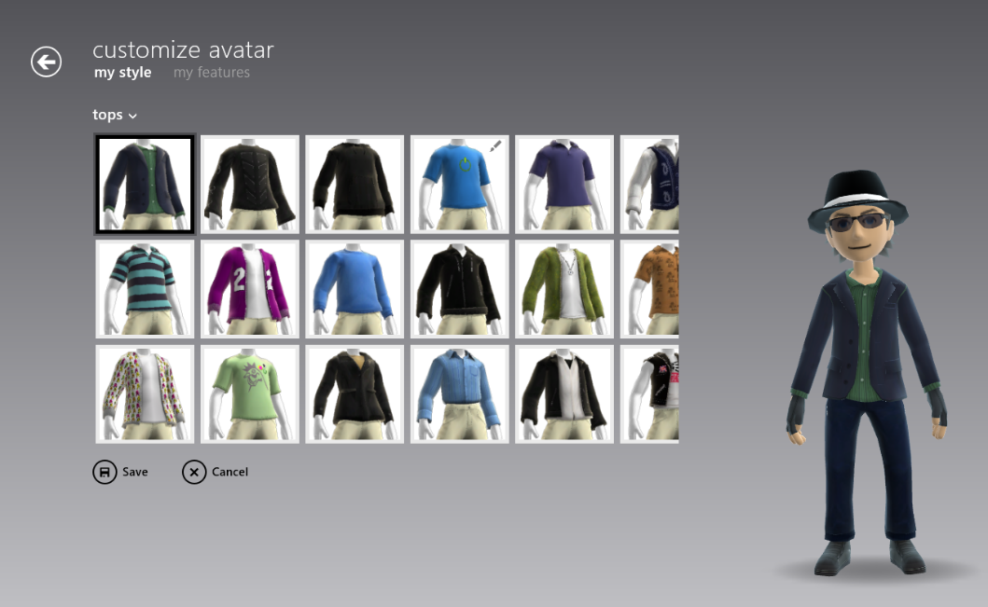
Custom Scheduling
Many allow creation of own custom Scheduler
Customization for your application:
Run-Time?
Availability?
Fault Tolerance?
Hardware Accel?
Location?

Slide 13
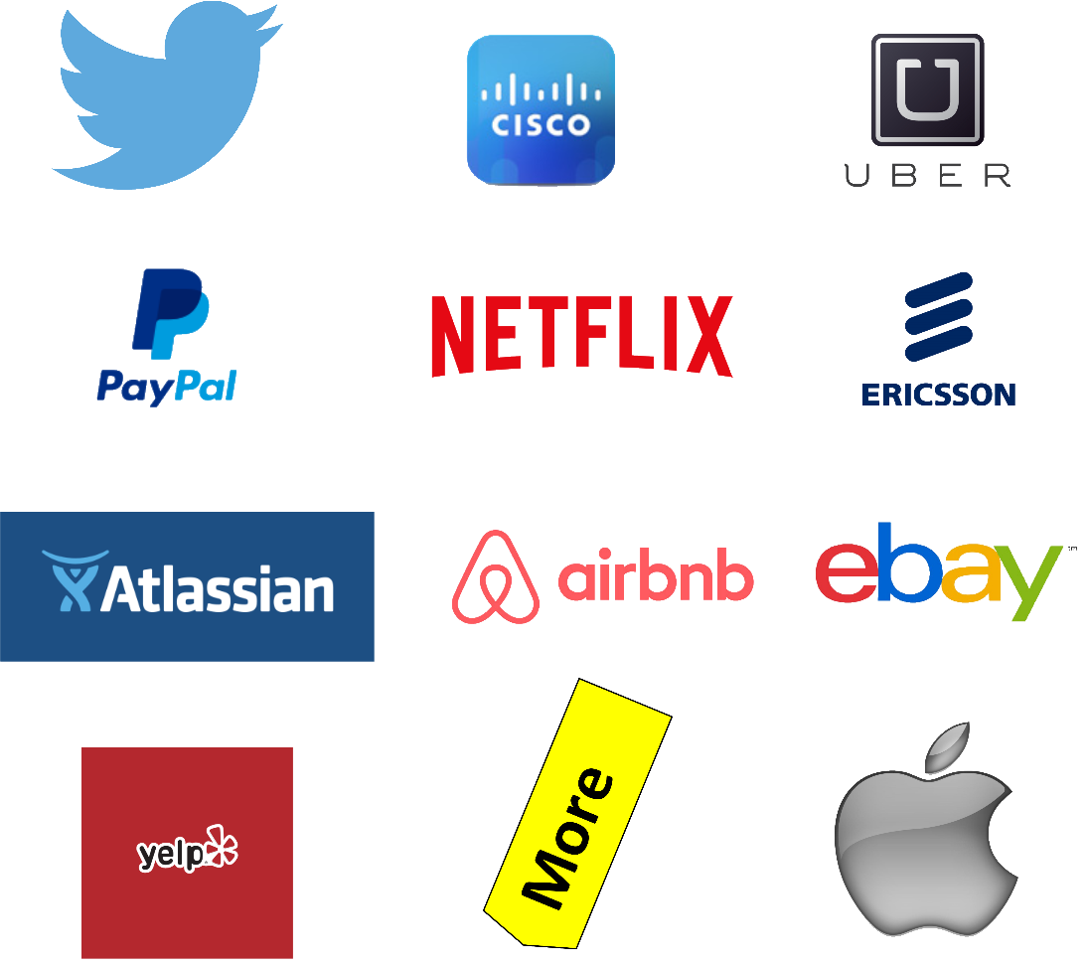
Apache Mesos
Notes:
Is a Container Scheduler
- Docker
- Unified Containerizer
Task placement based on CPU, Memory, and Disk
User defined constraints

Slide 14

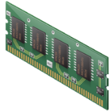
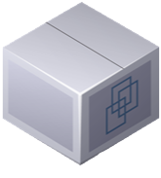
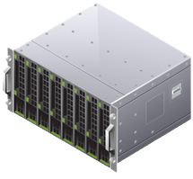
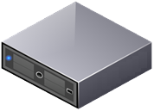
Mesos Frameworks
Ability to schedule tasks based on Application needs
Framework implements a Scheduler and Executor
Scheduler – Accepts/Denies resources
Executor – Application
Offer / Accept Mechanism
Multiple Frameworks run within the cluster

Slide 15
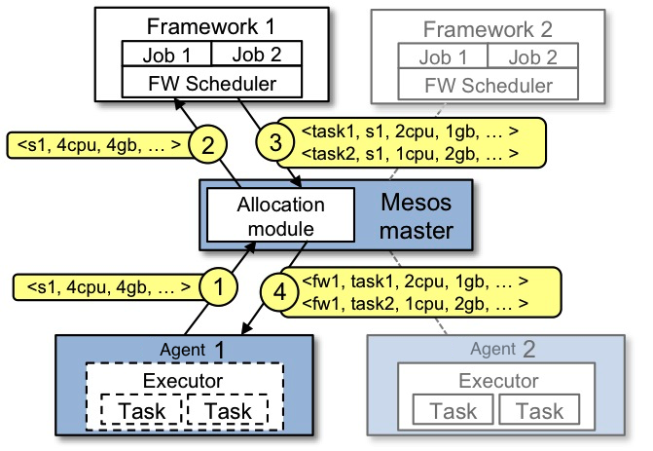
Framework / Offer Mechanism

Slide 16
Schedulers and Software-based Storage

Slide 17

Better Together
Let’s create a Software-based Storage Framework
ScaleIO + Mesos Framework = Awesome Sauce!
First released in Sept 2016. Now on version 0.3.1
https://github.com/codedellemc/scaleio-framework

Slide 18

Let’s take a look: ScaleIO
Software-based Storage Platform
Scale-out block storage
Linear performance
Elastic architecture
Infrastructure agnostic
Try ScaleIO. It’s a free download!
https://www.emc.com/products-solutions/trial-software-download/scaleio.htm

Slide 19
SDS Framework = Mind Blown
Framework installs and configures Storage Platform on all Scheduler’s compute nodes
Persistent storage native to scheduling platform
Globally accessible storage
What Storage array? Reduce complexity
Deploy Anywhere!

Slide 20
Containers Today
Many container workloads are long running
Many have state: user data, configuration, and etc
Top 7 of 12 Apps in Docker Hub are persistent applications

Slide 21


Death of a Container
/etc /var
/bin /opt
/data
Where does my data go?
Turned to the compute node’s local disk to store data
What happens on a node failure?
Production applications require high availability
External Storage!

Slide 22

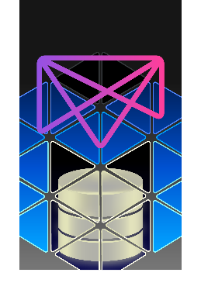
Manages the Storage Enablement
REX-Ray
Vendor agnostic storage orchestration engine
AWS, Azure, Ceph, DigitalOcean, GCE, ScaleIO, VirtualBox, many more
https://github.com/codedellemc/rexray
mesos-module-dvdi
Hook for Mesos nodes to manage external storage
https://github.com/codedellemc/mesos-module-dvdi
Contributed back to and is apart of Mesos proper

Slide 23

What this Means for your Apps
Tolerates node failures
Highly Available containers and Apps!
Insulates changes with:
container scheduler (APIs, etc)
storage platform (workflows, APIs, etc)
Production ready!

Slide 24
To the Cloud!

Slide 25
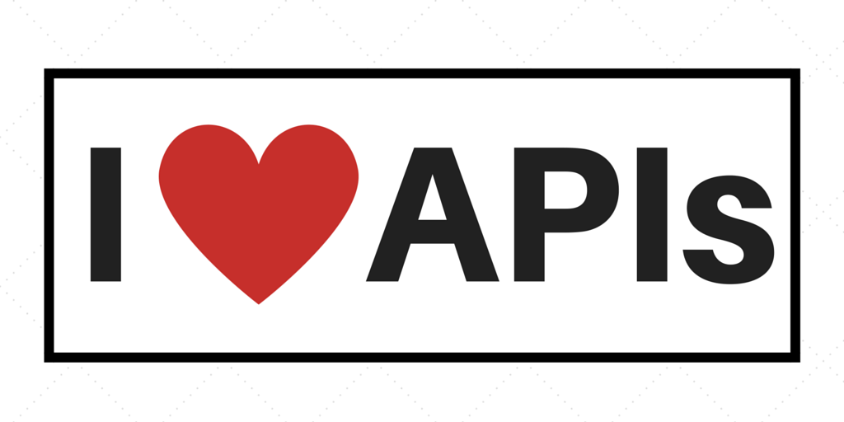
Moving towards the Cloud
Cloud is perfect to enable DevOps
What makes these cloud accessible?

Slide 26

Self Monitoring Apps
Framework deploy and configure applications.
Enable application monitoring via Management APIs
Determine health and remediate!
Can fix themselves, but to what end?

Slide 27
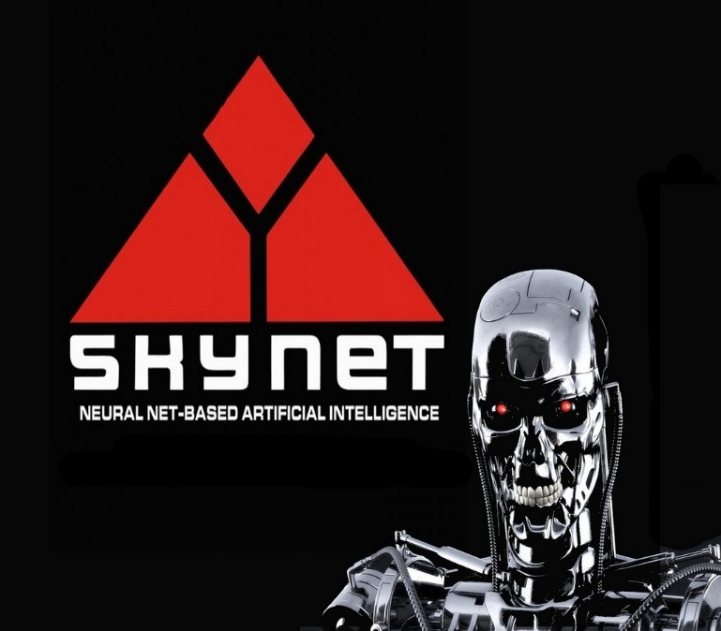
Self-aware Applications
Software-based Storage Platform with a Cloud Platform driven by APIs
AWS SDK – 10 Language bindings
Applications that change their environment
Auto-scale Instances
Dial in the IOPS for disk
Possibilities are endless!
Self-aware applications! Skynet!

Slide 28
Premise: Self Managing
Framework can monitor and self remediate Software-based Storage Platform
The Scenario:
ScaleIO has a Storage Pool that is approaching full
Identifies the health check warning
Creates new EBS volumes in EC2 to expand the Storage Pool

Slide 29
Demo

Slide 30
Configuration
Mesos Configuration
3 Node Mesos Cluster (Management)
3 Mesos Agent nodes (Compute)
ScaleIO Cluster (Scale-out storage)
Will install on top of 3 Mesos Agent nodes
180 GB local disks on each node to make up this Storage Pool

Slide 31
Configuration (Cont.)
ScaleIO Framework
GitHub: https://github.com/codedellemc/scaleio-framework
Persistent External Storage
Using REX-Ray
GitHub: https://github.com/emccode/rexray
Using mesos-module-dvdi
GitHub: https://github.com/emccode/mesos-module-dvdi

Slide 32
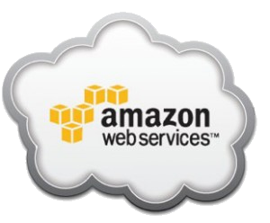

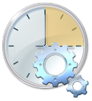
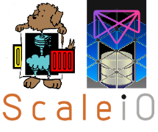

The Moving Parts
Mesos Cluster
EBS Vol API
Scheduler
Mesos
Agent
Mesos
Agent
Mesos
Agent

