Slide 1
Robust Applications in Mesos
Using External Storage
David vonThenen
{code} – Dell Technologies
@dvonthenen
http://dvonthenen.com
github.com/dvonthenen

Slide 2
Agenda
Mesos Storage Options
Traditional Databases
NoSQL, KeyValue Storage, etc
Wrap Up

Slide 3
Mesos Storage Options

Slide 4
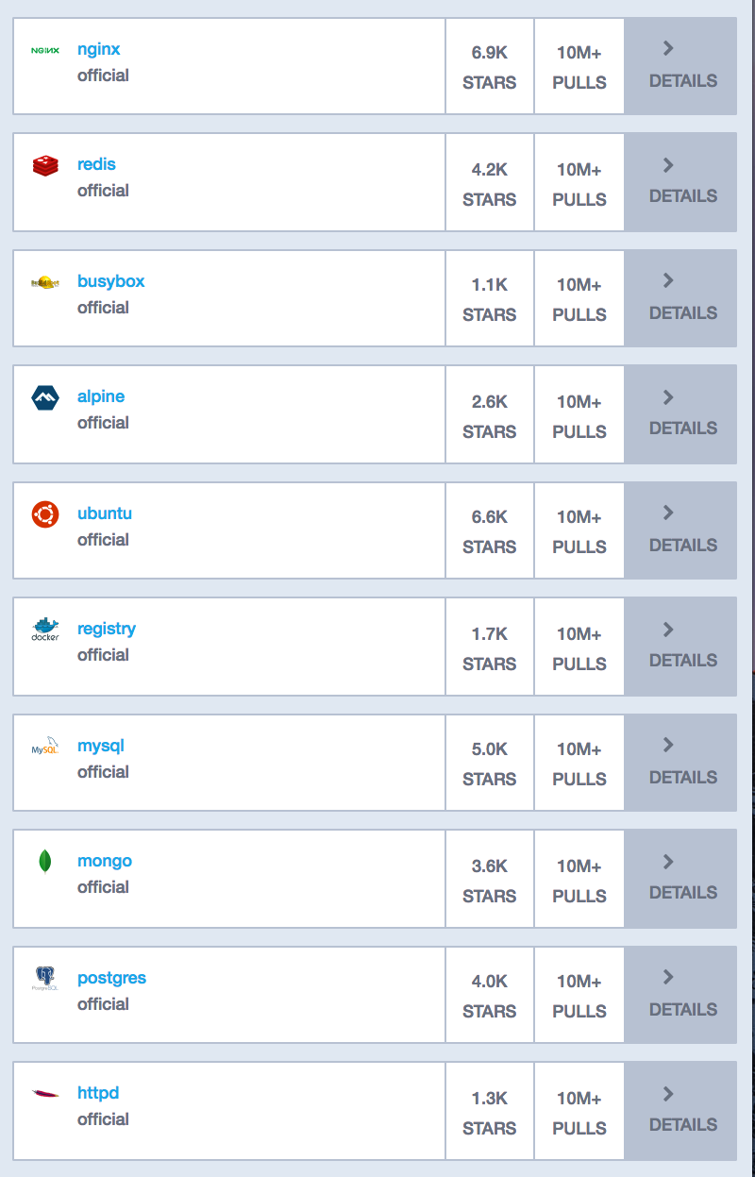
Containers Today
Many container workloads are long running
Many have state: user data, configuration, and etc
Top 10 of 20 Apps in Docker Hub are persistent applications
Notes:
Why is this important? Why do we care that we can deploy this anywhere?
It turns out that…

Slide 5
Container Advantages Make Sense for Stateful Too
Container attributes:
Consistent environment – same anywhere
Dependency management - packaging
Orchestration can add:
Health monitoring
Automated rollouts and rollbacks
Declarative configuration
App/package store deploy experience

Slide 6


Death of a Container
/etc /var
/bin /opt
/data
Where does my data go?
Production applications require high availability
Options:
Local Attached Disk
External Storage
Notes:
External Storage! This is where ScaleIO comes in.

Slide 7
Storage Options
Local Disk introduced in 0.23.0 [MESOS-1554]
External volumes via mesos-module-dvdi (Sept 2015)
3rd party component
Hooks into Docker Volume support
Configured/Managed outside of Mesos
Native external volume support in 1.0 [MESOS-4355]

Slide 8


External Storage Enablement
REX-Ray
Vendor agnostic storage orchestration engine
AWS, GCE, Ceph, DigitalOcean, Cinder, ScaleIO, VirtualBox, many more
https://github.com/codedellemc/rexray
mesos-module-dvdi
Hook for Mesos nodes to manage external storage
https://github.com/codedellemc/mesos-module-dvdi
Contributed back and is apart of Mesos proper (1.0+)
Notes:
This Framework also leverages a number of open source projects that provides the glue between the containers and ScaleIO.
ScaleIO on its own is just a storage platform. Schedulers need to provision storage for their container workloads and they do that using REX-Ray and mesos-module-dvdi

Slide 9

DC/OS Storage Options
Easily consume via curated repository:
Local attach disk
External storage
REX-Ray provides the means for external storage!

Slide 10

Looking to the Future…
Container Storage Interface
Modeled after OCI and CNI
Standardized storage plugins
Across multiple container orchestrators
The Container Storage Initiative: What is this Project About and Where are We Going?
Congress Hall 2 Thurs 4:30pm
Notes:
OCI = open container initiative
CNI = container network interface

Slide 11
Traditional Databases

Slide 12
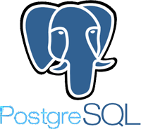

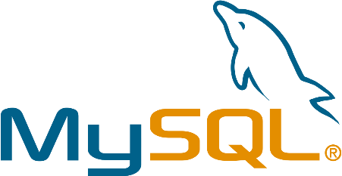
Traditional Databases
Typical deployments
Simple and straight forward
Monolithic
Some are complex
Sharding
Clustering

Slide 13
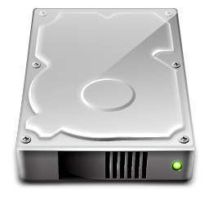
Initial Deploy Using Local Disk
Simple and straight forward
Performance based on compute node storage capabilities
Targeted deploy based on resources
Notes:
Performance based on… - No SSDs? Slow rotating disk
Targeted deploy… - Deploy to a node with that class of storage needs. Know the infrastructure OR tags for filtering

Slide 14
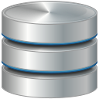
Initial Deploy Using External Storage
Requires an external storage platform
Some setup required
Managed outside Mesos
Performance based on platform
Storage Platform accessible everywhere!

Slide 15
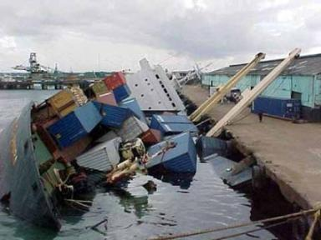
The ”Oh @#$%” Moment…

Slide 16
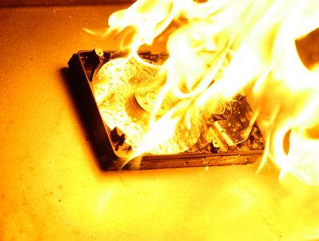
Day 2 Operations Using Local Disk
Data locality!
Host maintenance
Disk failure
Host failure
Fixed Resources
Reserve all capacity upfront
More capacity?

Slide 17

Day 2 Operations Using External Storage
Consume storage as you grow!
External volume moves with the Container
Maintenance
Hardware failure
Host failure
High Availability!

Slide 18
NoSQL and KeyValue Stores

Slide 19

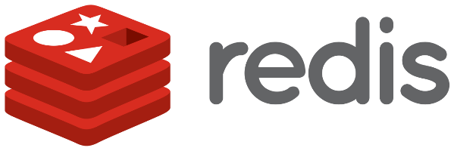


What about NoSQL & KeyValue Stores?
Initial Deploy
Local disk: Same
External storage: Same
Day 2 Operations?
Behavior characteristics of eventually consistent DBs
Multi-node

Slide 20
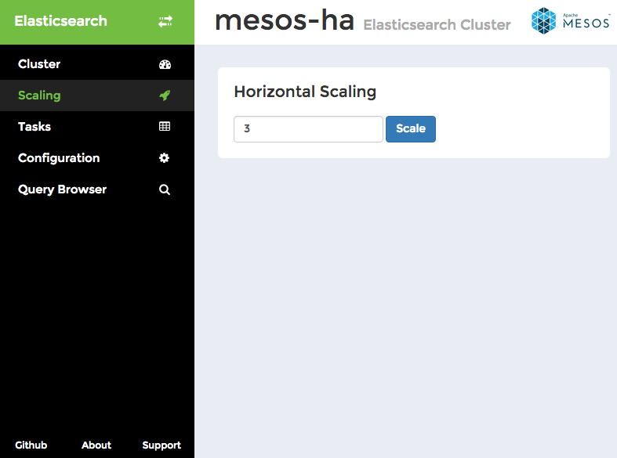
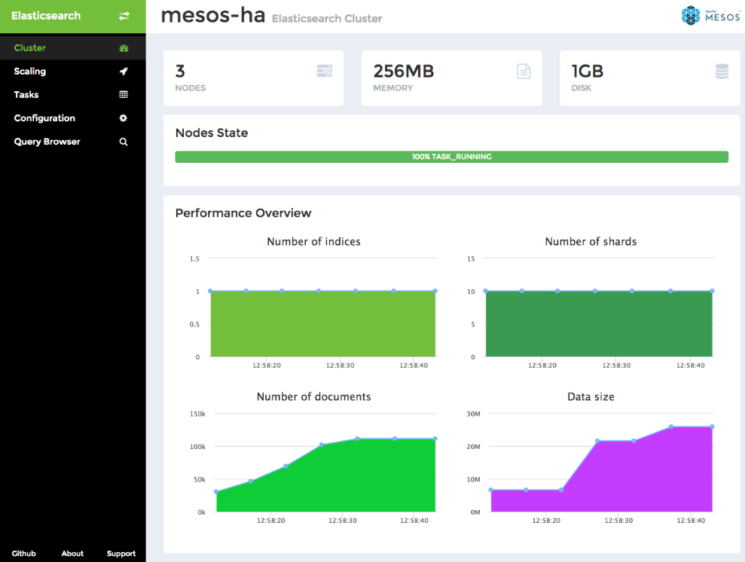
Frameworks Help, But…
Making operational aspects easier
Scale out & Scale in
Monitoring
Automated recovery
Bootstrap and rebuild
Elephant in the room!

Slide 21
The ”Oh @#$%” Moment…

Slide 22

Bootstrap and Rebuild
Cassandra (example)
Dataset grows, rebuild takes longer
Hours (and even Days)
When complete?
Alexander Dejanovski, Cassandra Summit 2016
How to: Bootstrap and Rebuild
https://www.youtube.com/watch?v=1Sz_K8UID6E

Slide 23

Degraded Performance
Latency increases – repair process is expensive
Your application…
Slows down
Grinds to a halt
Can even bring down Cassandra
Notes:
Latency increases
because the repair process is CPU and IO intensive
rebuilding the merkle trees are
There are tools and processes that can help mitigate this, but I won’t cover them here. Needless to say it will still impact performance.

Slide 24

Window of Vulnerability
Node repair
Vulnerable to additional failures
Multiple deployment strategies
Windows, Internet Explorer, No Anti-Virus, No Spyware
Limiting Risk!

Slide 25

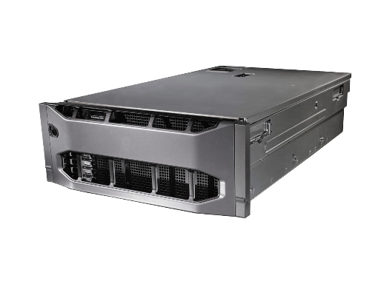

How External Storage Can Help!
Cassandra node failure
Disk
Network partition
Compute hardware
Migration of node
Volume tied to container!

Slide 26
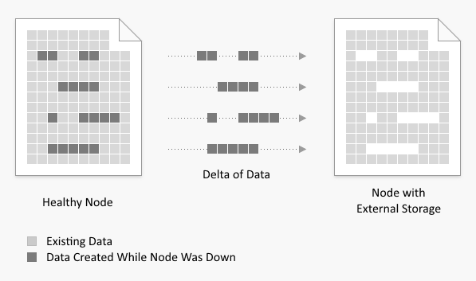
How External Storage Can Help!
Minimize window of vulnerability
Run node repair tool
Not a full node rebuild
Delta - Migration time

Slide 27
Wrap Up

Slide 28
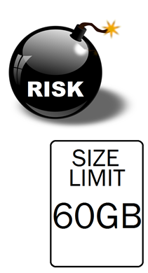
Local Storage for State
Availability Risk
Migrate container to another host – your storage is gone
Host goes down – your service goes down
Scale Limitation
Need more storage than the host has? Sorry…
Performance – simple + relatively low cost
Notes:
Using local storage is like smoking a cigarette. It tastes good at first, and all the other nodes are doing it. But leads to shorter data life expectancy, and leads to reduced (lung) capacity

Slide 29
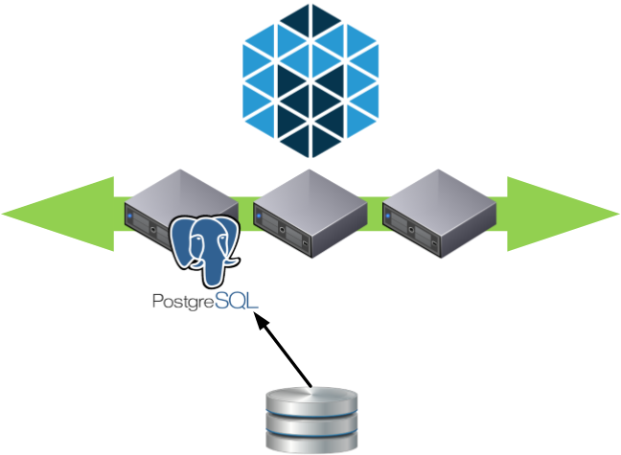
External Storage for State
Container migration
Tolerate host failures
Dynamic provisioning
Thin-provisioning
Facilitates growth
Add more disk
Performance can vary based on the platform
Notes:
Using local storage is like smoking a cigarette. It tastes good at first, and all the other nodes are doing it. But leads to shorter data life expectancy, and leads to reduced (lung) capacity

