Slide 1
Robust Applications in Mesos
Using External Storage
David vonThenen
{code} – Dell Technologies
@dvonthenen
http://dvonthenen.com
github.com/dvonthenen
Notes:
I work on the {code} team which is the Open Source Initiative within Dell Technologies that develops and contributes to a wide range of open source projects. Our group is most known for working on projects enabling container schedulers, like Kubernetes, Mesos, and Docker Swarm, to consume various storage platforms easily.
In a past life, I was working in the Backup and Recovery Solution space specifically working on VMware virtualized environments.

Slide 2
Agenda
Mesos Storage Options
Traditional Databases
NoSQL, KeyValue Storage, etc
Wrap Up
Notes:
So here is the agenda. We are first going to talk about the different storage options that are available to Mesos ecosystem and provide a brief history on when these options were introduced.
Then we are going to cover how consuming the storage options affect the Initial Deployment and Day 2 Maintenance operations for Traditional Databases.
Followed by what that looks like for modern applications like NoSQL Databases and KeyValues Stores.
Then just a small wrap of the highlights for each of these types of deployment architectures.

Slide 3
Mesos Storage Options
Notes:
This session is going to hopefully be a little different in format. A lot of presentations build up to the “ta-da” moment where they unveil the answer or solution to the problem at the end, but I am going to give you the answers first but then talk about how the different storage solutions and see how they fit with a given architecture or deployment for your application.

Slide 4
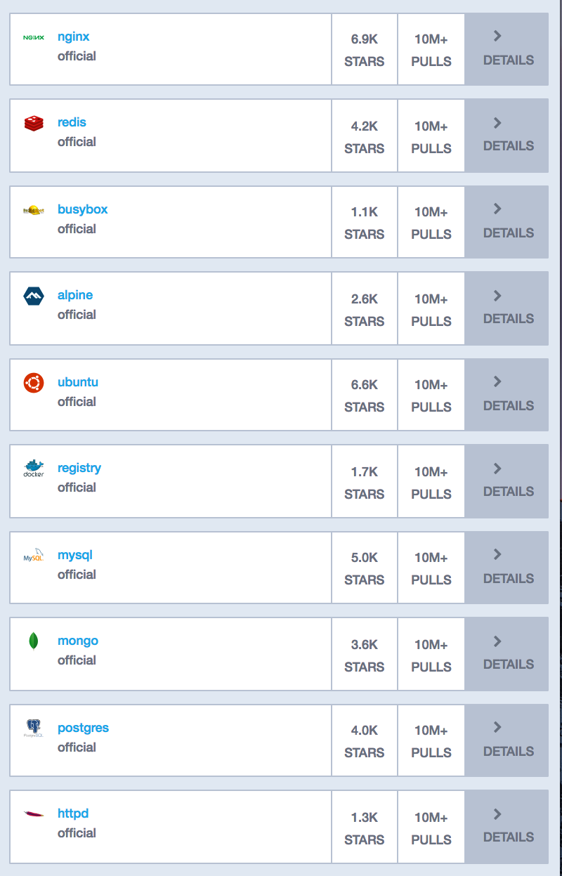
Containers Today
Many container workloads are long running
Many have state: user data, configuration, and etc
Top 10 of 20 Apps in Docker Hub are persistent applications
Notes:
- If we look at the container ecosystem today, there is a good mix of applications that transient and some that are long running.
- Whether these applications are transient or long running, many of those applications has state or need some form of data persistence.
- So here we have a small screen capture of the most popular containers in Docker Hub and it turns out that 10 of the top 20 applications require some form of persistent data.
Why is this important? Why do we care that we can deploy stateful applications in containers?

Slide 5
Container Advantages Make Sense for Stateful Too
Container attributes:
Consistent environment – same anywhere
Dependency management – packaging
No snowflakes!
Orchestration can add:
Health monitoring
Automated rollouts and rollbacks
Declarative configuration
App/package store deploy experience
Notes:
It turns out that there are some interesting advantages of running stateful applications in containers.
Consistent Environment – The runtime environment of the app is captured within the container.
Dependency Management – We don't want to worry about the Application's library dependencies, environments, configuration, settings and etc.
Declarative Configuration - Orchestration also provide Declarative Configuration which is to say that we just want to deploy our application and no matter which compute node in the cluster the container is being run on, we know that the container will function and behave correctly.

Slide 6


Death of a Container
/etc /var
/bin /opt
/data
Where does my data go?
Production applications require high availability
Options:
Local Attached Disk
External Storage
Notes:
The fundamental problem with stateful applications running in containers is the ephemeral nature of containers. When the container comes up, any data that is accumulated is lost when the container goes away.
The problem is running you need to run these container in production, you require some for high availability or data persistence.
Options…

Slide 7
Storage Options
Local Disk introduced in 0.23.0 [MESOS-1554]
External volumes via mesos-module-dvdi (Sept 2015)
3rd party component
Hooks into Docker Volume support
Configured/Managed outside of Mesos
Native external volume support in 1.0 [MESOS-4355]
Notes:
- In Mesos version 0.23.0, the ability to consume direct attached disk was introduced. You were able to carve out the necessary amount of disk that was available on a given host to allocate to your container.
In Sept of 2015, the mesos-module-dvdi was created by the {code} team. The mesos-module-dvdi is a 3rd party component that would you install and configure as an add-on to Mesos. It was implemented as a filesystem isolator and provided a hook to existing a Docker Volume Driver support.
Then in Mesos 1.0, the mesos-module-dvdi was contributed upstream to Mesos and makes external volume support native to Mesos.

Slide 8

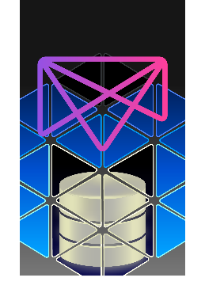
External Storage Enablement
REX-Ray
Vendor agnostic storage orchestration engine
AWS, GCE, Ceph, DigitalOcean, Cinder, ScaleIO, VirtualBox, many more
https://github.com/codedellemc/rexray
mesos-module-dvdi
Hook for Mesos nodes to manage external storage
https://github.com/codedellemc/mesos-module-dvdi
Contributed back and is apart of Mesos proper (1.0+)
Notes:
How the {code} team enables external storage in Mesos is done via 2 projects. The first is through REX-Ray which is a vendor agnostic storage orchestration engine that implements the Docker Volume Driver Interface.
The second is the mesos-module-dvdi which we already had talked about and enables external storage for the Mesos universal containerizer and like I said previously was contributed back upstream to Mesos is natively available in 1.0 or higher.

Slide 9

DC/OS Storage Options
Easily consume via curated repository:
Local attach disk
External storage
REX-Ray provides the means for external storage!
Notes:
How many people are using DC/OS?
So as we all know, one of the awesome feature that DC/OS provides is being able to consume content or applications from their curated repo. DC/OS makes it extremely easy to provision applications/containers with local attached disk or external storage.
It turns out that all DC/OS who are running persistent applications with external storage are all REX-Ray users as that is what is being used with under the covers.

Slide 10

Looking to the Future…
Container Storage Interface
Modeled after OCI and CNI
Standardized storage plugins
Across multiple container orchestrators
The Container Storage Initiative: What is this Project About and Where are We Going?
Congress Hall 2 Thurs 4:30pm
Notes:
OCI = open container initiative, CNI = container network interface
One of the goals for CSI is to standardize storage plugins via documented API spec that will allow multiple container orchestrators, like Mesos and Kubernetes, to consume storage.
If you are interested in learning more about it, there is a session later this afternoon entitled “The Container Storage Interface: What is this Project About and Where are we Going?” in Congress Hall 2 at 4:30. A fellow colleague in the {code} team will be co-presenting that session.

Slide 11
Traditional Databases
Notes:
Now that we have talked about the storage options available in Mesos, let’s take a look at how these deployment strategies affect traditional databases both in terms of the initial deployment and also for Day 2 type stuff like disaster recovery and maintenance.

Slide 12
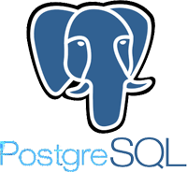

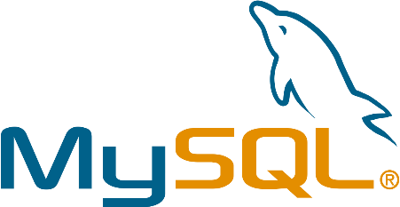
Traditional Databases
Typical deployments
Simple and straight forward
Monolithic
Some are complex
Sharding
Clustering
Notes:
When it comes to Traditional databases, typical deployments tend to be monolithic which in turn makes them simple and straight forward to deploy.
There are more complex use-cases like sharding and clustering, but how you approach storage in those types of deployments are similar.
We are just going to focus on the typical deployment, but if you want to talk more about it, stick around and catch me after the session to discuss this further.

Slide 13
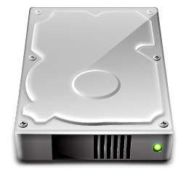
Initial Deploy Using Local Disk
Simple and straight forward
Performance based on compute node storage capabilities
Targeted deploy based on resources
Notes:
The initial deploy of traditional databases like MariaDB are simple using local disk.
Performance is based on the compute nodes they are deployed to. If all your nodes in the cluster has only rotating disk, then your application’s performance is subject to that storage type.
However, if you have a mix of local attached disk in your cluster and require a certain performance characteristic, you need to know specifics about your infrastructure or use Mesos tagging to label that those capabilities exist.

Slide 14
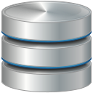
Initial Deploy Using External Storage
Requires an external storage platform
Some setup required
Managed outside Mesos
Performance based on platform
Storage Platform accessible everywhere!
Notes:
Doing an initial deploy of a traditional database using external storage obviously requires an external storage platform. This in turn requires additional knowledge for the end user for both setup and maintenance. In some cases, that knowledge is minimal. As an example, consuming EBS volumes in AWS. Sometimes, that knowledge is not trivial. As an example, using and configuring a cinder implementation. What needs to be done in the form of maintenance on the storage platform?
The performance depends on the storage platform you provisioning or consuming storage from.
That storage platform minimally must either be target to certain subset of your compute or accessible everywhere.

Slide 15
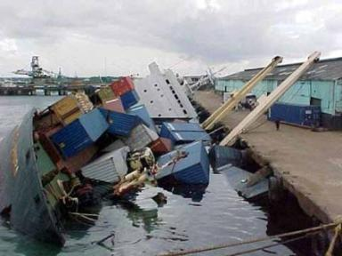
The ”Oh @#$%” Moment…
Notes:
So let’s take a look at what things can go wrong after you have deployed your stateful application. I am calling this the “oh shit” moment.

Slide 16

Day 2 Operations Using Local Disk
Data locality!
Disk failure
Host failure
Host maintenance
Fixed Resources
Reserve all capacity upfront
More capacity?
Notes:
Data locality:
- The obvious is what happens when you have a disk failure or host failure. That data no longer is available for your stateful application. The not so obvious are things like what happens when you need to do maintenance on a given host? How long will your application be down for?
Fixed Resources:
You don’t have the ability to thin provision the capacity. You must allocate the required storage upfront which can be expensive.
What happens when you have out grown the capacity available on a host? There are ways to fix this, but often times they require manual intervention from a person. This goes back to avoiding snowflakes.

Slide 17

Day 2 Operations Using External Storage
External volume moves with the Container
Hardware failure
Host failure
Maintenance
High Availability!
Consume storage as you grow!
Notes:
Now Traditional Databases using external storage, the Day 2 aspects start to get interesting. If there happens to be a disk failure, host failure, or even required maintenance, the container housing your application can get rescheduled on another piece of compute and the volume will move with the container.
Depending on the storage platform, you can take advantage of features like thin provisioning.
If your storage platform is starting to reach capacity, you can expand the overall capacity of the system by adding more devices.

Slide 18
NoSQL and KeyValue Stores
Notes:
So now we are going to take a look at NoSQL databases and KeyValues store and how those type of applications are affected by using Direct Attached Storage vs External Storage.

Slide 19

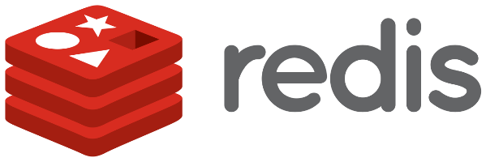

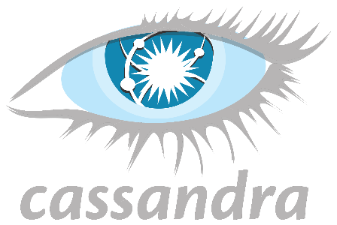
What about NoSQL & KeyValue Stores?
Initial Deploy
Local disk: Same
External storage: Same
Day 2 Operations?
Behavior characteristics of eventually consistent DBs
Multi-node
Notes:
Initial Deploy for NoSQL and KeyValue stores on Local and External storage are pretty much the same
Local disks:
Simple Straight Forward
Performance based on disk available
External Storage:
Additional knowledge may be required on setup, configurations, and also what type of maintenance is required for your storage platform.
Worry about storage platform accessibility among your various compute nodes
Day 2 operations and maintenance also start to get real interesting with these type of applications because of the behavioral/operational characteristics of these eventually consistent Databases and the fact that they are distributed and multi-node.

Slide 20
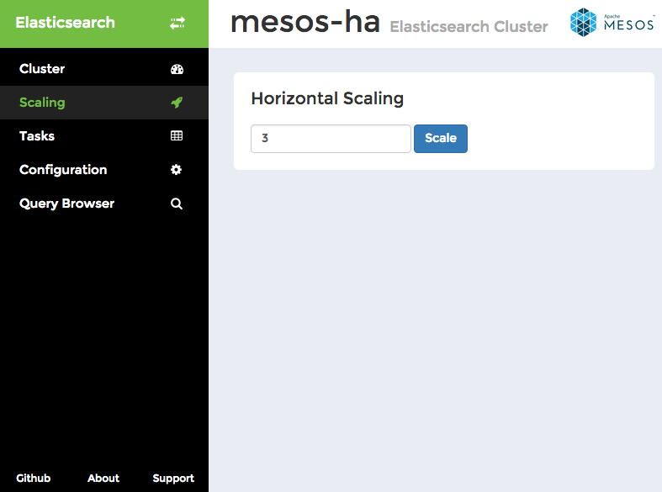
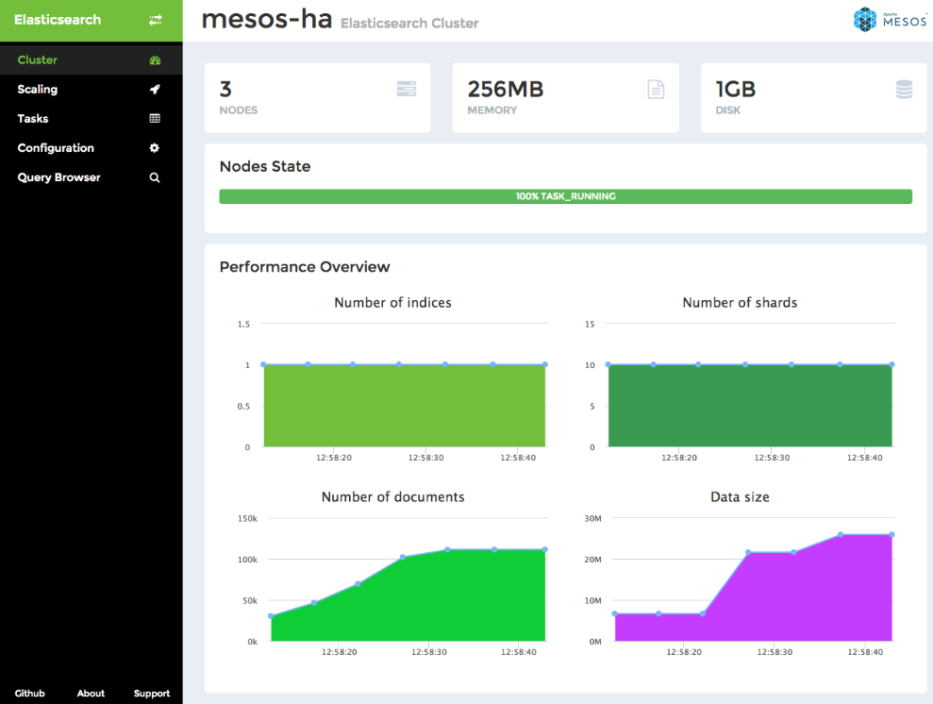
Frameworks Help, But…
Making operational aspects easier
Scale out & Scale in
Monitoring
Automated recovery
Bootstrap and rebuild
Elephant in the room!
Notes:
One huge advantage that Mesos and DC/OS has is the 2 layer scheduling that Frameworks provide. Depending on the Framework, they often times provide functionality that allows you to handle a lot of the operational aspects of application. So I have an example here of the ElasticSearch framework. You can do scale out/in of ElasticSearch by provisioning more nodes. Also provides monitoring, recovery, and even bootstrapping for doing a node rebuild.
The Elephant in the room is that a lot of these frameworks are great at initial deployment, some are even good at monitoring and metrics, and only a small fraction is capable of handling the inevitable failure efficiently. That’s the key word… efficiently.

Slide 21
The ”Oh @#$%” Moment…
Notes:
Let's take a look what happens when we have our "Oh shit" moment when we focus NoSQL database. We are going to talk about Cassandra specifically so that we have a good concrete example.

Slide 22

Local Disk: Bootstrap and Rebuild
Cassandra (example)
Dataset grows, rebuild takes longer
Hours (and even Days)
When complete?
Alexander Dejanovski, Cassandra Summit 2016
How to: Bootstrap and Rebuild
https://www.youtube.com/watch?v=1Sz_K8UID6E
Notes:
So if we are using local disk and there is a node failure, Cassandra and other NoSQL implementations need to rebuild and rebalance for data availability.
Now if your Cassandra cluster doesn’t contain much data, the repair process is quick. However if your Cassandra cluster has been running for some time and is dense with data, the repair can take longer to rebuild.
There is a great session done by Alexander Dejanovski at Cassandra Summit in 2016 called “How to: Bootstrap and Rebuild” which talks about how rebuilding take days and semi-jokingly 15 days. If you are interested a deep dive, I would highly recommend taking a look at his talk.

Slide 23

Local Disk: Degraded Performance
Latency increases – repair process is expensive
Your application…
Slows down
Grinds to a halt
Can even bring down Cassandra if you aren’t careful
Notes:
As the bootstrap and repair process is going on, latency increases
because the repair process is CPU and IO intensive
rebuilding the merkle trees are very expensive
While this repair process is happening, the performance and responsiveness of your application may be impacted. Even to the point where you application might no longer be responsive.
There are tools and processes that can help mitigate this, but I won’t cover them here. Needless to say, if you aren't careful it can still impact performance of Cassandra and in turn your application.

Slide 24

Local Disk: Window of Vulnerability
Node repair
Vulnerable to additional failures
Multiple deployment strategies
Windows, Internet Explorer, No Anti-Virus, No Spyware
Limiting Risk!
Notes:
While node repair is happening, you potentially have a window of vulnerability to additional failures. This depends on the number of nodes in your cluster and how your replication factor is configured and etc. I kind of compare it to running Windows, using Internet Explorer, with No Anti-Virus or Spyware detection software.
Limit risk!

Slide 25

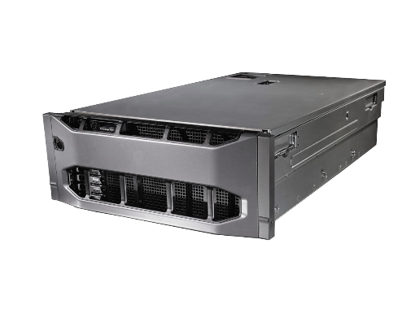

How External Storage Can Help!
Cassandra node failure
Bad Disk
Compute failure
Network partition
Maintenance
Migration of Cassandra instance
Volume tied to container!
Notes:
How External Storage Can Help!
Compute failure– not the actual disk has failed but something else like the storage controller
Network partition – It's entirely possible you have a simple network partitioning event. You wouldn't want to start a full rebuild and have that rebuild impact your application on perhaps some transient event.
Maintenance - Maybe you are only taking the node offline for 30 minutes because you are adding in a new network card.
If you are using external storage, when the Cassandra node is migrated from one compute node to the next and you are using something like REX-Ray to handle the storage orchestration, the volume will be tied to that Cassandra node and migrate along with it.

Slide 26
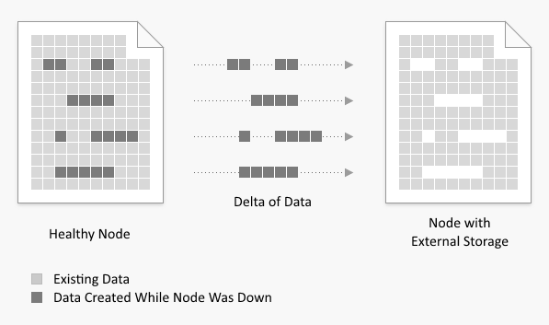
How External Storage Can Help!
Minimize window of vulnerability
Run node repair tool
Not a full node rebuild
Delta - Migration time
Notes:
By having the volume tied to the container, when the container comes up on a new compute node, the volume will be reattached to the container, and Cassandra will only be missing the data in the delta of time that it took to migrate the container.
So when a node repair occurs on that migrated Cassandra node, only that delta of data needs to be repaired or rebuilt. This effectively limits the Window of Vulnerability that you are exposed to.

Slide 27
Wrap Up
Notes:
We covered a lot here in this discussion and I just wanted to highlight the key takeaways when it comes to deploying stateful containers/applications using local attached disk vs external storage.

Slide 28
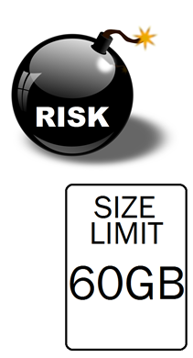
Local Storage for State
Availability Risk
Migrate container to another host – your storage is gone
Host goes down – your service goes down
Scale Limitation
Need more storage than the host has? Sorry…
Performance – simple + relatively low cost
Notes:
Availability risk – You need to pin your container/application to the host that it is running on.
Scale – Over allocate the initial amount of storage you plan on using when you launch your application.
Performance – Weigh cost and simplicity in the decision to use local attached disk.

Slide 29
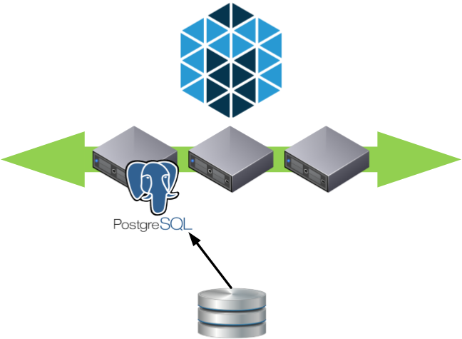
External Storage for State
Container migration
Tolerate host failures
Dynamic provisioning
Thin-provisioning
Facilitates growth
Add more disk
Performance platform based

Slide 31
David vonThenen
{code} – Dell Technologies
@dvonthenen
http://dvonthenen.com
github.com/dvonthenen

