Slide 1
Updates on Obesity DCEA
Neeti Kulkarni

Slide 2
Reasoning for DCEA
Ozempic is a hot topic right now—but it is generally established that it is not cost-effective compared to bariatric surgery
But there could be space for a DCEA
The most inequitable part of semaglutide (Ozempic) is its cost and disparities in access, but clinical trials have shown limited variations in actual effectiveness across racial and ethnic groups
There could be more upstream, structural barriers associated with bariatric surgery
Drastic alteration of diet and lifestyle habits may not be feasible for marginalized populations
Certain disadvantaged groups are also known to face worse surgical outcomes

Slide 3
Population of interest
Black and White Medicare population (ages 65-70) w/ cardiovascular risk in obesity class II or higher
Ages 65-70
for patients
with a BMI
of 35 or higher (obesity class II
or higher)
Bariatric surgery qualifications
Established cardiovascular risk
Wegovy qualifications

Slide 4
Model so far

Slide 5
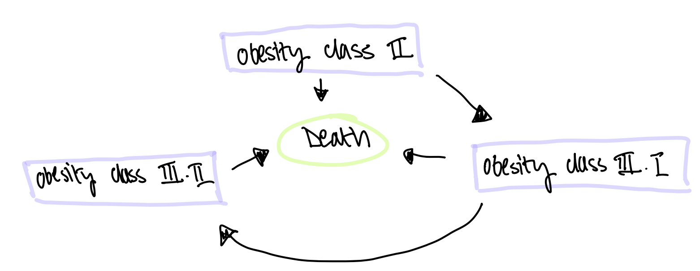
Model Diagram-Status Quo

Slide 6
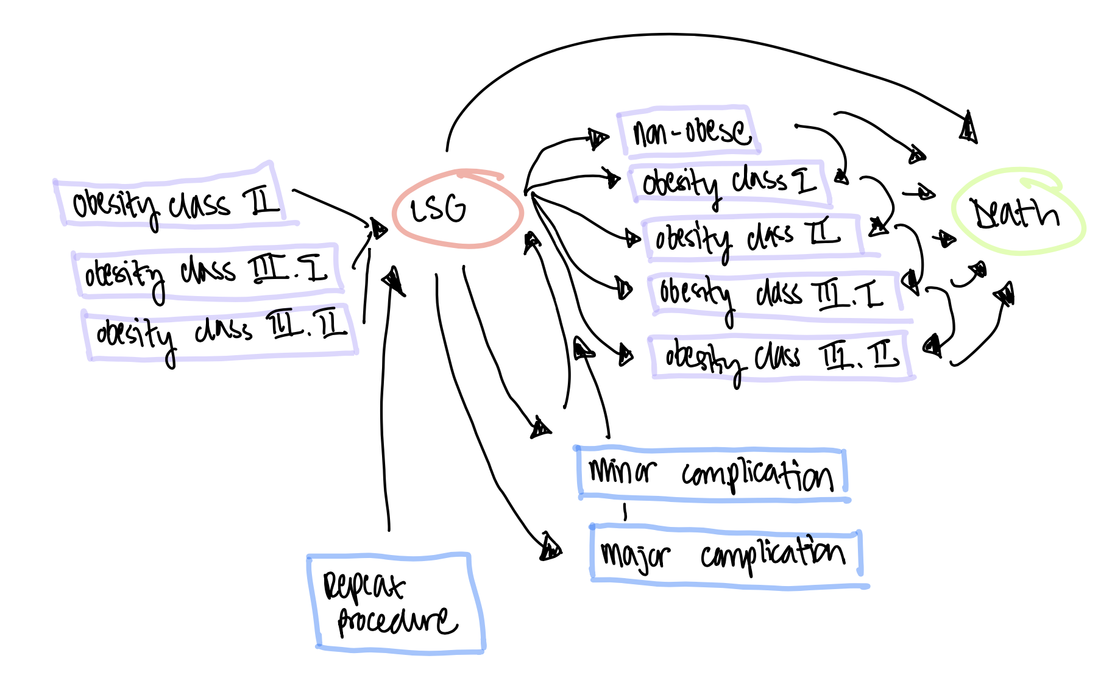
Model Diagram-Bariatric Surgery

Slide 7
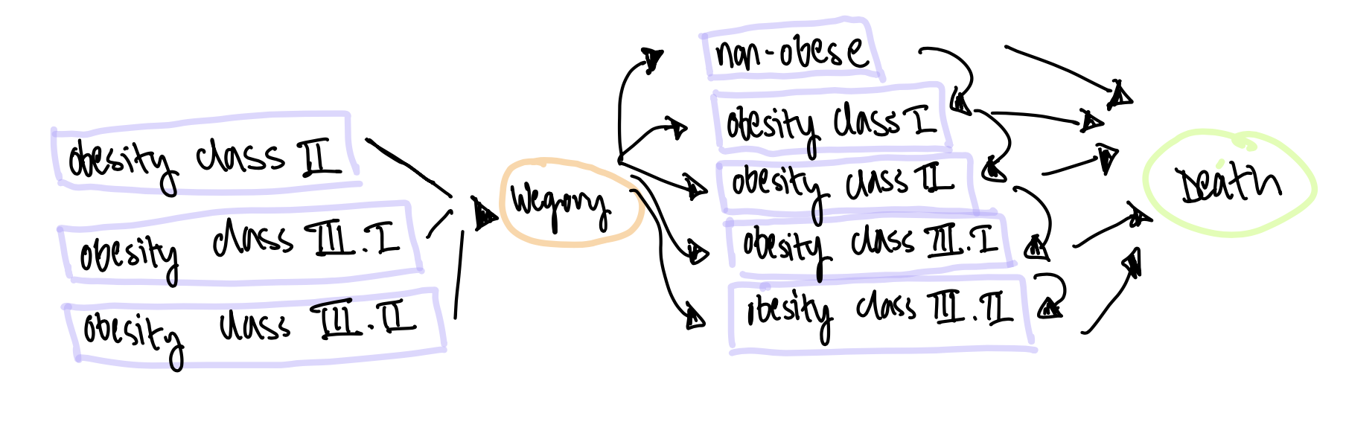
Model Diagram-Semaglutide

