Slide 1
Aiversecity
Career exploration with visible evidence
A fictional profile. Three role families. A first practice step.
Ctrl+S / Aiversecity
01
Notes:
0:00-0:20. Introduce Ctrl+S, Domain 1 and the student/recent-graduate decision. Full narration and browser actions are in PITCH-RECORDING-RUNBOOK.md.
Sources and disclosures:
Review deck prepared 23 October 2026 MYT. Reconcile against final commit, tests and release links before recording.

Slide 2
The career exploration problem
1 in 4
A learner still needs to judge
which evidence applies locally
and what to practise next.
workers globally are in occupations
with some GenAI exposure
ILO, 2025. Exposure describes task potential. It does not measure Malaysian job losses.
Ctrl+S / Aiversecity
02
Notes:
0:20-0:55. The target-user problem is a design hypothesis, not interview findings. ILO context is global. No user research or measured Malaysian prevalence is claimed.
Sources and disclosures: https://www.ilo.org/publications/generative-ai-and-jobs-refined-global-index-occupational-exposure (20 May 2025, checked 23 October 2026 MYT).
Review deck prepared 23 October 2026 MYT. Reconcile against final commit, tests and release links before recording.

Slide 3
A learner’s decision journey
01
02
03
Profile and evidence
Role exploration
A practice pathway
Four workplace questions
Editable synthetic skills
Dated public trend source
Three supported role families
Explainable alignment scores
Visible skill gaps
Prerequisites and public resources
Role and skill SDG explanations
Two qualitative scenarios
Ctrl+S / Aiversecity
03
Notes:
0:55-1:15. Explain all six Domain 1 capabilities. Trend radar remains limited: only a U.S. related-role direction is available. Supported roles: Data Analyst, Software Developer, Operations Research Analyst. Other role directions remain unknown.
Sources and disclosures:
Review deck prepared 23 October 2026 MYT. Reconcile against final commit, tests and release links before recording.

Slide 4
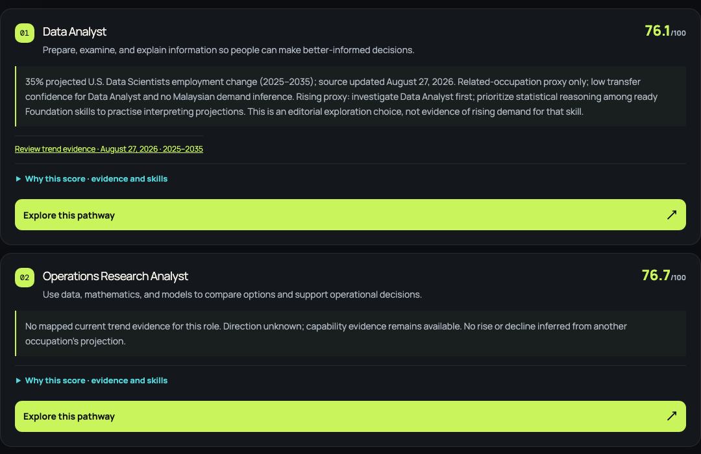
Personal alignment and trend evidence
Alignment stays personal
Fresh BLS evidence changes
exploration priority.
Other roles: direction unknown.
Actual local UI, fictional profile. U.S. Data Scientists proxy, low transfer confidence for Malaysia.
Ctrl+S / Aiversecity
04
Notes:
1:15-3:05. Screenshot from the real running local application, fictional answers and actual BLS 35% 2025-2035 record retrieved 23 October MYT. This is not a fixture or hosting proof. Switch to the real browser and show intake, score components, gaps, source/date/geography, refresh and changed output using two clearly labelled controlled evidence versions. Never imply fixture values are fresh upstream BLS releases. Eligible evidence requires retrieval/check within 30 days, publication within 550 days, current year in horizon and no stale/failure state. Positive projection prioritizes Data Analyst exploration, negative moves it later, zero/missing/ineligible removes adjustment. News never serves as demand evidence. This is partial coverage of the full Domain radar.
Sources and disclosures: https://www.bls.gov/ooh/math/data-scientists.htm; docs/TREND-METHODOLOGY.md; docs/verification/2026-10-23-live-http.json.
Review deck prepared 23 October 2026 MYT. Reconcile against final commit, tests and release links before recording.

Slide 5
A pathway the learner can inspect
Foundation
Specialization
Capstone
Practise the basics
with explicit prerequisites
Apply role-specific tasks
and check the evidence
Combine the skills
in a fictional project
Estimated practice time and self-reported completion do not verify mastery or job readiness.
Ctrl+S / Aiversecity
05
Notes:
3:05-3:50. Demonstrate skill editing, scenario change and a resource link. Prerequisites always govern. Positive BLS trend prioritizes statistical reasoning among ready Foundation steps as a pedagogical rule, not measured demand for that skill. Free digital resources may offer paid certificates.
Sources and disclosures: Learning resource review: docs/research/DOMAIN1-EVIDENCE-2026-10-22.md.
Review deck prepared 23 October 2026 MYT. Reconcile against final commit, tests and release links before recording.

Slide 6
Proposed SDG contribution
4.4
Employment-relevant technical
and vocational skills
Each practice step explains the capability it develops.
Supporting role links: Target 8.2 productivity and Target 9.5 technological capability.
No learning, employment or SDG indicator improvement has been measured.
Ctrl+S / Aiversecity
06
Notes:
3:50-4:20. Explain that mappings are proposed contribution pathways. The app is not UN-endorsed and does not measure official indicators.
Sources and disclosures: https://sdgs.un.org/goals/goal4 (Target 4.4), https://sdgs.un.org/goals/goal8 (Target 8.2), https://sdgs.un.org/goals/goal9 (Target 9.5).
Review deck prepared 23 October 2026 MYT. Reconcile against final commit, tests and release links before recording.

Slide 7
Application architecture
Fictional profile
and four questions
Deterministic rubric
and role weights
Alignment scores
and skill gaps
>
>
Fixed BLS fetch
RSS context separately
BLS evidence dates
and eligibility rules
Exploration priority
and ordered practice
>
>
Session memory only. Fixed-source APIs cache for 30 minutes. No runtime model, database or GPU.
Ctrl+S / Aiversecity
07
Notes:
4:20-4:55. Native editable block diagram. React 19.3.1, TypeScript 5.9.3, Vite 8.3.5, fast-xml-parser 5.11.2. Browser answers do not go to upstream data providers. Codex major development assistance requires team review. Diagram simplifies pathway inputs: selected role, self-reported skills and scenario also govern ordering. No runtime LLM/ML or trained prediction.
Sources and disclosures:
Review deck prepared 23 October 2026 MYT. Reconcile against final commit, tests and release links before recording.

Slide 8
Phase 2 evaluation targets
20%
80%
lower median decision-task time
versus browsing the same sources
comprehension pass rate
on score, geography and prerequisite
Proposed goals, not results. No measured local baseline yet. Report paired sample sizes and failures.
Ctrl+S / Aiversecity
08
Notes:
4:55-5:30. Proposed moderated pilot uses fictional profiles. Paired same-source comparison measures median task time. Comprehension covers meaning of score, source geography and first prerequisite. Targets are locally proposed, not sourced impact statistics. No achieved effect is asserted.
Sources and disclosures:
Review deck prepared 23 October 2026 MYT. Reconcile against final commit, tests and release links before recording.

Slide 9
Limits and submission gates
Evidence coverage
Release gates
Three roles, editorial rubric
U.S. related-role trend proxy
Skills demand remains unmeasured
Actual Replit use and proof
Mandatory sponsor identity / access
Team declarations and public access
Review status as of 23 October 2026 MYT. Update only with verified evidence before recording.
Ctrl+S / Aiversecity
09
Notes:
5:30-6:00. These are real outstanding gates. Replit login work paused at user request while login rules are checked. API Premium sponsor mandatory wording exists in portal but identity/docs unresolved. No final public release, YouTube upload or signed declarations claimed.
Sources and disclosures:
Review deck prepared 23 October 2026 MYT. Reconcile against final commit, tests and release links before recording.

Slide 10
A decision the learner can explain
Which role should I explore,
and what should I practise first?
Response evidence, trend scope and a visible first step
Ctrl+S / Aiversecity
10
Notes:
6:00-6:20. Close with the specific decision and proposed evaluation. Use actual finalized source/demo/slides/video links in the README after publication approval. Do not invent placeholders that look live.
Sources and disclosures:
Review deck prepared 23 October 2026 MYT. Reconcile against final commit, tests and release links before recording.

