Slide 1
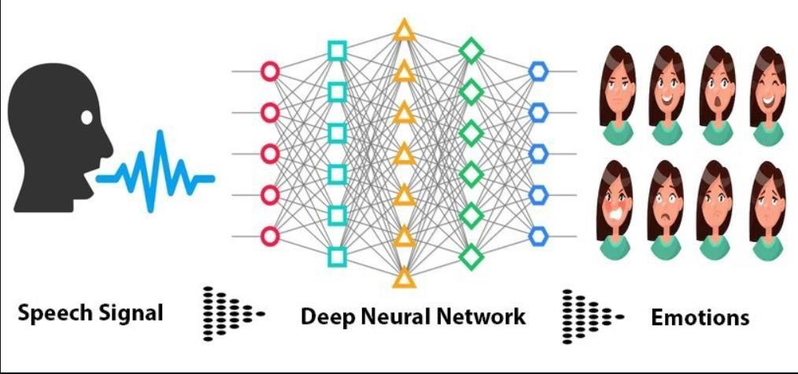
SPEECH EMOTION RECOGNITION

Slide 2

AN INTERNSHIP PROJECT AT HCLTECH
Prepared By:
Dharmendra Yadav
Department of Computer Science &
Engineering

Slide 3



ABOUT THE COMPANY
•
HCL Technologies is a leading global technology company that provides IT services and solutions.
•
Established in 1976, HCL has grown to become one of the largest IT services firms in the world.
•
It operates in various industries, including banking, finance, healthcare, retail, manufacturing, and more.
•
HCL Technologies has a strong global presence with offices and delivery centers in over 50 countries.
•
It serves clients across the Americas, Europe, Asia Pacific, the Middle East, and Africa.
•
With a workforce of over 175,000 employees, HCL delivers services in more than 50 languages.
•
HCL offers a wide range of services, including IT consulting, application development, infrastructure management, cybersecurity, and engineering services.

Slide 4
INTRODUCTION
SER is the process of automatically identifying and categorizing emotions expressed in speech signals.
It involves analyzing acoustic features, prosody, and linguistic content to determine emotional states.
SER aims to go beyond the words spoken and capture the underlying emotional information conveyed through speech.
Speech Emotion Recognition (SER) enables machines to understand and respond empathetically, improving human-computer interaction.
SER has applications in various fields such as mental health assessment, customer feedback analysis, and entertainment industry.

Slide 5
IMPORTANCE
Developing empathetic virtual assistants:
Virtual assistants can understand and respond appropriately to user emotions, improving user experience.
Analyzing customer feedback:
SER enables sentiment analysis of customer feedback, helping businesses gauge customer satisfaction and improve products or services.
Enhancing human-computer interaction:
Systems capable of recognizing emotions can respond more empathetically and adaptively to human needs.
Assisting in mental health assessment:
Analyzing speech patterns and emotions can aid in early detection of emotional disorders and mental health conditions.

Slide 6
INTRODUCTION TO CNN
CNN Stands For Convolutional Neural Network
CNN is a deep learning architecture widely used for image analysis and pattern recognition.
It excels at capturing spatial dependencies and extracting hierarchical features from input data.
CNNs have achieved state-of-the-art performance in various computer vision tasks, such as image classification and object detection.

Slide 7
ADVANTAGE OF CNN FOR SER
Learning hierarchical features:
CNNs can automatically learn and capture relevant features from speech data, enabling better representation of emotional cues.
Handling sequential data:
CNNs can process sequential speech signals by using 1D convolutions, capturing temporal patterns and variations in emotions.
Robustness to variations:
CNNs are capable of handling variations in speech patterns, accents, and languages, making them suitable for SER tasks.

Slide 8
CHALLENGES
Variability in Emotional Expressions:
Emotions are subjective and expressed differently across individuals, cultures, and languages, making recognition challenging.
Ambiguity and Context:
Emotions can be context-dependent and ambiguous, requiring understanding of linguistic and situational cues.
Noisy Environments:
Background noise, environmental factors, and speech quality issues can affect the accuracy of emotion recognition.
Subjectivity and Individual Differences:
Perception and interpretation of emotions can vary among individuals, making it challenging to define objective ground truth labels.
Limited Labeled Data:
Availability of large, diverse, and well-labeled datasets for training SER models is limited, hindering model performance and generalization.

Slide 9
BENEFITS OF CNN FOR SER
Feature extraction:
CNNs automatically extract relevant acoustic features from speech signals, reducing the need for manual feature engineering.
Pattern recognition:
CNNs capture temporal patterns and variations in speech, improving the accuracy of emotion recognition.
Robustness to noise and variations:
CNNs can handle the presence of background noise and variations in speech signals, making them more
CNNs excel in learning hierarchical features from input data.
1D CNN architectures are used to analyze sequential speech data, capturing local and global patterns.
CNNs automatically extract relevant features and learn discriminative representations for emotion recognition.

Slide 10
CONCLUSION
Speech Emotion Recognition (SER) is a crucial field that enables machines to understand and interpret emotions expressed through speech.
Advancements in SER have significant implications across various domains, including human-computer interaction, mental health assessment, customer feedback analysis, and the entertainment industry.
Convolutional Neural Networks (CNNs) have emerged as a powerful tool for SER, allowing for the extraction of relevant features and the recognition of patterns and variations in speech emotions.
Despite challenges such as variability in emotional expressions, ambiguous context, noisy environments, subjectivity, and limited labeled data, SER continues to evolve and improve.
The future of SER holds promising opportunities, including the development of more empathetic virtual assistants, enhanced mental health support systems, and emotion-driven human-computer interfaces.

