Slide 1
DBscan
Joseph Nelson, Data Science Immersive

Slide 2
Agenda
What is DBSCAN?
How does DBSCAN work?
How does DBSCAN compare to K-Means and Hierarchical Clustering?
Implementation
Code Example

Slide 3
What is Dbscan?
Review: what is clustering?

Slide 4
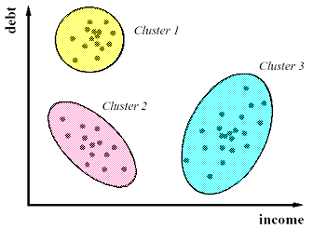
What is Dbscan?
Review: what is clustering?
Clustering is an unsupervised learning technique we employ to group “similar” data points together
With unsupervised learning, remember: there is no clear objective, there is no “right answer” (hard to tell how we’re doing), there is no response variable, just observations with features, and labeled data is not required

Slide 5
What is Dbscan?
DBSCAN: Density-based Spatial Clustering of Applications with Noise
For DBSCAN, clusters of high density are separated by clusters of low density

Slide 6
What is Dbscan?
DBSCAN: Density-based Spatial Clustering of Applications with Noise
For DBSCAN, clusters of high density are separated by clusters of low density
DBSCAN is the most widely used and applicable clustering algorithm - given that it takes minimum predefined input and can discover clusters of any shape, not just the sphere-like clusters that k-means often computes. This way, we can discover less pre-defined patterns and glean some more useful insights.

Slide 7
How does dbscan work?
DBSCAN is a density based clustering algorithm, meaning that the algorithm finds clusters by seeking areas of the dataset that have a higher density of points than the rest of the dataset.
Given this, unlike in our previous examples, after you apply DBSCAN there may be data points that aren't assigned to any cluster at all!
When we use DBSCAN, it requires two input parameters - epsilon, which is the max distance between two points for them to be considered a cluster, and the minimum number of points necessary to form a cluster, which we'll call the minimum points.

Slide 8
How does dbscan work?
DBSCAN Algorithm:
1. Choose an “epsilon” and “min_samples”
2. Pick an arbitrary point, and check if there are at least “min_samples” points within distance “epsilon”
If yes, add those points to the cluster and check each of the new points
If no, choose another arbitrary point to start a new cluster
3. Stop once all points have been checked

Slide 9
How does dbscan work?
BRAVE VOLUNTEER: Whiteboard example

Slide 10
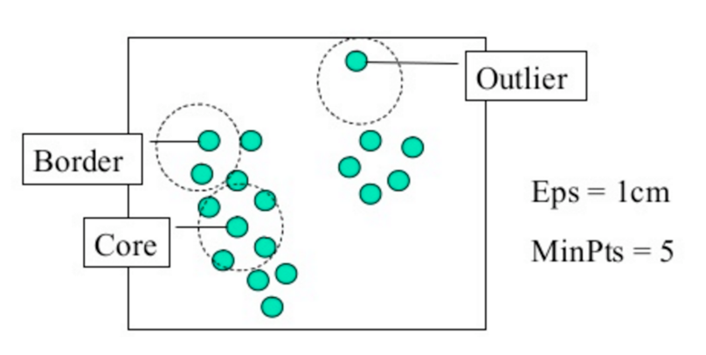
How does dbscan work?
Visually:

Slide 11
How does dbscan work?
DBSCAN algorithm in words/review of concept:
VOLUNTEER EXPLANATION?

Slide 12
How does dbscan work?
DBSCAN algorithm in words/review of concept:
DBSCAN will take the epsilon and minimum points we provided it and cluster all of the points in a neighborhood, first passing the minimum points requirement and then clustering each of the points within epsilon distance to form the clusters. Once one cluster is formed, the algorithm then moves to a new datapoint, and seeks to find related points to form yet another cluster; this will continue until DBSCAN simply runs out of points!

Slide 13
How does dbscan work?
Algorithm visualization:
http://www.naftaliharris.com/blog/visualizing-dbscan-clustering/
Let’s play with this a bit^^^
Independently, select the “Pimpled Smiley” distribution of points. What is an optimal epsilon? What about minimum number of points?

Slide 14
How does dbscan work?
Algorithm visualization:
http://www.naftaliharris.com/blog/visualizing-dbscan-clustering/
Let’s play with this a bit^^^
Now, independently, select the “Pimpled Smiley” distribution of points. What is an optimal epsilon? What about minimum number of points? (5-10min)

Slide 15
HOW DOES DBSCAN COMPARE TO K-Means and hierarchical?
Class?

Slide 16
HOW DOES DBSCAN COMPARE TO K-Means and hierarchical?
Whereas k-means can be thought of as a "general" clustering approach, DBSCAN performs especially well with unevenly distributed, non-linear clusters.
The fundamental difference with DBSCAN lies in the fact that it is density based rather than k-means, which calculates clusters based on distance from a central point, or hierarchical clustering. When choosing epsilon in the minimum points in DBSCAN, a selection of < 2 will result in a linkage cluster - essentially the same result as if you were to perform a hierarchical clustering. To diversify the DBSCAN, we therefore must give it a significant amount of points to form a cluster.
DBSCAN is density based, which means that it determines clusters based on the number of points in a certain area
By choosing too few points for DBSCAN, i.e. less than two, we'll effectively get a straight line if we connect the points, just like linkage clustering.

Slide 17
HOW DOES DBSCAN COMPARE TO K-Means and hierarchical?
DBSCAN can be useful to us when we have a lot of dense data. If we used k-means on this data, the algorithm would effectively give us just one large cluster! However with DBSCAN, we can actually break down this cluster into smaller groups to see their attributes.
ADVANTAGES – Class?
DISADVANTAGES – Class?

Slide 18
HOW DOES DBSCAN COMPARE TO K-Means and hierarchical?
DBSCAN can be useful to us when we have a lot of dense data. If we used k-means on this data, the algorithm would effectively give us just one large cluster! However with DBSCAN, we can actually break down this cluster into smaller groups to see their attributes.
ADVANTAGES –
Clusters can be any size or shape
No need to choose number of clusters
DISADVANTAGES –
More parameters to tune
Doesn’t work with clusters of varying density
NOTE: Not every point is assigned to a cluster!

Slide 19
How do we implement dbscan?
To implement DBSCAN in Python, we first import it from sklearn:
from sklearn.cluster import DBSCAN
Next, assuming that we are using the classic Iris dataset, we define X as the data and y are the class variables
X, y = iris.data, iris.target
Next, we call DBSCAN from sklearn:
db = DBSCAN(eps=0.3, min_samples=10).fit(X)
Given the above input, what have we said about our clusters?

Slide 20
How do we implement dbscan?
To implement DBSCAN in Python, we first import it from sklearn:
from sklearn.cluster import DBSCAN
Next, assuming that we are using the classic Iris dataset, we define X as the data and y are the class variables
X, y = iris.data, iris.target
Next, we call DBSCAN from sklearn:
db = DBSCAN(eps=0.3, min_samples=10).fit(X)
Given the above input, what have we said about our clusters?
Here, we've set epsilon to a standard value of .3 and set the minimum number of points at 10, and then fit the model to our data X.

Slide 21
How do we implement dbscan?
As a general rule when choosing the minimum points - you should always aim to have the minimum number of points be greater or equal to the amount of dimensions in your data, plus one. This typically will give the algorithm a good estimation of how to evaluate the clusters. Calculating epsilon is a bit trickier and uses a method called the k-distance, which can help visualize the best epsilon.

Slide 22
How do we implement dbscan?
core_samples = db.core_sample_indices_
labels = db.labels_
The DBSCAN algorithm in Python returns two items - the core samples and the labels. The core samples are the points which the algorithm initially finds and searches around the neighborhood to form the cluster, and the labels are simply the cluster labels.
Comprehensive question: how labels should we expect to receive?

Slide 23
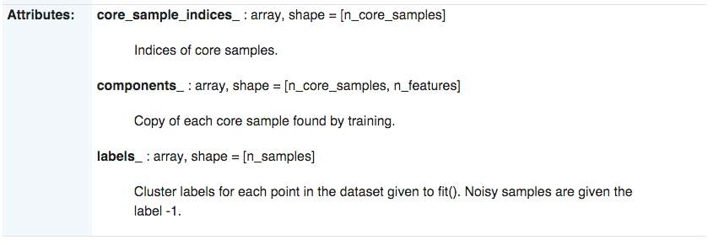
How do we implement dbscan?
Comprehensive question: how labels should we expect to receive?
From the documentation http://scikit-learn.org/stable/modules/generated/sklearn.cluster.DBSCAN.html

Slide 24
Coding implementation
To the repo…

