Slide 1
How Did That Get In My Phone? Unwanted App Distribution on Android Devices
Authors: Platon Kotzias, Juan Caballeroy, Leyla Bilge
NortonLifelock Research Group, IMDEA Software Institute
Presented by: Sadaf MD Halim
Research Assistant, UT Dallas

Slide 2

Background
Android is the number one mobile operating system
2.5 billion devices, 75% of the market
Open and accessible, unlike iOS
Pros: OS customization, affordable and easy app development
Key issue: Makes the platform vulnerable

Slide 3
Unwanted Apps
Malware: Deliberately Harms the System: ransomware, trojans
Potentially Unwanted Programs (PUP): Most commonly adware
Investigate their distribution, prevalence, sources
Unclear how these apps are installed:
Many possible sources – detailed later

Slide 4
Preliminaries
APKs: Android app distribution method
Compressed files that contain app code, certificates, resources
Contains a package name which is used to identify the app
Unwanted apps often impersonate the package name from a well known Play Store app, and distribute the impersonating app on some alternative market

Slide 5
App Signing
All APKs are digital signed using a private key
Public/private key cryptography: Sign with the private key, corresponding public key can verify
APKs include digital signature and certificate, used by Android framework during installation to see if the APK has not been modified.
An installed app can only be updated if it is signed with the same private key as before.
Impersonation defense: Instead of checking just the package name, check signer

Slide 6
Platform Keys
An Android OS Distribution (a “skinned” version of Android, like OxygenOS, OneUI etc) requires several keys
Relevant key for this work: the platform key
Every device vendor (Samsung, OnePlus etc) will have at least one platform key to builds its Android Images
There is also a publicly available “AOSP” (Android Open Source Project) platform key.
Should never be used to sign final builds
Finding: Commonly used signer key for unwanted apps

Slide 7
Dataset
Reputation Logs
Security Vendor’s dataset
12M Android Devices (where the security app is installed)
7.9M Apps
34M APKs
Four months between June and September 2019
Who-installs-who: Tracks name of parent package installer
Installation Tracking:
Android framework stores package name of the installer
Updated if package is reinstalled from separate source

Slide 8
Dataset
Each device in the dataset queries a cloud-based reputation system to obtain the reputation of APKs installed in the device.
Reputation server returns a reputation score
Used to determine assessment of the APK by the security app (not extensively used in this study)

Slide 9
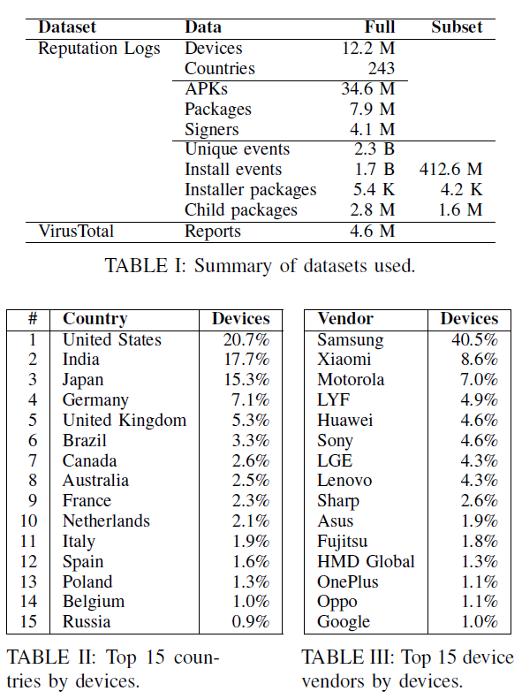
Dataset

Slide 10
VirusTotal (VT)
Commercially available API
Takes a hash of a file (APK in this case)
Returns list of detection labels assigned by a large number of AV engines
VT database limited: offered VT reports for 4.6M APKs out of 34.6M APKs. (APKs can change based on slight modifications)
Not much of an issue because:
All APKs that performed at least one installation were queried
All APKs with a negative reputation score as returned by reputation server

Slide 11
Challenges
Obtaining parent info: Dataset contains package name of parent APK, but not parent APK’s hash
Scan all reputation queries from device for preceding 4 months, extracting those which queried an APK whose package name matches the parent in the install event.
Take most recent query’s APK hash.
Parent info found for only 24% install events. Dealing with lower bounds.
Identifying Platform keys: Look for the 65 package names that are part of the Android OS. Keys in logs that sign at least 10 of these packages should be platform keys since they’re signing system-critical packages.

Slide 12
Installer Categories
12 different categories:
Play Store
Alternative markets (Amazon, etc)
Browsers
Commercial pay per install (PPI)
Backup and restore
Instant messaging
File managers
Bloatware
Package installers (apps that allow installing apks, including androids own installer)
…

Slide 13
Classifying Installers
A tedious, manual task
In many cases descriptions are not known
If lucky, can find in the Play store
Authors scoured through alternative sources such as alternative markets, the internet to find information on installer APKs
Out of 4.2K installers, only 665 installed at least one unwanted app in the dataset.
Authors were able to identify information for 622 (95%)
These 622 included the most prevalent unwanted app installers, so 96% of all install events (with parent info) could be covered.

Slide 14
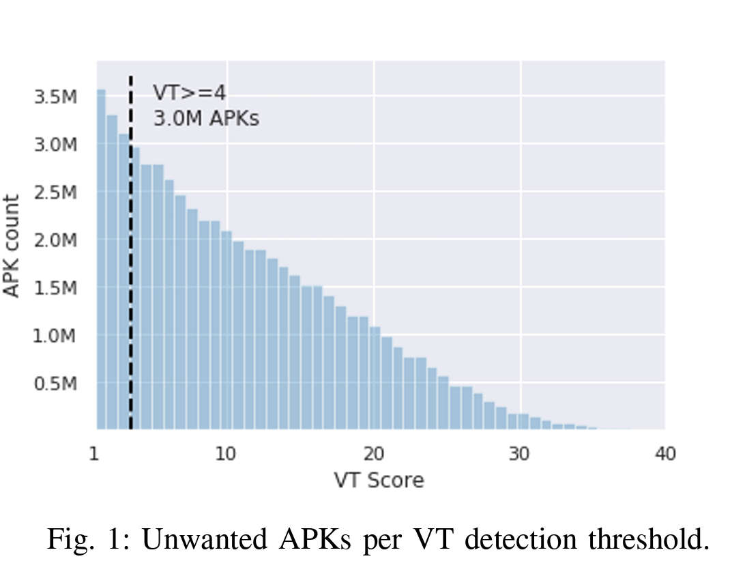
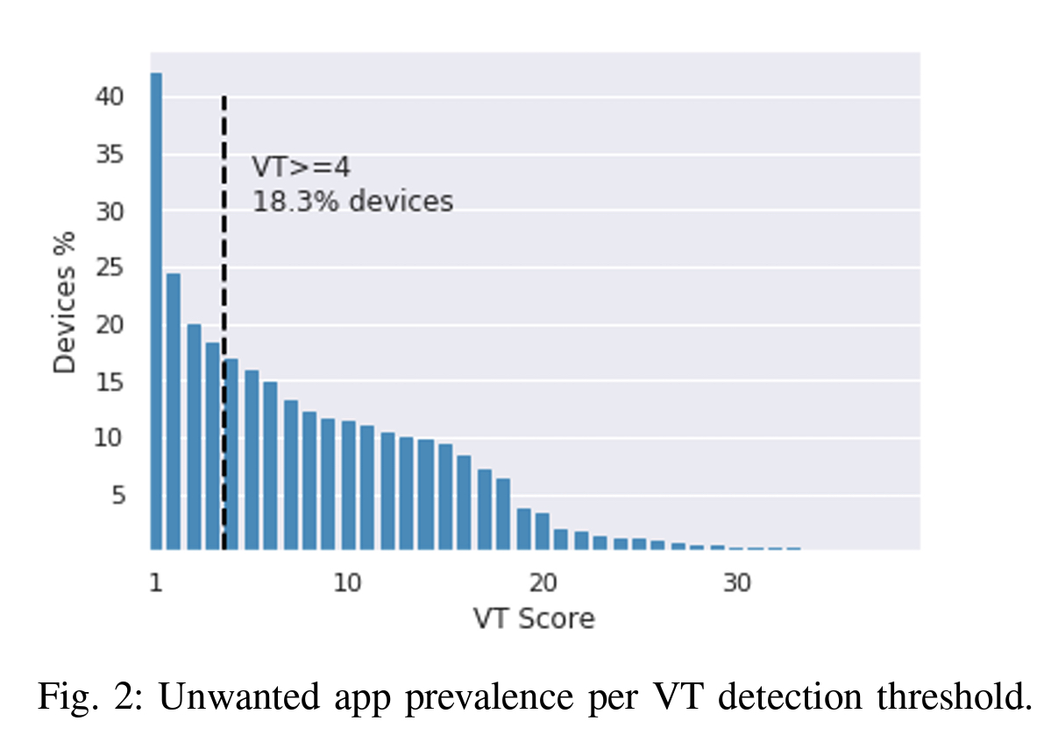
Results

Slide 15
Results
Unwanted app prevalence rates vary depending on the threshold number of AV Engines we want to consider.
Based on previous work, we can conclude that the unwanted app prevalence rate varies between 10% (t=14) and 24.3% (t=2)
Choose t=4 going forward
18% prevalence

Slide 16
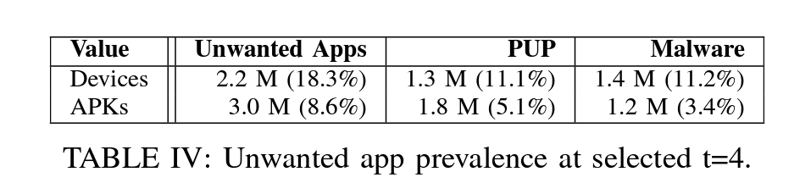
Results

Slide 17
Takeaways – Android vs Windows
Even using the authors’ conservative estimates, malware in Android appears to be more prevalent than Windows machines (~15%)

Slide 18
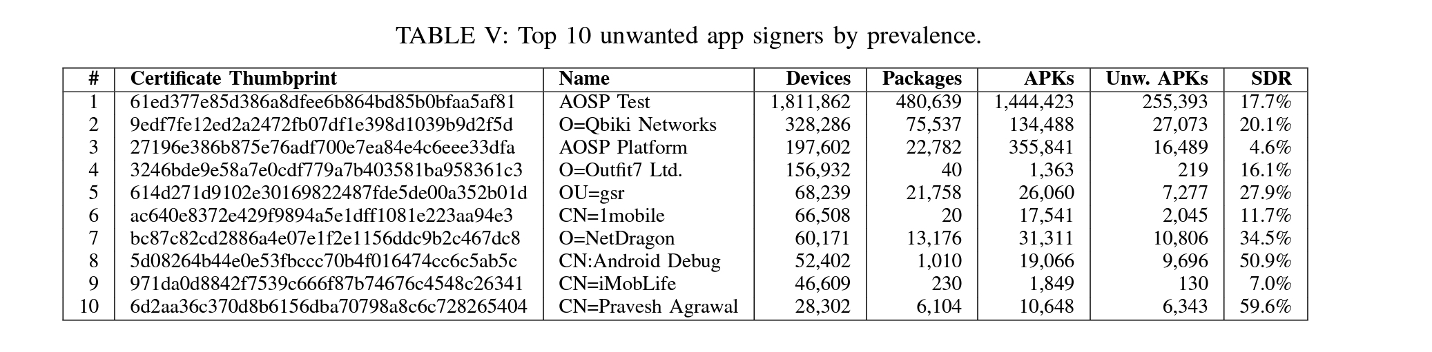
Unwanted App Signers
Signer Detection Ratio: the fraction of unwanted APKs it signs over the total number of APKs it signs
Most signers are honest, those that are not are very dishonest.
86% of the signers have 0% SDR and 13% have 100% SDR, with only 1% in between.

Slide 19
Developer Polymorphism
Problematic developers adopt many different developer names to appear benign

Slide 20
Vector Distribution
Vector Distribution Ratio (VDR): the fraction of unwanted APKs installed using a distribution vector over all APKs installed via that vector.
RVDR is the relative VDR with respect to the Play market, which is set as 1.0

Slide 21
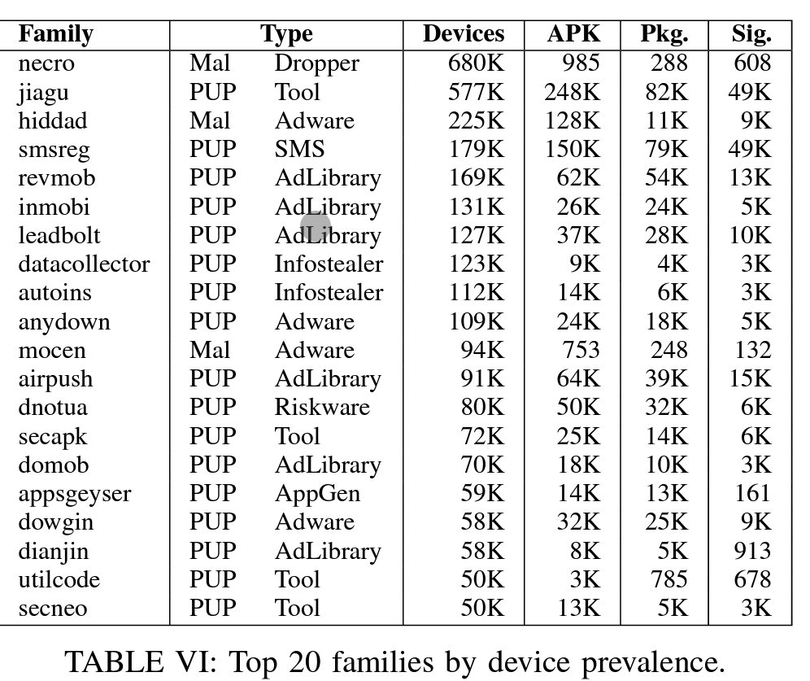
Malware Family Classification
Use AV labels from VirusTotal (VT) report to the AVClass Malware Labeling tool
Outputs malware family name,
Also classifies whether PUP or malware

Slide 22
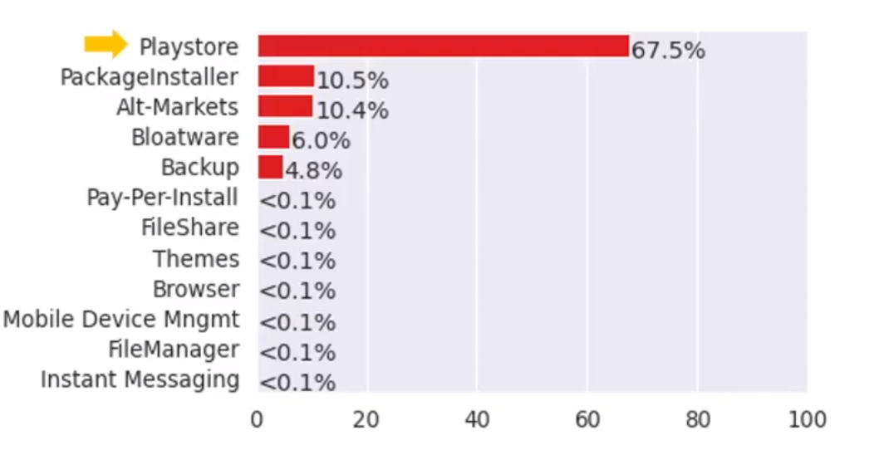
Vector Distribution: Play Store
Biggest Distribution Vector
87% of all installs
67% of unwanted installs
One of the safest vectors:
VDR of only 0.6%
Fourth lowest RVDR
Measures such as rejecting AOSP keys and other internal defenses seem to help

Slide 23
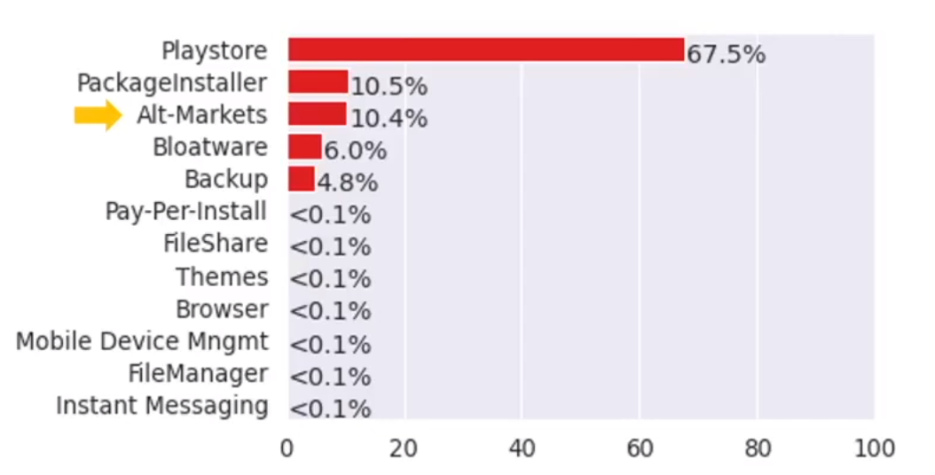
Vector Distribution: Alt Markets
Over 100 alternative markets
Responsible for 5.7% of all installs
10.4% of unwanted installs
Among the worst VDR values (3.2)%

Slide 24
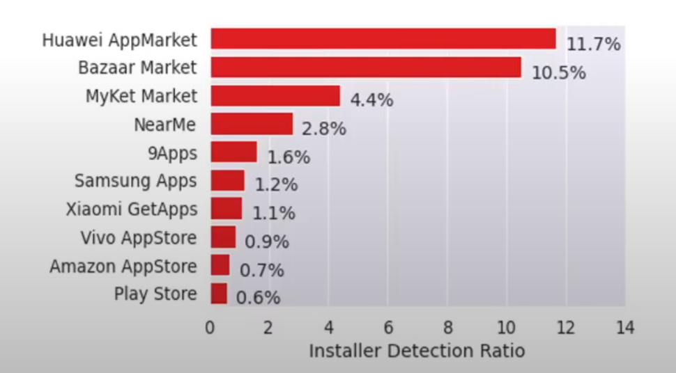
Vector Distribution: Alt Markets
Not all alt markets equally bad

Slide 25
Vector Distribution: Package Installers
Refers to manual APK installs by users
Consciously installing unwanted apps because they think it has some desirable functionality

Slide 26
Vector Distribution: Bloatware
Apps that don’t appear to have much purpose but come preloaded anyway
Most likely arrangements made in the background between phone vendors and advertisers
Cannot usually be removed, only disabled.
Silent installs - Apps that have INSTALL_PACKAGES permission can do silent installs (no user consent needed).

Slide 27
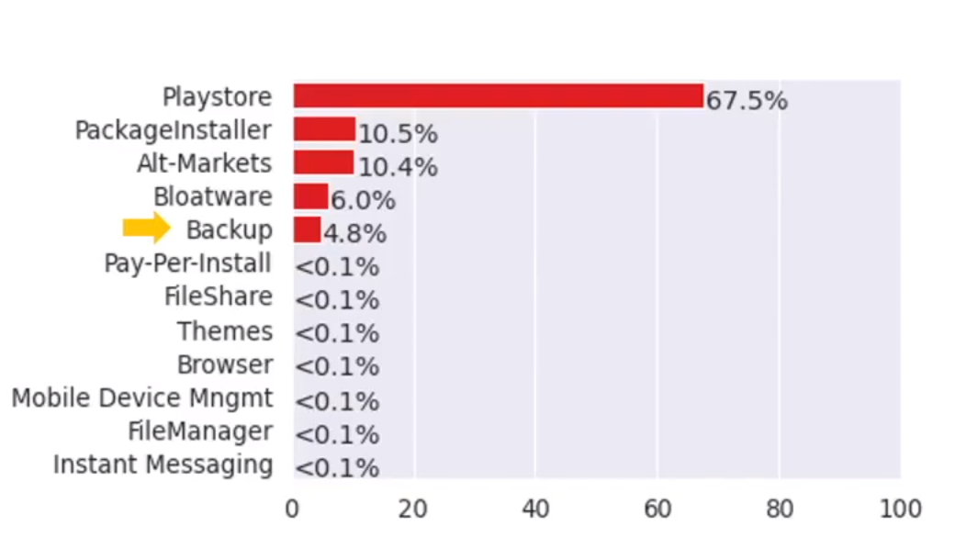
Vector Distribution: Backup and Restore
Phone cloning apps are usually privileged (platform key signed)
Can copy over all previous apps
Including unwanted apps

Slide 28
Vector Distribution: Browser
Contribute to only 0.1% of unwanted installs, but also the most unsafe: VDR of 3.8%

Slide 29
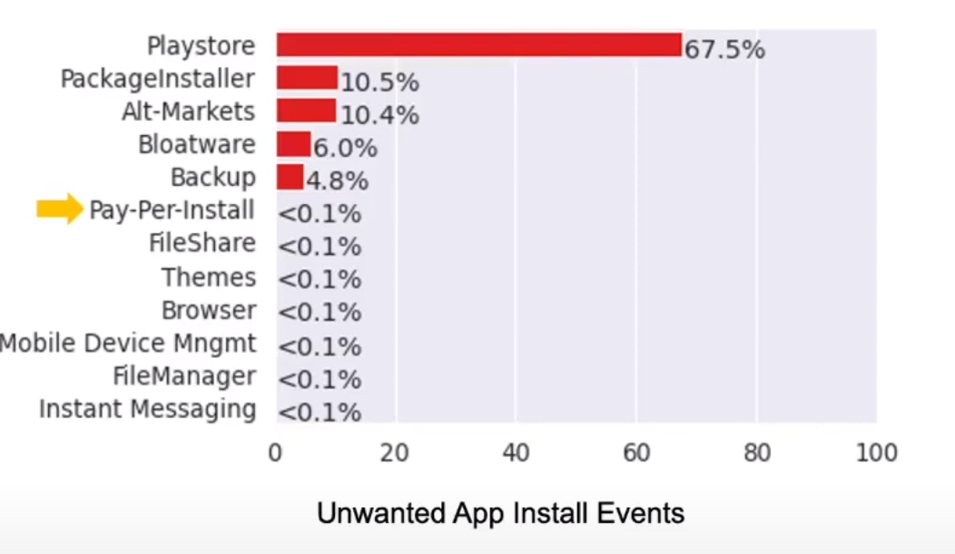
Vector Distribution: Pay per install
Advertiser pays publisher to have program installed on device
Publishers can be:
Owners of popular apps
Device vendors themselves
If the user installs the app, vendor gets money

Slide 30
Vector Distribution: Pay per install
Some popular PPI service apps include IronSource and DigitalTurbine.
Installers related to these PPI services carry their names
Some really popular apps such as Netflix, Snapchat, TikTok use these installers to increase user base

Slide 31
Limitations
Selection Bias:
Dealing with phones that have an AV installed
This means we may be getting a skewed distribution of apps based on this specific type of user who keeps an AV.
Their unwanted app rate might in fact be lower.
Preinstalled app:
Assumption was made when classifying whether preinstalled.
Dataset doesn’t include APK’s installation path.
Strictly speaking, /system/ directory apps are considered preinstalled.
Instead, assume that apps signed by platform keys are preinstalled.

Slide 32
Limitations
Selection Bias:
Dealing with phones that have an AV installed
This means we may be getting a skewed distribution of apps based on this specific type of user who keeps an AV.
Their unwanted app rate might in fact be lower.
Preinstalled app:
Assumption was made when classifying whether preinstalled.
Dataset doesn’t include APK’s installation path.
Strictly speaking, /system/ directory apps are considered preinstalled.
Instead, assume that apps signed by platform keys are preinstalled.

Slide 33
Limitations
Publisher clustering: Publisher can use multiple app signing keys
Using multiple keys leads to a lower publisher detection ratio: unwanted apps may be interspersed between “good” apps
Investigating user consent: Reputation Logs dataset doesn’t directly capture whether consent was taken
Use request of “install_packages” permission to assume it is doing silent installs.
Not all apps requesting this may in fact be doing silent installs
For user-level apps this permission may not even be granted by the user.

