Slide 1
A Comprehensive Study on Deep Learning Bug Characteristics
By: Nathan McBride

Slide 2
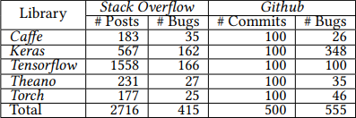
An Overview on the Libraries Used and the study
An overview of the study is that data gathering from both Stack Overflow and GitHub was used to determine issues within deep learning and bugs.
This focused on five different deep learning libraries. This was used to narrow the search and look for recurring characteristics among the libraries.

Slide 3
The Focus of the Research
Bug Type/Root Cause
Bug Impact/Bug Prone Stages
Commonality/Bug Evolution
This asks what type of bugs are more frequent. It also asks what some of the root causes of these bugs may be.
This asks what is the impact of the bugs. It also focuses on which deep learning pipelines are more vulnerable.
This asks what bugs are most common, and how did the bug pattern change overtime.

Slide 4
Classification and the Labelling of Bugs
Classification focuses on three different things. These are:
Bug Types
Root Causes
Effects of the Bug
Labelling the bugs would take on the information based on classification, where there was constant supervision and discussion until agreement for common bug labels.

Slide 5
The Bugs
API Bug: This is caused by issues in the API, and are inherited from it.
Coding Bug: These are caused by coding syntax (this was a large percent). It cannot be fixed by just changing lines of code.
Data Bug: This is caused when input data is not cleaned properly. Both Data/Coding Bugs tend to be flagged by the compiler.
Structural Bug: Caused by mismatch of dimensions, anomalies with test and train sets, use of incorrect data sets, and other structural issues.
Control and Sequence Bug: Wrong if-else or other loop conditions, causing the model to not perform correctly.
Data Flow Bug: Different from the Data Bug, as in it occurs after the data has been fed and an error occurs during the flow.
Initialization Bug: This bug occurs when parameters are not initialized properly.
Logic Bug: These are a bit more complex, but in simple terms occur when there is a wrong choice of algorithms.

Slide 6
Classification of Root Causes
Wrong Documentation: Incorrect information in documents led to issues.
Confusion with Computation Model: Occurs when there is a misunderstanding of the API, using incorrect models for tasks.
API Misuse/Change: Issues with the API itself. Misuse is when it’s used improperly, change is when there’s an issue with compatibility.
Absence of Type Checking: This is usually caused by a mismatch and more often than not causes a crash.
Structure Inefficiency: This usually leads to instability and poor performance instead of outright crashing.
Others: A catch all term for other root causes that may not already be specified.

Slide 7
Bug Types and their Frequencies
Data Bugs – 26%
Structural Logic Bugs – 43% (Caffe)
API Bugs – 11-16% (Torch, Keras, and Tensorflow)
The results indicate issues with data pre-processing. There is potential that this could be addressed with data verification tools.
Other libraries also have Structural Logic Bugs, but they range from 0-27% which is far less than Caffe. This indicates the vast amount of bugs originate from data construction and logical organization from Caffe.
More than 81% of all API bugs come from Keras and Tensorflow alone. This usually happens because one library is updated in a major way that impacts the way the other libraries behave.

Slide 8

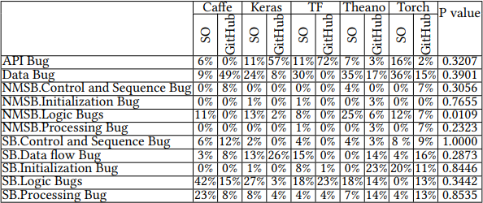
Bug Types and their Frequencies (cont.)

Slide 9
Root Causes and their Frequencies
Incorrect Model Parameters – 24% for all bugs
Structural Inefficiency – 25-37% (Keras, Caffe)
Unaligned Tensor – 28% (Torch)
Incorrect Model Parameters causes crashes at runtime, and does not succeed in execution. This makes up the majority of root causes for bugs.
Structural Inefficiencies tend to not cause crashes, but do result in poor performance. This can result in issues with non-functional requirements or other issues within the program.
Unaligned Tensor can cause issues with the construction of the model. Throughout the other libraries, the amount of root causes can vary from 3-28%.

Slide 10
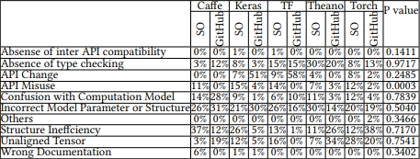
Root Causes and their Frequencies (cont.)
Absence of Type Checking – 30% (Theanos)
API Change – 7%-9% (Tensorflow and Keras)
Since a lot of deep learning libraries are written in Python. Due to this, the absence of type checking is can be a strong root cause for issues within these libraries.
API changes from upgrades/updates or changes in libraries can be a root cause for bugs.

Slide 11
Impacts from Bugs
Crashes – 66% of bugs cause outright crashes.
Bad Performance – 8-31% of bugs cause poor performance.
Incorrect Functionality – 12% of bugs cause unexpected behavior within programs.

Slide 12
Difficult Deep Learning Stages
Data Preparation
Training Stage
Choice of Model
32% of bugs are found in the data preparation stage of the deep learning pipeline. Earlier we discussed issues with data preparation, and this is reflected on the difficulty of this stage.
27% of bugs occur in the training stage. This may not seem expected at first, but keep in mind that bugs from Structural Inefficiency and Incorrect Model Parameters
23% of bugs occur here, this is the part of the pipeline where we are constructing the model and deciding the best algorithm. Several potential issues can arise that cause bugs in this stage.

Slide 13
Commonality of Bugs
There was a lot of study done on what causes these bugs. There is somewhat of a clear answer, and there is some information on how libraries relate to each-other in terms of commonality. Namely, the following “anti-patterns” are to blame :
Continuous Obsolescence, Cut-and-Paste Programming, Dead Code, Golden Hammer, Input Kludge, Mushroom Management, Spaghetti Code

Slide 14
The Evolution of Bugs
Positive growth of Structural Logic Bugs. This does not necessarily indicate that these bugs are becoming more prominent, but are being discussed more on the platforms which the research was conducted.
Decreasing Trend of Data Bugs. This is likely because of the use of tools to help reduce the issues with inputting data into a program.

Slide 15
Conclusion
The focus of this research was to take a look at data gathered from developers and observed their reports as well as findings on the data from these sources. (Stack Overflow, GitHub, etc.)
Different libraries had different issues, where some libraries struggled with bugs other libraries did reflect similar results.
The data clearly indicates which parts of the deep learning pipeline are prone to causing bugs. Out of 7 pipeline steps, 82%~ of the bugs accounted for in this paper were attributed to only three steps.

Slide 16
Questions?
Thank you!

