Slide 1
T-Fuzz: fuzzing by program transformation
Presenter: Yuchen Cai

Slide 2
Background
What is fuzzing ?
Fuzzing is an automated software testing technique that discovers faults by providing randomly-generated inputs to a program
Useful for discovering new bugs/vulnerabilities in software
Dynamic techniques: it must trigger the code that contains the bugs

Slide 3
Background
Fuzzer types
Fuzzers can be divided into two categories:
Generational fuzzers that construct inputs according to some provided format specification
Mutational fuzzers that create inputs by randomly mutating analyst-provided or randomly generated seeds
 | Limitations
Generational Fuzzer | Requiring an input format specification, imposing significant manual effort to create
 | Inapplicable if the format is not availavble

Slide 4
Background
Fuzzer types and limitations
Fuzzers can be divided into two categories:
Generational fuzzers that construct inputs according to some provided format specification
Mutational fuzzers that create inputs by randomly mutating analyst-provided or randomly generated seeds
 | Limitations
Generational Fuzzer | Requiring an input format specification, imposing significant manual effort to create
 | Inapplicable if the format is not availavble
Thus, the most resent work in the field of fuzzing, including this paper, focuses on mutational fuzzing

Slide 5
Background
Fuzzer types and limitations
Mutational Fuzzer | Limitations
 | It highly unlikely for the fuzzers to bypass complex sanity checks in the target program, since they are ignorant of the expected input format.

Slide 6
Background
Fuzzer types and limitations
Mutational Fuzzer | Limitations
 | It highly unlikely for the fuzzers to bypass complex sanity checks in the target program, since they are ignorant of the expected input format.
- This inherent limitation prevents mutation fuzzers from finding “deep” bugs
- Limited by its coverage

Slide 7
Motivation
Existing better input mutation techniques
Coverage guided fuzzers (AFL, honggfuzz) use coverage as feedback from the target program to guide the mutational algorithm
Keep track of interesting inputs that triggered new code path
Focus on mutating the interesting inputs while generating new inputs
However, generating inputs to pass through complex sanity checks remains a well-known challenge
When mutational fuzzers fail to generate inputs to bypass the sanity checks, they become “stuck”

Slide 8
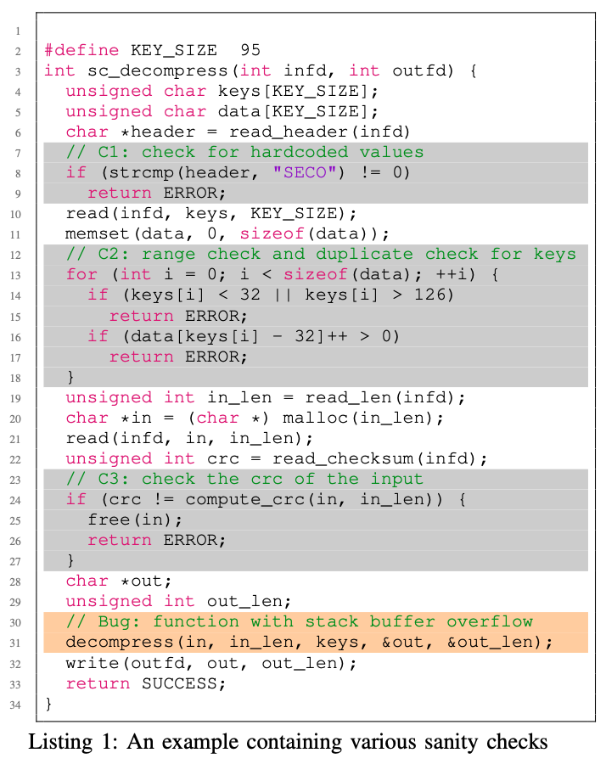
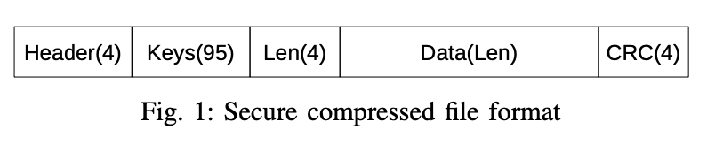
Motivation
Challenges of existing better input mutation techniques
Notes:
Fig1 shows a secure compressed file format: the first four bytes are a file header which contains hardcoded magic values (“SECO”); the Keys field declares 95 unique chars whose ASCII values must be within the range of [32, 126]; the Len field specifies the length of the following compressed data; and finally a 4-byte CRC field to integrity check the compressed data.

Slide 9
Motivation
Challenges of existing better input mutation techniques
Challenges in mutational fuzzer and related techniques:
Without the help of other techniques, it takes a lot of effort for a mutational fuzzer to bypass Check 1
As mutational fuzzers are unaware of the file format, they will struggle to pass Check 2 & 3.
Although symbolic based approaches like Driller can quickly bypass Check 1 & 2, they will fail to pass Check 3 (derived from checksum algorithm; too complex for modern constraint solver)

Slide 10
Motivation
Challenges of existing better input mutation techniques
It is therefore unlikely that the buggy decompress function will be triggered through either mutational fuzzing or symbolic analysis

Slide 11
Motivation
observations
Sanity checks can be divided into two categories: NCC (Non-Critical Check) and CC (Critical Check)
CCs are essential to functionality of the program
NCCs are present in the program logic to filter some orthogonal data (e.g. check magic value)
NCCs can be removed without triggering spurious bugs as they are not intended to prevent bugs
If remove all checks in previous example, then every input will trigger bugs in the decompress function
Bugs found in the transformed program can be reproduced in the original program
Removing CCs may introduce spurious bugs in the transformed program which may not be reproducible in the original program.
These false positive bugs needs to be filtered out during a post-processing phase
Notes:
1) e.g., the check for a magic value in the decompressor example above. CCs are those which are essential to the functionality of the program, e.g., a length check in a TCP packet parser.
2) Assume we remove the three checks in the decompressor above, producing a transformed decompressor. All inputs gener- ated by the fuzzer will be accepted by the transformed decompressor and the buggy decompress function will be
3) In the decompressor above, as the checks are not intended for preventing the stack buffer overflow bug in the decompress function, bugs found in the transformed decompressor are also present in the original decompressor.
4) to ensure that only the bugs present in the original program are reported.

Slide 12
Motivation
takeaways
T-fuzz is designed to improving fuzzing by detecting and removing NCCs in program, instead of necessitating time-consuming and heavyweight program analysis techniques to generate test cases
By removing NCCs in the program, the code paths protected by them will be exposed to the fuzzer generated inputs and potential bugs can be found

Slide 13
Unsolved Problems From Last Time
If NCCs, why they are present in the program?
NCCs are present in the program logic to filter some orthogonal data, e.g. the check for a magic value in the decompressor example above.
NCCs can be removed without triggering spurious bugs as they are not intended to prevent bugs.
How come you know it would not lead to a bug if you remove a NCC?
Will explain how to detect NCCs later…

Slide 14
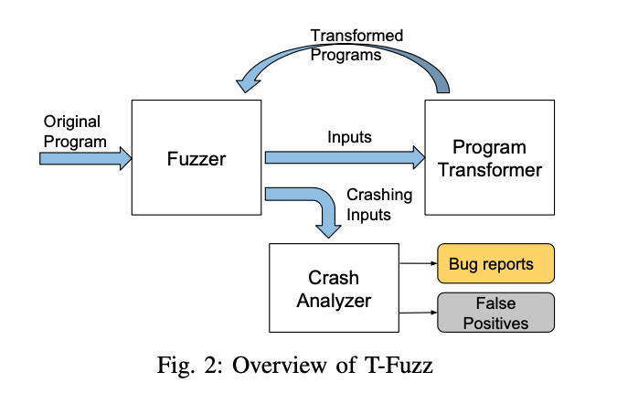
T-fuzz Intuition
Fuzzer: T-fuzz uses an existing coverage guided fuzzer, e.g. AFL, to generate inputs.
Crash Analyzer: For crashing inputs found against the transformed programs, the Crash Analyzer filters false positives
Program Transformer: generate transformed program, when the fuzzer gets stuck
Notes:
1. Fuzzer: T-Fuzz depends on the fuzzer to keep track of the paths taken by all the generated inputs and realtime status information regarding whether it is “stuck”. As output, the fuzzer produces all the generated inputs. Any identified crashing inputs are recorded for further analysis.
2. Program Transformer: Using the inputs generated by the fuzzer, the Program Transformer first traces the program under test to detect the NCC candidates and then transforms copies of the program by removing certain detected NCC candidates.

Slide 15
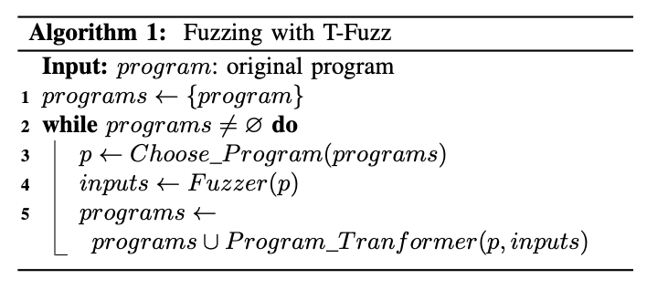
T-fuzz Intuition
T-fuzz iteratively detects and disables NCC that the fuzzer encounters in the target program
Fuzz a program until it is unable to generate inputs that further Improve coverage (before “stuck”)
Using these inputs to detects additional NCCs candidates and generates multiple transformed programs with different NCCs disabled.
All crashes found by the Fuzzer in each iteration are post-processed by the Crash Analyzer to identify false positives

Slide 16
T-Fuzz Design
Detecting NCC Candidates
Use the set of checks that could not be satisfied by any fuzzer-generated inputs when the fuzzer gets stuck
Sanity checks are compiled into conditional jump instructions in the program. In CFG, its block contains two outgoing edges (T or F). Failing to bypass a sanity check means that only T or F edge is ever taken by any fuzzer-generated input
Use all the boundary edges in the CFG as approximation of NCC candidates

Slide 17
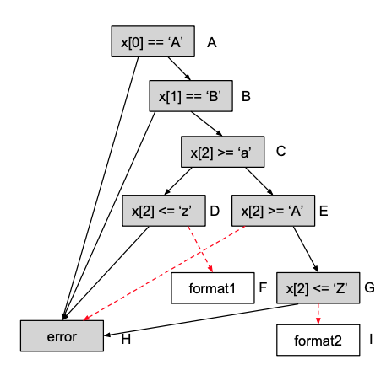
T-Fuzz Design
Detecting NCC Candidates
Use the set of checks that could not be satisfied by any fuzzer-generated inputs when the fuzzer gets stuck
Sanity checks are compiled into conditional jump instructions in the program. In CFG, its block contains two outgoing edges (T or F). Failing to bypass a sanity check means that only T or F edge is ever taken by any fuzzer-generated input
Use all the boundary edges in the CFG as approximation of NCC candidates
Notes:
all inputs in I

Slide 18
T-Fuzz Design
Detecting NCC Candidates
Use the set of checks that could not be satisfied by any fuzzer-generated inputs when the fuzzer gets stuck
Sanity checks are compiled into conditional jump instructions in the program. In CFG, its block contains two outgoing edges (T or F). Failing to bypass a sanity check means that only T or F edge is ever taken by any fuzzer-generated input
Use all the boundary edges in the CFG as approximation of NCC candidates
Use dynamic tracing based approach to get the cumulative edge and node coverage for a set of inputs

Slide 19
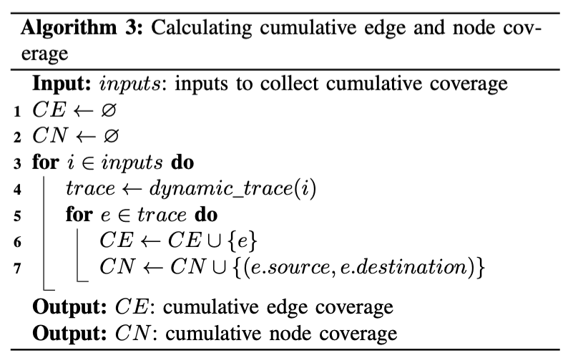
T-Fuzz Design
Detecting NCC Candidates
Use the set of checks that could not be satisfied by any fuzzer-generated inputs when the fuzzer gets stuck
Sanity checks are compiled into conditional jump instructions in the program. In CFG, its block contains two outgoing edges (T or F). Failing to bypass a sanity check means that only T or F edge is ever taken by any fuzzer-generated input
Use all the boundary edges in the CFG as approximation of NCC candidates
Use dynamic tracing based approach to get the cumulative edge and node coverage for a set of inputs

Slide 20
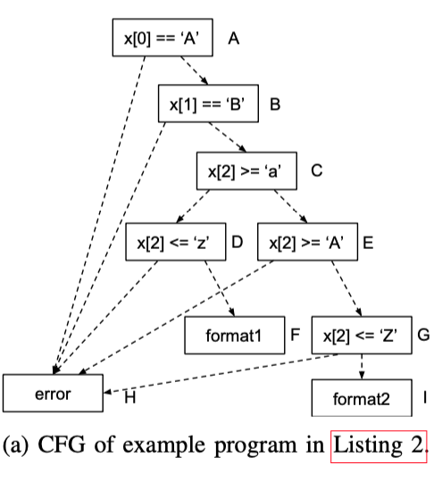
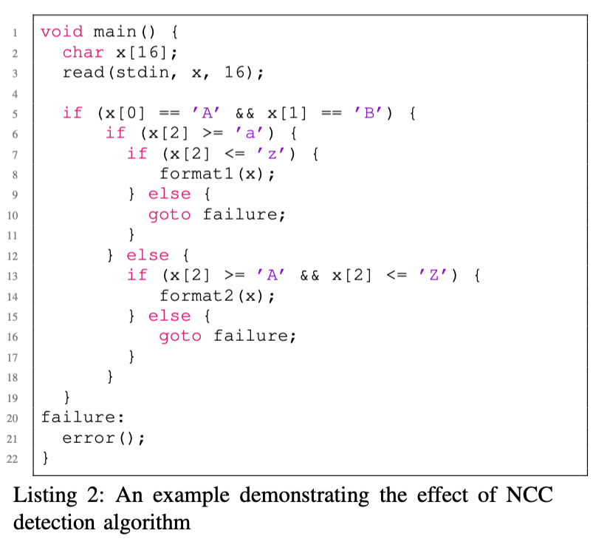
T-Fuzz Design
Detecting NCC Candidates: example
Notes:
1. takes 16 bytes as input and uses the first two bytes as magic values and the third byte to decide whether to use format1 or format2 to process the input.

Slide 21
T-Fuzz Design
Assume the fuzzer component has generated a set of input {“123…”, “A12…”…} without being able to cover format1 or format2 we are interested in.
Running the algorithm we can detect the sanity check that are guarding the invocation of format1 and format2
NCC candidates are {D->F, E->H, G->I}
D->F and G-> I are the sanity checks that preventing the fuzzer generated inputs to cover format1 and format2
Detecting NCC Candidates: example
Notes:
1. takes 16 bytes as input and uses the first two bytes as magic values and the third byte to decide whether to use format1 or format2 to process the input.

Slide 22
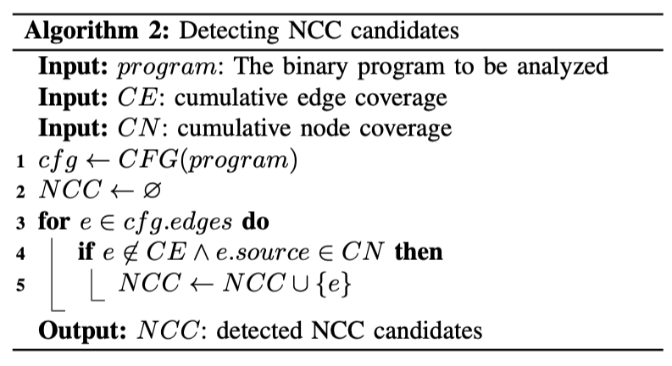
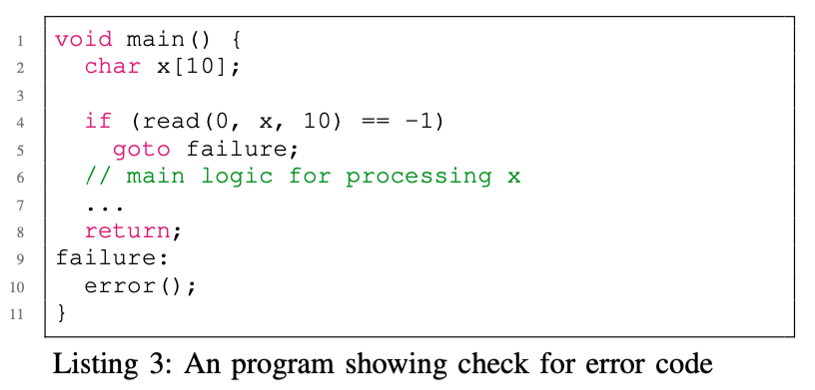
T-Fuzz Design
The NCC candidates detected using the algorithm is an over-approximation and may contain undesired checks
Before feeding NCC candidates from Alg.2 into the Program Transformer, a filtering step prunes undesired candidates that are unlikely to help with bug funding
Pruning Undesired NCC Candidates
Case 1
Pruning any candidates that are not in the desired object (executables, or a specific library)
Case 2
Notes:
Given that the program often terminates with very short code paths after detecting such a severe error, we heuristically use the number of basic blocks following the detected NCC candidate as the length of code paths and define a threshold value to tell an error handling code path. The intuition behind this approach is to focus on NCCs that result in a large amount of increased coverage compared to NCCs that immediately terminate the program under test (due to, e.g., a severe error).

Slide 23
T-Fuzz Design
Program Transformation: remove detected NCCs
Flipping conditions for conditional jumps
Neutral to the length of the binary
Simplicity
T-Fuzz transforms programs by replacing the detected NCC candidates with a negated conditional jump
As the addresses of the basic blocks stay the same in the transformed program, the traces of the transformed program directly map to the original program
Scan all the instructions in the source block of the NCC candidate and overwrite the first conditional jump instruction with its negated counterpart

Slide 24
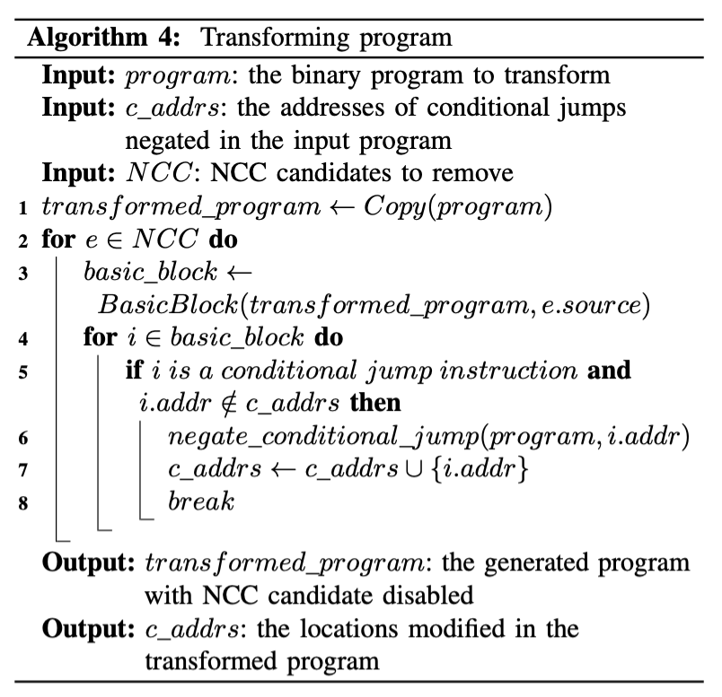
T-Fuzz Design
Program Transformation: remove detected NCCs
Flipping conditions for conditional jumps
Neutral to the length of the binary
Simplicity
T-Fuzz transforms programs by replacing the detected NCC candidates with a negated conditional jump
As the addresses of the basic blocks stay the same in the transformed program, the traces of the transformed program directly map to the original program
Scan all the instructions in the source block of the NCC candidate and overwrite the first conditional jump instruction with its negated counterpart

Slide 25
T-Fuzz Design
Filtering out the False Positives and Reproducing Bugs
As the removed NCC candidates might be meaningful guards in the original program (as opposed to, e.g. magic number check), removing detected NCC edges might introduce new bugs in the transformed program

Slide 26
T-Fuzz Design
Filtering out the False Positives and Reproducing Bugs
As the removed NCC candidates might be meaningful guards in the original program (as opposed to, e.g. magic number check), removing detected NCC edges might introduce new bugs in the transformed program
Consequently, T-Fuzz’s Crash Analyzer verifies that each bug in the transformed program is also present in the original program, thus filtering out false positives. (As it relies on symbolic analysis, it may not work in the presence of “hard” checks. In that case, manual analysis is needed)

Slide 27
T-Fuzz Design
Filtering out the False Positives and Reproducing Bugs
As the removed NCC candidates might be meaningful guards in the original program (as opposed to, e.g. magic number check), removing detected NCC edges might introduce new bugs in the transformed program
Consequently, T-Fuzz’s Crash Analyzer verifies that each bug in the transformed program is also present in the original program, thus filtering out false positives. (As it relies on symbolic analysis, it may not work in the presence of “hard” checks. In that case, manual analysis is needed)
For remaining true positives, an example input that reproduces the bug in the original program is generated

Slide 28
T-Fuzz Design
Filtering out the False Positives and Reproducing Bugs
As the removed NCC candidates might be meaningful guards in the original program (as opposed to, e.g. magic number check), removing detected NCC edges might introduce new bugs in the transformed program
Consequently, T-Fuzz’s Crash Analyzer verifies that each bug in the transformed program is also present in the original program, thus filtering out false positives. (As it relies on symbolic analysis, it may not work in the presence of “hard” checks. In that case, manual analysis is needed)
For remaining true positives, an example input that reproduces the bug in the original program is generated
The Crash Analyzer collects path constraints of the original program by training the program path leading to a crash in the transformed program. If the path constraints are satisfiable, the Crash Analyzer reproduces the bug in the original program by solving the path constraints

Slide 29
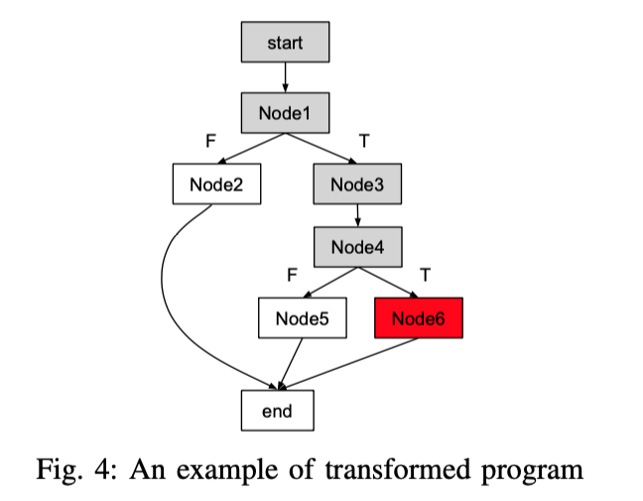
T-Fuzz Design
Filtering out the False Positives and Reproducing Bugs : example
The Crash Analyzer uses a transformation-aware combination of the preconstrained tracing technique and the Path Kneading technique to collect path constraints of the original program by training the program path leading to a crash in the transformed program. If the path constraints are satisfiable, the Crash Analyzer reproduces the bug in the original program by solving the path constraints
When the Crash Analyzer traces the transformed program, it maintains two sets of constraints: one for keeping track of the constraints in the transformed program (denoted as CT ) the other for keeping track of that in the original program (denoted as CO)
Before tracing starts, a crashing input (I) is converted to a preconstraint (PC) and added to CT
While tracing, if the basic block contains a negated jump, the inverted path constraint associated conditional jump is added to CO
When the tracing reaches the crashing instruction in the program, the cause of crash (CC) is encoded to a constraint and also added to CO.
If the path constraints in CO can be satisfied, it means that it is possible to generate an input that will execute the same program path and trigger the same crash in the original program
Notes:
4. For example, if it is an out-of-bound read or write, the operand of the load instruction is used to encode the constraint, if it is a divide by zero crash, the denominator of the div instruction is used to encode the constraint. If the path constraints in CO can be satisfied, it means that it is possible to generate an input that will execute the same program path and trigger the same crash in the original program. Otherwise it is marked as a false positive.

Slide 30
Evaluation
datasets
DARPA CGC dataset
LAVA-M dataset
A set of 4 real-world programs built on wide-spread libraries
implementations
T-Fuzz is implemented in Python based on a set of open source tools:
The Fuzzer component was built on AFL
The Program Transformer was implemented using the angr tracer and radare2
The Crash Analyzer was implemented using angr

Slide 31
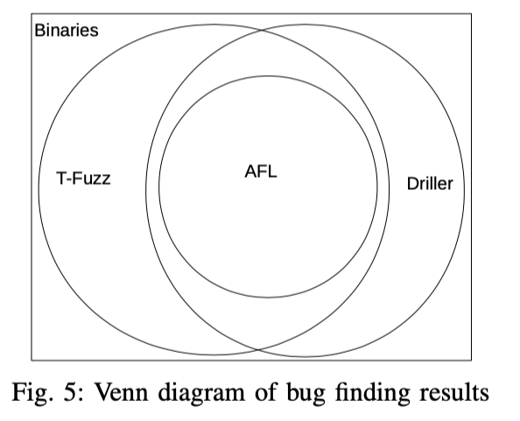
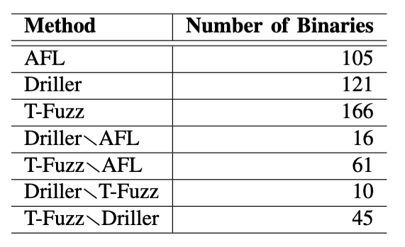
Evaluation
DARPA CGC dataset
DARPA CGC dataset contains a set of vulnerable programs used in the Cyber Grand Challenge event hosted by DARPA (Defense Advanced Research Projects Agency)
248 challenges with 296 binary programs. For each bug in these programs, the dataset contains a set of inputs as a Proof of Vulnerability. These inputs are used as ground truth in the evaluation.
Run T-Fuzz on the same set of binaries. Each binary is fuzzed for 24 hours
Compared to AFL (heuristic based approach), Driller (symbolic execution based approach)

Slide 32
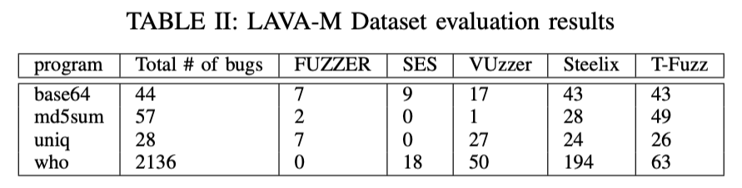
Evaluation
LAVA-M Dataset
The LAVA dataset contains a set of vulnerable programs created by automatically injecting bugs
LAVA-M is a subset of the LAVA dataset consisting of 4 utilities from coreutils, each of which contains multiple injected bugs

Slide 33
Evaluation
LAVA-M Dataset
The LAVA dataset contains a set of vulnerable programs created by automatically injecting bugs
LAVA-M is a subset of the LAVA dataset consisting of 4 utilities from coreutils, each of which contains multiple injected bugs
It is important to note that the bugs mentioned here are bugs that have been confirmed by Crash Analyzer or manually

