Slide 1
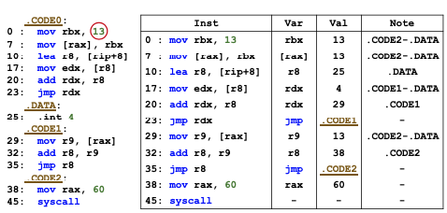
STOCHFUZZ: Sound and Cost-effective Fuzzing of Stripped Binaries by Incremental and Stochastic Rewriting
Presented by: Kunal Mukherjee
Reviewer: Saquib Irtiza
Zhuo Zhang, Wei You, Guanhong Tao, Yousra Aafer, Xuwei Liu, Xiangyu Zhang

Slide 2
Sections
Introduction
Motivating Example
Current Solution-Issue
System
Evaluation
Conclusion

Slide 3
Introduction - I
stripped binaries – application without source code
Current state-of-the-art binary fuzzing solutions
leveraging hardware support: Intel PT to collect runtime traces that can be post-processed to acquire coverage information
- difficult to collect runtime information other than control-flow traces
leveraging on-the-fly dynamic binary rewriting: dynamic rewriting engines such as QEMU and PIN that automatically instrument a subject binary during its execution
- extremely expensive
relying on offline static binary rewriting instruments the binary just once before the whole fuzzing process
– static binary rewriting is an undecidable problem

Slide 4
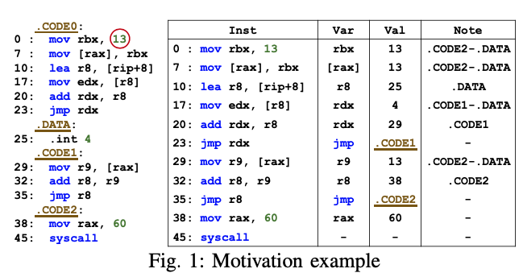
Motivating Example
Issue:
Issue 1: separating code and data (inlined data)
Issue 2: identifying indirect jump and call targets

Slide 5
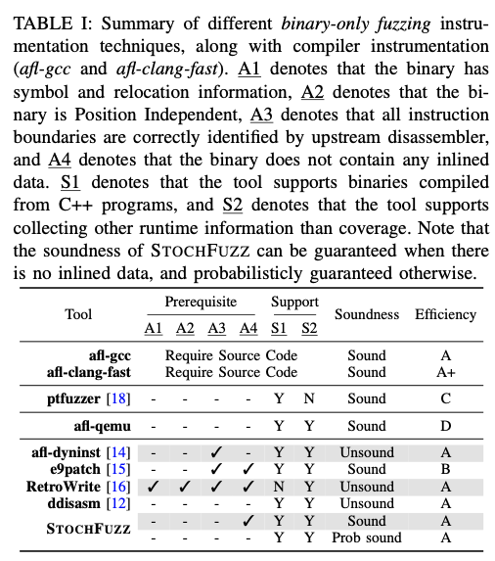
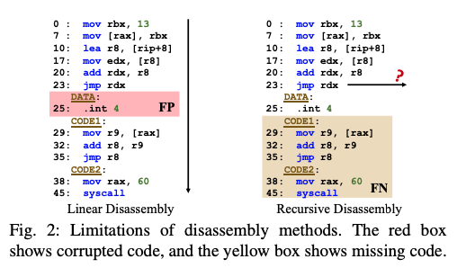
Current Solution-Issue
Current solution issues:
based on heuristics - unsound
restricted assumptions: no inlined data is allowed, relocation information must be available – not satisfied in real world

Slide 6
System
Insights:
enhanced to mutate the program on-the-fly, static rewriting can be incrementally performed over time
fuzzing is a highly repetitive process that provides a large number of opportunities for trial-and-error
Probabilistic Inference Problem: new observations (e.g., indirect call and jump targets) and exposed rewriting errors, it continuously updates probabilities until convergence

Slide 7
System
code sections are filled with a special one-byte hlt instruction
Causes seg fault, intentional crashes
discovered a code region that has not been disassembled or rewritten
randomly generates a rewritten version for each fuzzing run
a byte with a high probability of being code is more likely replaced with hlt
If seg fault then determines if it is caused by a rewriting error (binary-search like debugging technique)
Same input but all uncertainly removed from binary
System Requirement
the rewriting errors are distributed in many random versions such that the fuzzer can make progress in at least some of them
rewriting errors can be automatically located and repaired.

Slide 8
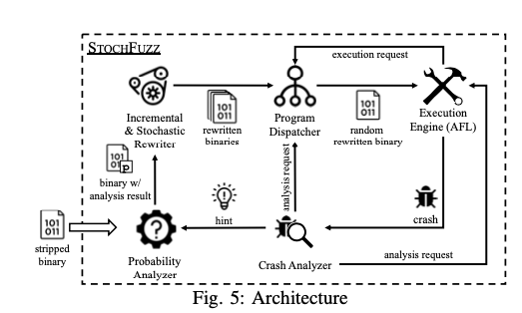
System

Slide 9
System
Work flow 1:
execution engine sends a request to the program dispatcher for a binary. The dispatcher randomly selects a rewritten binary to be executed by the engine
The binary subsequently exits normally without any crash

Slide 10
System
Work flow 2:
Execution terminated by an intentional crash (i.e., a hlt instruction).
The crash is reported to the crash analyzer, which identifies the new code coverage indicated by the crash and analyzes the newly discovered code to collect additional hints for distinguishing data and code.

Slide 11
System
Work flow 3:
the execution is terminated by an unintentional crash (i.e., a crash not caused by hlt)
Program dispatcher to send a binary that has all uncertain rewritings removed for execution
If the previous crash persists, it must be caused by a latent bug in the original program.
Otherwise, the crash is caused by rewriting error.
The crash analyzer further performs delta-debugging to locate the root cause and repairs it
The repair is passed on as a hint to the probability analyzer and triggers probabilities updates and generation of new binaries.

Slide 12
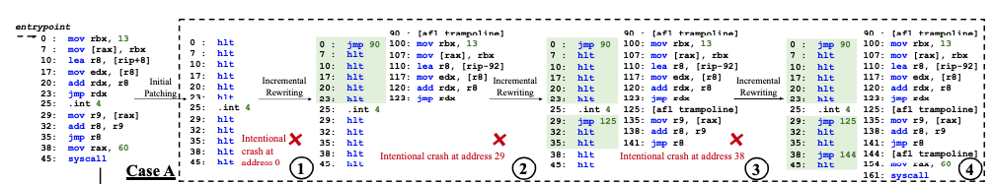
Case A

Slide 13
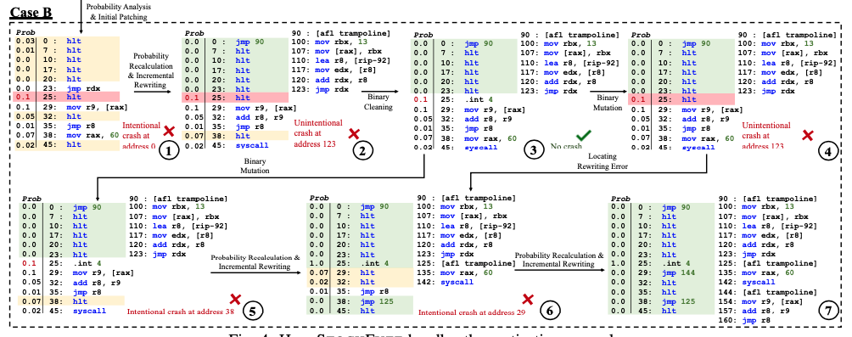
Case B

Slide 14
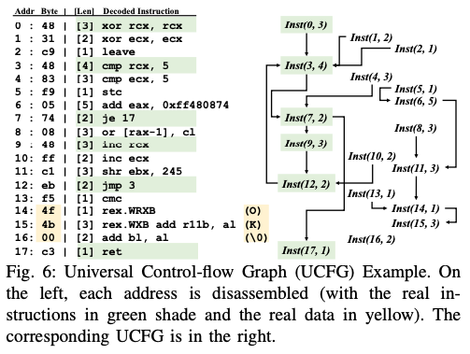
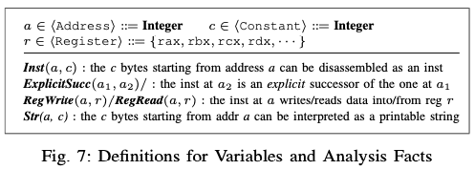
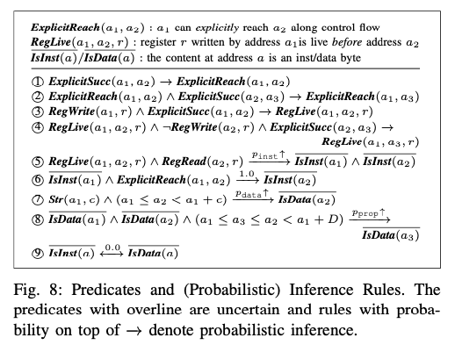
System – Inference Rules

Slide 15
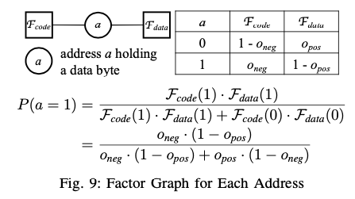
System – Probabilistic Guarantees
the likelihood of rewriting errors (i.e., data bytes are mistakenly replaced with hlt) corrupting coverage information without triggering a crash - 0.05%
likelihood of instruction bytes not being replaced with hlt so that we miss coverage information. (some instructions are invisible to our system and not rewritten) - 0.01%

Slide 16
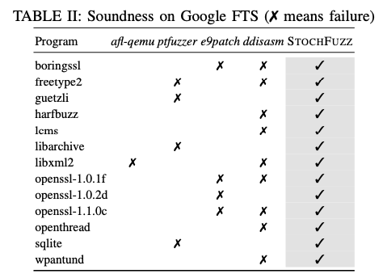
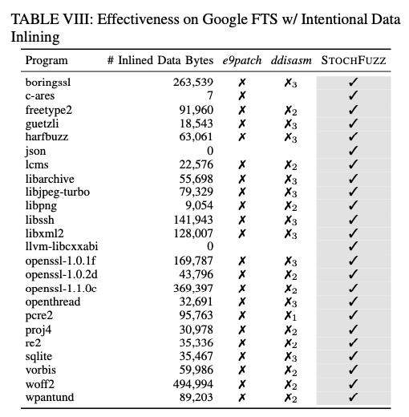
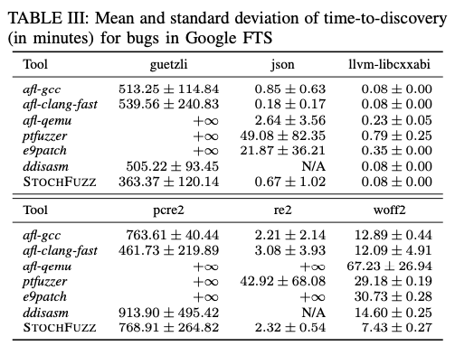
Evaluation
Google FTS

Slide 17
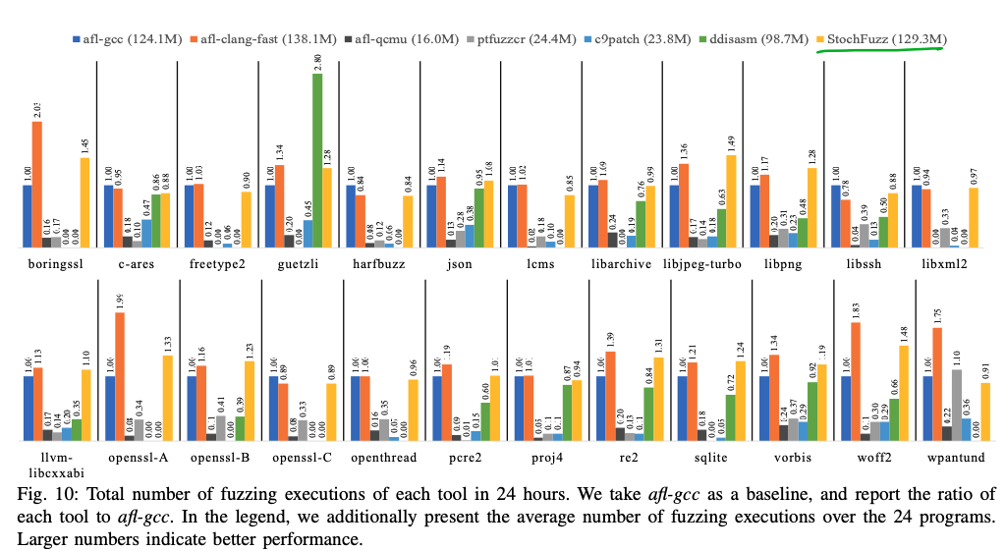
Evaluation

Slide 18
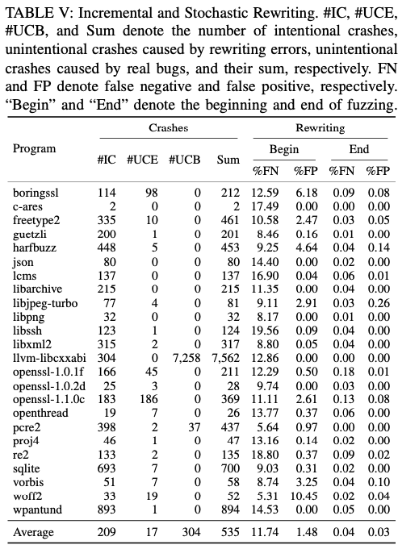
Evaluation
STOCHFUZZ can expose and repair their rewriting errors
study how the numbers of false positives (i.e., a data byte is replaced with hlt) and false negatives (i.e., a code byte is not replaced with hlt) change over the procedure.

Slide 19
Conclusion
new fuzzing technique for stripped binaries
a novel incremental and stochastic rewriting technique
probabilistic guarantees on soundness

Slide 20
THANK YOU

