Slide 1

Trust, But Verify: A Longitudinal Analysis Of Android OEM Compliance and Customization
Presented by: Kunal Mukherjee
Reviewer: Siva Sai Nagender Vasireddy
Andrea Possemato, Simone Aonzo, Davide Balzarotti, Yanick Fratantonio
This Photo by Unknown Author is licensed under CC BY-NC

Slide 2
Sections
Introduction
Background
Dataset
Results
Conclusion

Slide 3
Introduction - I
Android OS - Android Open Source Project (AOSP)
AOSP doesn’t include all component to build a complete system
3rd party vendors or Original Equipment Manufacture (OEM) customize the AOSP base image
Issue 1: security safeguards at risk of overall system
Issue 2: increase attack surface
Issue 3: introduce new vulnerability
Issue 4: compatibility problem and delay in security patches

Slide 4
Introduction - II
Fixes
Compliance:
Android-brand: meet requirement in Compatibility Definition Document (CDD)
requirement categories: must, strongly recommended and recommended
Compatibility Testing Suite (CTS) – automated testing suite, entirely compatible with AOSP
OEM Customization standardization:
Patches can be added without backward compatibility
Vendor Test Suite (VTS) – automate the testing of the hardware abstraction layer and OS
Requirement: Android One, Google software suite
improve the robustness, reliability, and compliance of the Android system
GMS Requirement Test Suite (GTS) - allow the vendor to obtain the Google license for their apps

Slide 5
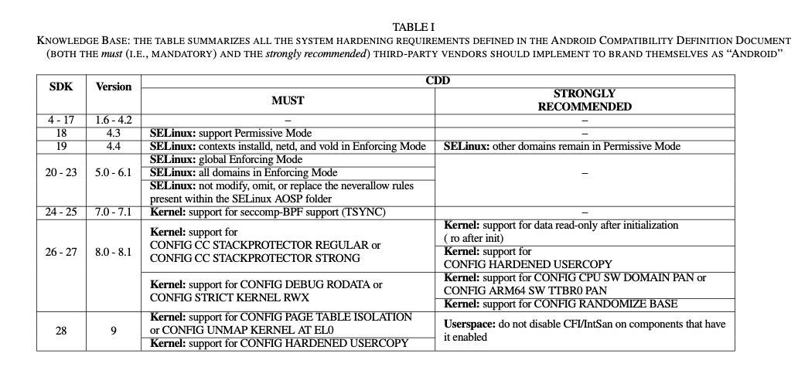
Compliance

Slide 6
Main Study
Longitudinal analysis: longitudinal study, researchers conduct several observations of the same subjects over a period of time, sometimes lasting many years [1]
Focus 1: OEM complies with various regulations imposed on branded Android devices (CDD, CTS, VTS)
Focus 2: whether and how the various OEM customizations affect the security posture of the entire OEM
[1] https://www.iwh.on.ca/what-researchers-mean-by/cross-sectional-vs-longitudinal-studies

Slide 7
climax
579 over 2,907 (∼20%) Android-branded ROM violate at least one “must comply” CDD rule, while 289 (∼10%) do not implement at least one “strongly recommended” suggestion.
29% of ROMs with SELinux modified their policies in a way that bypasses never allow specifications of the main AOSP SELinux policy: “commented out” never allow SELinux policies to compile their customized version of the policies.

Slide 8
Background
ROM component
Binary and libraries (ELF)
security hardening techniques, new functionality binaries or libraries, security posture of new binaries compared to native AOSP binaries
SELinux policies
Mandatory Access control system, follows the principle of least privilege: if no rule grants a capability C to a context X, then X does not have access to that capability.
Look at all the customization to the base SELinux policy
Init scripts
specify the user/group the binary should be run with, the Linux capabilities that should be granted, and the SELinux context the program should be run with
Fatal security consequences of improper customizations
Kernel security configuration
Extract all kernel config options, to identify the ROMs that violated several CDD “must” requirements.

Slide 9
Dataset
Source: base image: https://developers.google.com/android/images
Custom ROMS: firmwarefile.com, stockrom.net
2907 Android ROMs : 42 vendors, 1403 different device models
Android system : 2.3.3 – 9
SDK : 10 -28
All GMS certified from Google

Slide 10
Results - kernel configuration
7.9% (190 out of 2,396) of the kernels (from 10 different vendors) violate the CDD for their specific Android version since they do not implement one or more mandatory security requirement.
150 kernels has absence of kernel memory protections aimed at marking sensitive memory regions and sections read-only or non-executable
10% (241 out of 2,396) of the kernels (from 10 vendors) do not implement one or more strongly recommended features

Slide 11
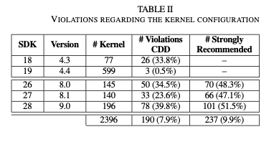
Results - kernel configuration

Slide 12
Results – SELinux Compliance
The CDD mandates that third- party vendors must support SELinux in Permissive Mode
violations related to Permissive Mode by inspecting the SELinux policy available in the ROM
vendors that manipulated the base policy provided in AOSP to overcome the restrictions imposed by the neverallow rules
Out of the 2,907 ROMs, identified 1,090 of them not containing a SELinux policy
1,817 ROMs that define a SELinux policy. Out of them, 7% (108 ROMs) violate the CDD specification for their corresponding Android version as they still define one or more permissive domains
Out of 1,533 ROMs with a SELinux policy (and that target Android ≥ 5), identified that 29% of them (443) violated the CDD by defining one or more rules violating one of them default neverallow rules

Slide 13
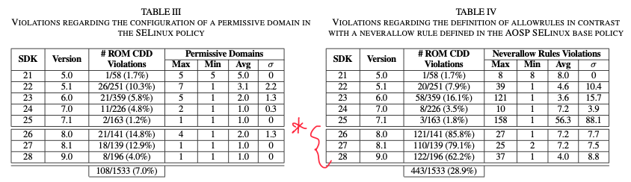
Results – SELinux Compliance

Slide 14
Results – Binary Compliance
Control Flow Integrity (CFI) and Integer Overflow Sanitization (IntSan)
introduced in the CDD from Android 9
considered the 196 ROMs with SDK ≥ 28
85 (43.37 %) contained at least one binary that disabled CFI
104 (53.06 %) contained at least one that disabled IntSan.
six unique vendors lowered the security of a binary
violating the CDD recommendation.
the vendors disabled CFI for 38.7% (σ = 36.5) of the binaries
disabled IntSan for 35.8% (σ = 34.9) of them

Slide 15
Results – Additional Customization
New Functions in System Libraries
Compile-time Hardening
Stack Canaries
No eXecute (NX)
Position Independent Executables (PIE)
Full Relocation Read-Only (Full RELRO)
Fortify Source
the use of setuid/setgid binaries

Slide 16
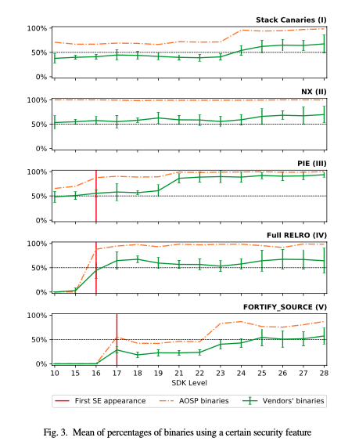
Results – Additional Customization
All graphs clearly show that the new binaries added by the vendors consistently use fewer mitigation techniques than the binaries in AOSP.
319/447 (71%) of the ROMs with SDK < 18 and 371/2453 (15%) of the ROMs with SDK≥18 contain atleast one setuid executable

Slide 17
Results – SELinux Customization
rules that modify a pre-existing rule to extend the permissions and operations allowed on a given resource
rules that modify an exiting core policy domain but just by extending it to support new resources introduced by the vendor
rules that are completely new and that operate on domains and resources that are not present in the original AOSP policy.
443/1,533 (∼29%) violate the SELinux policies requirements.

Slide 18
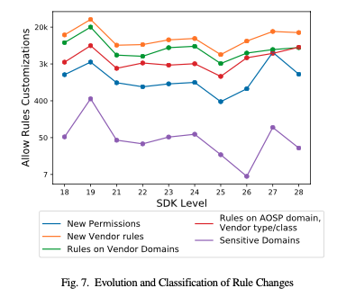
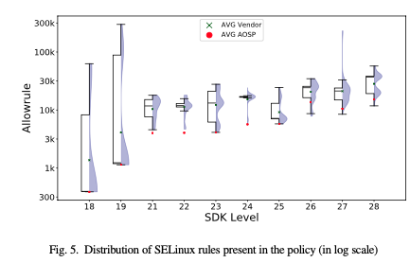
Results – SELinux Customization

Slide 19
Conclusion
current set of regulations and checks is clearly insufficient
The result casts some shadow on the effectiveness of the ROM certification process
Vendor customizing their ROMs in ways that go against many well-established security practices and principles
testing and verification procedure, which is fundamentally based on trust since the tests are executed by the vendors themselves, is not effective at catching problems and it is very often violated

Slide 20
THANK YOU

