Slide 1

Really Simple Membership
Native Mobile Wallet Passes & Membership Management
Ditch plastic cards. Launch in minutes.

Slide 2
The Value Proposition
Traditional Credentials
Really Simple Solution
High Overhead
Printing and shipping physical plastic cards is expensive and slow.
Low Member Adoption
Members forget their plastic cards and dislike downloading custom apps.
Stale & Static Info
Physical cards cannot reflect live tier upgrades or dynamic details.
Native Mobile Passes
Deliver digital cards directly into native Apple Wallet and Google Wallet.
Zero Install Friction
Members scan a QR code or tap a link to instantly add their pass.
Real-Time OTA Sync
Changes push instantly over the air to all member devices in one click.

Slide 3
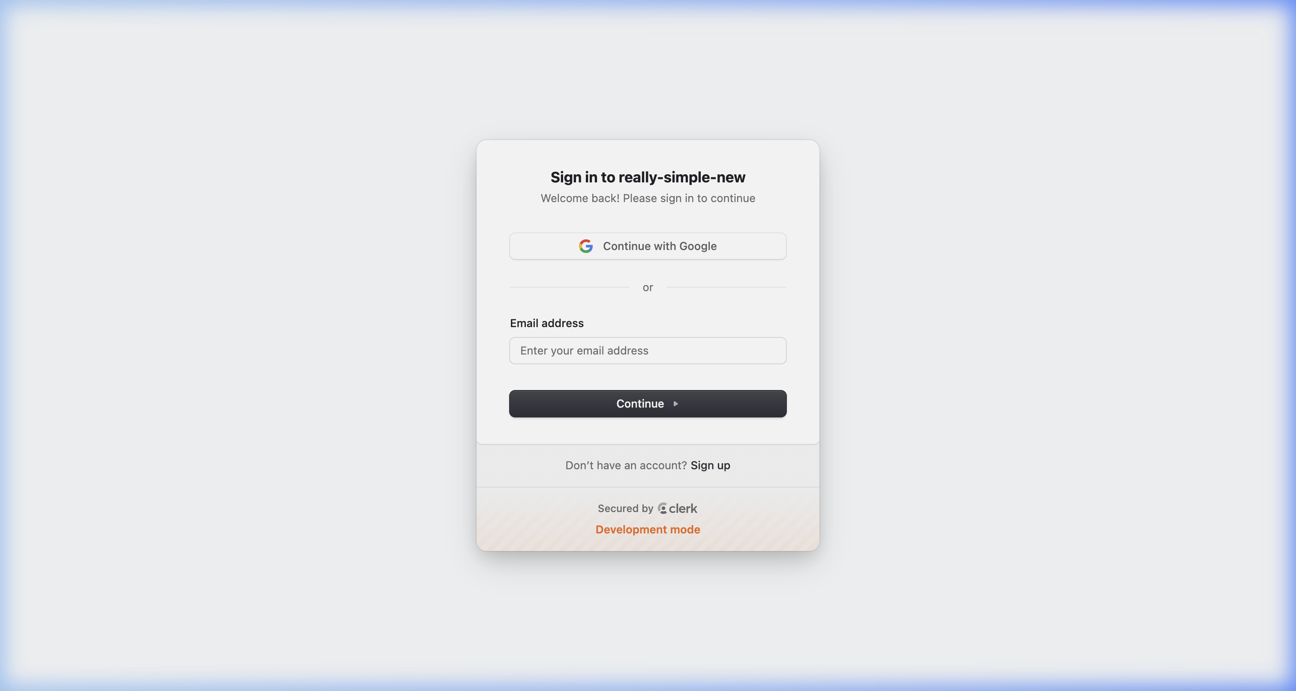
Admin Panel Setup
Get Started in Minutes
Zero Coding Required
Our admin dashboard lets you customize layouts, fields, and logo branding visually.
Centralized Management
Manage all clubs, active tiers, and integration settings in one unified workspace.
Instant Distribution
Launch templates immediately and start registering members in real time.
Figure 1: Unified setup dashboard for club administrators.

Slide 4
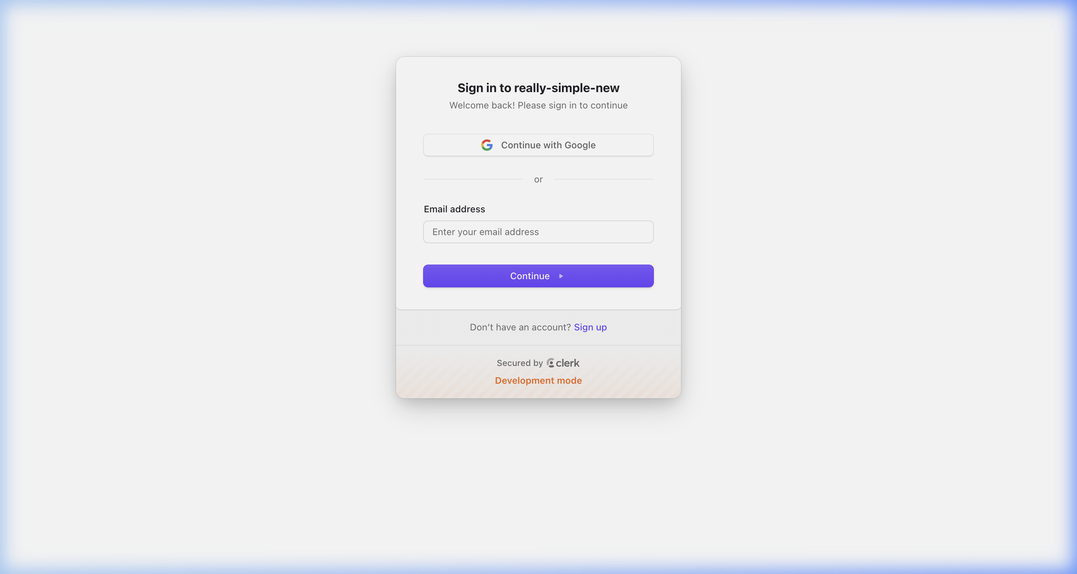
Members Dashboard & Features
Frictionless Member Experience
Self-Service Portal
Members access active tier, renewal date, and terms via a simple personal link.
One-Tap Wallet Save
Instant buttons to save cards directly to native iOS Apple Wallet or Google Wallet.
Automatic Synchronization
Pass updates dynamically reflect tier upgrades, loyalty points, or validity changes.
Figure 2: Dubai Sharks club membership details page.

Slide 5
The Power of Templates
Brand Consistency
Rapid Deployment
Centralized Updates
Enforce visual branding across all active cohorts, events, or membership tiers with pre-built layouts that keep assets aligned.
Define fields, text tags, and layout styles once. Instantiate new member cards instantly from a master design template.
Modify template-level layouts, labels, or colors in the admin panel to instantly update all active passes on member phones.

Slide 6
Bulk Upload & Onboarding
Designed for Any Scale
1. Upload CSV Spreadsheet
Import columns like name, email, tier, and member numbers.
1-Click CSV Upload
Import thousands of member records at once using simple spreadsheet files.
Manual Creation
Quickly register walk-ins, temporary guests, or VIPs via the clean admin panel.
Automated Onboarding
The system immediately triggers welcome emails with wallet activation links.
2. Auto-Generate Passes
The platform generates unique Apple Wallet and Google Wallet credentials.
3. Deliver & Onboard
Members receive an email notification with a 1-click 'Add to Wallet' link.

Slide 7

Card Generation & Custom Styling
Pixel-Perfect Brand Customization
Flexible Asset Uploads
Upload high-quality custom logos, icons, and hero strip images.
Harmonious Color Control
Define background and text colors to match your club's design system.
Dynamic Labels & Value Fields
Map custom database fields to display specific details on the card face.
Back-of-Card Details
Place terms and conditions, contact details, and links on the back.
Figure 3: Custom strip assets for pass generation.

Slide 8
Native Wallet Integration
Apple Wallet (.pkpass)
Google Wallet & Google Pay
Native Compatibility
Works instantly on all iOS and watchOS devices. No app store downloads.
Geofenced Lockscreen Alerts
Automatically shows pass when members approach the venue coordinates.
Silent Push Updates
Dynamic fields sync in background over Apple Push Notifications (APNs).
One-Click Save Flow
Simple 'Save to Google Pay' button for instant Android device integration.
Direct Push Notifications
Updates trigger native Android notifications with live detail summaries.
Highly Secure Platform
Leverages the robust Google Pay Wallet API for secure pass delivery.

Slide 9
OTA Upgrades & Live Verification
Over-the-Air (OTA) Upgrades
Live Scanner Verification
Real-Time Tier Upgrades
Upgrade members from Gold to VIP in the dashboard—their pass updates instantly.
Expiry & Status Changes
Lapsed memberships instantly show 'Expired' or 'Revoked' badges on devices.
Zero Friction Delivery
Pushes updates silently in the background without requiring pass re-installation.
Secure Barcode Displays
Unique barcodes and QR codes rendered dynamically on member passes.
Door-Side Check-in App
Scan passes at the venue door using webcams, smartphones, or dedicated scanners.
Instant Validation Checks
Verify live database status, active expiration date, and entry permissions.

Slide 10
Simplify Your Membership Management
A digital-first, frictionless platform built for modern clubs.
90%
100%
Reduction in card issuance and administrative overhead
Mobile delivery—no physical cards to print, lose, or replace
Start today at reallysimpleapp.com

