Slide 1
3DMIP-MRIQA
David Zhang

Slide 2

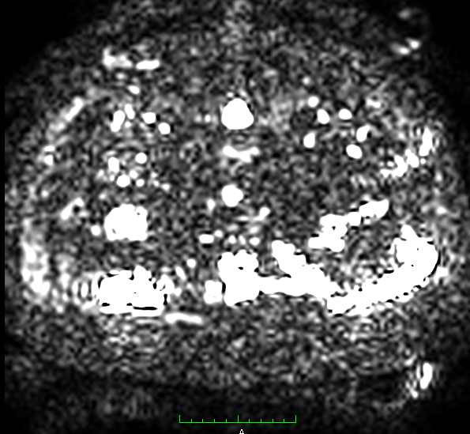
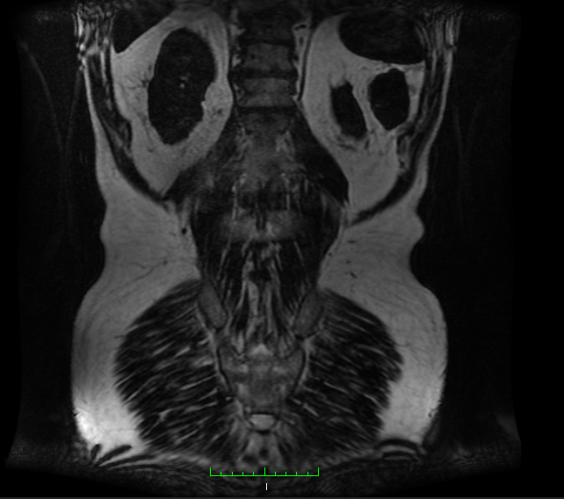
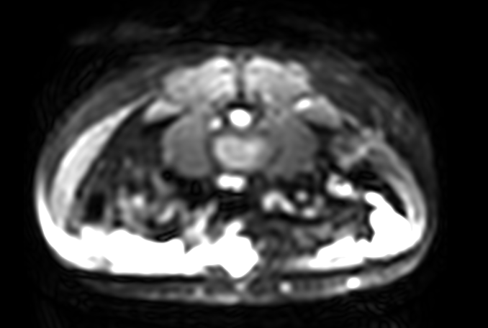
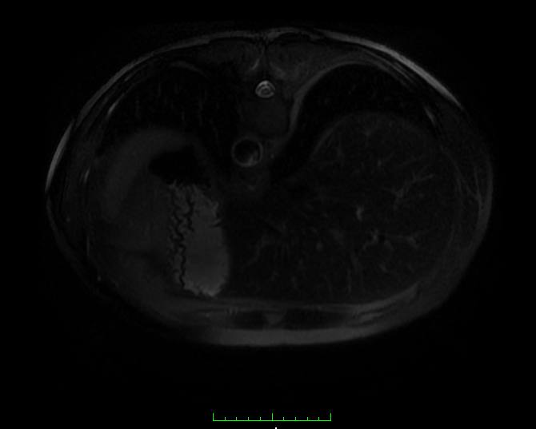
Background
The radiologists are exposed to a huge amount of MRI images each day, only a small part of them can help them make further diagnostic. Most of the MRI datasets are noisy and blurry, we want to create a tool for them to automatically filter out bad MRI datasets and fast select the best MRI datasets using relevant image processing. We can also use MRI with good quality for other tasks e.g. specific organ detection as well as automatic diagnostic.

Slide 3
Background
Goal for our tool
high resolution
small slice distance
many slices
wide contrast range
high sharpness.

Slide 4

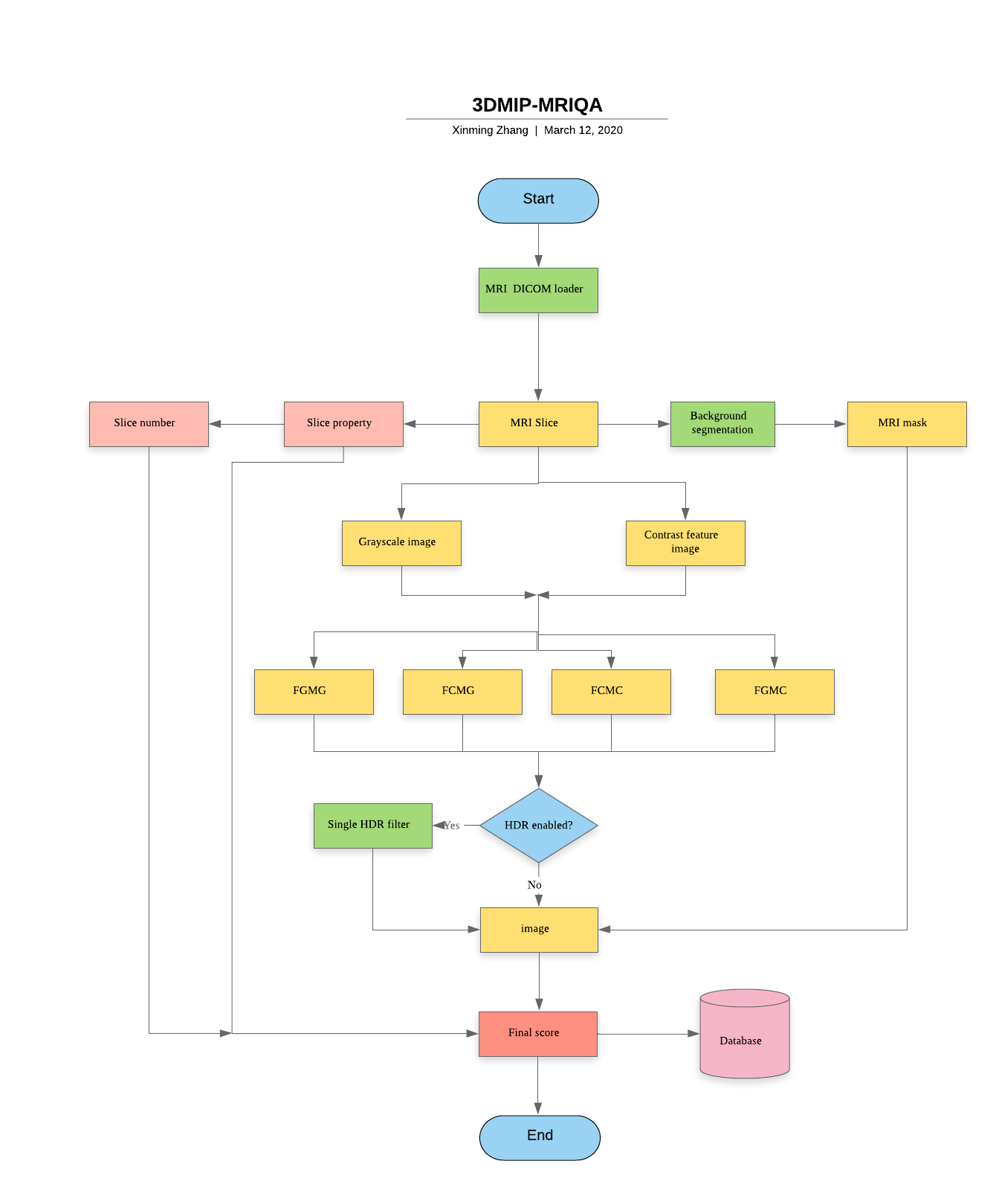
Solution
Background foreground separation of MRI images using Anisotropic Diffusion Filtering Thresholding
Standardized quality metric system for structural brain magnetic resonance images in multi-centering neuroimaging
Slice property by ration of slice thickness by slice distance
Mapping slice number to sigmoid space
Generation of HDR Illumination from a single image for the enhancement of undesirably illuminated images

Slide 5
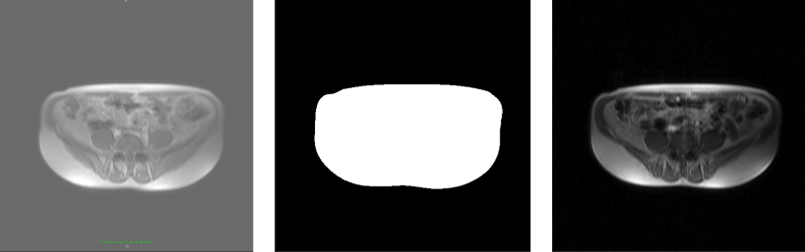
Background foreground separation
Used Nonlinear Anisotropic Diffusion Filtering followed by hysteresis thresholding to achieve the desired result. For hysteresis thresholding all we need is High and Low thresholding value. High thresholding value : mean of image after perform Nonlinear Anisotropic Diffusion Filtering Low thresholding value : std of image after perform Nonlinear Anisotropic Diffusion Filtering

Slide 6
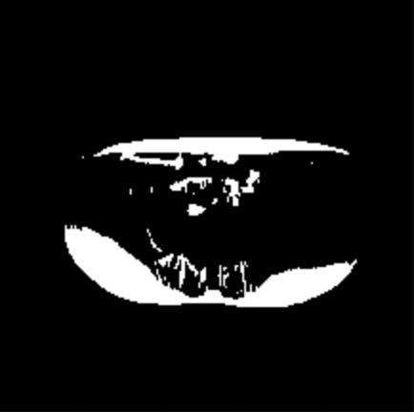
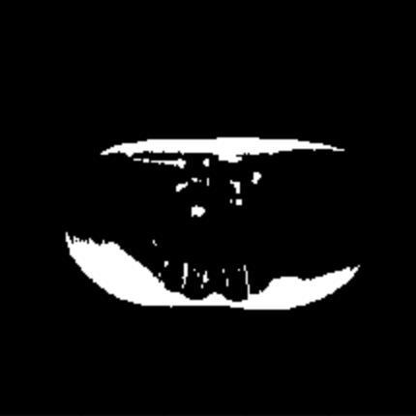
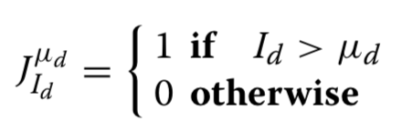
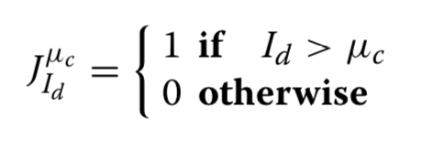
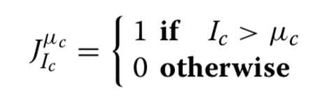
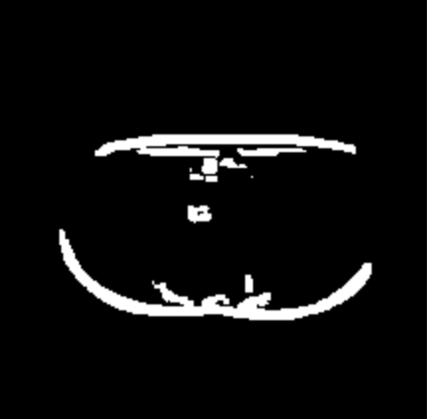

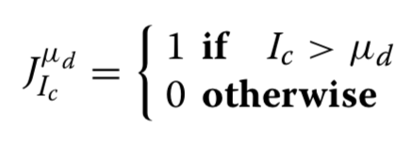
MRI quality metric system
Grayscale image & contrast feature image
a) First grayscale moment grayscale binary image
b) First contrast moment grayscale binary image
c) First contrast moment contrast binary image
d) First grayscale moment contrast binary image
a
b
c
d

Slide 7
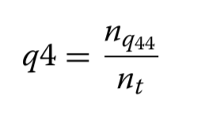
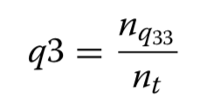
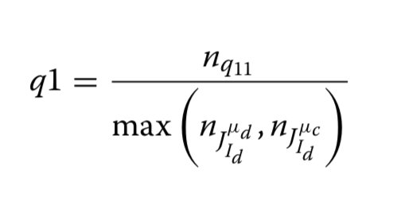
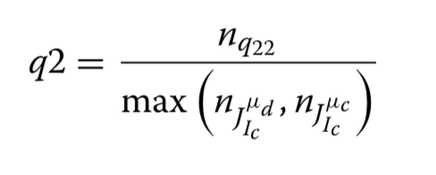
Image quality score
Luminance contrast quality score, q1
Texture quality score, q2
Texture contrast quality score, q3
Lightness quality score, q4
Total = w1 * q1 + w2 * q2 + w3 * q3 + w4 * q4

Slide 8
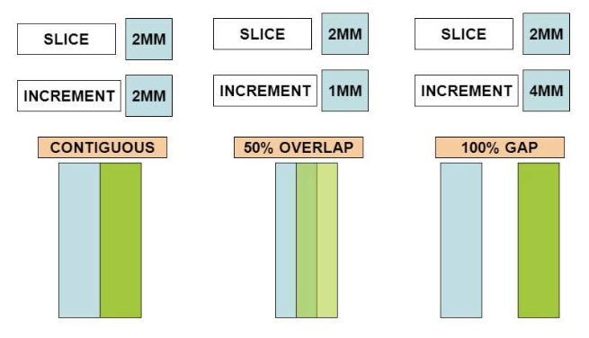
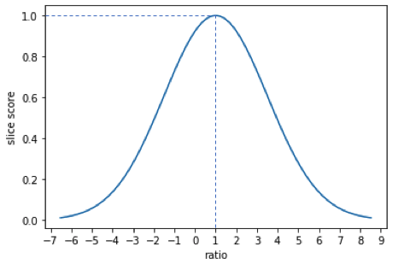
Slice property
Slice thickness and slice increment
When the ratio gets 1, the score becomes maximum

Slide 9
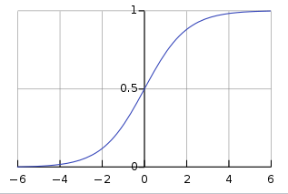

Number property
All dataset slices in the range of [3, 1216]
$S\left(x\right)= \frac{1}{1+e^{−x}} −0.5$

Slide 10
Current result
Need to be verified
 | 0.0 | 0.147 | 0.058 | 0.602

Slide 11
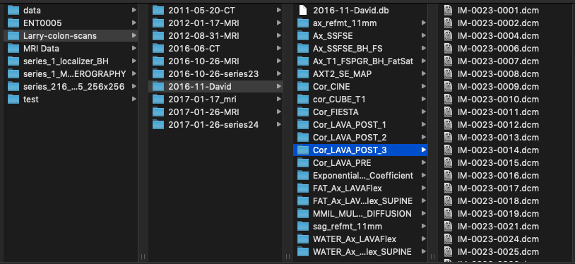
Integrated tool
Dataset input

Slide 12
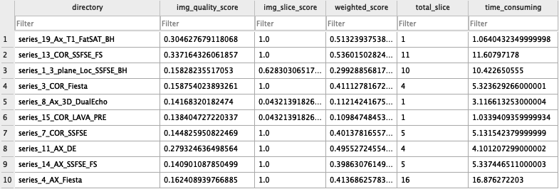
Integrated tool
Portable database file

Slide 13

Thanks

