Slide 1
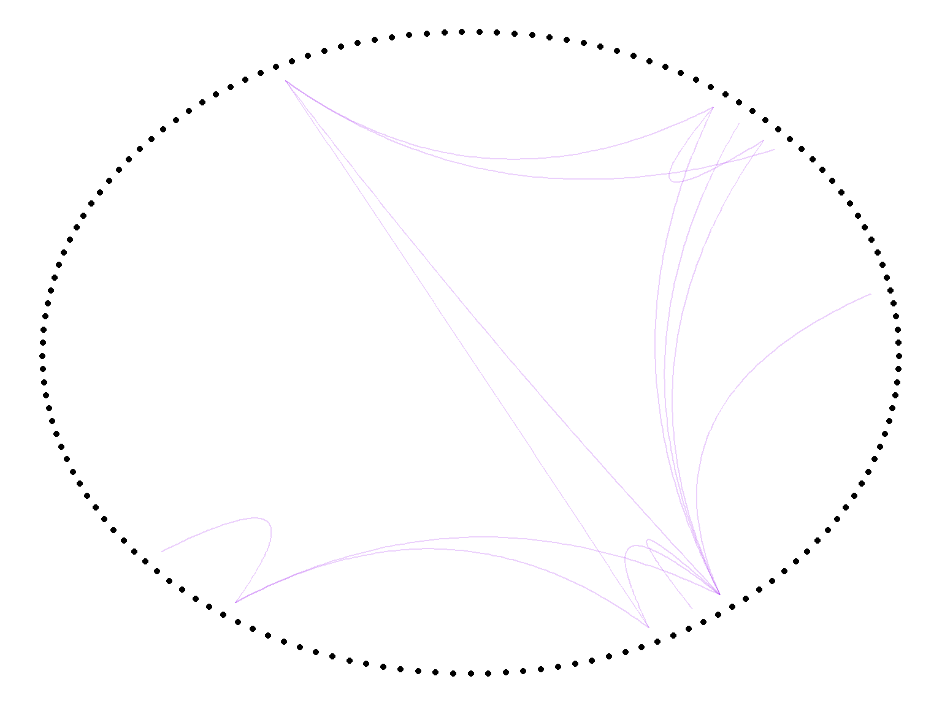
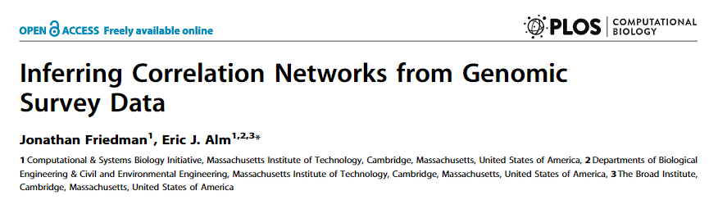
SparCC
developed by Friedman and Alm
Species-species correlation network
inferred from the gut microbiome data of a twin-cohort

