Slide 1
Fantasy Everything
COMP 307 Fall 2015
David, Grady, and Valerie

Slide 2
Project Description
Fantasy football format, applied to anything and everything.
Users can set up custom leagues with scoring systems.
Admin & regular users
  The league admin verifies events.
Examples of leagues: elections, award shows, supreme court decisions, celebrity death pools, etc.

Slide 3
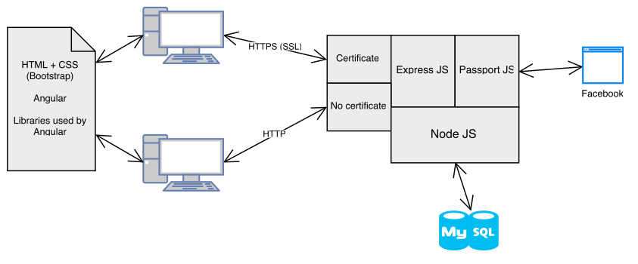
Architecture

Slide 4
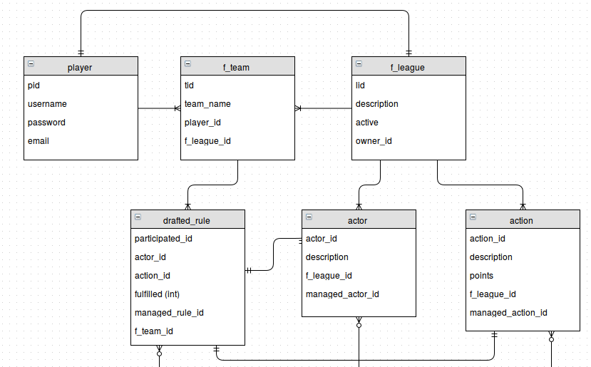
Data Model

Slide 5
Technologies Used
Front end
HTML5 + CSS
Bootstrap
Angular.js
Back end
Node.js (Express.js)
MySQL
Security
  SSL
  Passport.js
  Sessions

Slide 6
Experiences
MySQL + Node.js + Angular.js was weird and didn’t have much help online - use MongoDB (noSQL).
IDEs are nice.
Javascript is weakly typed and thus frustrating to debug (especially on backend, with node.js) - mostly used log messages.
Frameworks do a lot of work, but they can be conflicting by design.
  Exe: Passport conflicted with Express for the cookie sessions.

Slide 7
Demo
US Presidential Elections
Notes:
- Create an account
- Join league for Presidents
- Show how to select stuff, general tour
- Log in as David, admin for Presidential election
- Show how to approve

