Slide 1
Open Ground Speed Sensor
A forensic reconstruction of one night of testing: what broke, what we fixed, and how accurate it really is
Objective: turn an iPhone (camera + torch + LiDAR + IMU + GPS) on a cart or car into an optical ground-speed and distance sensor, like a commercial Correvit, with a Kalman filter running on the phone.
MHacks 2026 · team repository davidzonavirus/kalman-hackathon-26 (app: David · Kalman filter: Joseph · dashboard: Sean)
Independent re-analysis of all 58 recorded runs, rebuilt from code, logs and git history · every number traceable to analysis/out/final_metrics.json
Notes:
Team roles from README.md. Analysis code: analysis/ (run_all.py).

Slide 2
WHAT WE BUILT
An iPhone looking at the floor, fused by a 4-state Kalman filter
Camera
Phase correlation
Shift → velocity
Kalman filter
Distance
1280×720 @ 240 fps, torch, exposure ≤ 1/1000 s; 256² centre crop → 128²
image shift (px/frame) + quality PSR (peak-to-sidelobe ratio)
v = shift·2·h / (f·Δt); h from LiDAR, f from lens FOV; gyro de-rotation
x = [vₓ, v_y, bₓ, b_y]; IMU 100 Hz predict; flow, GPS speed, zero-velocity updates
∫|v̄|dt: 0.05 m/s deadband, 0.5 s low-pass, lead term
Where error can enter the measurement
• Scale (multiplies everything): camera height h and focal length f. A 1 mm error in h at 19 cm = 0.5 % in speed and distance.
• Image noise: per-frame shift jitter, weighted in the filter by 1/PSR²; frames with PSR < 8 are dropped.
• Tracking failures: blur, window wrap, lock onto the sensor's fixed pattern → speed reads low or zero.
• Integration: deadband and smoothing change how speed becomes distance.
What counts as truth in this archive
Cart: taped 16 ft (4.877 m) and 20 ft (6.096 m) courses → distance truth only, no speed-vs-time truth.
Car: phone GPS Doppler speed at 1 Hz → an independent but noisy speed reference, no distance truth.
Neither is a calibrated reference (no wheel encoder, no RTK). Every accuracy number in this deck inherits that limitation.
Source: README.md, docs/HACKATHON_WRITEUP.md §2, docs/KALMAN_INTEGRATION.md, SensorFusionEngine.swift, FlowConverter.swift
2
Notes:
Pipeline as found in the code, not assumed. Velocity is primary; distance is integrated from the filtered velocity.

Slide 3
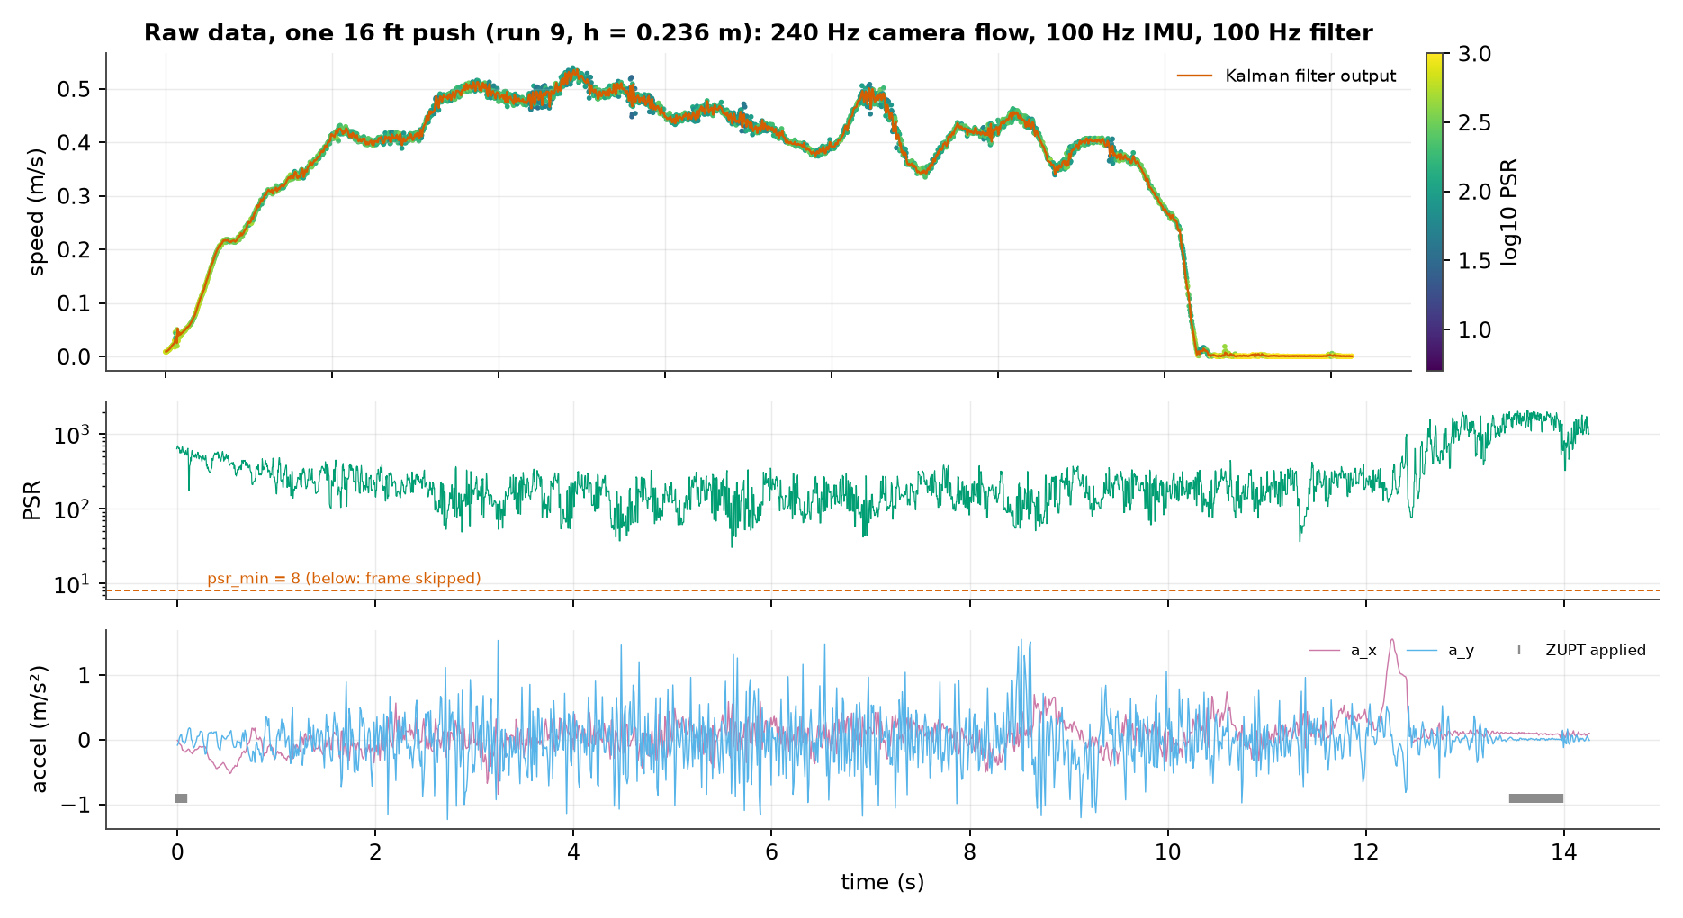
THE DATA
58 runs, 4 sensor streams, and clean timestamps
Stream (file) | Rate | Content
flow.csv | 240 Hz (60–120 early) | camera vₓ, v_y (m/s), PSR, h
imu.csv | 100 Hz | accel (gravity removed), gyro
gnss.csv | ~1 Hz | speed, speed accuracy, course
est.csv | 100 Hz | filter v, σ, distance, status
events.csv | — | start/stop, ZUPT, calibrate…
lidar/*.csv | ~30 Hz, 1.5 s | 36 height measurements
• Archive: 58 phone runs, 36 LiDAR logs, 21 dashboard sessions, 21 iOS crash/resource reports.
• Health: 0 NaN, 0 infinite values, 0 backwards timestamps; 1 duplicate flow and 3 duplicate GPS timestamps (dropped).
• Replay check: our Python port of the filter reproduces the phone's own est.csv on all 53 runs from 20:06 on (median max |Δv| 2e-6 m/s, worst 0.015 m/s), so we analyse exactly what ran.
• Gaps: camera pauses of 2.1 s during in-run height measurements; a 0.84 s camera interruption in the final car run.
Source: analysis/out/inventory_runs.csv, data_health.json, figures/story_raw_push.png
3

Slide 4
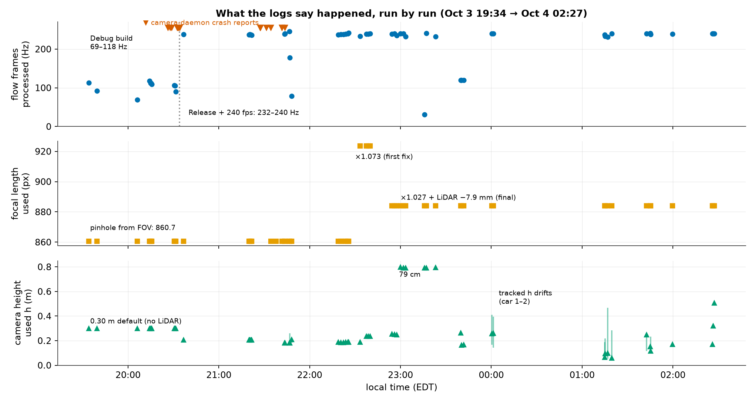
CHRONOLOGY
One code commit for the whole night: the run logs tell the story
• 19:34–20:31 Debug build: 60–120 frames/s processed; h stuck at the 0.30 m default.
• 20:26–21:43 14 camera-daemon crash reports, all after LiDAR height measurements.
• 22:22–22:25 16 ft pushes read +7 % → focal length ×1.073 at 22:37, then ×1.027 plus a −7.9 mm LiDAR offset from 22:54.
• 22:59–00:01 79 cm mount and varying-ride-height experiments (both failed, see slide 9).
• 01:14–01:59 three car drives; the image-expansion height tracker drifts in drives 1–2 and is switched off for drive 3.
• 02:26–02:27 three short pushes at 0.17, 0.32 and 0.51 m with no GPS fix and no recorded course length (last runs).
Source: meta.json (focal_px, mount_height_m), flow.csv rates, ios_diagnostics/ file times; git log (5 commits)
4
Notes:
Git history: a9e3712 initial, 379dcfd 19:41 (whole project), aa0d32a 02:12 (all fixes), ef48eaa 02:25 (data + write-up). Intermediate builds are only visible through what they logged.

Slide 5
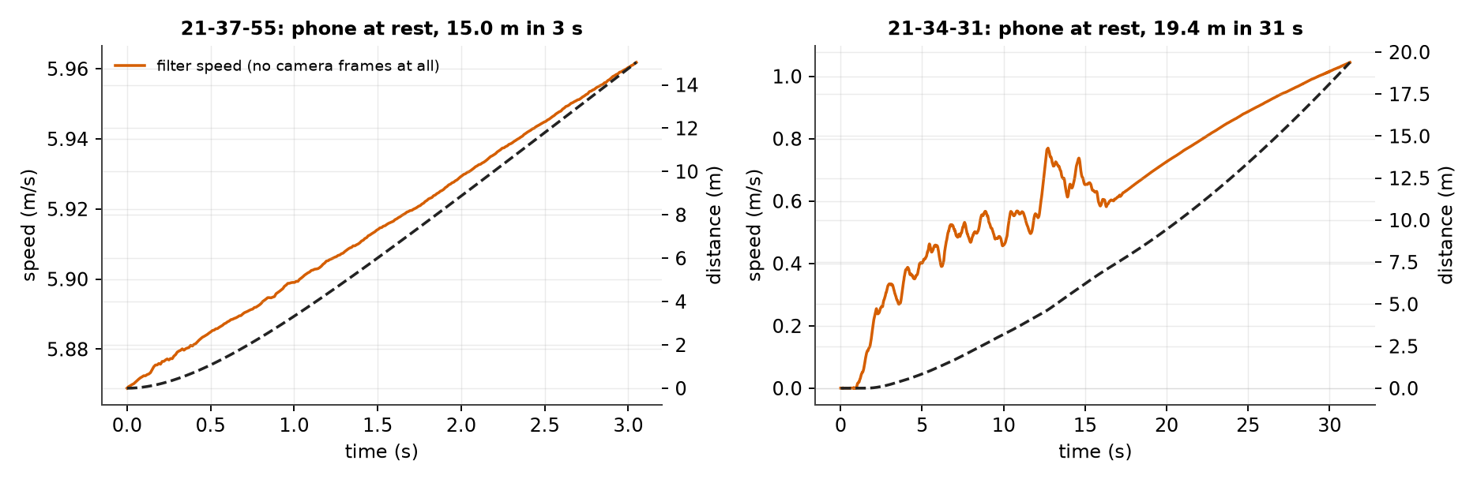
PROBLEM → FIX #1
Problem 1: the camera died after every height measurement, and the IMU kept 'driving'
15.0 m
14
in 3 s with the phone at rest (21:37)
camera-daemon crash reports, 20:26–21:43
CONFIRMED
crash logs + zero flow frames
• Symptom: no flow frames at all; IMU-only velocity integrates accelerometer bias: 19.4 m in 31 s, 15.0 m in 3 s.
• Root cause (from crash logs): LiDAR leaves the camera in a 30 fps mode; asking for 240 fps straight afterwards aborted iOS's camera service.
• Fix: restart at 30 fps and step up to 240; watchdog restarts the camera after 1.5 s without flow; after 2 s without flow any still IMU moment forces v = 0.
• Verified: the next two in-run height measurements (21:46, 21:48) show a 2.1 s camera gap, then flow resumes; those runs end at 0.07 m and 0.00 m at rest. No crash reports in the archive after 21:43.
Source: story_metrics.json; runs 2026-10-03_21-37-55, 21-34-31, 21-46-55, 21-48-05; ios_diagnostics/cameracaptured-*.ips; writeup §3.6
5

Slide 6
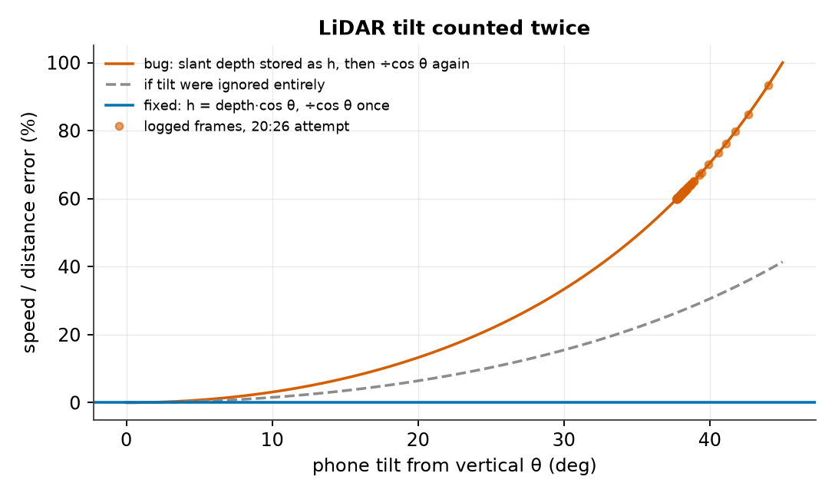
PROBLEM → FIX #2
Problem 2: camera tilt was counted twice, inflating speed by 61 % at 38°
CONFIRMED
code diff + logged LiDAR frames
• Evidence in code: commit 379dcfd uses the centre depth directly as h (no cos θ); FlowConverter divides h by cos θ for tilt. Commit aa0d32a multiplies depth by cos θ once.
• Evidence in data: the 20:26 attempt logs depth 0.132 m at 38° tilt → vertical h 0.104 m. Under the bug, speed reads 1/cos²θ = +61 % high.
• Fix: convert depth to vertical height once; reject readings with > 8 % frame spread, non-metric depth, or h outside 5 cm–2 m; log every frame.
• Limit: no recorded run used a buggy LiDAR height (all runs before 20:36 used the 0.30 m default), so there is no before/after distance for this one. The size of the bug comes from geometry plus the logged frames.
Source: git diff 379dcfd..aa0d32a DepthSource.swift; data/lidar/2026-10-03_20-26-19.csv; story_metrics.json
6
Notes:
The 19:41 code stored the LiDAR depth along the optical axis as the height; FlowConverter then divided by cos θ again. Error factor 1/cos²θ.

Slide 7
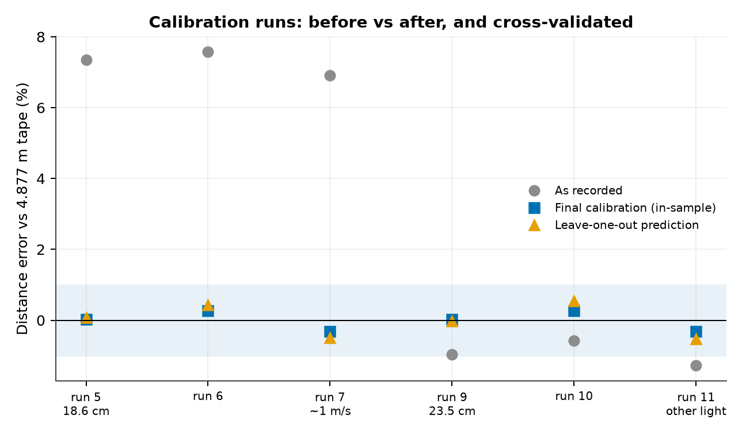
PROBLEM → FIX #3
Problem 3: every push read 7 % long; a 2-parameter calibration fixed it
+6.9…+7.6 %
−1.3…−0.6 %
±0.32 %
runs 5–7, before any fix
runs 9–11, focal ×1.073
all six, final (in-sample)
• Cause (supported): at 240 fps iOS gives no per-frame intrinsics, so f came from the field of view; barrel distortion magnifies the image centre where the flow patch sits. Path length, net displacement and raw flow all agreed, so it was a scale error, not filtering.
• Fix: focal ×1.027 and LiDAR height −7.9 mm. Our independent refit gives ×1.0268 ± 0.012 and -8.0 ± 2.3 mm (correlation 0.99).
• Caveat: 2 parameters fitted to 2 heights force each height's mean error to 0, so ±0.32 % shows repeatability. Leave-one-out prediction is the honest figure: max ±0.54 %.
• Focal-only fit (no height offset) leaves ±0.8 % and an error that grows with height; the offset term removes that trend.
Source: distance_calibration.json, distance_runs.csv (replay of each run with the final constants), meta.json focal_px
7
Notes:
Calibration refit: least squares over the six 16 ft runs; the scale for each run is applied by replaying its logged sensors through the filter.

Slide 8
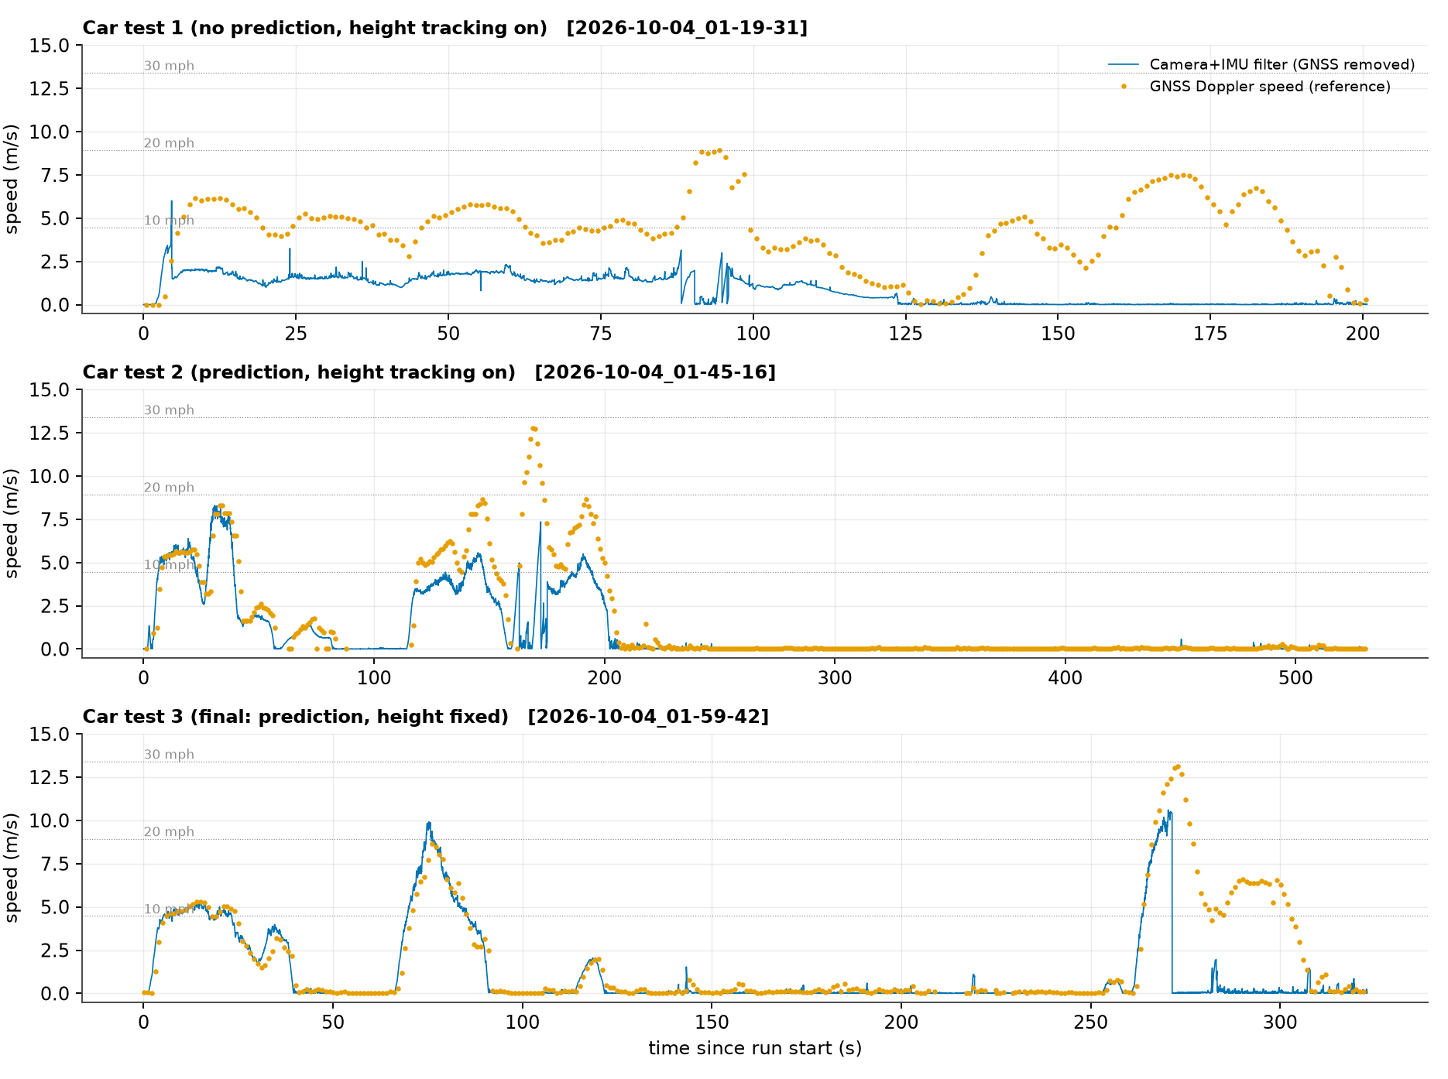
PROBLEM → FIX #4
Problem 4: in the car, three failures in a row, each found in the logs
Drive | Main failure (evidence) | speed ÷ GPS
1 (01:19) | height tracker collapsed 0.17 → 0.06 m; window wrap ≈ 6 m/s | 0.31 (median, 10–15 mph)
2 (01:45) | tracker drifted to 0.11 m; zero-lock at t = 163 s | 0.69 (median, 10–15 mph)
3 (01:59) | height fixed by LiDAR; motion prediction | 0.984 (steady 4.5–5.3 m/s)
• Fixes: motion-predicted correlation window (bench range 3 → 9 m/s); height tracking switched off; coast 24 frames before re-acquiring; weak results that jump far are rejected.
• Still failing in drive 3: above ~25 mph blur drops PSR to ~11; the tracker then locked onto zero and read 0 from t = 273 to 304 s while GPS said 4–6.6 m/s.
• Not verified: the 'fake-stop' rule meant to prevent that lock (commit ef48eaa) was never driven: the only runs recorded after it are three short pushes (02:26–02:27) with no GPS fix and no course length.
Source: velocity_summary.json (filter replayed without GPS vs GPS speed), figures/vel_car_runs_timeseries.png, vel_height_tracker.png; writeup §3.13–3.16
8

Slide 9
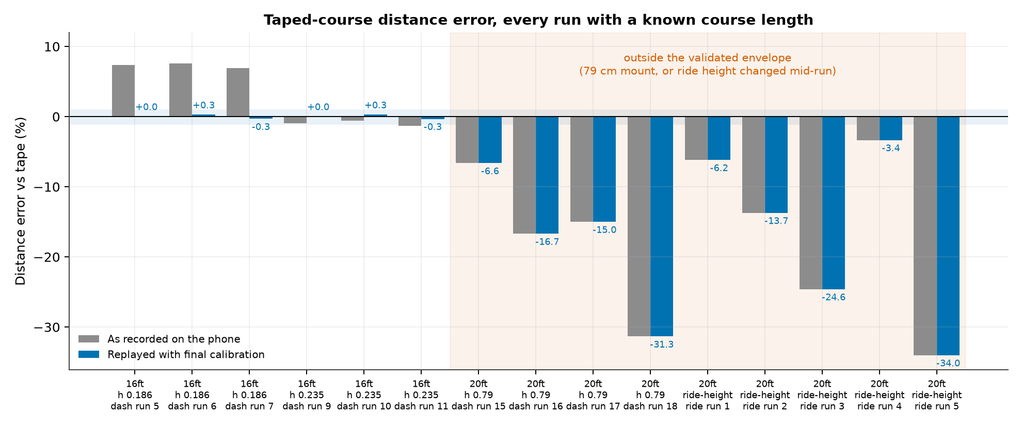
WHAT DID NOT WORK
What failed: high mounts and changing ride height
FAILED
• 79 cm mount: −6.6, −16.7, −15.0 %. Correction: the write-up says runs 15–17 read '15–17 % low', but run 15 (a faster push) was −6.6 %.
• Static-pattern subtraction: −8.4 → −0.4 % in simulation, −31.3 % on the real cart. Reverted.
• Ride height changed mid-run: −6.2, −13.7, −24.6 % with fixed h; image-expansion tracking gave −3.4 % once and −34 % the next run.
• Hypothesis (untested): at 79 cm the floor moves ~1 px/frame and static image content pulls the shift toward zero.
Lesson: the simulator (flowbench) was right about window wrap and blur, and wrong twice about real optics. Only fully logged runs caught that.
Source: distance_runs.csv (as recorded; these runs already used the final calibration), writeup §3.8, §3.10
9

Slide 10
FINAL ESTIMATION PIPELINE
The final configuration (what the accuracy numbers below describe)
LiDAR h (once)
Flow 240 Hz
De-rotate
ReferenceKF4
Odometer
depth·cos θ − 7.9 mm; cart still; also zeroes IMU bias
f = FOV focal ×1.027; motion-predicted window; PSR ≥ 8
v −= h·ω (gyro); wobble lowers PSR weight
q_accel 0.1, q_bias 1e-5, R = 1.6e-3·(20/PSR)², gate 9
∫|v̄|, deadband 0.05, τ 0.5 s, lead term
Change | When (evidence) | What it fixed | Status
Release build, 240 fps | 20:36 (flow rate 69–118 → 232–240 Hz) | fewer px per frame at a given speed → higher PSR | kept
Camera restart / watchdog / ZUPT after flow loss | after 21:43 (no later crash reports) | IMU-only runaway after Measure h | kept
LiDAR tilt: depth × cos θ once | aa0d32a code diff | +61 % speed at 38° tilt | kept
Distance low-pass τ = 0.5 s + lead | 21:20 (inferred from est.csv) | wobble counted as distance | kept
Focal ×1.027, LiDAR −7.9 mm | 22:54 (focal_px 883.89) | +7 % scale error | kept
Image-expansion height tracking | 00:00–01:45 | variable ride height | OFF (failed in car)
Motion prediction, coast, relock PSR 30 | 01:45 and 01:59 drives | wrap at 6 m/s; zero-lock | kept
Fake-stop rule; prediction only > 32 px/frame | ef48eaa, 5295780 (02:37) | zero-lock after overspeed; keeps cart path calibrated | NOT ROAD-TESTED
Source: CameraFlowSource.swift, DepthSource.swift, GroundSpeedFilter.swift (FilterConfig), SensorFusionEngine.swift; meta.json of final runs
10

Slide 11
DISTANCE ACCURACY (REAL DATA)
Distance: about ±0.5 % on a 4.9 m course, within a narrow envelope
Metric (6 runs, 4.877 m) | In-sample | Leave-one-out
Bias (mean error) | −0.01 % | +0.00 %
MAE | 0.21 % (10 mm) | 0.34 %
RMSE | 0.24 % (12 mm) | 0.41 %
SD | 0.27 % | 0.44 %
Max |error| (observed) | 0.32 % (16 mm) | 0.54 %
95 % CI of the mean | −0.29…0.27 % | −0.47…0.47 %
95 % prediction interval, new run | −0.75…0.73 % | −1.23…1.23 %
• Valid for: indoor floor, mount 0.186–0.235 m, walking pace, straight 16 ft course. Six runs is a small sample: the SD itself has a 95 % CI of 0.17–0.65 % (in-sample).
• Not valid for: 79 cm mounts (−7 to −17 %), mid-run height changes (−6 to −34 %), or the car (no distance truth there; integrated GPS agrees within +2.2 % over 306 m, but GPS is not a reference).
Source: distance_calibration.json, distance_runs.csv
11
Notes:
Error = replayed final-calibration distance − tape length. In-sample: calibration fitted on the same 6 runs. Leave-one-out: each run predicted with constants fitted on the other 5. t-based 95% CI on the mean and 95% prediction interval for a new run, n = 6.

Slide 12
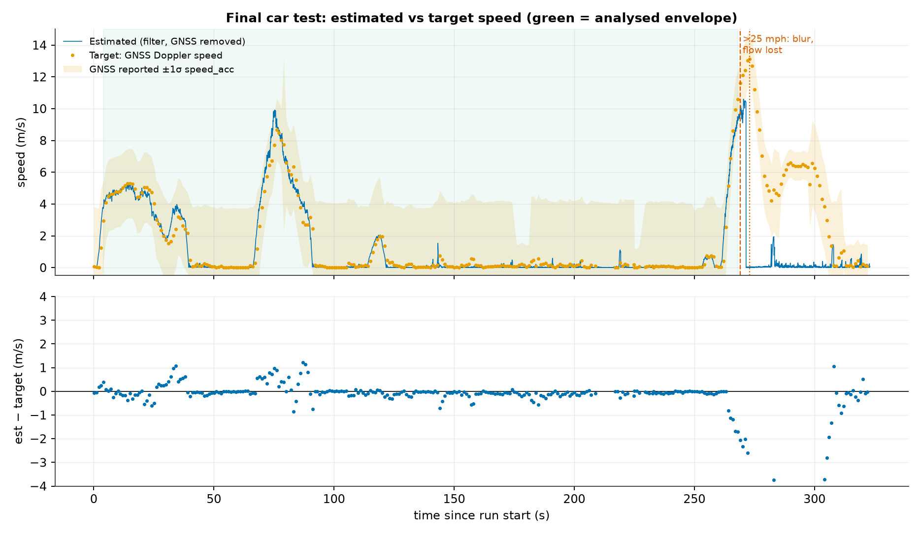
VELOCITY ACCURACY (REAL DATA)
Velocity: 0.63 m/s RMSE vs GPS, worst when accelerating
est − target (m/s) | envelope, n = 61
Bias | +0.07 [95 % CI −0.09…0.41]
RMSE | 0.63 [95 % CI 0.40…0.73]
MAE / SD | 0.49 / 0.64
|e| p50 / p90 / p95 | 0.40 / 1.08 / 1.19
Max |e| (observed) | 1.71
Steady (|a| < 0.3 m/s²) | RMSE 0.42, n = 24
Accel / braking | RMSE 0.74, n = 37
PSR < 15 (near blur limit) | bias −1.30, n = 5
• Segments: cruise 4.5–5.3 m/s ratio 0.984 (RMSE 0.27); 2.6 m/s 1.24; accelerate to 8.7 m/s and brake 1.09; just before overspeed 0.87. Only ~7 effectively independent samples. Including the zero-lock failure, RMSE is 4.0 m/s.
Source: velocity_summary.json → final_envelope; velocity_samples_2026-10-04_01-59-42.csv; figures/vel_final_timeseries.png
12
Notes:
Target = GPS Doppler speed (iOS CLLocation.speed), 1 Hz, shifted by the fitted 0.65 s lag. Estimate = filter replayed WITHOUT GPS updates, so the comparison is independent. Envelope = GPS 2–11.2 m/s before the first >25 mph excursion. Errors are autocorrelated: CIs use a moving-block bootstrap.

Slide 13
MONTE CARLO METHODOLOGY
Monte Carlo: the real filter, real timestamps, measured noise
Input | Value | Derived from | Type
Flow frame noise (per PSR band) | robust SD 7 mm/s cart, 6 mm/s car; excess kurtosis 15–25 | residual vs 0.1 s median, 12.5k cart / 17.9k car frames; resampled empirically | empirical
Camera height h | SD 0.67 mm | repeated Measure-h at an unchanged mount + 1 mm app rounding | empirical
Focal correction c, LiDAR offset δ | 1.0268 ± 0.0118, -8.0 ± 2.3 mm, r = 0.99 | our least-squares refit, 6 runs (covariance × residual variance) | empirical
Unexplained per-run term (distance) | 0.00 % | variance matching: LiDAR + flow already explain the observed 0.33 % scatter | derived
Slow speed error (velocity) | SD 0.50 m/s, τ = 2.9 s (Ornstein–Uhlenbeck) | GPS residuals at PSR ≥ 15 minus GPS white noise; 1 s autocorrelation | empirical, weakly constrained
GPS reference | white SD 0.16 m/s, lag 0.65 s | 2nd difference of the 1 Hz series; lag by cross-correlation | empirical
IMU | SD 0.062 (car), 0.046 (cart) m/s²; bias SD 0.02 | ZUPT (at rest) samples; bias SD assumed | empirical + assumption
Trials | 100,000 distance · 100,000 velocity | seeds 20261004, 20261011 | —
Kept distinct: TARGET (true speed or length) · MEASURED (camera flow) · ESTIMATED (Kalman output) · MONTE CARLO (distribution of estimated − target across trials). Velocity error is propagated through the filter dynamics and is time-correlated, not an independent Gaussian. Distance error comes from integrating the simulated velocity through the real odometer.
Source: 06_mc_distance.py, 07_mc_velocity.py, noise_params.json, mc_*_summary.json
13
Notes:
Vectorised ReferenceKF4 was checked against the scalar port on real runs (max difference 9e-16 m/s). Each trial uses one recorded run's timestamps, PSR sequence and ZUPT times; only the measurements are synthetic.

Slide 14
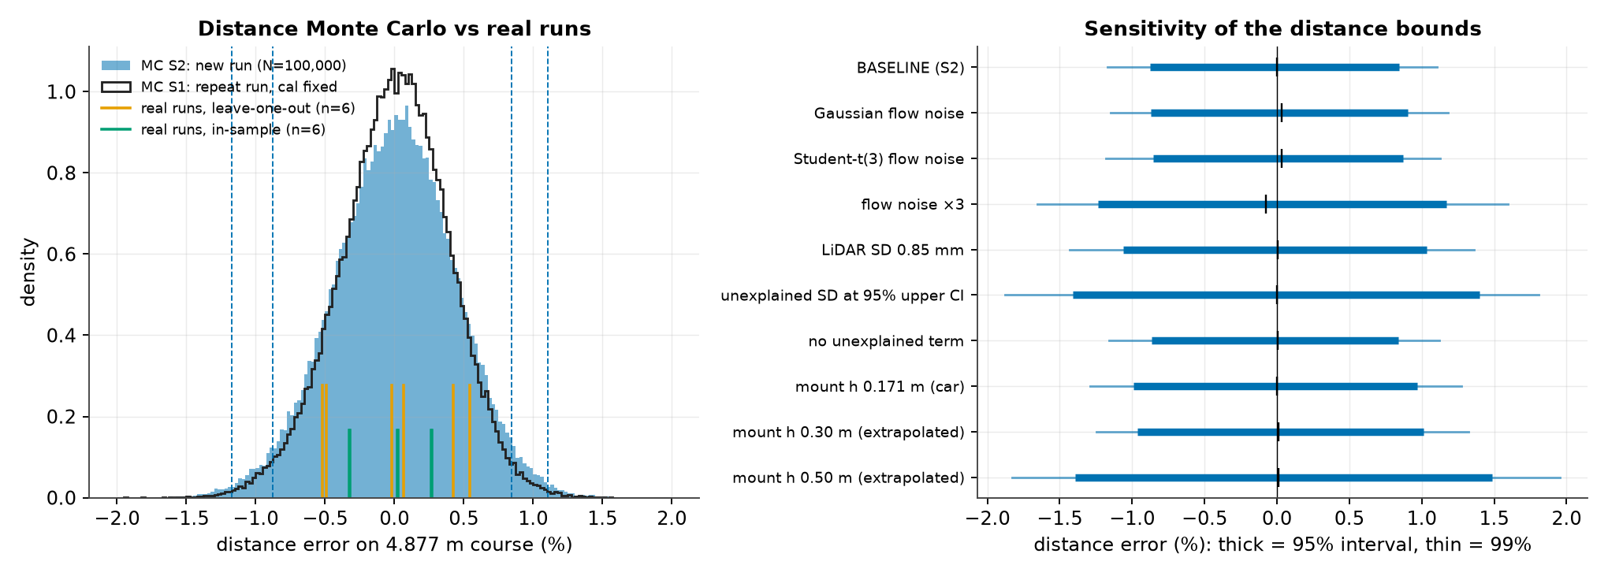
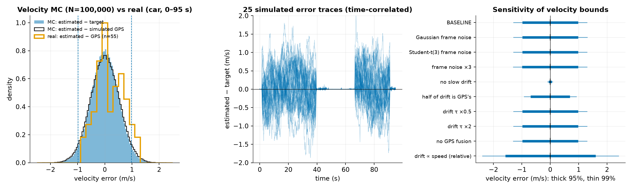
MONTE CARLO RESULTS
Monte Carlo bounds (95 %): ±0.9 % on distance, ±1.0 m/s on speed
Distance on 4.877 m | Repeat run (cal fixed) | New run (cal uncertain)
Mean error | +0.00 % | +0.00 %
SD (1σ) | 0.39 % | 0.44 %
95 % interval | −0.80…0.74 % | −0.88…0.84 %
99 % interval | −1.07…1.00 % | −1.17…1.11 %
|e| 95th pct | 0.77 % (3.8 cm) | 0.86 % (4.2 cm)
P(|e| > 1 %) | 1.3 % | 2.4 %
Speed, car 2–9 m/s | Instantaneous | 10 s average
Bias / SD (1σ) | −0.00 / 0.50 m/s | SD 0.32 m/s
95 % interval | −0.98…0.98 m/s | |e|₉₅ 0.62 m/s
99 % interval | −1.29…1.29 m/s | |e|₉₉ 0.82 m/s
P(|e| > 0.5 / 1 m/s) | 32 % / 5 % | —
These are prediction (uncertainty) intervals for one new measurement, i.e. percentiles of simulated error. They are not confidence intervals of a mean. Outside the envelope (high mount, ride-height change, above 25 mph, zero-lock) they do not apply.
Source: mc_distance_summary.json, mc_velocity_summary.json; figures/mc_dist.png, mc_vel.png
14

Slide 15
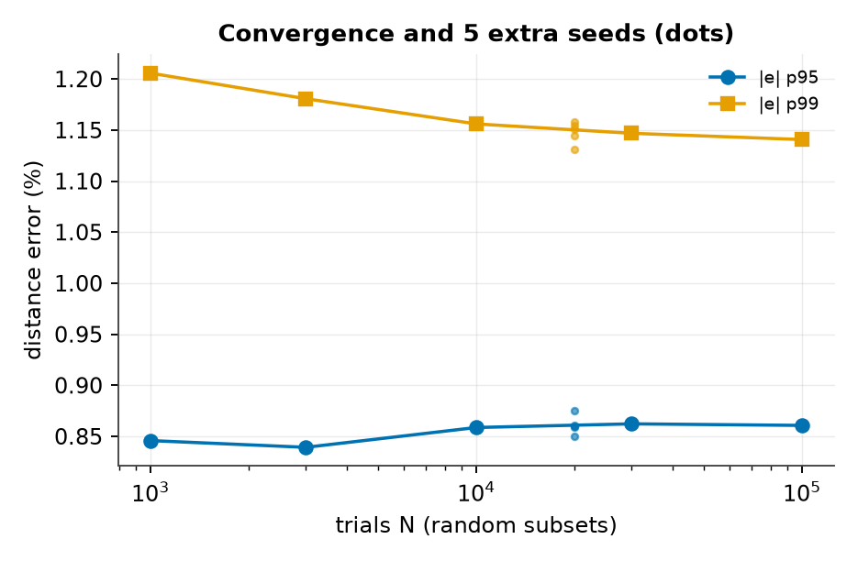
VALIDATING THE MONTE CARLO
Reality vs simulation: agreement where we can test it, and what dominates
Check | Distance | Velocity
Mean (bias) | LOO mean +0.00 % vs MC +0.00 % | real +0.19 vs MC −0.00 m/s (real 95 % CI −0.09…0.41; drift model is zero-mean)
Real vs MC spread | LOO SD 0.44 % vs MC 0.44 % | real SD 0.50 vs MC (incl. GPS noise) 0.53 m/s
Tails | worst real LOO run at MC pct 79 | |e|₉₅ real 1.01 vs MC 1.03 m/s
Analytic | independent-term SD 0.43 % vs MC 0.44 % | filter's own σ (white noise only) 12 mm/s ≪ real error
Convergence / seeds | |e|₉₉ within ±0.01 % across 5 seeds | |e|₉₉ stable across 5 seeds
• Distance is dominated by scale: LiDAR height repeatability alone (0.33 %) explains the observed run-to-run scatter. Flow noise integrates to 0.09 % and push-profile effects to about 0.17 %. The calibration constants dominate when extrapolating: at 0.50 m the 95 % interval widens to −1.4…1.5 %.
• Velocity is dominated by a slow error the data barely constrain: frame noise is ~1 % and averaged away by the filter; the ±0.5 m/s, ~3 s drift (pitch/ride height, reference lag) sets the bound. A model where that error scales with speed over-predicted the real spread (0.79 vs 0.53 m/s), so the additive model is used. Frame-noise model (empirical, Gaussian, Student-t, ×3) barely moves the bounds; the drift size does: if half of it is really GPS's own error, the 95 % bound shrinks from ±0.98 to ±0.70 m/s.
• Circularity, stated plainly: the slow-error size is fitted to the same drive it is compared with. The match in spread is built in; the matching tail (p95) and time structure are the real test.
Source: mc_distance_summary.json (convergence, seeds, sensitivity, analytic), mc_velocity_summary.json; figures/mc_dist_convergence.png
15

Slide 16
CONCLUSION
What we learned, what the sensor can claim, and what to do next
±0.9 % (95 %)
±1.0 m/s (95 %)
0.984 × GPS
≈ 25 mph
distance, new run, 0.19–0.24 m mount, indoor, ~5 m; observed max 0.54 % (LOO)
instantaneous car speed 2–9 m/s; real RMSE vs GPS 0.63 m/s
best steady cruise (4.5–5.3 m/s); other segments 0.87–1.24×
tracking limit at night (blur); 31 s zero-lock after overspeed; fix untested
Lessons
Remaining limits
Next
• Scale errors (h, f) mattered far more than filter tuning: 7 % and 61 %, versus ~0.1 % from frame noise.
• Logging every sensor was the decisive choice: every fix here was found and checked in recorded data.
• The simulator was right about window wrap and blur and wrong about real optics (twice).
• Only 6 truth runs, 2 heights, 1 floor: bounds are wide and local.
• No independent speed truth: GPS has 0.65 s lag and reports 1σ ≈ 2 m/s.
• Ride height is measured once; pitch/heave is unmeasured.
• 79 cm mounts read 7–17 % low; cause unproven. Last pushes at 0.32 and 0.51 m have no recorded course length.
• Drive the fake-stop build; repeat the 30 mph pass.
• Ground truth: wheel encoder or RTK GPS, plus 20+ taped runs at 3+ heights.
• Second rangefinder (or LiDAR at intervals) for live ride height.
• Per-device lens calibration (checkerboard) instead of a FOV-based focal length.
• Daylight and higher mount to push the blur limit.
Source: final_metrics.json
16

