Slide 1
PUBLIC-CORE VALIDATION RELEASE · 28 JULY 2026
CrisisForge Decision-Focused Market Simulation
Factor-structured temporal diffusion, asset-level tail risk, and robust portfolio control
Notes:
Open with the research question: does a more sophisticated scenario generator improve risk decisions?
The answer from the current validation release is deliberately mixed and mostly negative.
[Sources]
- reports/crisisforge_research_report.md
- docs/research_proposal.md
[/Sources]

Slide 2
The answer is no—at least on the current validation evidence
Main finding
Strong historical and block-bootstrap generators remain hard to beat. Added architecture did not translate into better validation decisions.
0 / 7
4
SEALED
paired score intervals clearly favor Stage 1
diffusion reporting origins—engineering pilot only
post-2019 test evidence remains unopened
2
Notes:
Lead with the negative result rather than the architecture.
Five paired intervals exclude zero against Stage 1; none clearly favors it.
The diffusion experiment has four origins and cannot support ranking or coverage claims.
[Sources]
- reports/crisisforge_research_report.md#technical-summary
- experiments/stage3_comparison/summary.json
- experiments/stage2_diffusion/summary.json
[/Sources]

Slide 3
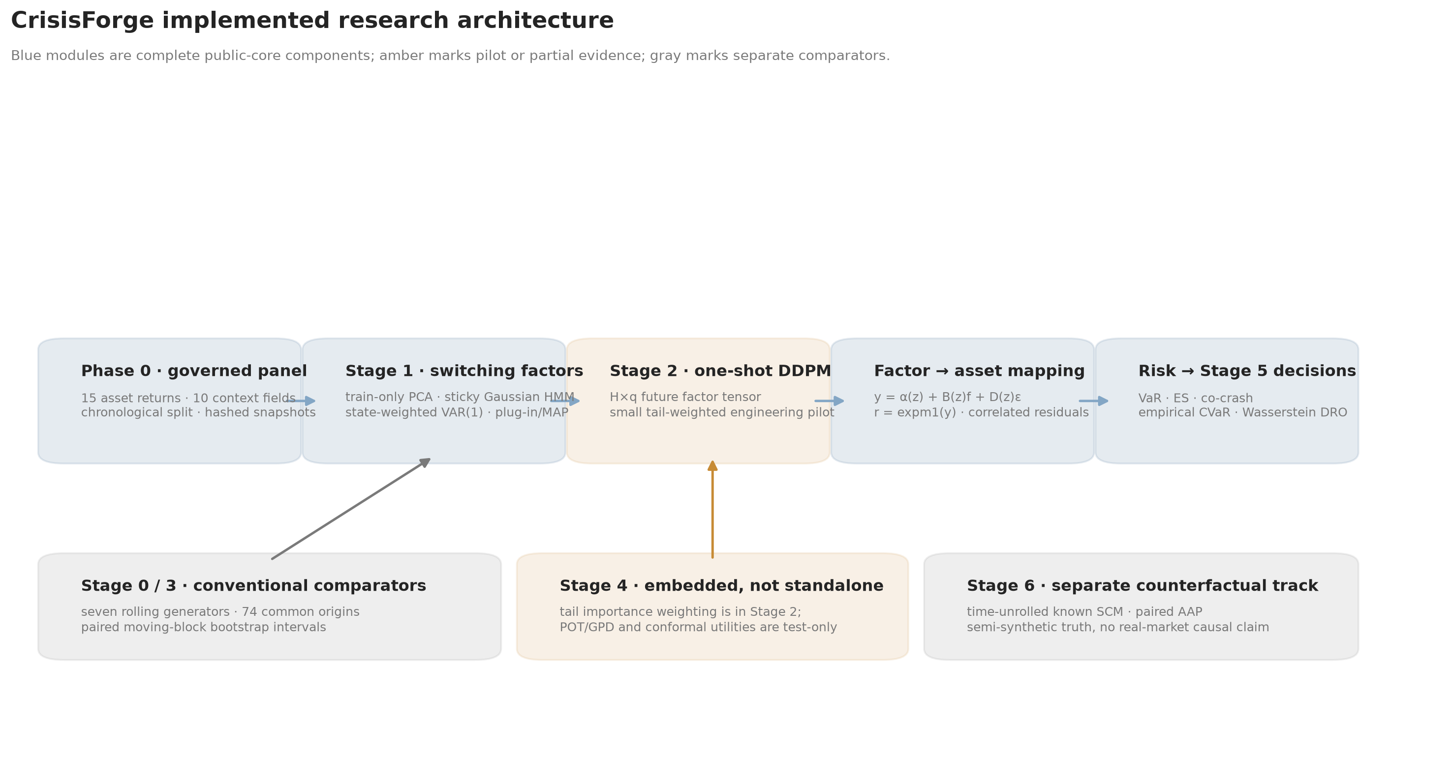
The architecture is broad, but its evidence levels are explicit
Governed public data feeds a plug-in switching-factor simulator, asset mapping, risk engine, and decision layer.
CORE
PILOT
completed public validation path
diffusion and causal extension
3
Notes:
Blue components are completed public-core modules; amber marks pilot or partial evidence.
The switching-factor system is PCA–HMM–VAR with plug-in parameters, not a joint Bayesian posterior.
The semi-synthetic structural counterfactual track is deliberately separate from observed-market claims.
[Sources]
- reports/figures/00_implemented_research_architecture.png
- docs/mathematical_formulation.md
[/Sources]

Slide 4
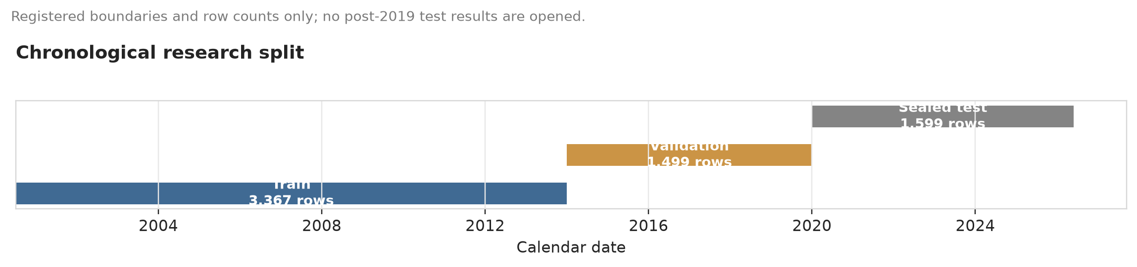
Governance prevents the test set from becoming a tuning resource
Chronological split
All reported model scores and portfolio decisions end in 2019. Post-2019 rows are governed-excluded from evaluation.
6,465
1,599
complete common- endpoint rows
sealed test rows from 2020
4
Notes:
The public matrix contains 15 asset-return targets and 10 context variables.
The data are method-development proxies: French portfolios are research constructs and Treasury returns are duration-convexity approximations.
Sealed means excluded from fitting, selection, scoring, and decisions—not encrypted or physically inaccessible.
[Sources]
- reports/figures/01_chronological_research_split.png
- data/processed/phase0_manifest.json
- https://mba.tuck.dartmouth.edu/pages/faculty/ken.french/data_library.html
- https://home.treasury.gov/resource-center/data-chart-center/interest-rates
- https://www.newyorkfed.org/markets/reference-rates/effr
[/Sources]

Slide 5
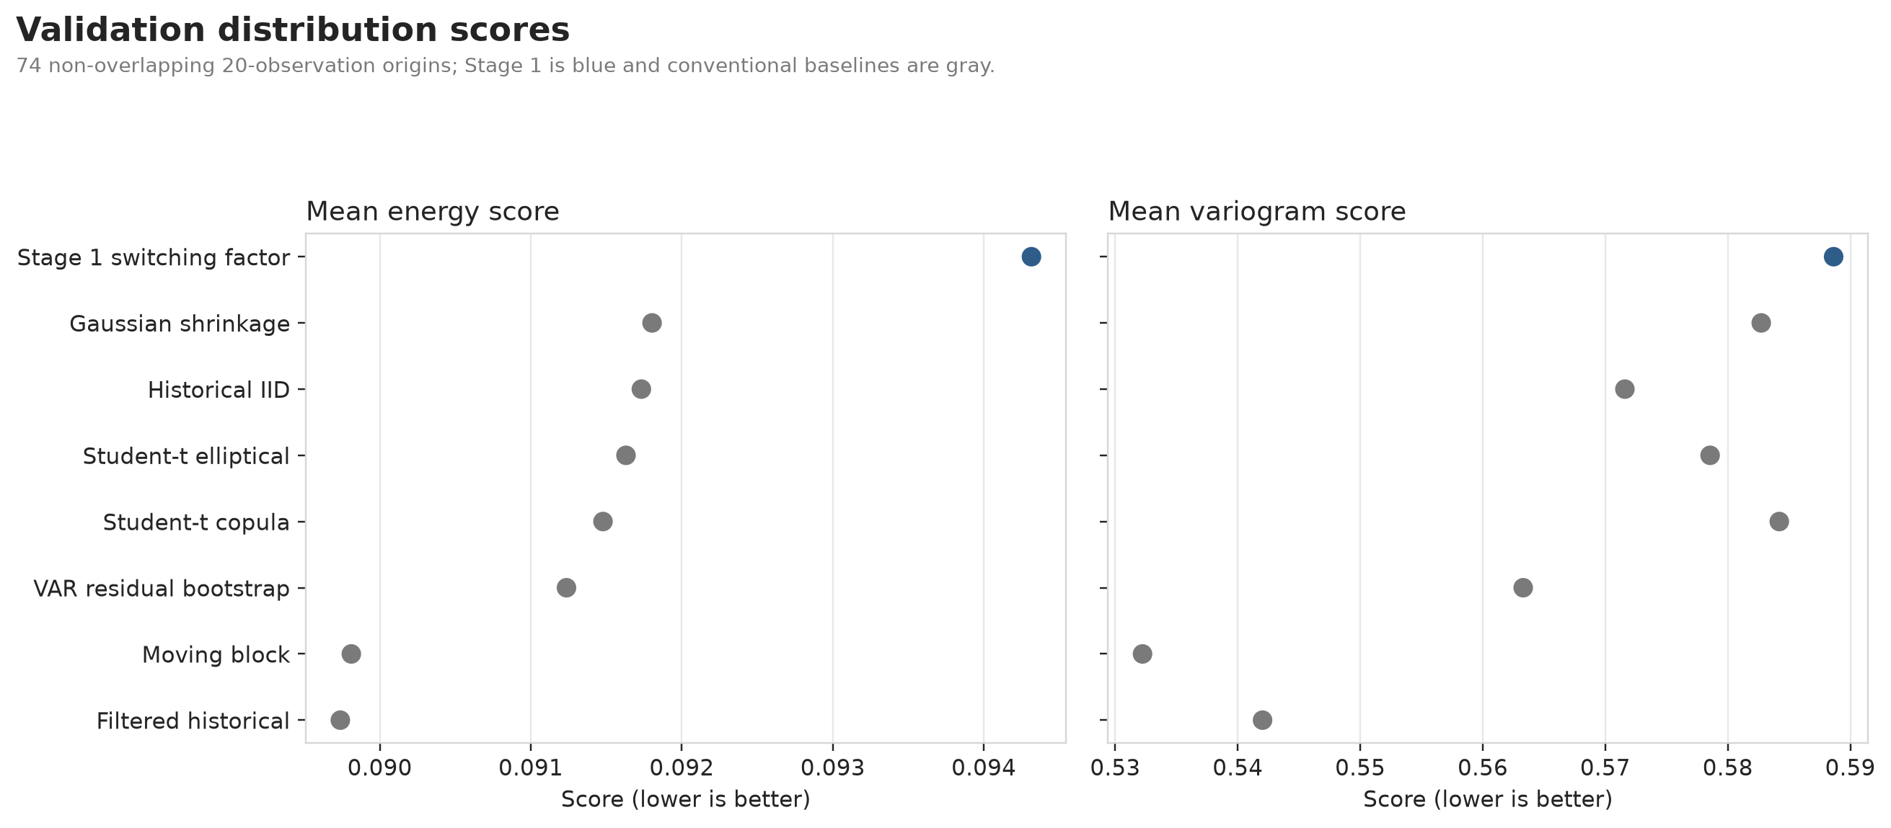
Conventional time-dependence baselines lead the structured model
Filtered historical simulation wins energy score; moving blocks win variogram and closest 5% VaR coverage.
0.089739
5.41%
best energy filtered historical
moving-block VaR violations
5
Notes:
The evaluation uses 74 non-overlapping 20-day validation origins and 1,000 scenarios per origin.
Stage 1 energy is 0.094315 and variogram is 0.588639; lower is better.
No conventional baseline wins every metric, so the report avoids selecting a model from one aggregate score.
[Sources]
- reports/figures/02_validation_distribution_scores.png
- experiments/stage0_baselines/summary.json
- experiments/stage1_switching_factor/summary.json
[/Sources]

Slide 6
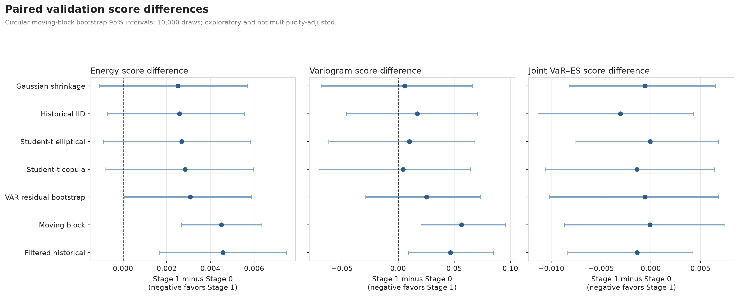
Paired uncertainty rejects a broad Stage 1 superiority story
Origin-matched comparison
Energy and variogram differences are positive against leading baselines; positive values favor Stage 0.
5 / 21
0 / 7
intervals exclude zero against Stage 1
joint VaR–ES intervals exclude zero
6
Notes:
Circular moving-block bootstrap: block length four, 10,000 draws.
Versus filtered historical, Stage 1 energy difference is +0.00458 and variogram difference is +0.0466; both 95% intervals exclude zero.
The comparison mixes architecture and update policy because Stage 0 rolls 1,500-row refits while Stage 1 freezes parameters after training.
[Sources]
- reports/figures/03_paired_validation_intervals.png
- experiments/stage3_comparison/summary.json
[/Sources]

Slide 7
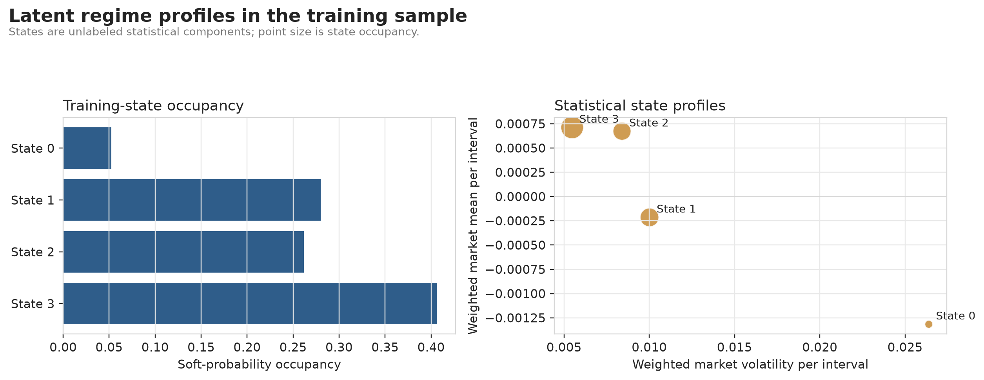
Latent states are statistical profiles—not economic causes
Asset risk is reconstructed through rₜ = α(zₜ)+B(zₜ)fₜ+D(zₜ)εₜ with correlated residual draws.
4
85.995%
PCA factors and HMM states
training variance explained
7
Notes:
The HMM converged after 37 iterations from the selected of 12 starts; the smallest state has 5.23% soft occupancy.
State 0 has a high-volatility, negative-mean profile ex post, but that does not make it a structural crisis regime.
The observation map samples complete state paths and correlated idiosyncratic residuals; it does not probability-average Cholesky matrices.
[Sources]
- reports/figures/04_latent_regime_profiles.png
- docs/mathematical_formulation.md#factor-to-asset-observation-map
- experiments/stage1_switching_factor/summary.json
[/Sources]

Slide 8
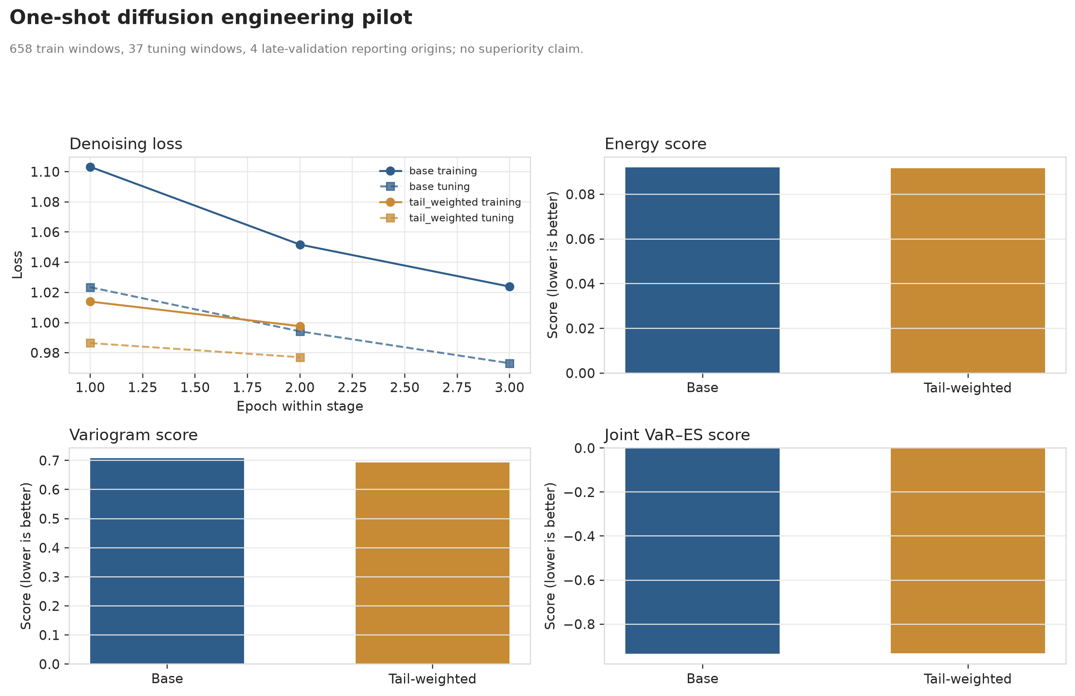
The one-shot diffusion run proves plumbing—not superiority
20 × 4 tensor generation
Tail weighting improves two distribution scores but worsens the joint VaR–ES score in a four-origin pilot.
4
64
reporting origins; no ranking claim
scenarios per origin in the pilot
8
Notes:
Base DDPM energy: 0.092049; tail-weighted DDPM energy: 0.091680.
Variogram improves 1.94%, while joint VaR–ES worsens from -0.934902 to -0.933368.
Future HMM paths are sampled separately from factor paths conditional on the origin belief, so joint dynamic consistency is not guaranteed.
[Sources]
- reports/figures/07_diffusion_engineering_pilot.png
- experiments/stage2_diffusion/summary.json
- https://proceedings.mlr.press/v202/shen23d.html
- https://proceedings.iclr.cc/paper_files/paper/2024/hash/f90fc76b199fe6b0ec2a51aaf72c3277-Abstract-Conference.html
[/Sources]

Slide 9
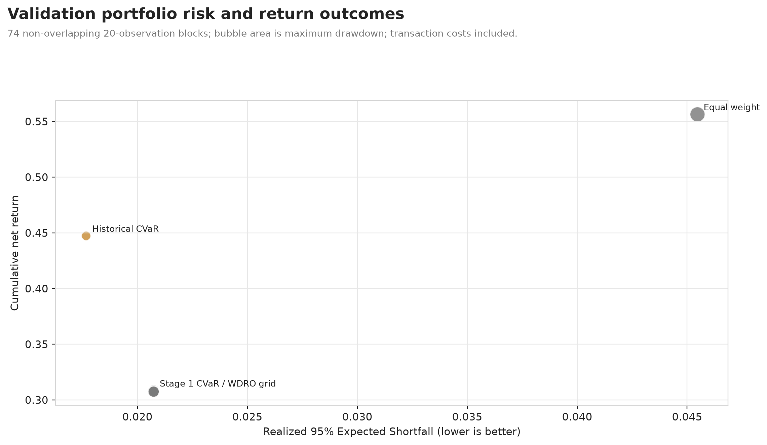
Better-looking scenarios did not deliver better risk decisions
Historical empirical CVaR has lower realized ES, drawdown, turnover, and cost than Stage 1 scenario CVaR.
0.01767
0.02074
historical CVaR realized ES
Stage 1 CVaR realized ES
9
Notes:
All decision rules are long-only, fully invested, with a 20% asset cap, 40% L1 turnover cap, and 10-basis-point linear cost.
Historical CVaR cumulative net return is 0.4473 versus 0.3083 for Stage 1 scenario CVaR.
The registered Wasserstein radius grid barely changes the allocation and does not improve ES or drawdown.
[Sources]
- reports/figures/05_portfolio_decision_outcomes.png
- experiments/stage5_decisions/summary.json
- https://link.springer.com/article/10.1007/s10107-017-1172-1
[/Sources]

Slide 10
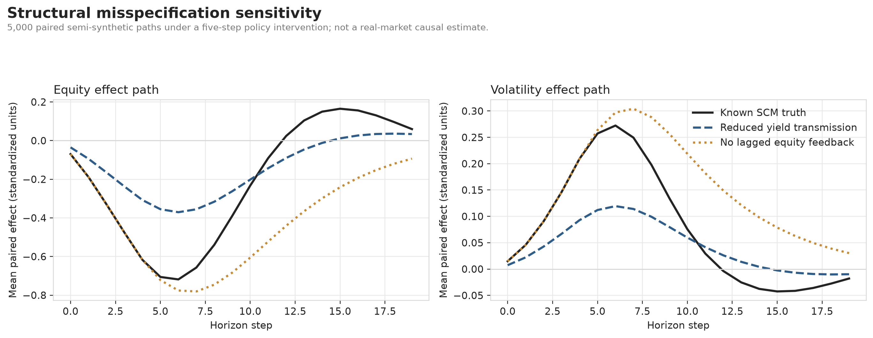
Counterfactual correctness under truth is fragile to structure
Known semi-synthetic SCM
Abduction–action–prediction is numerically exact under the registered equations, then degrades under two deliberate misspecifications.
4.08e−17
3.4354
oracle maximum path error
volatility tail-effect error without feedback
10
Notes:
The experiment uses 5,000 paired 20-step paths and shared exogenous noise.
Path loss signs are equity −1 and volatility +1, so lower equity and higher volatility both represent stress losses.
No-feedback misspecification produces equity tail-effect error 3.2142 and volatility tail-effect error 3.4354.
Nothing here identifies a Federal Reserve policy effect in observed markets.
[Sources]
- reports/figures/06_counterfactual_misspecification.png
- experiments/stage6_counterfactual/summary.json
- docs/mathematical_formulation.md#structural-counterfactual-extension
- https://iclr.cc/virtual/2026/poster/10011565
- https://openreview.net/forum?id=FwC6CyaHop
[/Sources]

Slide 11
The evidence boundary is part of the contribution
What this release can—and cannot—support
The claims are deliberately narrower than the architecture.
Established
Reproducible public pipeline and sealed-test governance.
Established
Finite asset scenarios, paired comparisons, and retained negative results.
Not established
Test-set superiority, investability, or live-trading profitability.
Not established
Full Bayesian uncertainty, selected DRO radius, or real-market causality.
11
Notes:
The report distinguishes system completion from evidence strength.
Co-crash discrimination is also not established: the realized validation label is zero at every evaluated origin.
POT/GPD, conformal recalibration, and ESR utilities are not integrated into the reported diffusion experiment.
[Sources]
- reports/crisisforge_research_report.md#what-the-experiments-establishand-what-they-do-not
- reports/crisisforge_research_report.md#co-crash-validation-is-event-limited
[/Sources]

Slide 12
Integration is the contribution—not novelty by label
Research anchors
Each module is tied to a distinct literature and a claim limit.
Latent states
Hamilton and Kim ground the regime layer.
One-shot paths
TimeDiff and FTS-Diffusion motivate sequence generation.
Tail decisions
Tail-GAN, EVT, CVaR, and WDRO define comparisons.
Causal boundary
Intervention work motivates a separate known-SCM track.
12
Notes:
The closest factor-structured diffusion paper is a preprint and is used only to motivate a falsifiable hypothesis.
The project does not claim to invent Markov switching, diffusion, CVaR, Wasserstein DRO, or structural causal models.
[Sources]
- https://www.jstor.org/stable/1912559
- https://www.sciencedirect.com/science/article/pii/0304407694900361
- https://proceedings.mlr.press/v202/shen23d.html
- https://proceedings.iclr.cc/paper_files/paper/2024/hash/f90fc76b199fe6b0ec2a51aaf72c3277-Abstract-Conference.html
- https://pubsonline.informs.org/doi/10.1287/mnsc.2023.00936
- https://arxiv.org/abs/2504.06566
- docs/literature_review.md
[/Sources]

Slide 13
The next release must reduce uncertainty before adding capacity
GATE 1
GATE 2
GATE 3
Confirm diffusion
Run all 74 origins with direct, unconditional, hard-state, and fixed-map ablations.
Match policies
Equalize rolling versus frozen estimation; integrate one tail method at a time.
Freeze, then test
Calibrate the DRO radius on nested validation. Unlock post-2019 only after preregistration.
13
Notes:
Do not open the sealed test while the diffusion experiment remains underpowered and registered ablations are missing.
Joint factor/state consistency is a priority because current future state paths and factor paths are sampled separately.
Keep observed-market causal work separate until there is an identification design.
[Sources]
- reports/crisisforge_research_report.md#recommended-next-experiments
- docs/research_proposal.md
[/Sources]

Slide 14
CRISISFORGE
Complexity must earn its place.
Validation first
Negative results retained
Test evidence still sealed
Notes:
Resolve the opening question: this release does not show that generative or structural sophistication improves decisions.
Its strongest contribution is an auditable framework that makes failure visible and the next experiment credible.
[Sources]
- reports/crisisforge_research_report.md
- README.md
[/Sources]

