Slide 1
PLACING TASK
Mediaeval 2013
JAMIE DAVIES
Notes:
Introduce myself
Unique approach, allows for aggregation of features from different mediums
Scalable

Slide 2
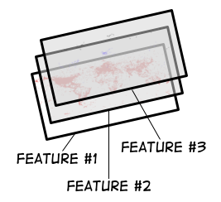
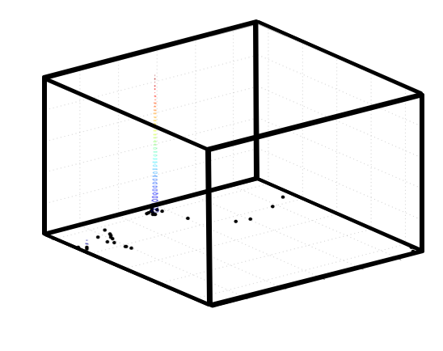
Approach
Each feature provides a fixed-size set of <lat,lng> pairs
MEAN-SHIFT USED TO ESTIMATE THE MOST PROBABLE LOCATION
Notes:
Kernel-density from mean-shift clustering used

Slide 3
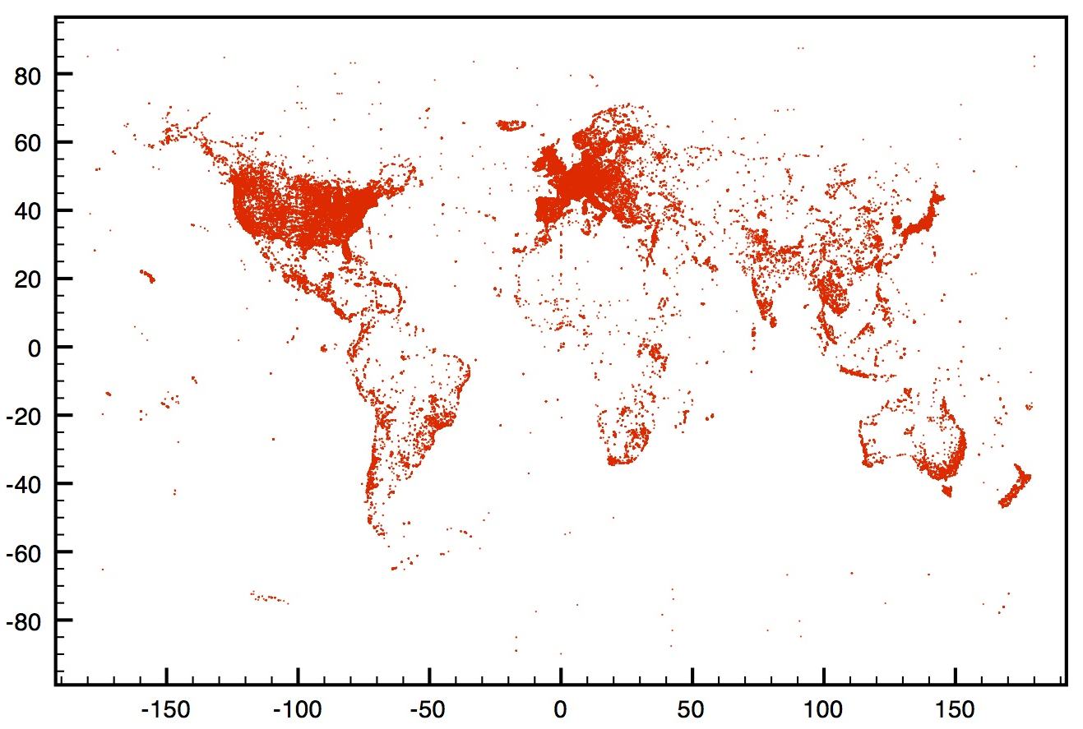
LOCATION PRIOR
Notes:
A prior feature was constructed based on where photos are most likely to be taken
Hotspots around US, Europe, major cities

Slide 4
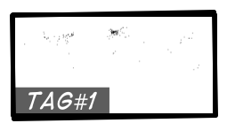

TAGS
Tags treated separately
Each tag returns a set of likely locations
Notes:
Approach means all tags are considered equal
All tags provide a little information, worst case = prior

Slide 5
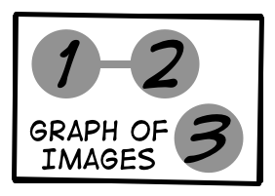
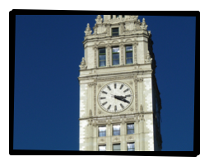
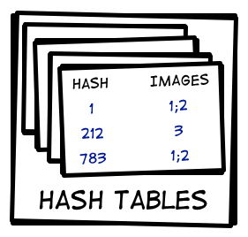


LSH-SIFT Features
HIGH PRECISION / LOW RECALL
Notes:
Image
Difference of Gaussian SIFT Features
Random Gaussian P-Stable hash functions, 4 x 32 bit partitions
Collision in hash table = graph edge
Search: looks up image vertex, returns connected vertices, ordered by weight

Slide 6
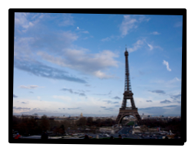
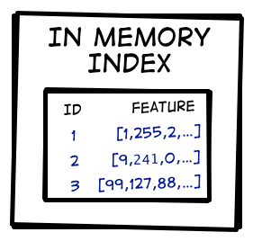
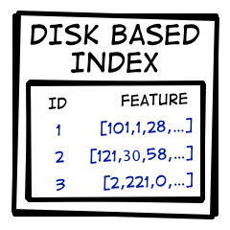


PQ-CEDD Features
LOW PRECISION / HIGH RECALL
Notes:
CEDD describes colour + texture, 144 dimensions
18 products with 256 clusters each
26 bytes / image (18 for feature)
Search: query = raw features, asymmetric distance, closest 100 images used

Slide 7
Normalisation
All features provide exactly 1000 <lat,LNG> pairs
Uniform sampling for the prior and tags
Search engine ranked sampling for the visual features
GeoNames Boosting
Tags matched with an entry in the geonames database doubled to provide 2000 <lat,Lng> pairs.
Notes:
Super/sub sampling
Each feature is given equal weight
Matches with geonames place or alternate place name

Slide 8
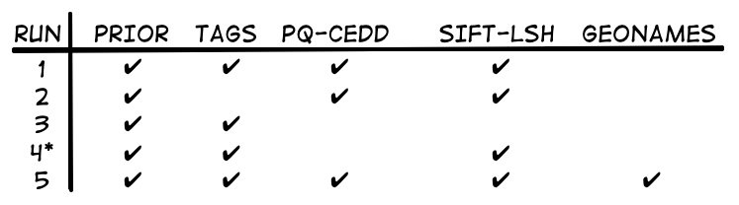
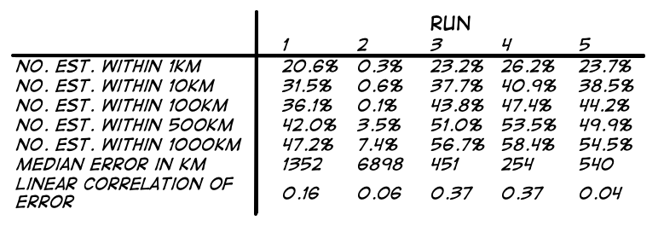
Runs & Results
Notes:
Run 4 uses larger dataset of GEOTAGGED flickr images crawled independently. All images from the set of users from the query images were removed from this dataset to keep to the spirit of the task.
Geonames provides helpful boost
Using just tags seems most effective (run 3)
Big dataset helps (run 4)

Slide 9
Runs & Results
Notes:
Run 4 uses larger dataset of GEOTAGGED flickr images crawled independently. All images from the set of users from the query images were removed from this dataset to keep to the spirit of the task.
Geonames provides helpful boost
Using just tags seems most effective (run 3)
Big dataset helps (run 4)

Slide 10
Runs & Results
Notes:
Run 4 uses larger dataset of GEOTAGGED flickr images crawled independently. All images from the set of users from the query images were removed from this dataset to keep to the spirit of the task.
Geonames provides helpful boost
Using just tags seems most effective (run 3)
Big dataset helps (run 4)

Slide 11
Runs & Results
Notes:
Run 4 uses larger dataset of GEOTAGGED flickr images crawled independently. All images from the set of users from the query images were removed from this dataset to keep to the spirit of the task.
Geonames provides helpful boost
Using just tags seems most effective (run 3)
Big dataset helps (run 4)

Slide 12
Runs & Results
Notes:
Run 4 uses larger dataset of GEOTAGGED flickr images crawled independently. All images from the set of users from the query images were removed from this dataset to keep to the spirit of the task.
Geonames provides helpful boost
Using just tags seems most effective (run 3)
Big dataset helps (run 4)

Slide 13
FUTURE WORK
Why were visual features so bad?
Further experiments using just SIFT features
Experiment with different uses of external data, such as geonames

Slide 14
Questions?

