Slide 1
SOTON-WAIS @ CS2013
The shotgun approach to trying to find a technique that improves labels from the crowd

Slide 2
A tale of three techniques
How can we improve beyond majority voting with the provided workers?
Ideas:
Employ more workers
Play some statistical games
Find the unreliable workers and discount them
Play some more statistical games
Find the unreliable workers and discount them…
And at the same time try to learn classifiers from the data

Slide 3
Run 1: Statistical Games I
There is a stack of research on using generative probabilistic models of workers to improve over majority voting.
Goes all the way back to a paper in 1977/78!
Basic Idea:
Estimate worker reliability and thus better estimates of the true response
More complex models incorporate item difficulty, etc.

Slide 4
Run 1: Statistical Games I
We picked an off-the-shelf model by Paul Mineiro @ Microsoft
Per-image difficulty
Observed Label
Unseen true label
Worker-label reliability
Hyper-parameter on reliability

Slide 5
Run 2: Crowd & Experts
Idea: Generate additional labels, and use straight majority voting.
Employ crowd workers to re-label the images that had more than 2 “NotSure” answers
Used the CrowdFlower platform
824 additional responses from 421 images

Slide 6
Run 2: Crowd & Experts
Get two fashion “experts” to label 1000 randomly selected images

Slide 7
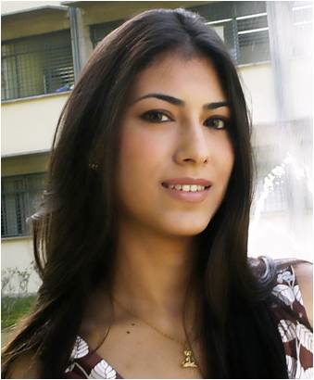
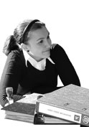
Run 2: Crowd & Experts
Get two fashion “experts” to label 1000 randomly selected images
Maribel
Fashion Experts
Elena

Slide 8
Run 2: Crowd & Experts
Get two fashion “experts” to label 1000 randomly selected images
Labelled images independently & then conferred on the ones which they disagreed
Maribel
Fashion Experts
Elena

Slide 9
Run 3: Crowd, Experts & Statistical Games
Use the run #1 PGM with the additional data from run #2
Use the expert labels to “clamp” the model during training.

Slide 10
Run 4: Crowd, Experts & More Statistical Games with text features
Apply another PGM by Paul Mineiro which extends the previous one with features
In learning the model parameters, the features are used to learn a classifier, which in turn informs the model parameters for the next iteration
Observed features
(we used BoW from the titles, tags, descriptions, contexts and notes)

Slide 11
Run 5: Crowd, Experts & More Statistical Games with text features
Same as run #4, but add visual features to the mix
2x2-4x4 PHOW from dense SIFT quantised into 300 visual terms
Observed features
(BoW from the titles, tags, descriptions, contexts and notes + PHOW)

Slide 12
Run 5: Crowd, Experts & More Statistical Games with text & Visual features

Slide 13
Results

