Slide 1




Natural Language Processing to identify substances related to overdose deaths: An R workshop
23‒25 October 2024 Lisbon, Portugal lisbonaddictions.eu #LxAddictions24
David Goodman-Meza, MD, PhD
Chelsea Shover, PhD
Funding: U.S. National Institute on Drug Abuse R01DA057630-01

Slide 2
References
R for data science: https://r4ds.had.co.nz/
Text Mining with R: https://www.tidytextmining.com/
Statistical Machine Learning: https://bcheggeseth.github.io/253_fall_2021/index.html
Supervised Machine Learning for Text Analysis: https://smltar.com/

Slide 3
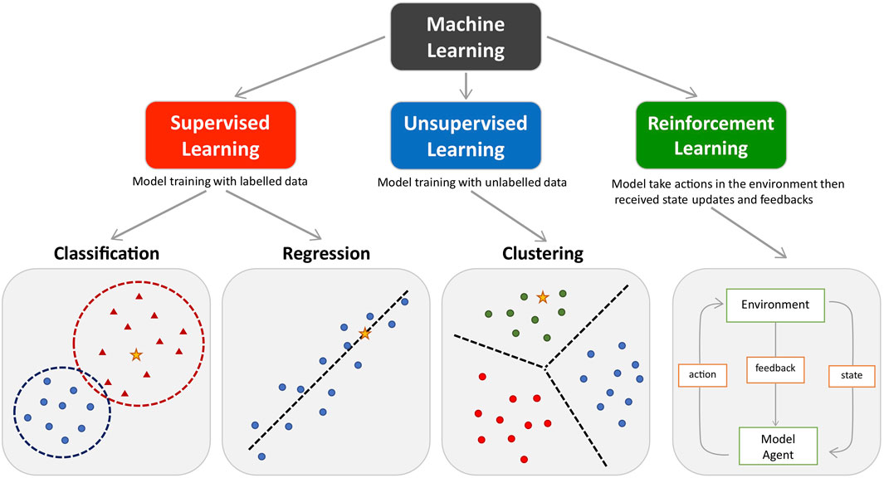
Types of Machine Learning

Slide 4
NLP
Subfield of computer science that focuses on enabling computers to understand, interpret, and generate human language in a way that is both meaningful and useful.
Examples:
Conversion of human speech and text
Sentiment analysis
Text/Document classification
Topic modelling
Content extraction
Translation
Summarization
Chatbots/virtual assistants
Text generation

Slide 5








NLP Workflow – R packages
Exploratory Data Analysis
Pre-Process Data
Linear regression - lm
Logistic regression - glm
KNN - kknn
Naive Bayes - naivebayes
Random forest - randomForest, ranger
Boosted trees - xgboost
SVM – Kernlab, liquidSVM
Neural networs – Keras, nnet
Model
Evaluate

Slide 6
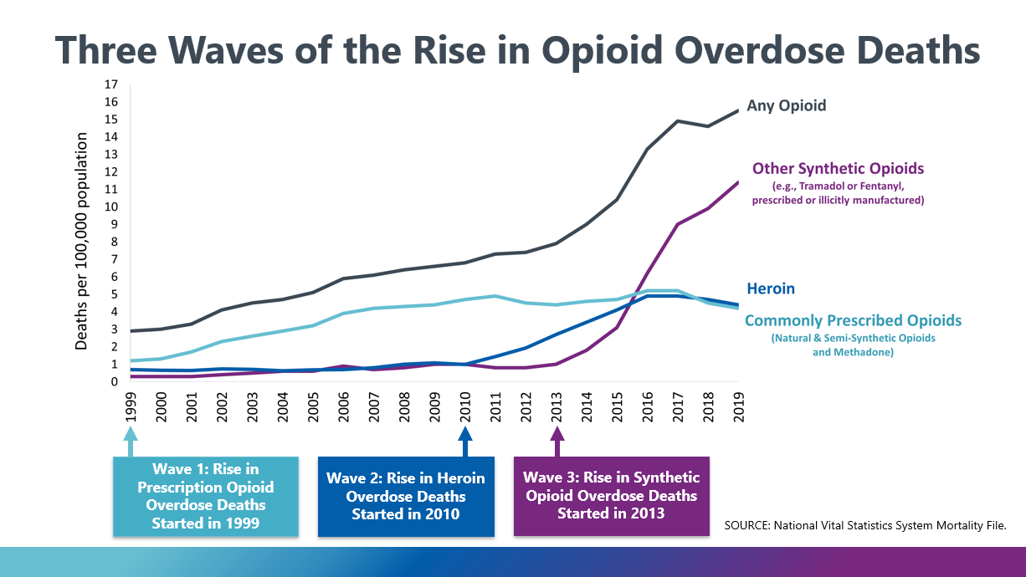
Drug Overdoses U.S.

Slide 7
Premise
According to the CDC there were over 93,000 deaths in 2020
We know this 7 months after the fact
We only know these trends at the national- and state-levels
We only know this over a 12-month period
Overall objective is to create an automated approach to rapidly and accurately identify substances that led to death in coroners’ report to provide much more rapid surveillance data around overdoses.
Aims:
To evaluate a natural language processing (NLP) based approach on their diagnostic accuracy to identify substances related to overdose in coroners/medical examiner data
Ahmad F, Rossen, LM, Sutton, P. Provisional drug overdose death counts: National Center for Health Statistics; 2021 [8/3/2021]. Available from: https://www.cdc.gov/nchs/nvss/vsrr/drug-overdose-data.htm.

Slide 8
Data
Death certificate data from either publicly available sources or by directly requesting the data from a coroner or medical examiner.
Data were obtained from the following:
Cook, IL; Denton, TX; Jefferson, AL; Johnson, TX; Los Angeles, CA; Milwaukee, WI; Parker, TX; San Diego, CA; Tarrant, TX. Connecticut.
Data were from between 1 Jan 2020 and 31 Dec 2020.
Variables:
Case number, county, age, gender, race, date of death, manner of death, primary cause, and secondary cause of death.

Slide 9
Classifications
Classification | Keywords
Methamphetamine | Methamphetamine
MDMA | 3,4-methylenedioxymethamphetamine, MDMA, methylenedioxymethamphetamine, 3,4-methylenedioxymethaphetamine
MDA | Methylenedioxyamphetamine, methylenedioxyamphetamine , MDA
Heroin | Heroin
Cocaine | Cocaine, cocaethylene
Fentanyl | Fentanyl, 4-ANPP, carfentanil, acetylfentanyl
Alcohol | Alcohol, ethanol, ethanolism
Benzos | Benzodiazapene, etizolam, chlordiazepoxide, lorazepam, flubromazolam, nordiazepam, diazepam, pyrazolam, clonazepam, estazolam, xanax, alprazolam, flualprazolam
Prescription opioids | Hydrocodone, oxycodone, hydromorphone, oxymorphone, codeine, oxycontin, methadone, percocet, buprenorphine, meperidine, morphine, tapentadol, tramadol, naltrexone, levorphanol
Anti-psychotics | Risperidone, quetiapine, olanzapine, aripiprazole, clozapine, haloperidol, chlorpromazine, ziprasidone, paliperidone, trifluoperazine, perphenazine, fluphenazine, lurasidone, pimozide
Anti-depressants | Citalopram, fluoxetine, fluvoxamine, paroxetine, sertraline, buproprion, venlafaxine, duloxetine, desvenlafasxine, levomilnacipran, imipramine, desipramine, nortriptyline, doxepin, trimipramine, amoxapine, protriptyline, trazodone, mirtazapine
Anticonvulsants | Carbamazepine, clobazam, oxcarbazepine, diazepam, ethosuxamide, phenytoin, gabapentin, lacosamide, levetiracetam, phenobarbital, pregabalin, lamotrigine, topiramate, valproate, valproic acid, zonisamide
Antihistamines | Diphenydramine, cetirizine, chlorpheniramine, fexofenadine, loratadine, hydroxyzine, doxylamine, xylazine
Muscle relaxants | Cyclobenzaprine, baclofen, carisoprodol, metaxalone, methocarbamol, tizanidine, orphenadrine
Barbituates | Butalbital, phenobarbital , pentobarbital, butabarbital, amobarbital
Hallucinogens | Phencycldine, LSD, diethylamide, ketamine, PCP, methylenedioxyamphetamine
Amphetamine | Amphetamine
R

Slide 10

NLP Workflow
Exploratory Data Analysis
Pre-Process Data
Model
Evaluate

Slide 11
Train-test split
data_split <- initial_split(df,
prop = 0.8,
strata = .y)
train <- training(data_split) #Save training as object
test <- test(data_split) #Save testing as object
#Other tools in rsample
cv_folds <- vfold_cv(training, v = 5, strata = .y) #Cross validation
boot_test <- bootstraps(testing, times = 1000, strata = .y) #Bootstrapping
R

Slide 12

Recipe
rec( y ~ x1 + x2 + x3, data = df) #Initial set-up
rec <- rec( y ~ x1 + x2 + x3, data = df) %>% #Initial set-up
update_role(new_role = “outcome”) %>% #Update roles (if needed)
update_role(all_continous( ), new_role = “predictor”) %>%
step_( ) %>% #Add steps
step_( )
prepped.rec <- Prep(rec)
baked.rec <- bake(prepped.rec, new_data = )

Slide 13
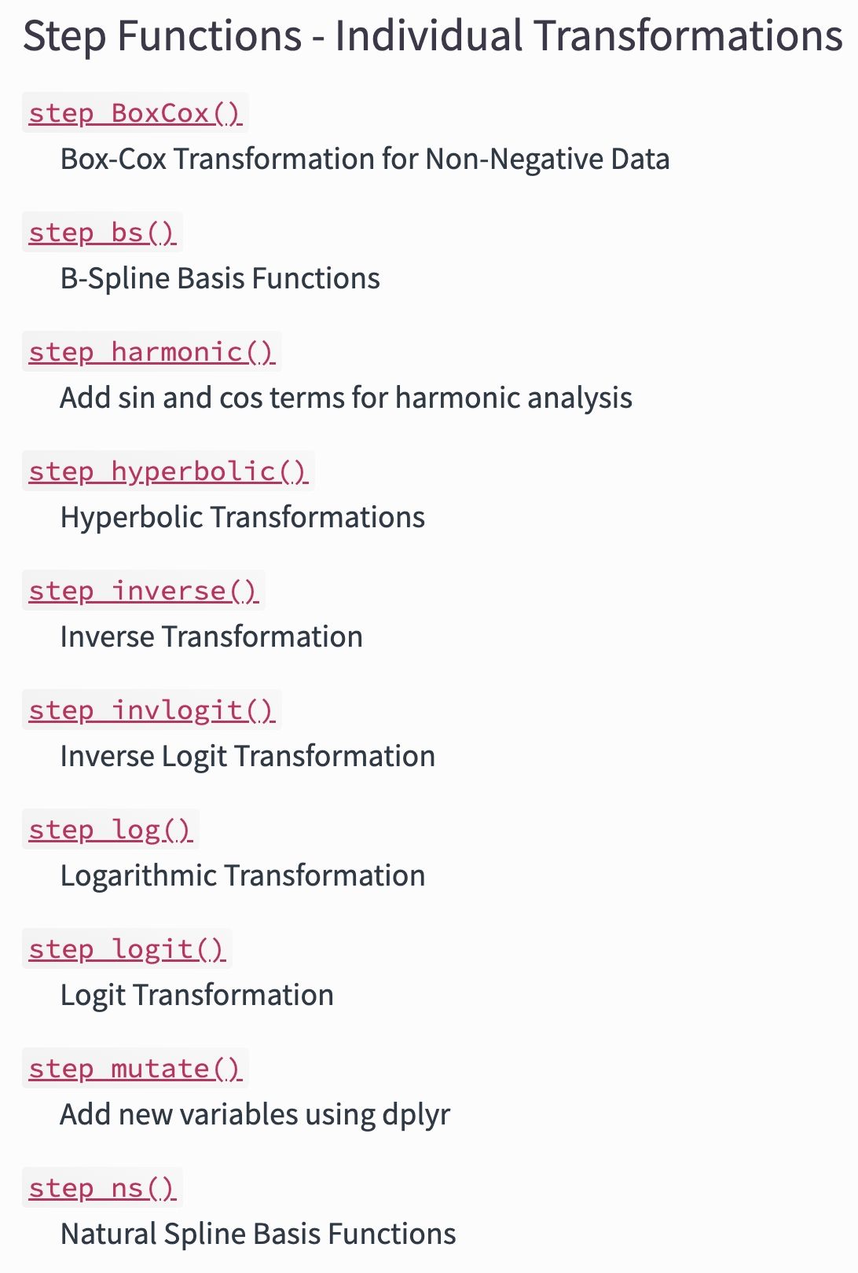
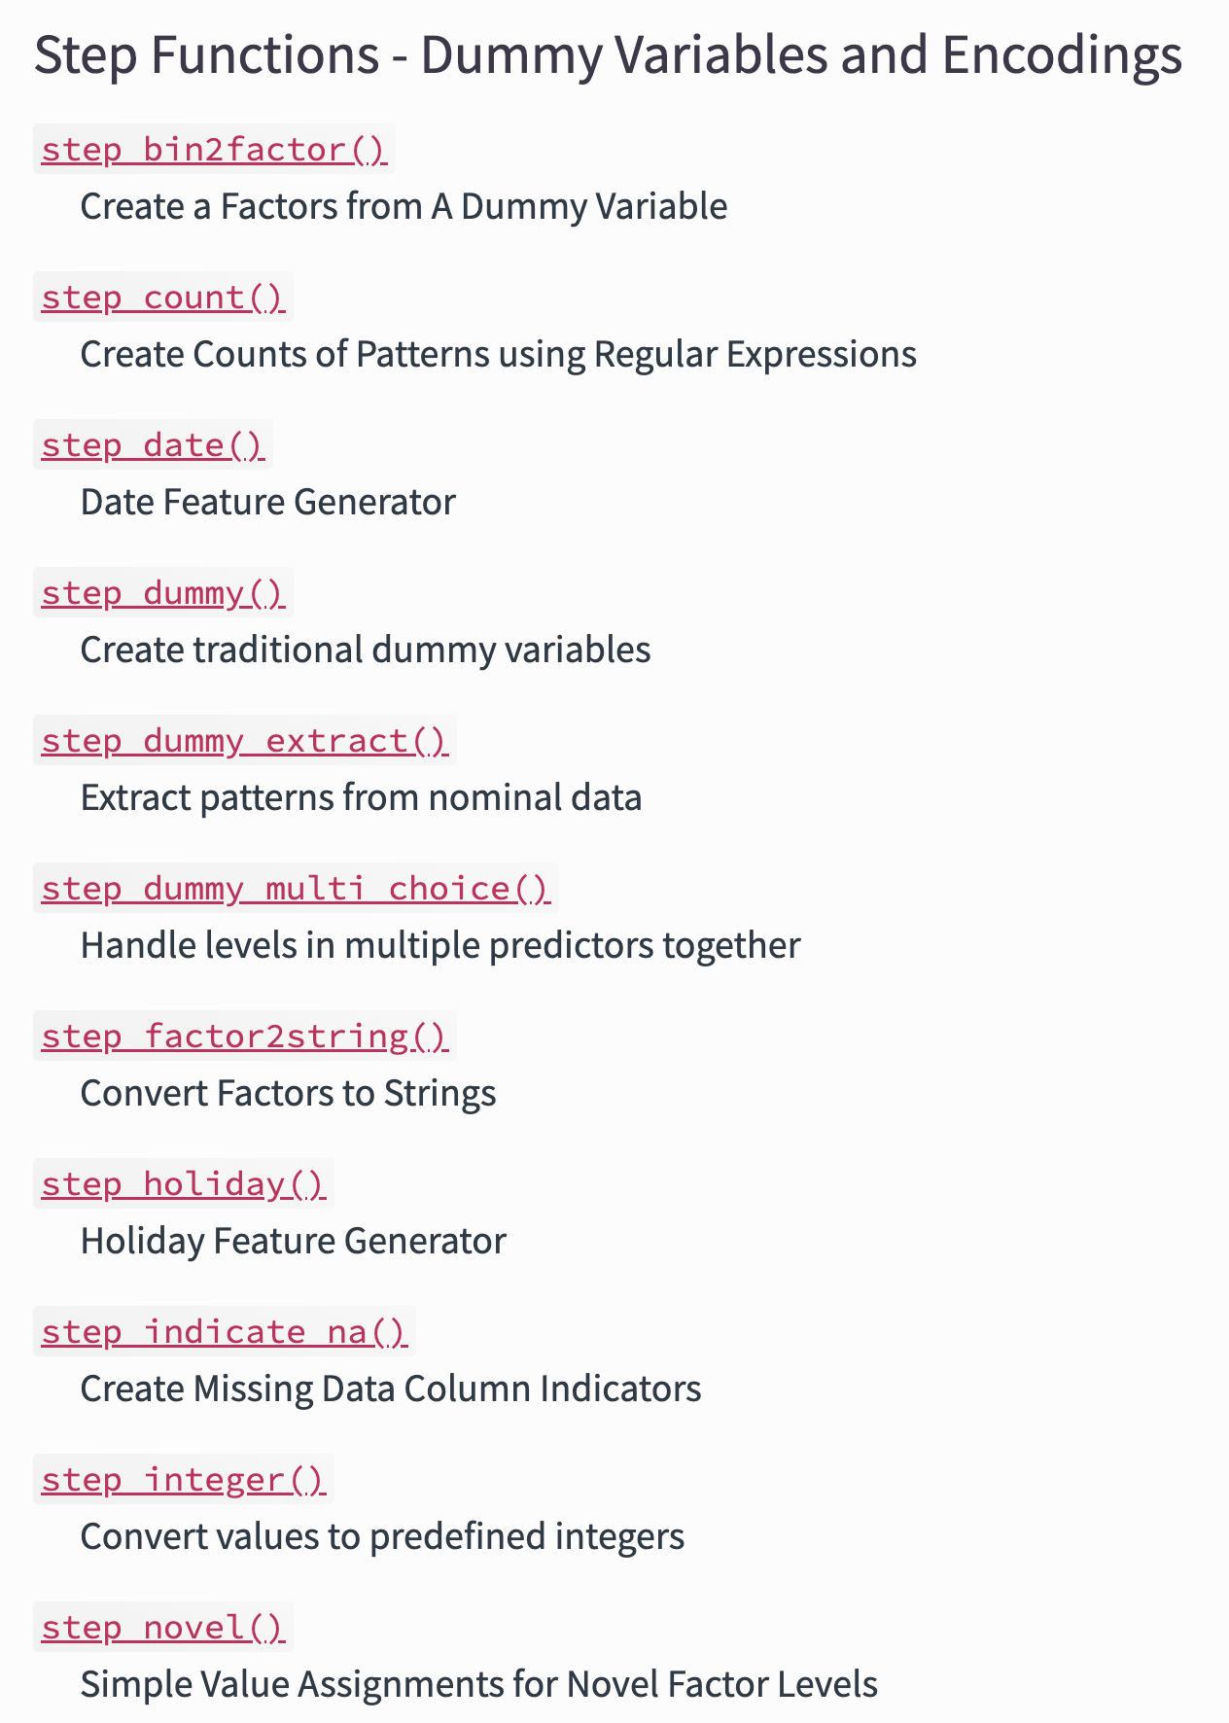
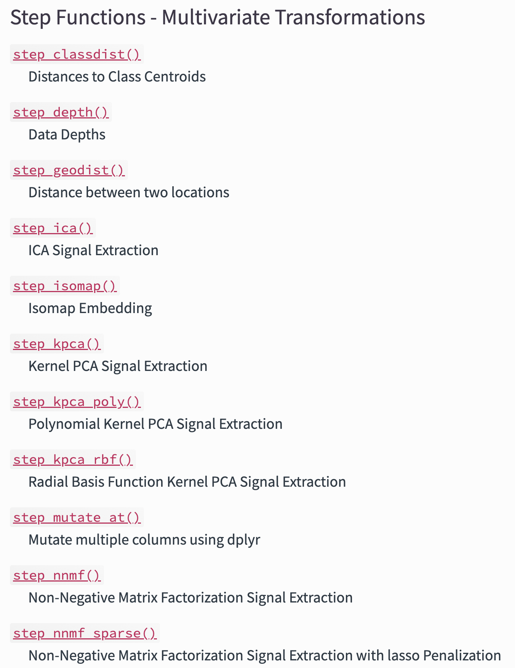
Recipes: Steps https://www.tidymodels.org/find/recipes/

Slide 14
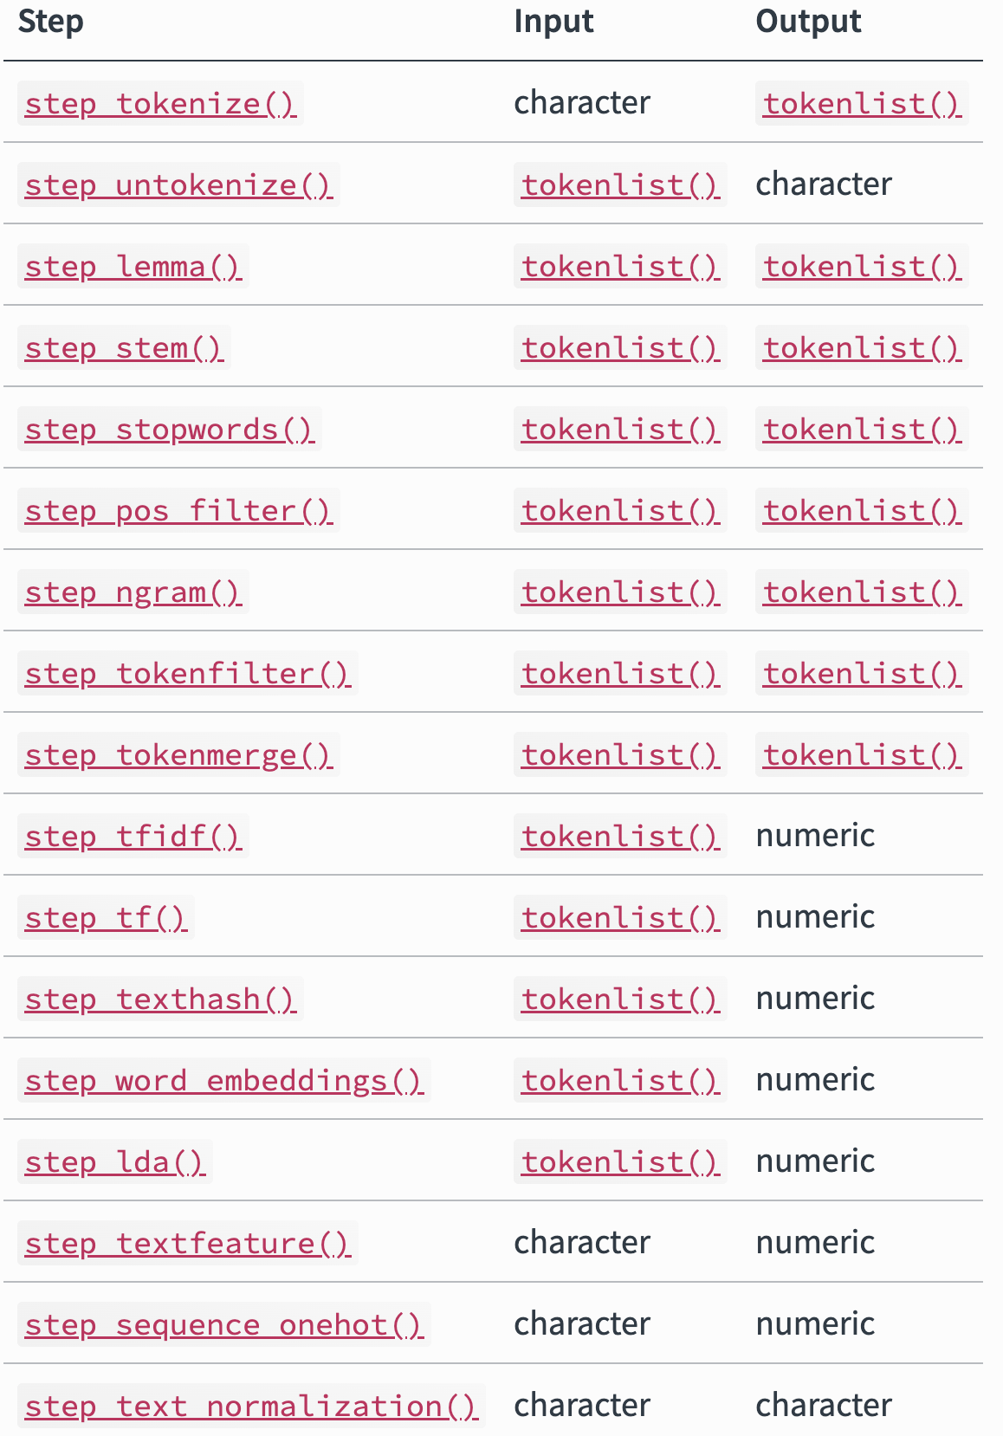
Textrecipes
R

Slide 15
Recipe: Example
rec <- rec(fentanyl ~ text, data = training) %>% #Initial set-up
step_tokenize(text, #Tokenize, default word
options = list(lowercase = F,
strip_punct = TRUE)) %>%
step_tokenfilter(text,
min_times = 5,
max_times = Inf) %>% #Filter
step_tfidf(text) #Weight words based on TF-IDF
#Others
step_tf(text)
step_sequence_onehot(text)
step_word_embeddings(text, embeddings = glove_embed, prefix ="emb_")

Slide 16
NLP Workflow
Exploratory Data Analysis
Pre-Process Data
Linear regression - lm
Logistic regression - glm
KNN - kknn
Naive Bayes - naivebayes
Random forest - randomForest, ranger
Boosted trees - xgboost
SVM – Kernlab, liquidSVM
Neural networks – Keras, nnet
Model
Evaluate

Slide 17
Set up Models
rf_spec <- rand_forest() %>% #Pick a model
set_mode(“classification”) %>% #Set the mode
set_enginge(“randomForest”) #Set the engine
Search models:
https://www.tidymodels.org/find/parsnip/

Slide 18
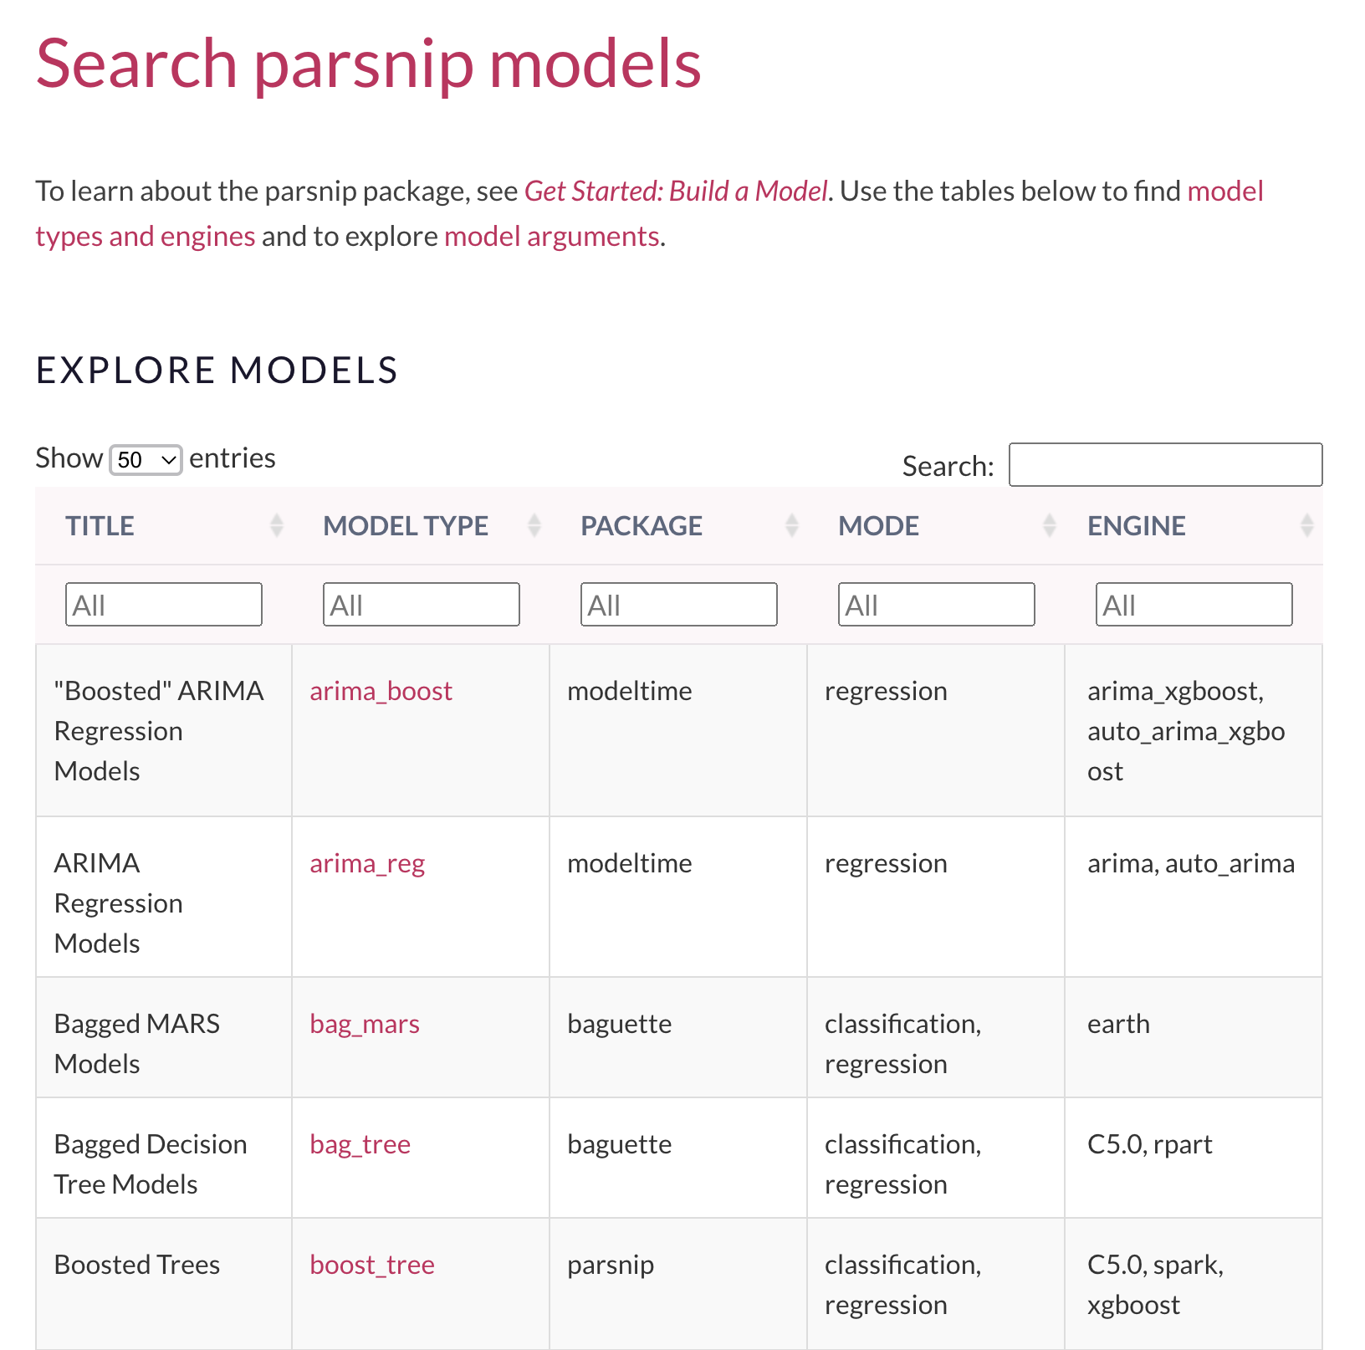
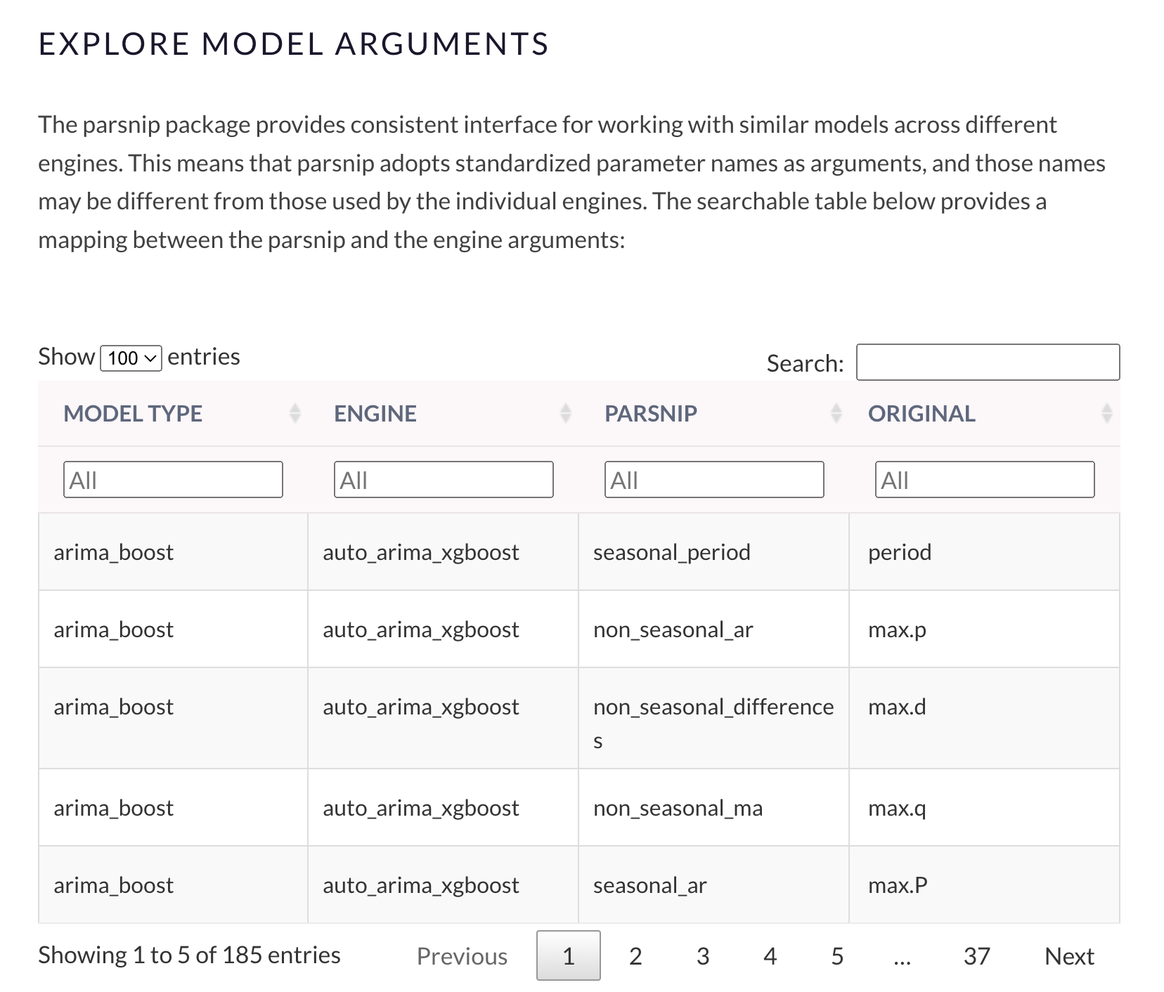

Slide 19
Set up Models
rf_spec <- rand_forest() %>% #Pick a model
set_mode(“classification”) %>% #Set the mode
set_enginge(“randomForest”) #Set the engine
#Set hyperparameters manually or for automatic tunning
rand_forest(min_n = tune( ), trees = tune( ), mtry = tune( )) %>% set_mode(“classification”) %>% set_enginge(“randomForest”)

Slide 20
Set up hyperparameter grid
grid_ctrl <- control_grid(
save_pred = TRUE,
parallel_over = "everything",
save_workflow = FALSE,
event_level = "first"
)
#Set cores for parrallelization
parallel::detectCores(logical = FALSE) # How many cores available
# Set up the parallel backend using future
plan(multicore, workers = 8) # Use 8 cores for parallel processing
registerDoFuture()

Slide 21
Putting it together: Workflow
rf_wflow <- workflow() %>%
add_recipe(rec) %>%
add_model(rf_spec)
rf_fit <- rf_wflow %>%
fit(data = mtcars)
#We would have to write individual code for each model

Slide 22
Putting it together: workflow vs Workflowsets
wflw_set <- workflow_set(
preproc = list(recipe_1 = rec1, recipe_2 = rec2, ...),
models = list(model_1 = model_spec, model_2 = model_spec2,..),
cross = TRUE)
grid_resutls <- wflw_set %>%
workflow_map( )

Slide 23
Putting it together: workflow vs Workflowsets
cv_folds_train <- vfold_cv(training, v = 5, strata = .y) #Cross validation
grid_results <- wflw_set %>%
workflow_map(
seed = 100, #For reproducibility
resamples = cv_folds, #Cross validation
grid = 10, #Number of tunning runs
control = grid_ctrl, #Grid set-up
metrics = metric_set( #Metrics to calculate
recall, precision, f_meas, accuracy, kap, roc_auc, sens, spec, ppv, npv),
verbose = T #View progress
)

Slide 24
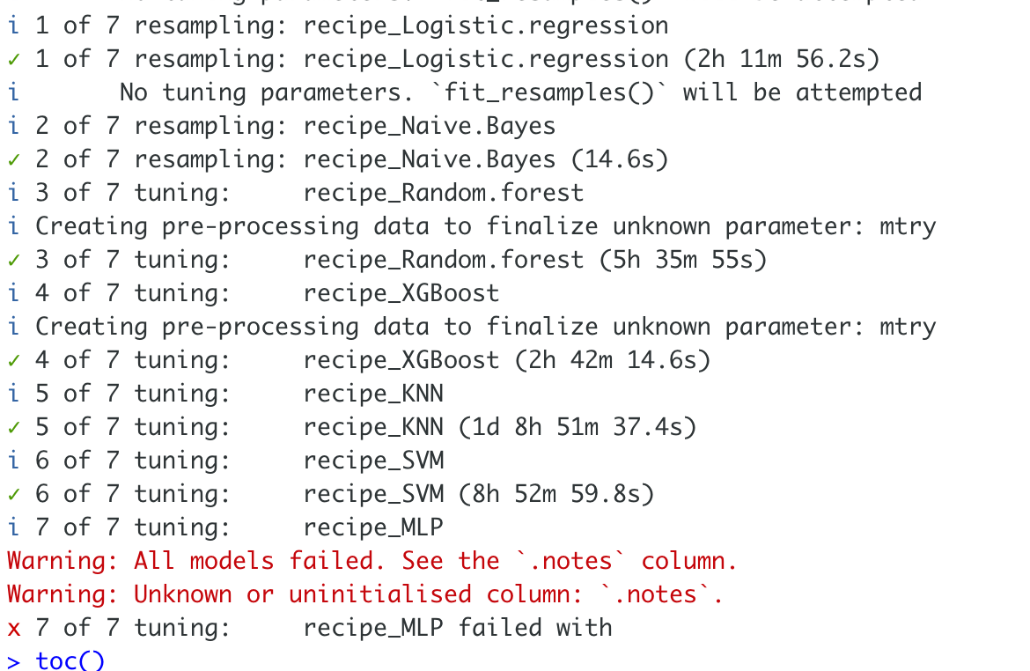
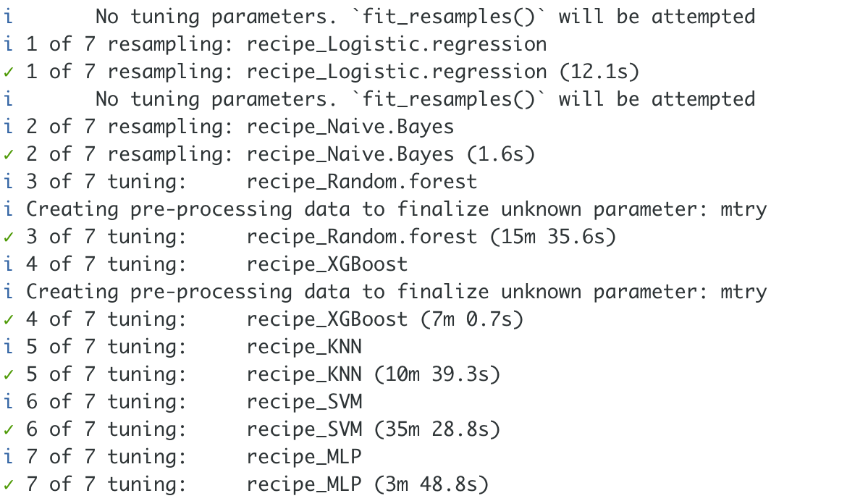
Training output
Inf tokens
100 tokens

Slide 25
NLP Workflow
Exploratory Data Analysis
Pre-Process Data
Model
Evaluate

Slide 26
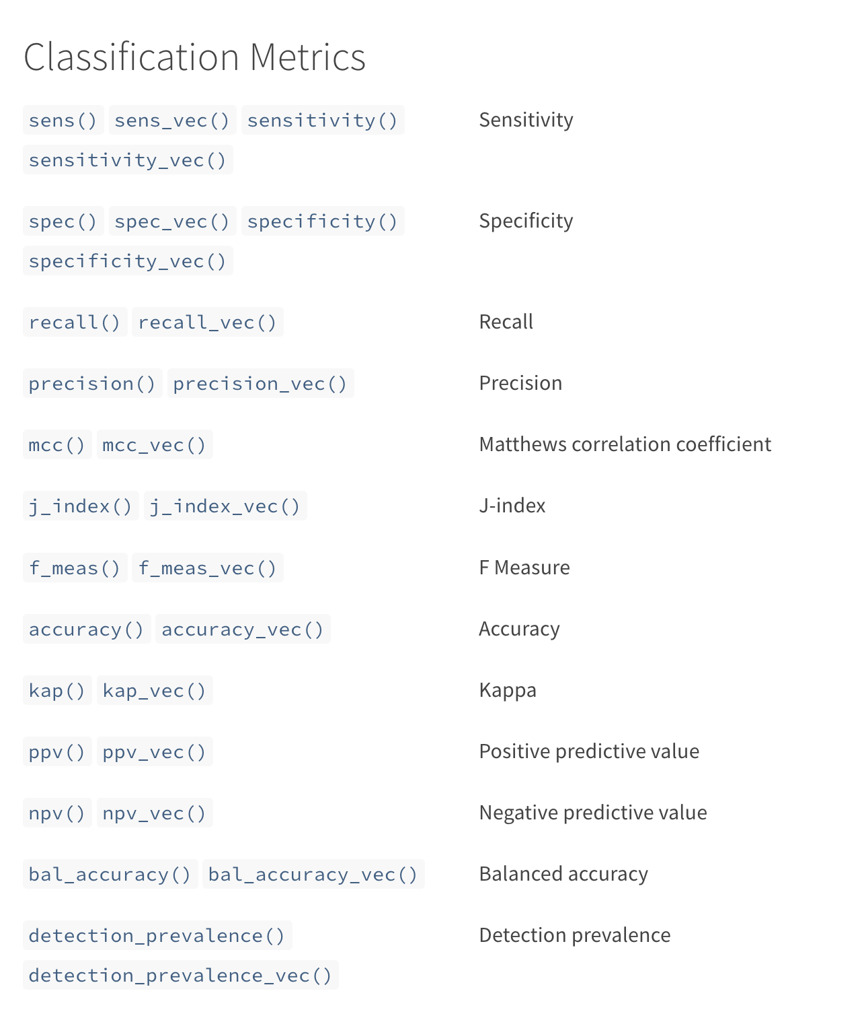
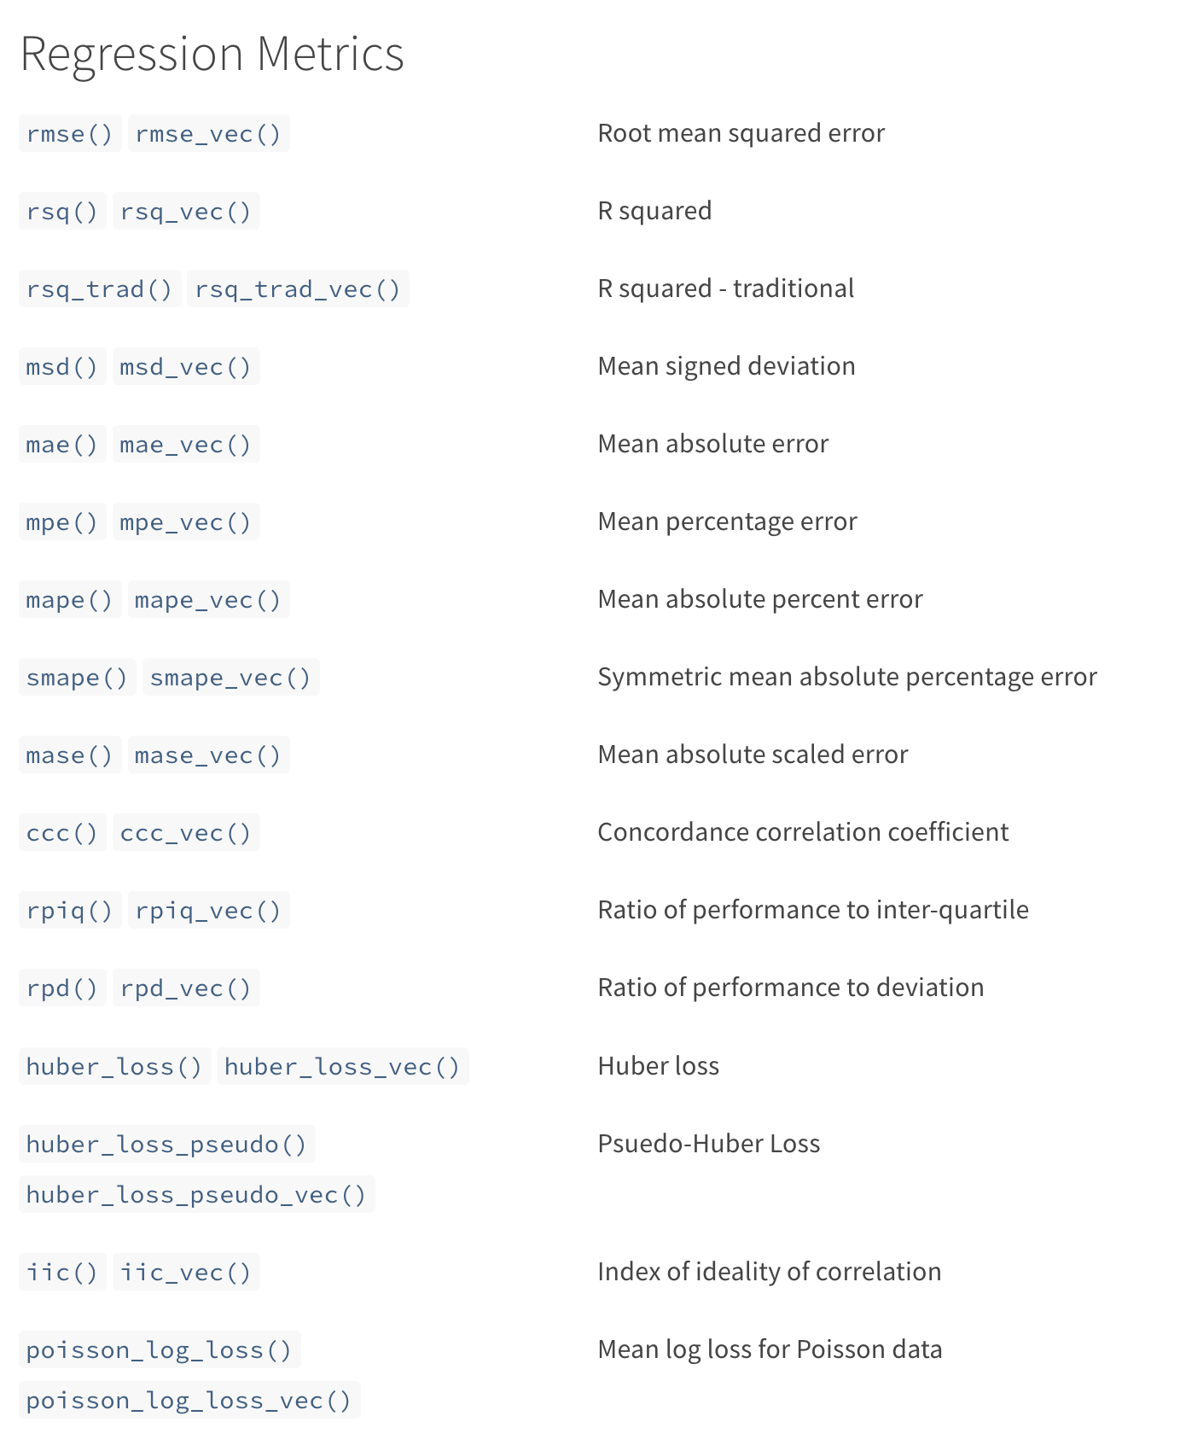

Slide 27
Plot Training Results
grid_results %>% autoplot() #Plot all results
grid_results %>% autoplot(select_best = T) #Plot best results
grid_results %>% collect_predictions() %>% #ROC curve
roc_curve(truth = var, estimate = .pred_1) %>%
autoplot()
grid_results %>% collect_predictions() %>% #PR curve
pr_curve(truth = var, estimate = .pred_1) %>%
autoplot()

Slide 28
Table Training Results
grid_results %>% #Get all metrics
collect_metrics( )
grid_results %>% #Get only best metrics
rank_results(
rank_metric = "f_meas",
select_best = TRUE
)

Slide 29
Evaluate on Test dataset alone
best.workflow <- tbl.train.results.best$wflow_id[1]
best.parameters <- grid_results %>%
extract_workflow_set_result(tbl.train.results.best$wflow_id[1]) %>%
select_best(metric = "f_meas")
test_results <- grid_results %>%
extract_workflow(best.workflow) %>%
finalize_workflow(best.parameters) %>%
last_fit(split = data_split,
metrics = metric_set(
f_meas, accuracy, kap, roc_auc, sens, spec, ppv, npv))

Slide 30
Get final results
test_results %>% collect_metrics() #Results long
test_results %>% #Results wide
collect_metrics() %>%
pivot_wider(
id_cols = .config,
names_from = .metric,
values_from = .estimate
)

Slide 31
Confusion Matrix
test_results %>%
collect_predictions( ) %>%
conf_mat(truth, .pred_class) %>%
autoplot(type = "heatmap") #Can also be “mosaic”

Slide 32
Feature importance
test_results %>%
pluck(".workflow", 1) %>%
extract_fit_parsnip() %>%
vip(num_features = 20)

Slide 33
Questions?
dgoodman@kirby.unsw.edu.au
clshover@mednet.ucla.edu

