Slide 1
Lab Guide 7: Quality Standards, Version Control and Software Testing
G7
Applied to EcoRecicla, a recycling web app for Bogotá
Samuel Ossa Escobar · David Alejandro Zambrano Arguello
Universidad Manuela Beltrán · Software Quality Standards and Metrics
Notes:
Hi, I'm Samuel Ossa. With my teammate David Zambrano, I will summarize Lab Guide 7: quality standards, version control and software testing, applied to EcoRecicla, our recycling web app for Bogotá.

Slide 2
ISO 9000: prove quality, do not just inspect it
1
ISO 9000
The big lesson
Principles and vocabulary of quality management
Inspect at the end
2
ISO 9001
Requirements; the only certifiable standard of the family
Prevent during the whole process
3
ISO 9001:2026
Published September 2026: stronger control of changes
ISO 9002 and ISO 9003 were withdrawn in 2000 and merged into ISO 9001.
Notes:
First, the theory. ISO 9000 gives the principles and the vocabulary of quality management, and ISO 9001 is the only certifiable standard of the family. Its new edition, published in September 2026, asks for a stronger control of changes. The big lesson is to move from inspecting at the end to preventing during the whole process.

Slide 3
Independent research: structure, companies and testing
High-level structure (Annex SL)
CMMI level 5 in Colombia
✓
ISO 9001 · quality management
Perficient Latin America (formerly PSL), Medellín
Heinsohn Business Technology, Bogotá
Minsait, an Indra company
✓
ISO 14001 · environment
✓
ISO/IEC 27001 · information security
✗
ISO/IEC 25010 · product quality model
✗
ISO/IEC/IEEE 29119 · software testing
Certifications require evidence.
Testing produces that evidence.
Only management system standards follow it.
Notes:
In our research we found that not all ISO standards follow the high-level structure: only management system standards, like ISO 9001, do. In Colombia, companies such as Perficient Latin America and Heinsohn reached CMMI level 5. These certifications do not test software, but they require evidence, and testing produces that evidence.

Slide 4
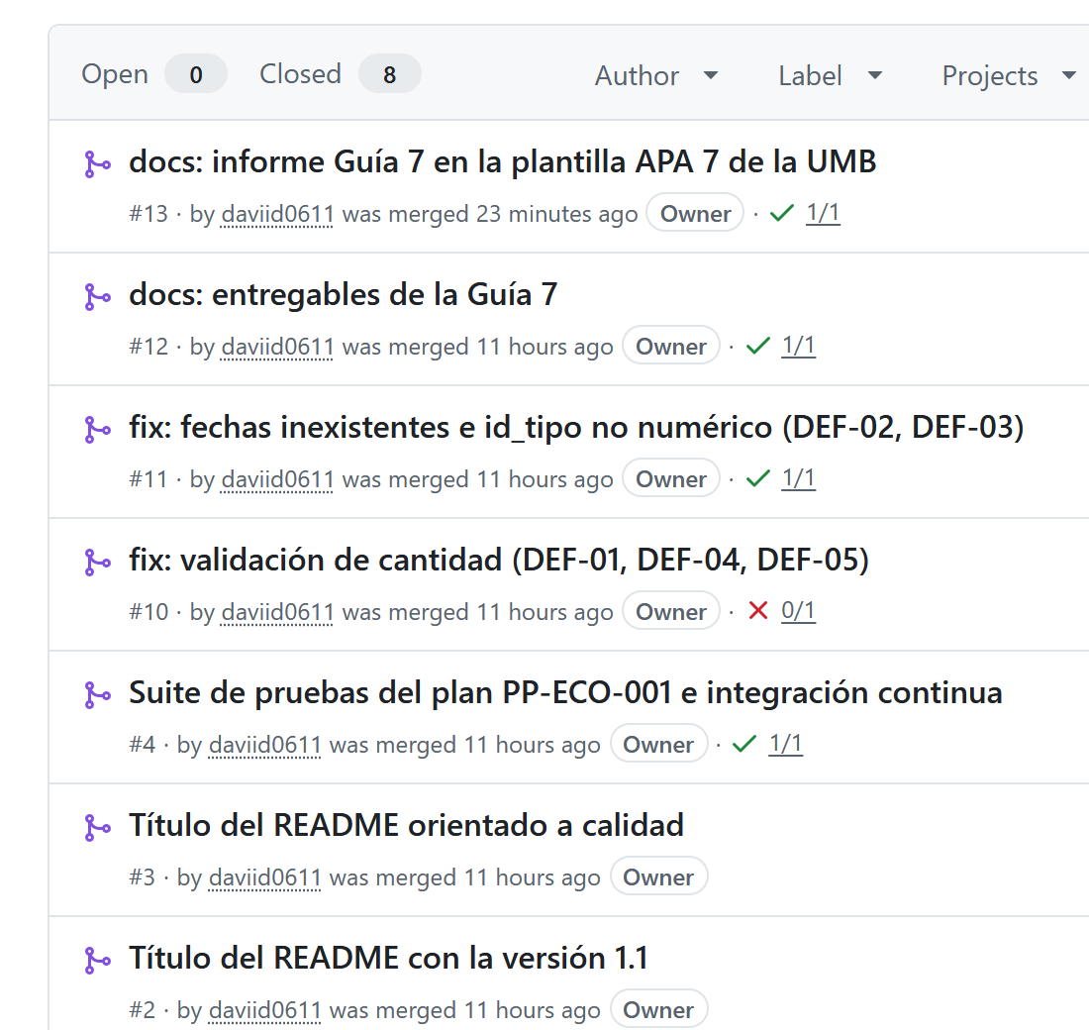
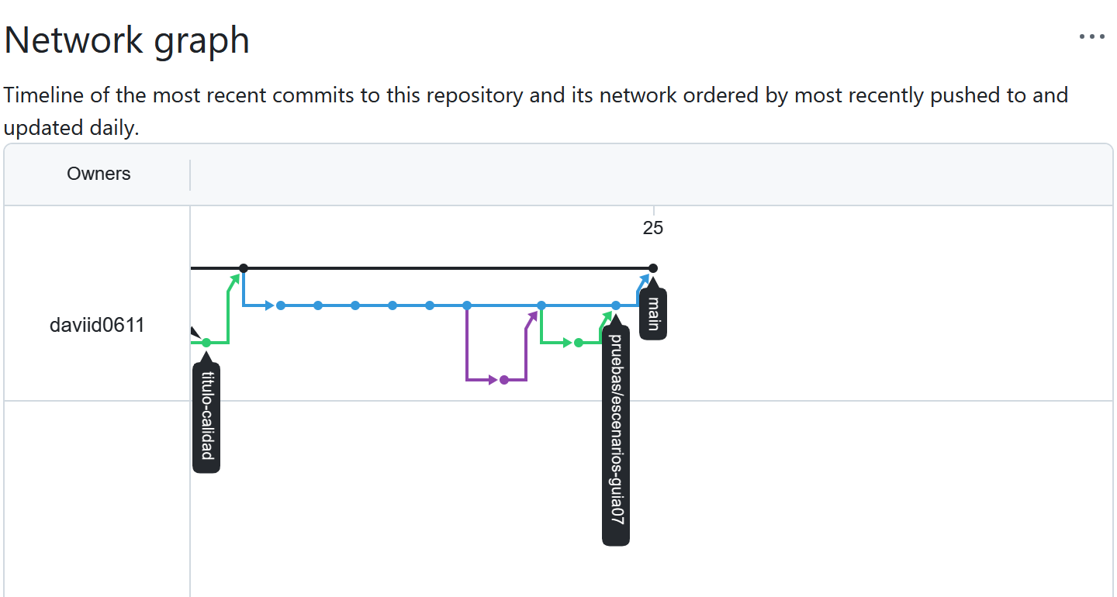
Session 1: every change follows six steps
1. Issue
2. Branch
3. Commits
4. Pull request
5. Tests + review
6. Merge
Pull requests (left) and branch graph (right): every branch returns to main through a pull request.
Notes:
In session one we practiced version control with Git and GitHub. Every change follows six steps: issue, branch, commits, pull request, automatic tests with review, and merge. Here are our pull requests and the branch graph.

Slide 5
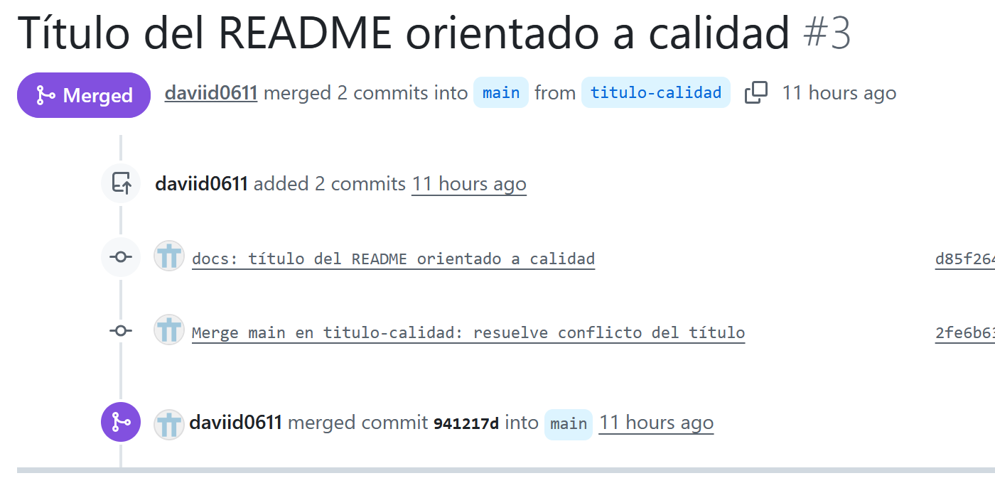
A real merge conflict, solved by hand
CONFLICT (content): Merge conflict in README.md
<<<<<<< HEAD
# EcoRecicla - Plataforma de reciclaje
urbano con pruebas automatizadas
=======
# EcoRecicla v1.1 - Prototipo completo
>>>>>>> origin/main
Resolution: combine both changes
# EcoRecicla v1.1 - Plataforma de reciclaje urbano con pruebas automatizadas
Notes:
We also created a real merge conflict. Two branches changed the same line of the README. Git marked the conflict, and we solved it by hand, combining both changes.

Slide 6
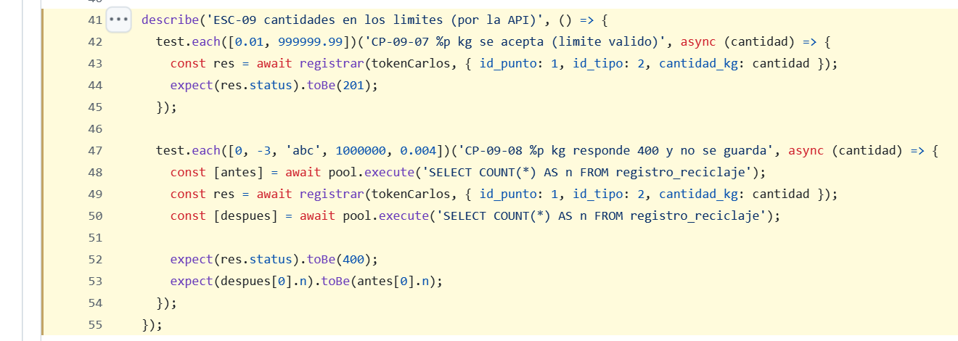
Sessions 2 and 3: 90 automated tests
90
automated tests
44
unit tests
46
integration tests (isolated database)
Notes:
In sessions two and three we executed our test plan. We wrote ninety automated tests with Jest and Supertest. This test checks the limits of the recycled quantity: valid values must be saved, and invalid values must be rejected without saving anything.

Slide 7
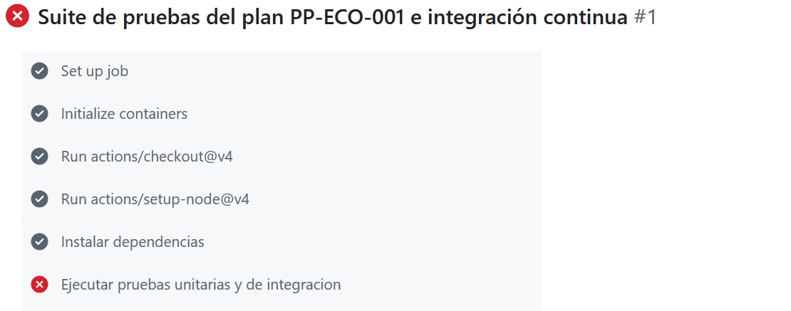
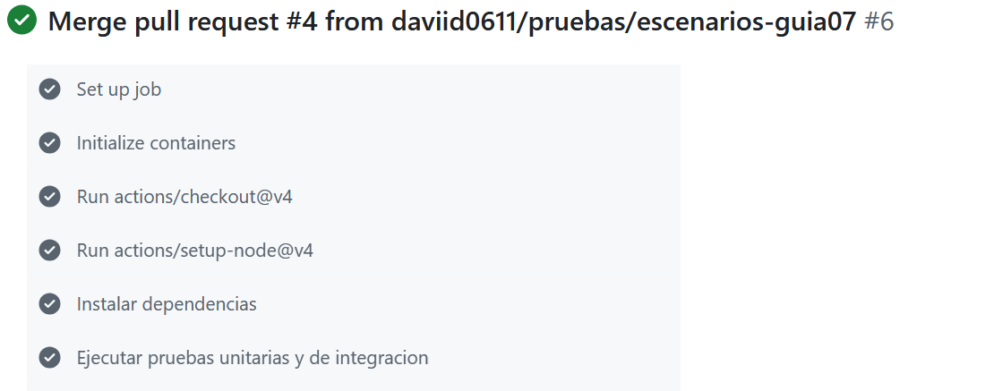
GitHub Actions found five real defects
First run: FAILED (10 of 76 tests)
After the fixes: PASSED (90 of 90)
Examples: 0.004 kg returned HTTP 500 (internal server error) · the date 2026-02-30 was accepted
Notes:
GitHub Actions runs all the tests on every pull request with MySQL 8. The first run failed and revealed five real defects. For example, a quantity of 0.004 kilograms caused an internal server error, and a date like February 30 was accepted.

Slide 8
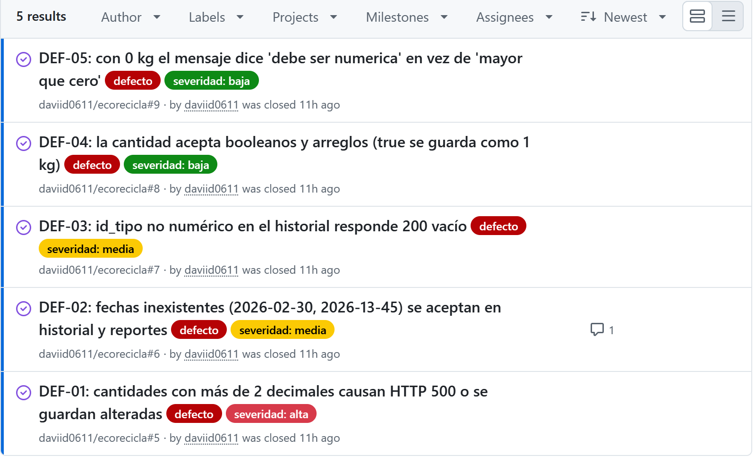
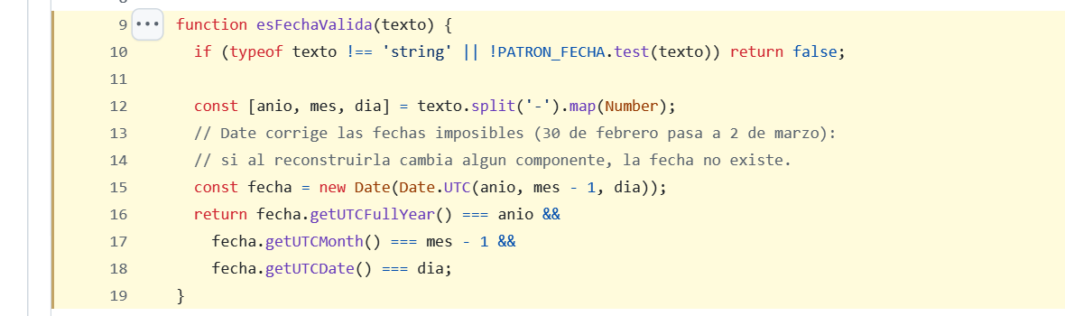
Each defect: issue, fix branch, test again
Fix for dates (DEF-02)
JavaScript turns February 30 into March 2. If the rebuilt date changes, the date does not exist.
5 issues closed: 1 high, 2 medium, 2 low severity
Notes:
Each defect became a GitHub issue, was fixed in its own branch and was tested again. This is the fix for the dates: it rebuilds the date and checks that it really exists in the calendar.

Slide 9
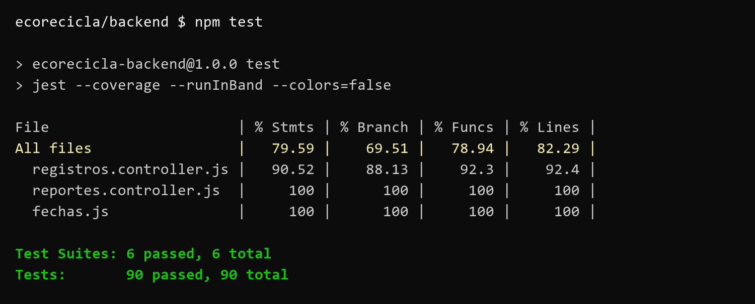
All 90 tests pass
90 / 90
tests pass
82.29 %
line coverage
5 / 5
defects fixed
ISO 9000 does not test the software: it asks us to prove quality with evidence.
Thank you for watching
Notes:
Now all ninety tests pass, and line coverage is eighty-two percent. Our conclusion: ISO 9000 does not test the software, but it asks us to prove quality with evidence. Thank you for watching.

