Slide 1

From Smartsheet to Cordova PPM
How Microsoft Cordova moved IT project intake, governance and delivery from Smartsheet into a Power Apps solution on Dataverse, and how a project now runs from intake to archive
16 template sheets per project
One IT Project record with its artifacts as child rows
MICROSOFT CORDOVA IT PMO · OCTOBER 2026
Notes:
This deck tells two stories. First, how Microsoft Cordova moved its IT project process out of Smartsheet: what the Smartsheet setup looked like, what we needed instead, and exactly how each Smartsheet sheet became part of Cordova PPM, a Power Apps code app on Dataverse. Second, how a project now runs from the BRM's intake to manual archive. On every step slide, the top-left panel shows how that step worked in Smartsheet, and the rest of the slide shows how it works now. The example project, ITProj-26-013 Supplier Self-Service Portal, was created live in the app for this walkthrough; later stages use sample projects that are already at those stages.

Slide 2

Every project ran on a Smartsheet workspace
THE STARTING POINT · BRD §5 CURRENT STATE
BRMs submitted requests through the PPM Intake sheet
Approval from Draft to Initiate copied the templates into a project workspace: 16 sheets and a dashboard folder
Each sheet repeated the Project ID and Project Name; cell links passed values between sheets
Gate readiness and decisions lived in columns on the Project Record and rows on the Approvals sheet
Resource capacity data in Smartsheet fed a Power BI RCP report
SMARTSHEET · ITPROJ-YY-NNN WORKSPACE
0.0
0.0a
0.0b
1.0
Stakeholder Register
Project Record
Project RACI
BRD
2.0
3.0
3.5
4.0
Project Plan
Resource Estimator Planning
Budget and Forecast
Cost Estimator
5.0
6.0
6.0b
7.0
RAIDD Log
UAT Test Plan
UAT Defect Tracker
Cutover Plan
8.0
9.0
X.0b
x.0
Hypercare Defect Tracker
Weekly Status Tracker
Approvals
Metadata
Plus a dashboard folder per project. Intake fields were copied into x.0 Metadata.
Notes:
This is the current state described in BRD section 5, and the structure of the Smartsheet exports for a real project. When a project was approved from Draft to Initiate, a copy of the templates created the project workspace: sixteen sheets numbered 0.0 to 9.0, plus Approvals, Metadata and a dashboard folder. Every sheet carried the Project ID and Project Name on its rows, and cell links moved values such as the intake fields between sheets. Resource capacity was also kept in Smartsheet and reported through a Power BI RCP report.

Slide 3






What we needed that sheets could not give us
WHY WE MOVED · BRD §2 BUSINESS OBJECTIVES
One system of record
Controlled, auditable workflow
Artifacts created for us
Intake, governance, status, approvals, forecasts, resource demand and reporting in one place
Replace Smartsheet-based workflows with controlled, auditable, role-based workflows
Create and manage the required project artifacts on approval from Draft to Initiate
PPM‑BO‑001
PPM‑BO‑002 · 008
PPM‑BO‑004
Capacity in the same tool
Portfolio visibility
Confidential and external work
Demand, capacity, nominations, confirmations and scenarios alongside the project
Stage, health, budget and forecast against SAP actuals, go-lives and overdue updates
NDA projects with an approved access list, and controlled access for external people
PPM‑BO‑005
PPM‑BO‑006 · 007
PPM‑BO‑009 · 010
Notes:
These are the business objectives from BRD section 2, grouped. PPM-BO-002 says it directly: replace Smartsheet-based workflows with controlled, auditable, role-based workflows. The rest describe what a spreadsheet workspace per project could not do on its own: one system of record across every project, artifacts created and governed automatically, capacity planning in the same tool, and confidential or external access that is controlled and audited.

Slide 4
Smartsheet and Cordova PPM, side by side
BEFORE AND AFTER
 | ● SMARTSHEET | ● CORDOVA PPM
Intake | PPM Intake sheet | BRM-only form, validated, with a unique Project ID
Project artifacts | 16 template sheets copied per project | Dataverse rows created under the project at SG0
Linking artifacts | Project ID on every sheet, plus cell links | One lookup from every artifact row to the project
Gate readiness | Checklist columns on the Project Record | Configurable checklist; blocks Approve until met
Approvals | Rows on the X.0b Approvals sheet | Gate reviews with segregation of duties, exceptions
Status and health | 9.0 Weekly Status Tracker sheet | Weekly status; overall health calculated
Resource capacity | Smartsheet data feeding a Power BI report | Heatmap, nominations, gaps and scenarios in-app
Reporting | Power BI built on Smartsheet data | Portfolio dashboard; Power BI on the same tables
Audit | Activity and cell history, sheet by sheet | One audit trail with before and after values
Notes:
Each row is one part of the process. The left column is how it worked in Smartsheet, from the BRD current state and the Smartsheet exports; the right column is how Cordova PPM handles it. The step-by-step walkthrough later in the deck shows each of these on the real screens.

Slide 5





How we got from Smartsheet to Cordova PPM
THE MOVE · SIX STEPS
1
2
3
4
5
6
Start from the BRD
Use the sheets as the spec
Model it in Dataverse
Provision the solution
Build the app
Test and deploy
BRD v2.0: 9 stages, 8 gates and reviews, roles, 18 acceptance criteria
A real project's Smartsheet exports gave each artifact's columns
Each sheet became a table with a lookup to the IT Project
A script created the ITProject solution: 30 tables, 2 security roles
A React and TypeScript Power Apps code app for the whole lifecycle
42 workflow checks and render tests; published and packaged for Teams
What moved: the templates, rules and process. Smartsheet project data was not migrated (BRD PPM‑OS‑004); new intakes start in Cordova PPM.
Notes:
This is exactly how the move was done. We started from the BRD, version 2.0, which sets the lifecycle, gates, roles and acceptance criteria. The Smartsheet exports of one real project served as the column-layout reference for each artifact. Each sheet was modeled as a Dataverse table under the IT Project, all defined in one model file in the code. A provisioning script, which can be rerun safely, created the ITProject solution with 30 tables, the relationships and two security roles. The app itself is a Power Apps code app written in React and TypeScript. It has 42 automated workflow checks mapped to the acceptance criteria, a render test of every page for every persona, and a live check that reads all 30 tables back from Dataverse. It was published with pac code push to the development environment and packaged as a Teams personal app. Migrating historical or active Smartsheet data is out of scope in the BRD, so what moved is the structure and the process, not the old rows.

Slide 6
Every Smartsheet sheet became a Dataverse table
THE MOVE · SHEET-TO-TABLE MAPPING
● SMARTSHEET SHEET | ● DATAVERSE TABLE
0.0 Stakeholder Register | cordova_stakeholder
0.0a Project Record | cordova_itproject
0.0b Project RACI | cordova_raciitem
1.0 BRD | cordova_requirement cordova_requirementtrace
2.0 Project Plan | cordova_plantask
3.0 Resource Estimator Planning | cordova_resourcedemand
3.5 Budget and Forecast | cordova_forecastline cordova_forecastentry cordova_financialactual
4.0 Cost Estimator | cordova_costitem
● SMARTSHEET SHEET | ● DATAVERSE TABLE
5.0 RAIDD Log | cordova_raidditem
6.0 UAT Test Plan | cordova_testcase
6.0b UAT Defect Tracker | cordova_uatdefect
7.0 Cutover Plan | cordova_cutovertask
8.0 Hypercare Defect Tracker | cordova_hypercaredefect
9.0 Weekly Status Tracker | cordova_statusupdate
X.0b Approvals | cordova_gatereview cordova_governanceexception
x.0 Metadata | fields on cordova_itproject
Plus 11 supporting tables for users and roles, the NDA access list, external access grants, notifications, audit events, settings, intake attachments and capacity planning: 30 tables in all. The dashboard folder became the in-app portfolio dashboard and reports.
Notes:
The numbering of the Smartsheet templates was kept, so PMs recognize every artifact. Where one sheet held more than one kind of row, it became more than one table: the Budget and Forecast sheet is now forecast lines, monthly forecast entries and SAP actuals, and the Approvals sheet is gate reviews plus governance exceptions. The Project Record and Metadata sheets became the IT Project row itself. Eleven supporting tables hold the things Smartsheet handled through sharing settings or not at all: user profiles and application roles, NDA access lists, external access grants, notifications, the audit trail, settings, intake attachments, and four capacity-planning tables.

Slide 7

One project record instead of sixteen linked sheets
THE MOVE · DATA MODEL
BEFORE · IN SMARTSHEET
NOW · IN DATAVERSE
0.0 Stakeholder Register
0.0 Stakeholder
5.0 RAIDD item
ITProj-YY-NNN
Project name
0.0b RACI item
6.0 Test case
1.0 Requirement
6.0b UAT defect
2.0 Project Plan
IT Project
ITProj-YY-NNN
Project name
2.0 Plan task
7.0 Cutover task
0.0a Project Record
x.0 Metadata
3.0 Resource demand
8.0 Hypercare defect
5.0 RAIDD Log
3.5 Forecast & SAP actuals
cordova_itproject
9.0 Status update
ITProj-YY-NNN
Project name
4.0 Cost item
X.0b Gate review & exception
Project ID and name repeated on every row of every sheet; cell links copied values across
Each artifact row has one parental lookup to its IT Project. Ownership and sharing cascade down, so NDA restrictions reach every artifact, and reports join on the lookup instead of matching ID text.
Notes:
In Smartsheet, each sheet was its own grid, so the Project ID and Project Name were repeated on every row and values such as the intake fields were copied across with cell links. In Dataverse, there is one IT Project row, and every artifact row points to it through a parental lookup. Because the relationship is parental, ownership, sharing and deletion cascade from the project to its artifacts. That is what lets the NDA restriction apply to every artifact of a confidential project, and why removing a sample project also removes its artifacts.

Slide 8
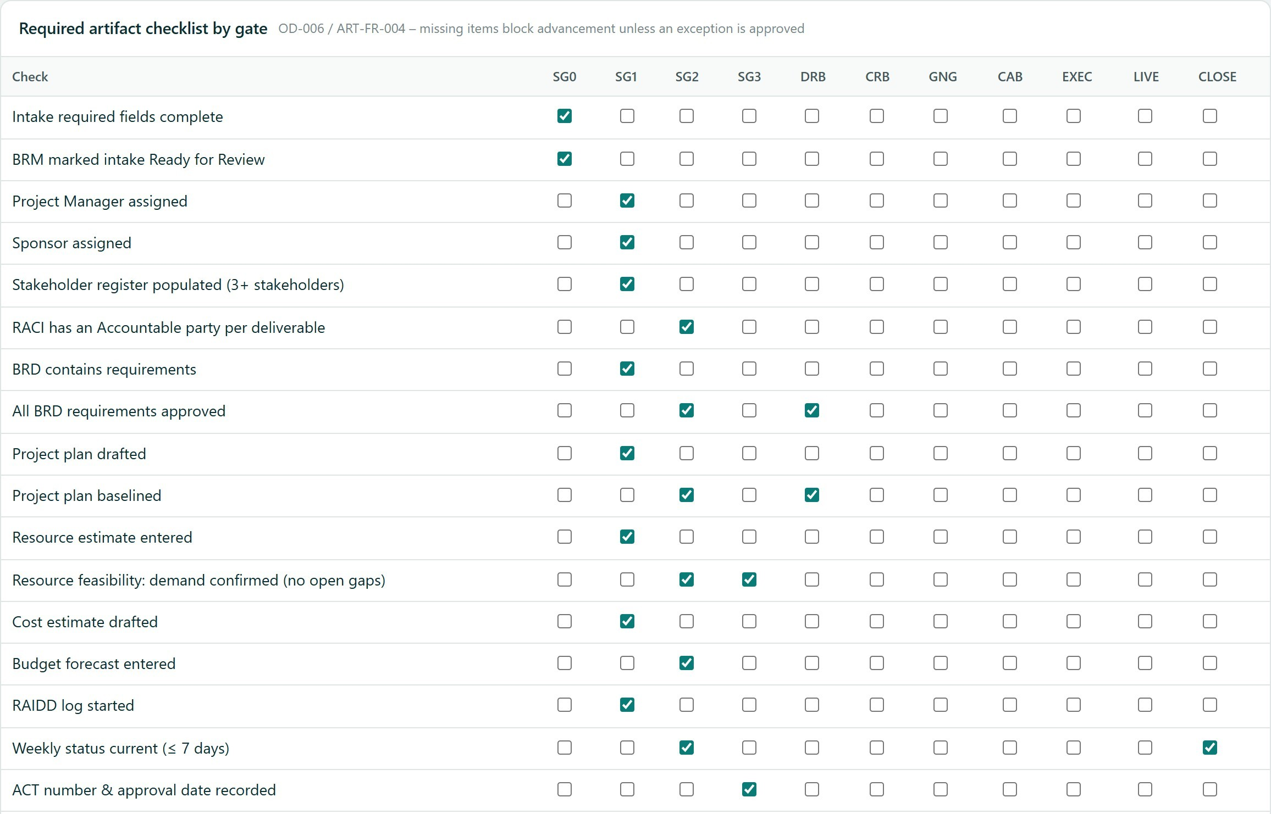
Checklist columns became gate rules
THE MOVE · GOVERNANCE
BEFORE · IN SMARTSHEET
The 0.0a Project Record had status checklist columns per gate: Project Record (S1), BRD (S1), Project Plan (S1), Resource Estimator (S1), Cost Estimate Draft (S1), ACT readiness review (S2).
NOW · IN CORDOVA PPM
Each gate has a checklist evaluated against the project's own records
The checklist per gate is an admin setting, not a fixed template
Missing items block Approve unless an exception is approved
The Approvals sheet became gate review records with approver, outcome and time
BRD PPM‑FR‑030 · ART‑FR‑004 · PPM‑CN‑005 · OD‑006
Notes:
In Smartsheet, readiness for Stage Gate 1 and 2 was tracked as checklist columns on the Project Record sheet. In Cordova PPM those columns became rules. Each check, such as three or more stakeholders, the plan baselined, or no open P1 or P2 defects, is evaluated from the project's own Dataverse rows. Which checks apply at which gate is configurable in Administration, which is BRD open decision OD-006. A gate cannot be approved while a mandatory check fails, unless the approver records an exception with a justification.

Slide 9



What runs where
THE MOVE · ARCHITECTURE
People: browser and Microsoft Teams
Power Automate
BRMs, PMs, approvers and executives open the same app in the Power Apps player or as a Teams personal app
Email and Teams notifications, reminders, NDA team sync, external sharing, SAP actuals load (flows to build)
Cordova PPM: Power Apps code app
Power BI
React 18, TypeScript and Vite. Runs as the signed-in user through the Power Apps client library. Holds the workflow rules: gate checks, segregation of duties, health, capacity and NDA visibility.
Optional reporting on the same Dataverse tables
Microsoft Dataverse: ITProject solution
SAP
30 tables with parental lookups to the IT Project, Cordova PPM User and Administrator security roles, table auditing on all 30 tables, and autonumber Project IDs
Still the system of record for financial actuals, loaded read-only
Notes:
Everyone uses the same Power Apps code app, either in the browser or as a Teams personal app; sign-in and Dataverse security work the same way in both. The app runs as the signed-in user, so Dataverse security roles still decide what data each person can reach, and the app's own rules handle the workflow. All data lives in the ITProject Dataverse solution. Around it, Power Automate flows will deliver email and Teams notifications, reminders, NDA team sync, external sharing and the SAP actuals load; these are on the list to build before production, and until then notifications appear in the app. Power BI can report from the same tables, and SAP remains the system of record for actuals.

Slide 10
One governed path from intake to archive
THE LIFECYCLE · BRD §6 FUTURE-STATE PROCESS
The same stage-gate model as in Smartsheet. Stage, gate and status are now separate fields, so reporting stays clean.
SG0
SG1
SG2
SG3
Stage gates: PMO and Pillar Lead decide; SG3 needs ACT approval evidence
Draft
Initiate
Plan
ACT Readiness
ACT Approved / Execute Ready
Execute
Go-Live / Hypercare
Close
Archive
Governance reviews
Design Review · CRB
Go/No-Go · CAB
PROJECT STATUS (PPM-FR-026)
Active
On Hold
Withdrawn
Rejected
Closed Complete
Archived
Notes:
Cordova PPM keeps the stage-gate model the PMO already used in Smartsheet, with the refinements from the BRD. Nine lifecycle stages (PPM-FR-025); four stage gates between the early stages; Design Review, CRB, Go/No-Go and CAB as governance reviews during delivery. In Smartsheet the Workflow Status column carried the stage; now stage, gate and status are separate, so a project can be On Hold in Plan, for example. Archive only ever happens manually (PPM-FR-031).

Slide 11
Who does what along the way
ROLES · BRD §8 AND §9.1 ROLE-BASED SECURITY
BRM
PMO
ADM
PM
Business Relationship Manager
PMO Director
PMO Program Administrator
Project Manager
Creates and submits the intake; the only role that can
Decides gates, approves exceptions and controls NDA projects
Notified on intake; coordinates reviews, artifacts and reporting
Owns the plan, RAIDD, status and forecast; confirms nominations
PL
RTM
FIN
EXE
Pillar Lead / Architect
Resource Team Manager
Finance
Executive viewer
Gate decisions, Design Review, CRB and CAB
Maintains capacity; nominates resources or flags gaps
ACT approval evidence, budget, WBS / PO and SAP actuals
Read-only portfolio dashboards and reports
Notes:
These roles come straight from BRD section 8. In Smartsheet, what someone could do depended on how each sheet was shared. In Cordova PPM permissions follow role, stage, artifact and action (SEC-FR-001). Only BRMs can create intake (SEC-FR-002); executives are read-only (SEC-FR-008). Gate approvals enforce segregation of duties: whoever requested a review, and the project's own BRM or PM, cannot approve it (SEC-FR-010). System Administrators manage users, roles and configuration.

Slide 12
From idea to archive in fourteen steps
THE WALKTHROUGH · 14 STEPS IN FOUR PHASES
1
2
3
4
Intake & approval
Initiate
Plan & fund
Deliver & close
1 BRM opens a new intake
2 Validation and a unique Project ID
3 Ready for Review notifies the PMO
4 Stage Gate 0 decision
5 Initiate: artifacts created in Dataverse
6 Assign the team and stakeholders
7 Draft the plan, estimates and RAIDD
8 Stage Gate 1 with readiness checks
9 Plan: staff the work
10 Weekly status and health
11 Stage Gates 2 and 3: ACT and funding
12 Execute: design, build and test
13 Go/No-Go, CAB and go-live
14 Close and archive
ON EACH STEP: HOW IT WORKED IN SMARTSHEET, THEN HOW IT WORKS NOW
Example project: ITProj-26-013 Supplier Self-Service Portal, created live in Cordova PPM. Later stages use sample projects already at those stages.
Notes:
The fourteen steps group into four phases. On every step slide the top-left panel shows how that step worked in Smartsheet, and the rest of the slide shows the same step in Cordova PPM with the BRD requirements it meets. The step tracker in the top right shows where we are. Four cross-cutting slides follow: confidential NDA projects, external collaborators, the portfolio view and the audit trail.

Slide 13
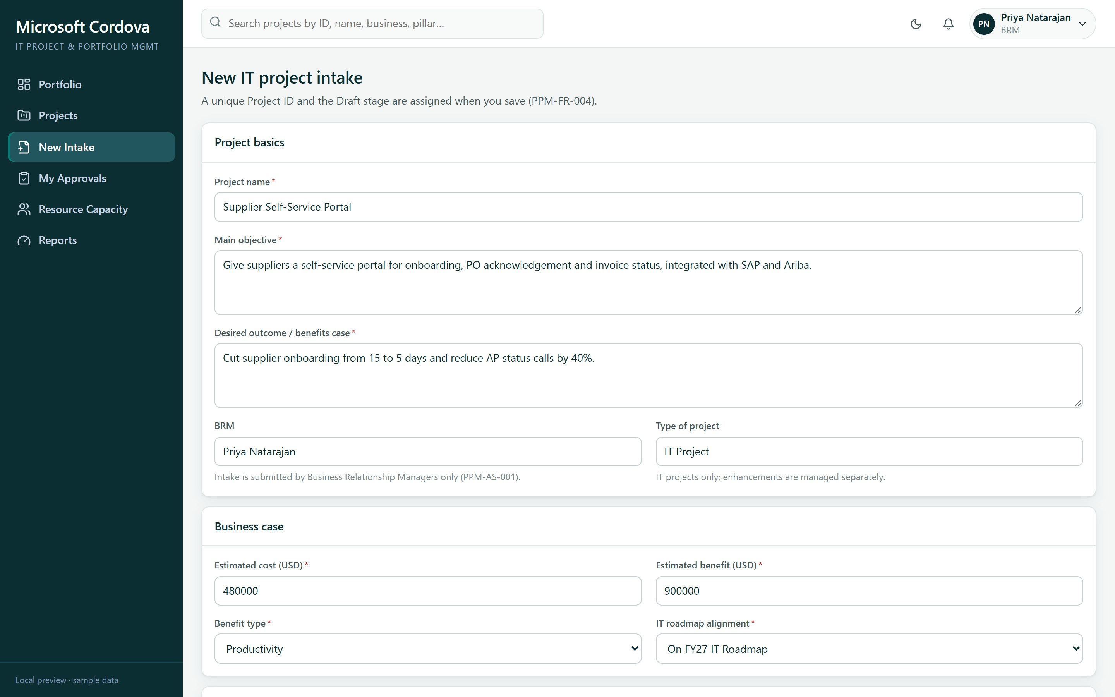
BRM opens a new intake
STEP 1 OF 14 · INTAKE & APPROVAL · BRM
BEFORE · IN SMARTSHEET
Requests went into the PPM Intake sheet; its fields were then carried into each project's x.0 Metadata sheet.
NOW · IN CORDOVA PPM
Only BRMs see New Intake; other roles cannot create projects
One form captures objective, benefits, cost, roadmap, business, function, priority, Agile and ITGC flags, dates and uploads
Drafts are saved and stay in Draft until the BRM submits
BRD PPM‑FR‑001 · PPM‑FR‑002 · PPM‑FR‑005 · SEC‑FR‑002 · AC‑001
Notes:
Priya Natarajan, a BRM, opens New Intake. In Smartsheet this information went into the PPM Intake sheet and was copied into the project's Metadata sheet; now it is one IT Project row in Dataverse from the start. The form captures every field PPM-FR-002 lists, including the Agile and ITGC flags and supporting uploads, which are stored on a Dataverse file column. Only users with the BRM role see this menu item (SEC-FR-002). A draft can stay in Draft indefinitely (PPM-FR-005).

Slide 14
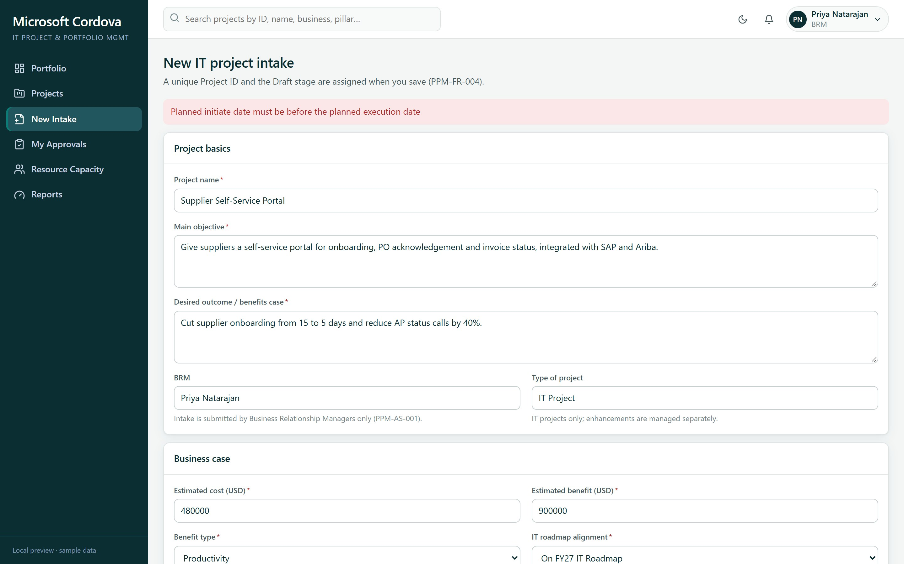
Validation and a unique Project ID
STEP 2 OF 14 · INTAKE & APPROVAL · SYSTEM
BEFORE · IN SMARTSHEET
The ITProj-YY-NNN Project ID and the Type of Project were assigned on the PPM Intake sheet.
NOW · IN CORDOVA PPM
Required fields are checked before the intake can be submitted
Initiate must come before execution and go-live; the form blocks the save and says why
On save the project gets the Draft stage and a unique ID in the same format: ITProj-26-013
BRD PPM‑FR‑003 · PPM‑FR‑004 · DATA‑FR‑005 · AC‑001 · AC‑002
Notes:
Here the BRM entered an execution date before the initiate date, so submission is blocked with a clear message (PPM-FR-003). Once corrected, the record is saved in Dataverse. The Project ID keeps the format everyone knows from Smartsheet, but now comes from a Dataverse autonumber column, so IDs stay unique even with many BRMs submitting at once (PPM-FR-004, AC-002).

Slide 15
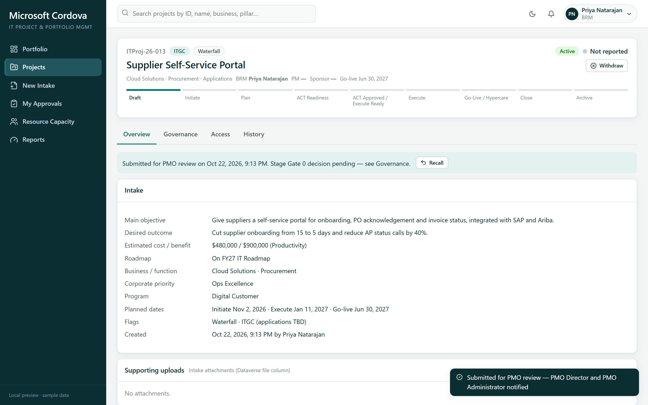
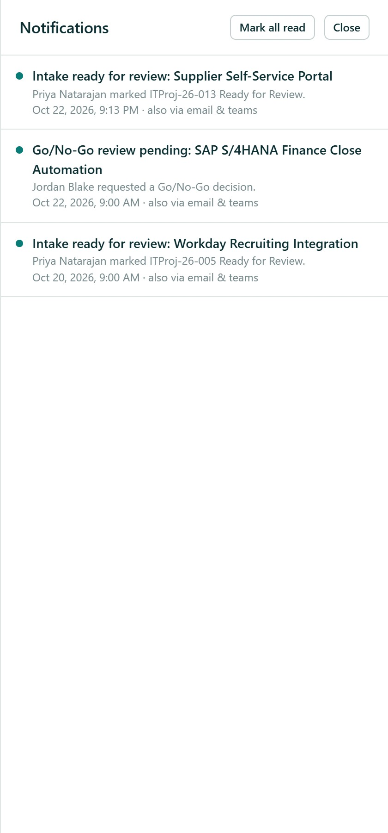
Ready for Review notifies the PMO
STEP 3 OF 14 · INTAKE & APPROVAL · BRM → PMO
BEFORE · IN SMARTSHEET
Progress was tracked in a Workflow Status column on the project sheets.
NOW · IN CORDOVA PPM
The BRM marks the intake Ready for Review; editing locks, and the BRM can recall it before a decision
The PMO Director and PMO Program Administrator are notified in the app
A Stage Gate 0 review opens automatically in My Approvals
BRD PPM‑FR‑005 · PPM‑FR‑006 · NOT‑FR‑001 · SEC‑FR‑003 · AC‑003
Notes:
After submission the intake is read-only for the BRM (SEC-FR-003). The PMO Director and PMO Program Administrator receive the notification in the app. Email and Teams delivery come from a Power Automate flow on the same notification row, which is on the list of flows to build before production (NOT-FR-006). Stage Gate 0 opens as a pending review so it shows up in My Approvals.

Slide 16
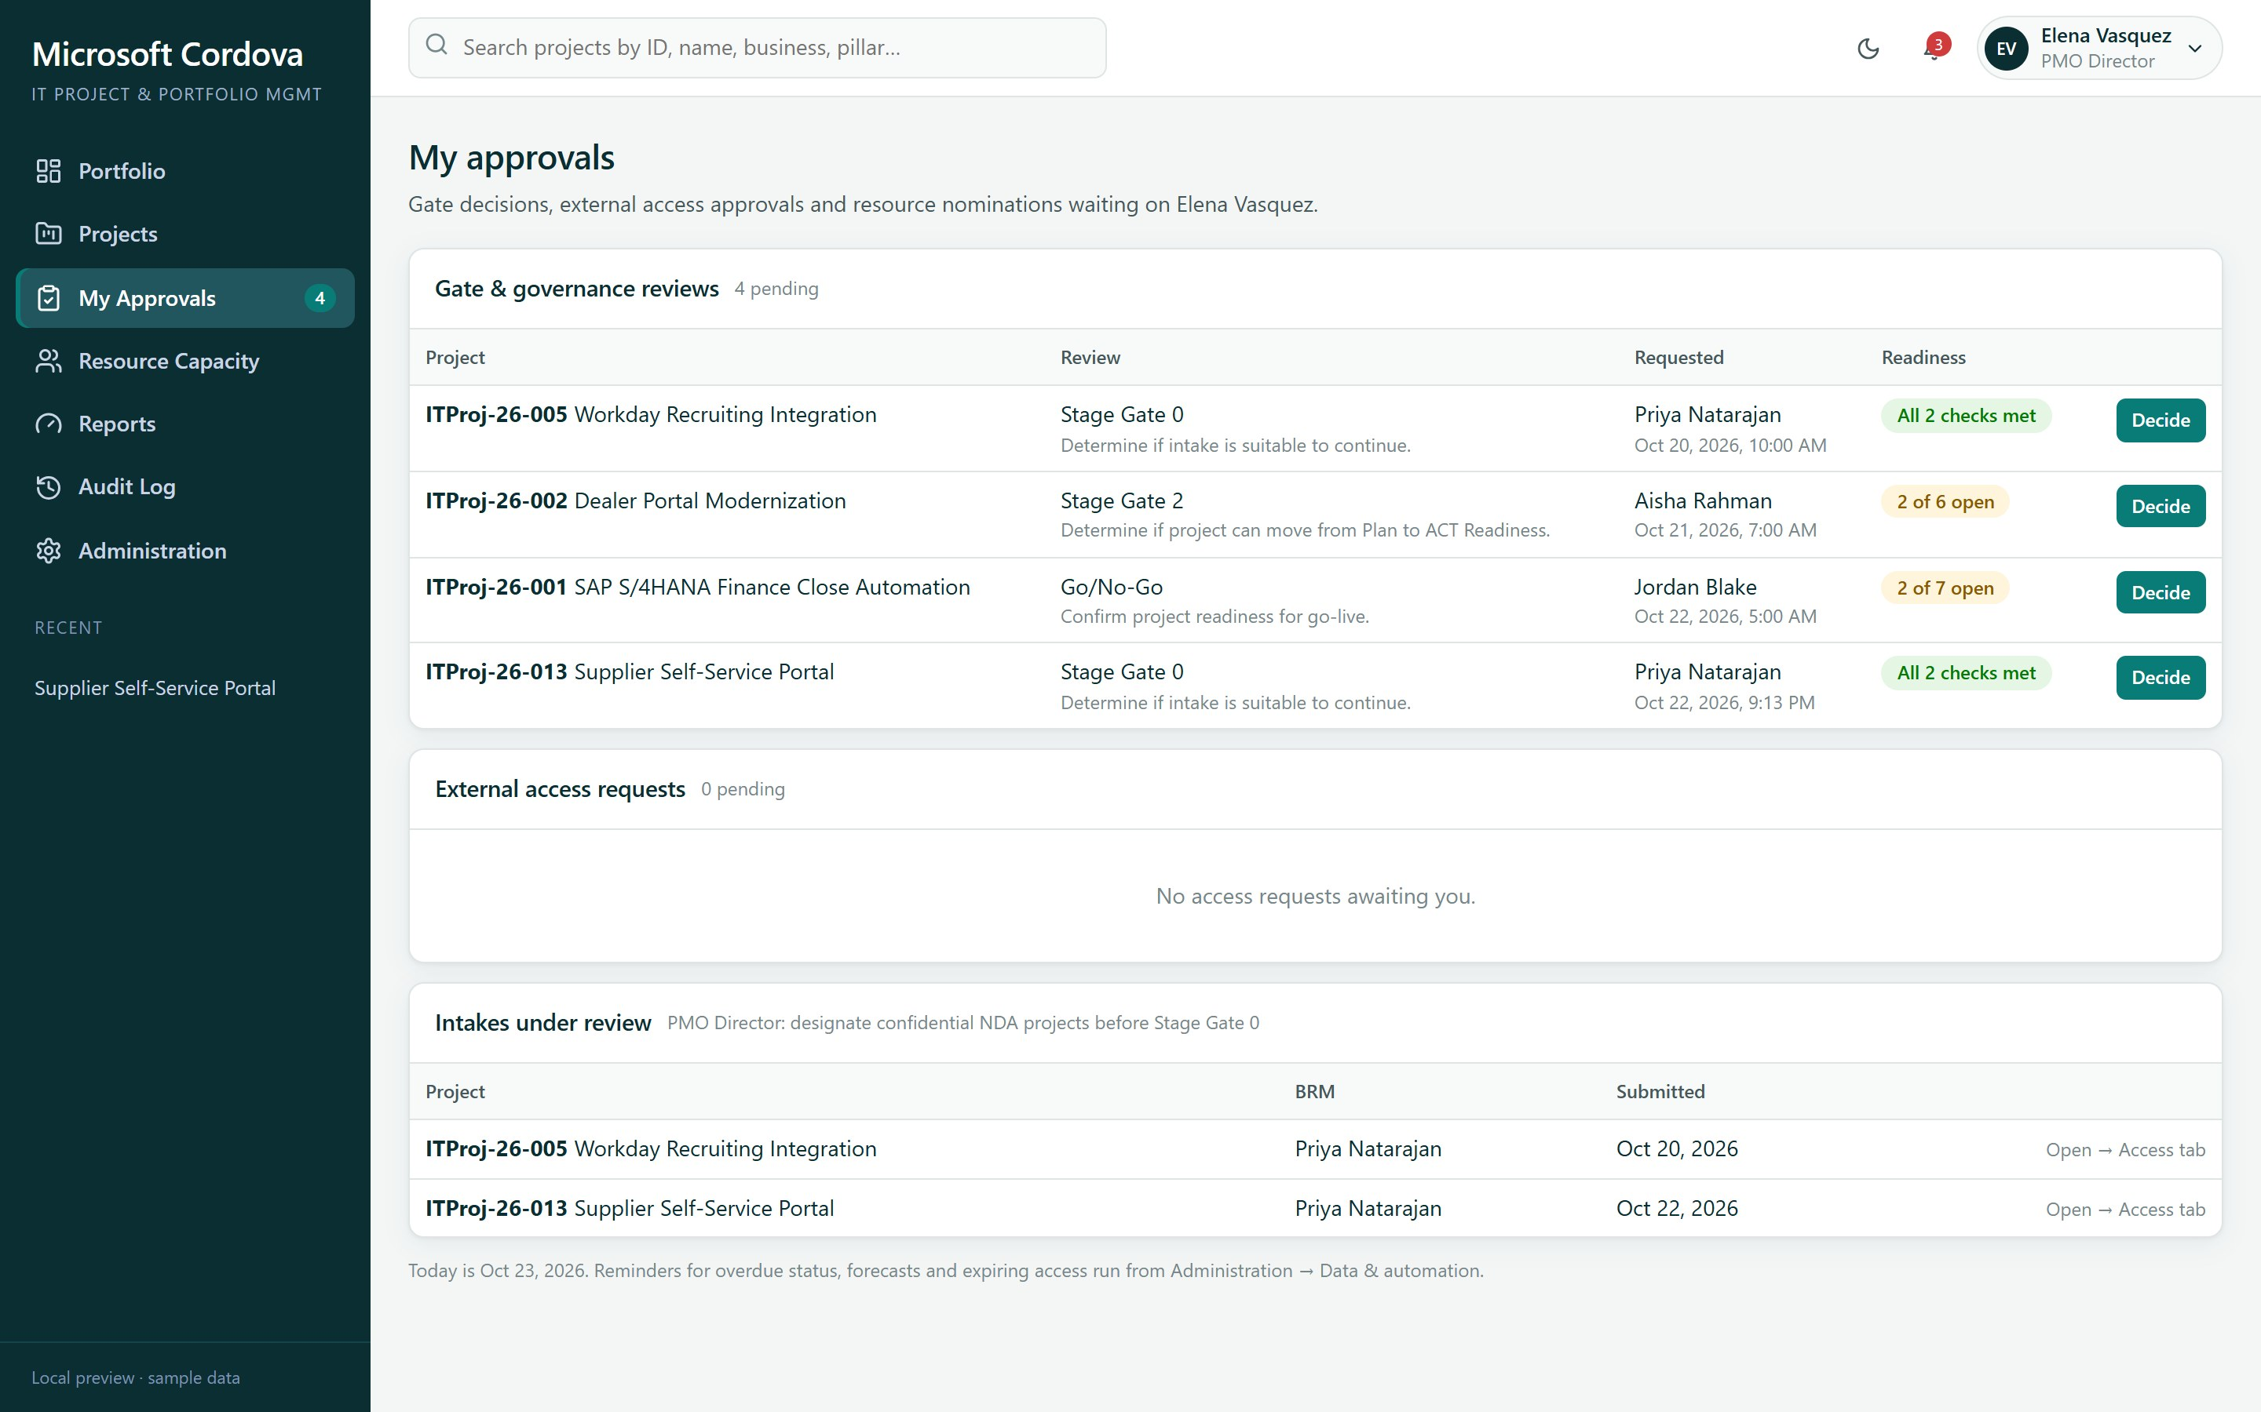
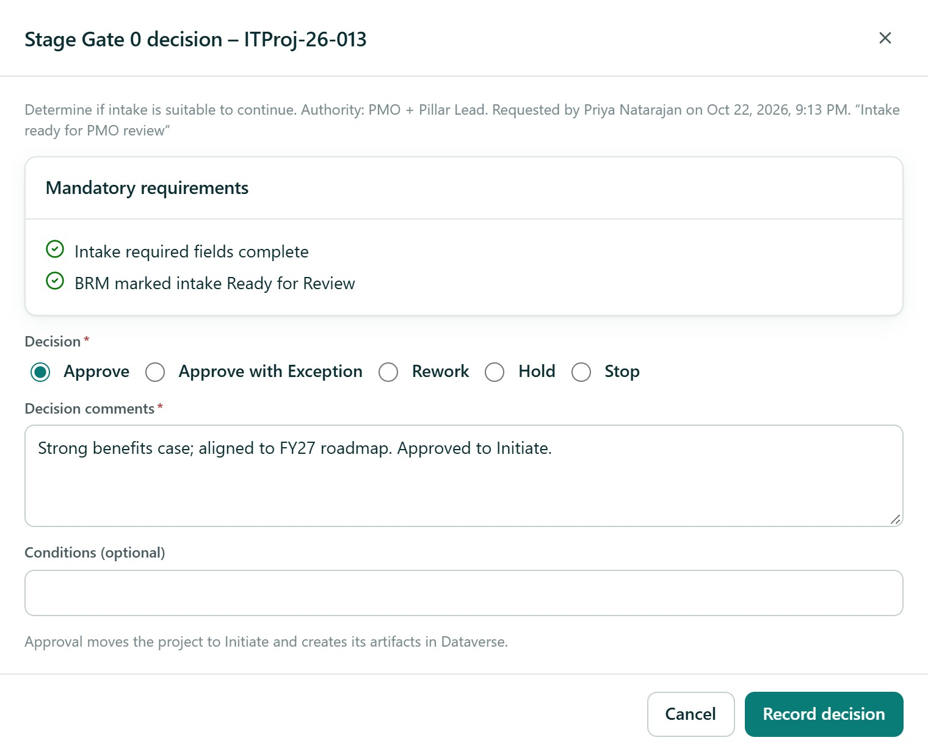
Stage Gate 0 decision
STEP 4 OF 14 · INTAKE & APPROVAL · PMO DIRECTOR
BEFORE · IN SMARTSHEET
Gate decisions were rows on the X.0b Approvals sheet: approval area, decision, notes and decision date.
NOW · IN CORDOVA PPM
My Approvals lists every pending gate with its readiness
Outcomes: Approve, Approve with Exception, Rework, Hold or Stop
The requester and the project's BRM or PM cannot approve
Each decision records approver, outcome, time, comments and conditions
BRD PPM‑FR‑028 · PPM‑FR‑029 · SEC‑FR‑009 · SEC‑FR‑010 · AUD‑FR‑003 · AC‑004
Notes:
Elena Vasquez, PMO Director, sees the Stage Gate 0 review in My Approvals with all mandatory checks met. What used to be a row on the Approvals sheet is now a gate review record that captures approver, outcome, timestamp, comments and conditions (AUD-FR-003), with segregation of duties enforced. Stop sets the project to Rejected and Hold to On Hold. The PMO Director can also designate a confidential NDA project before this gate; that is covered later.

Slide 17
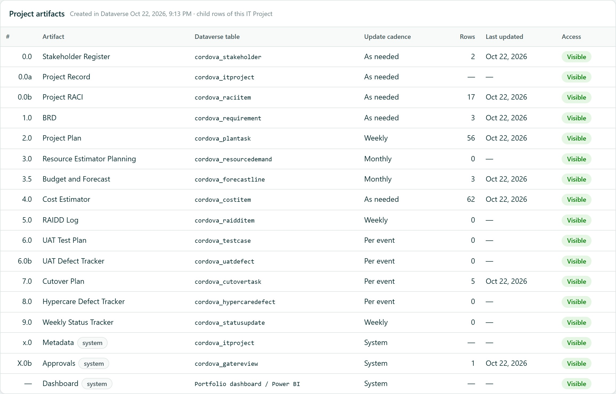
Initiate: artifacts created in Dataverse
STEP 5 OF 14 · INITIATE · SYSTEM
BEFORE · IN SMARTSHEET
Approval to Initiate copied the project templates into a new workspace: 16 sheets and a dashboard folder.
NOW · IN CORDOVA PPM
Approval moves the project to Initiate and records the approval date
The same 16 artifacts are created as Dataverse rows under the IT Project, numbered as before
Each artifact shows its table, update cadence, row count, last update and access
BRD PPM‑FR‑027 · ART‑FR‑001 · ART‑FR‑002 · ART‑FR‑003 · PPM‑BO‑004 · AC‑005
Notes:
This replaces the Smartsheet template copy. On approval to Initiate the system creates the stakeholder register, a 17-row RACI, BRD requirement groups, a 56-task WBS plan scheduled from the intake dates, a cost estimator tree, budget lines and a cutover outline. All of them are rows in Dataverse tables with a parental relationship to the IT Project, so security and sharing follow the project (ART-FR-001, ART-FR-002). The numbering matches the Smartsheet templates.

Slide 18
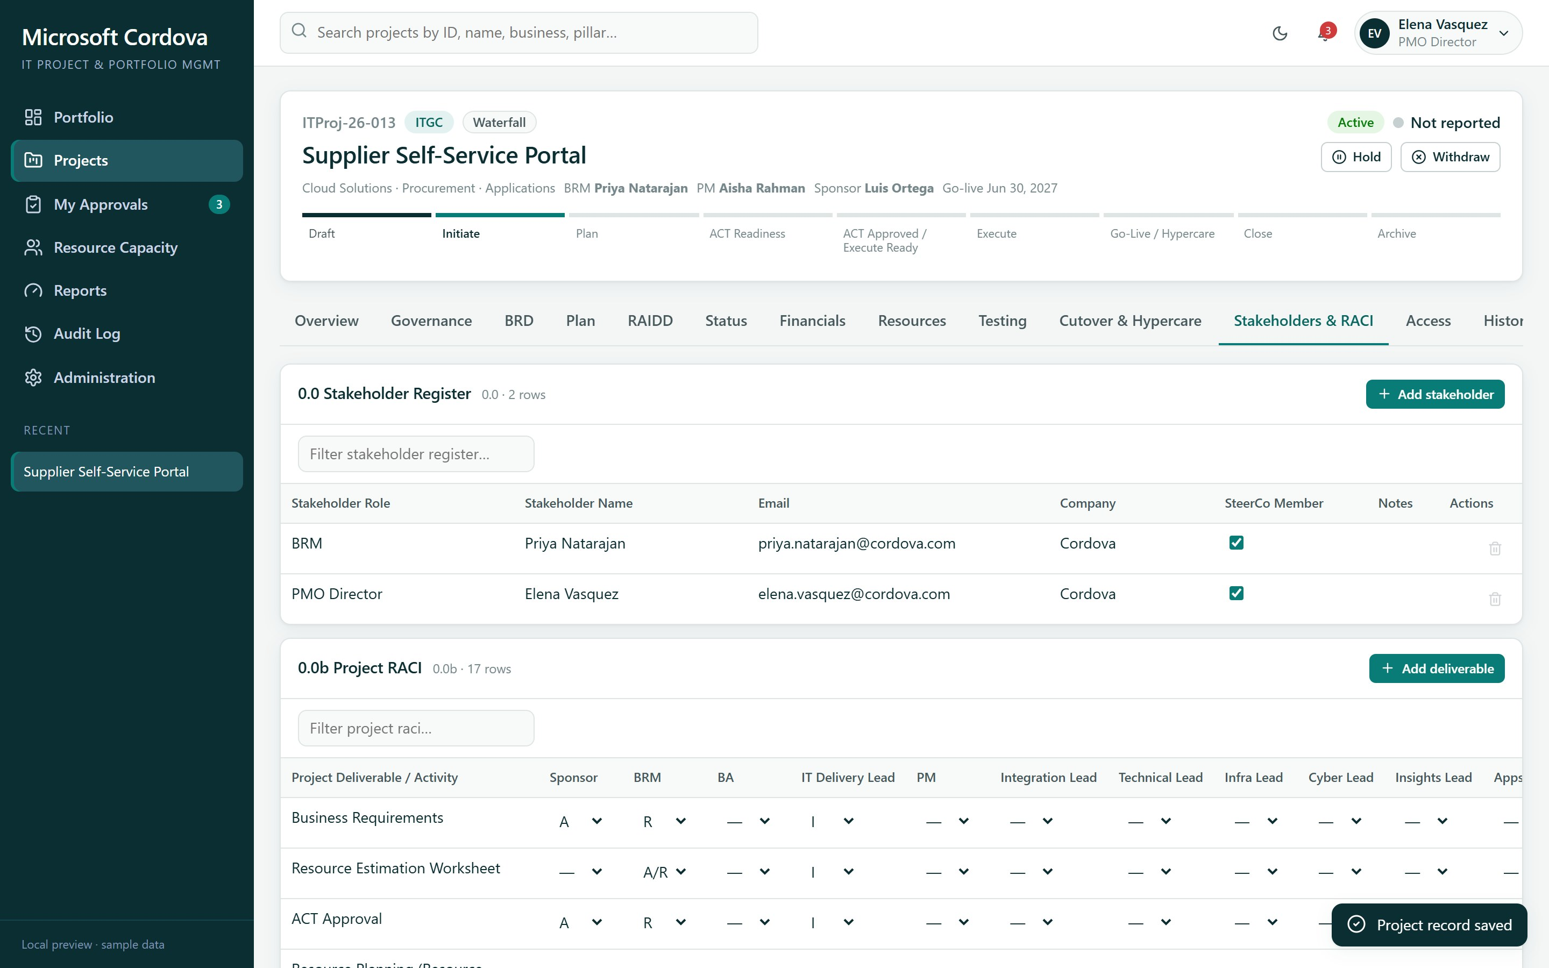
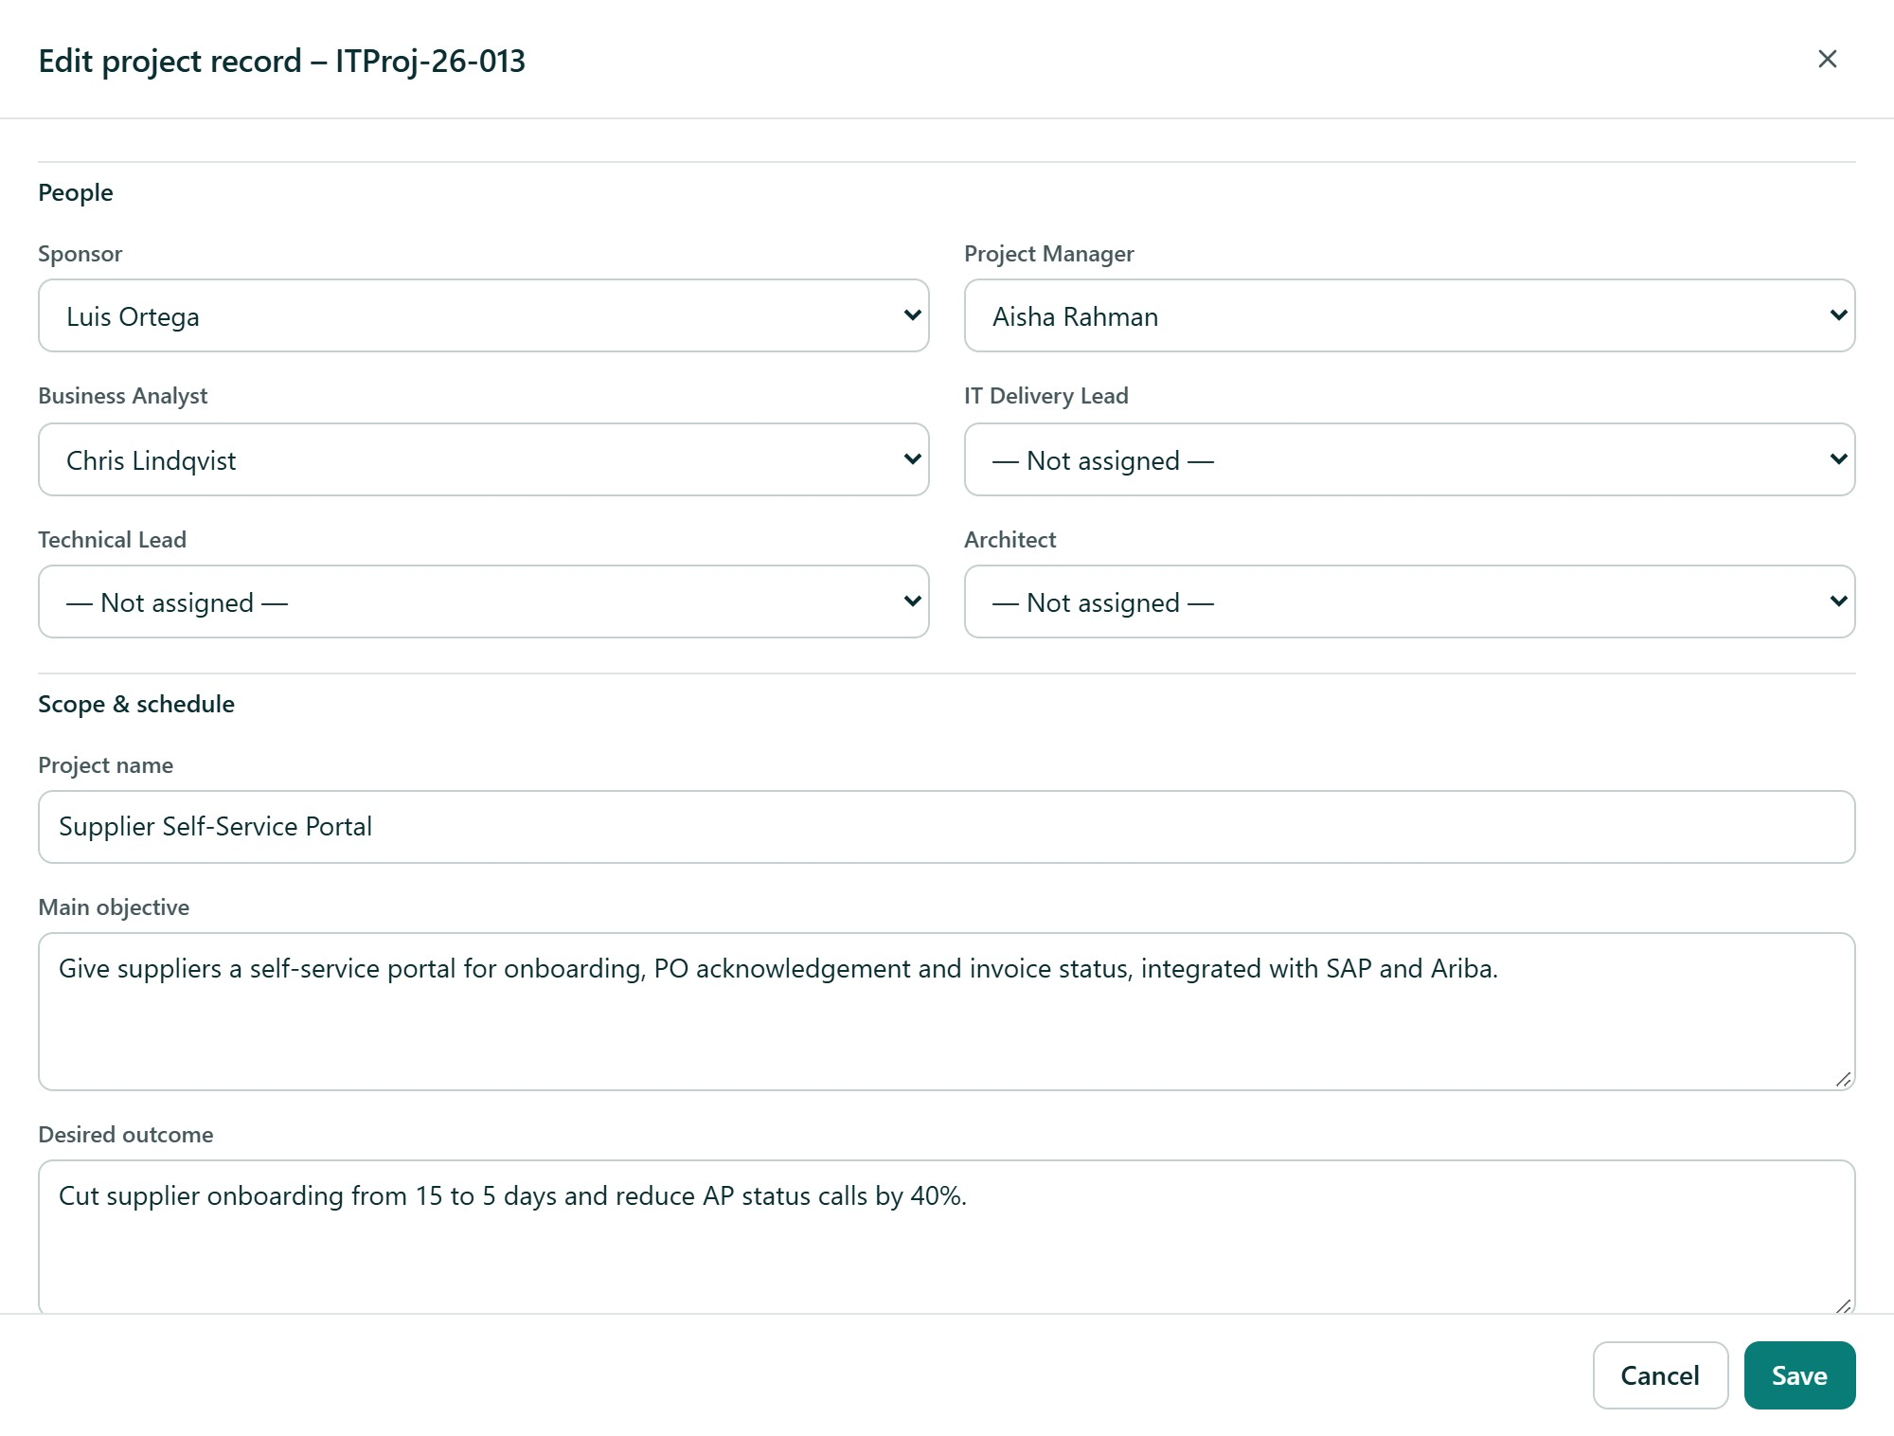
Assign the team and stakeholders
STEP 6 OF 14 · INITIATE · PMO / BRM
BEFORE · IN SMARTSHEET
The 0.0 Stakeholder Register and 0.0b Project RACI sheets, with Project ID and Project Name repeated on every row.
NOW · IN CORDOVA PPM
The PMO assigns the PM, sponsor, BA, IT delivery lead and technical lead
Stakeholder register and RACI are pre-filled from the template
The project record holds scope, applications, data migration and governance-board flags
BRD SEC‑FR‑005 · DATA‑FR‑003 · GOV‑FR‑002
Notes:
The PMO Director assigns Aisha Rahman as PM, Luis Ortega as sponsor and Chris Lindqvist as BA. Assignment notifications go out automatically. The stakeholder register and RACI are the same artifacts as the Smartsheet sheets, but each row now links to the project instead of repeating its ID and name. From Initiate onward the BRM, BA and PM can update artifacts (SEC-FR-005). The project record also captures whether Design Review, CRB or CAB is required and why (GOV-FR-002).

Slide 19
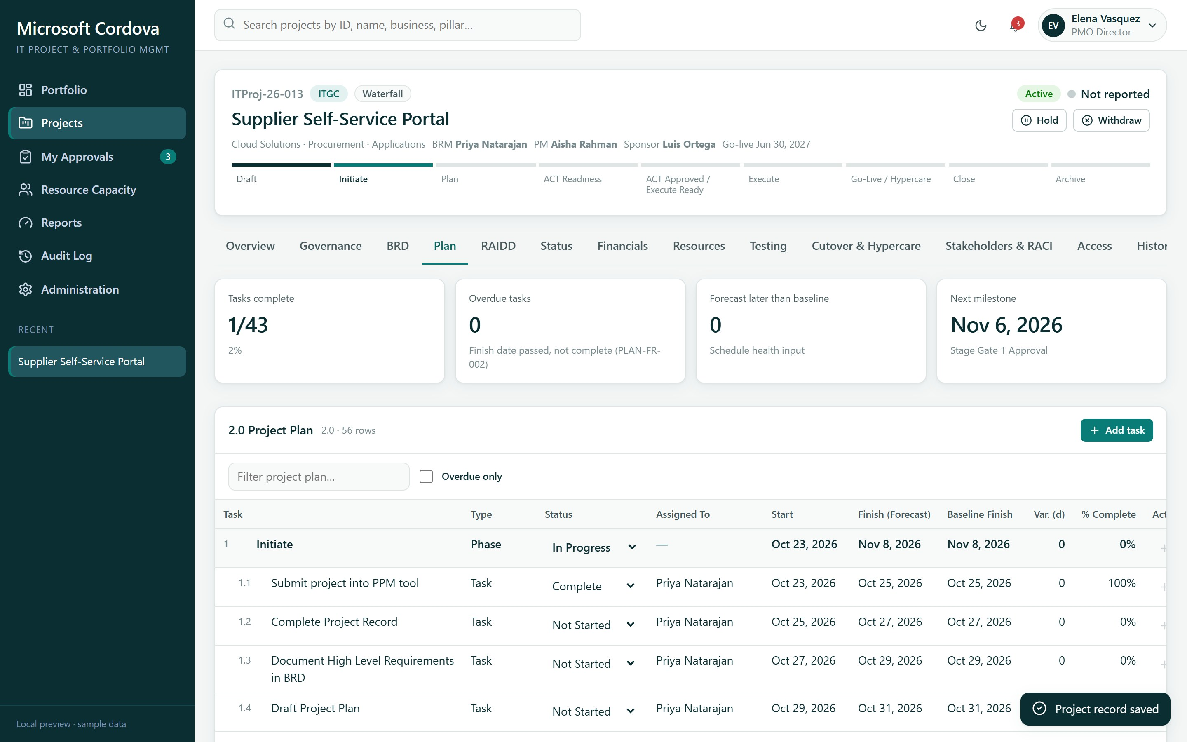
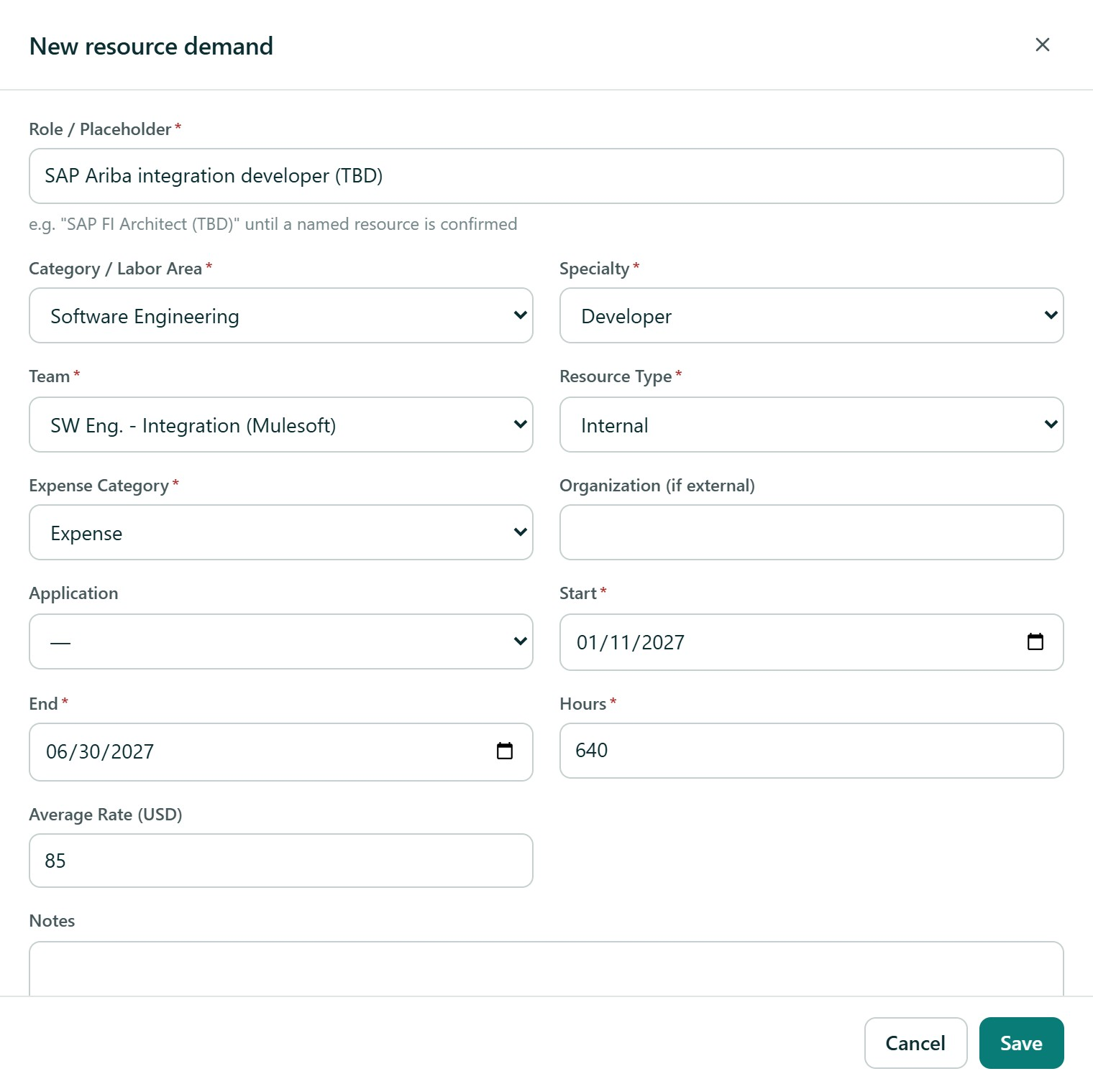
Draft the plan, estimates and RAIDD
STEP 7 OF 14 · INITIATE · PROJECT MANAGER
BEFORE · IN SMARTSHEET
Three separate sheets: 2.0 Project Plan, 3.0 Resource Estimator Planning and 5.0 RAIDD Log.
NOW · IN CORDOVA PPM
A WBS plan is generated from the standard template, with baseline and forecast dates and overdue flags
Resource demand by labor area, specialty, team, dates and hours; placeholders until named
RAIDD covers risks, actions, issues, decisions, dependencies, assumptions and change requests
BRD PLAN‑FR‑001 · PLAN‑FR‑002 · RCP‑FR‑002 · RCP‑FR‑003 · RAIDD‑FR‑001 · RAIDD‑FR‑002
Notes:
Aisha adds a 640-hour demand for an SAP Ariba integration developer with a placeholder name; the Resource Team Manager is notified to nominate someone. She also logs a supplier master-data risk in RAIDD. The plan is hierarchical with auto-numbered WBS IDs, and variance against baseline feeds schedule health. These were three separate sheets in Smartsheet; now they are tabs on the same project.

Slide 20
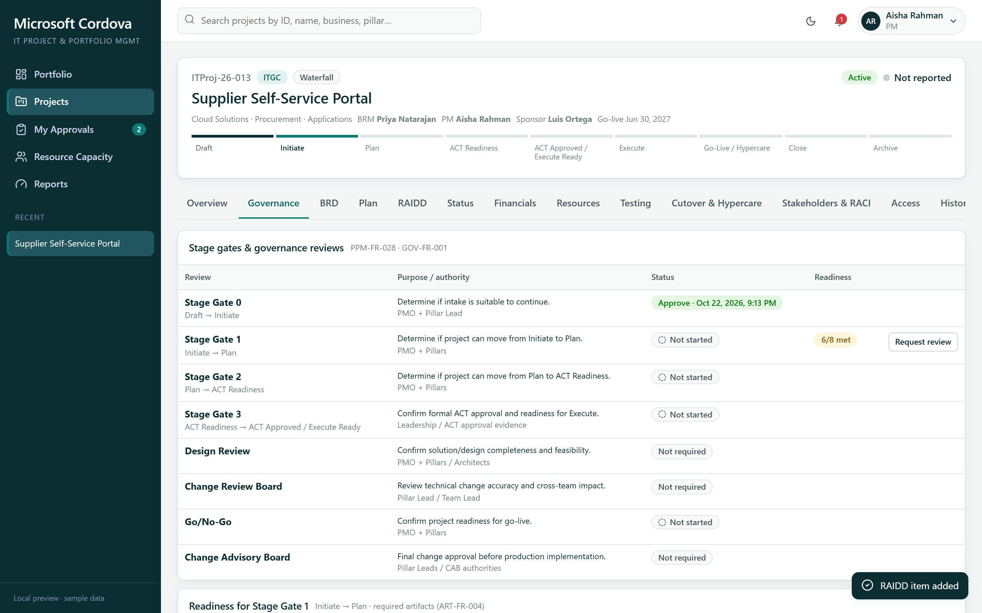
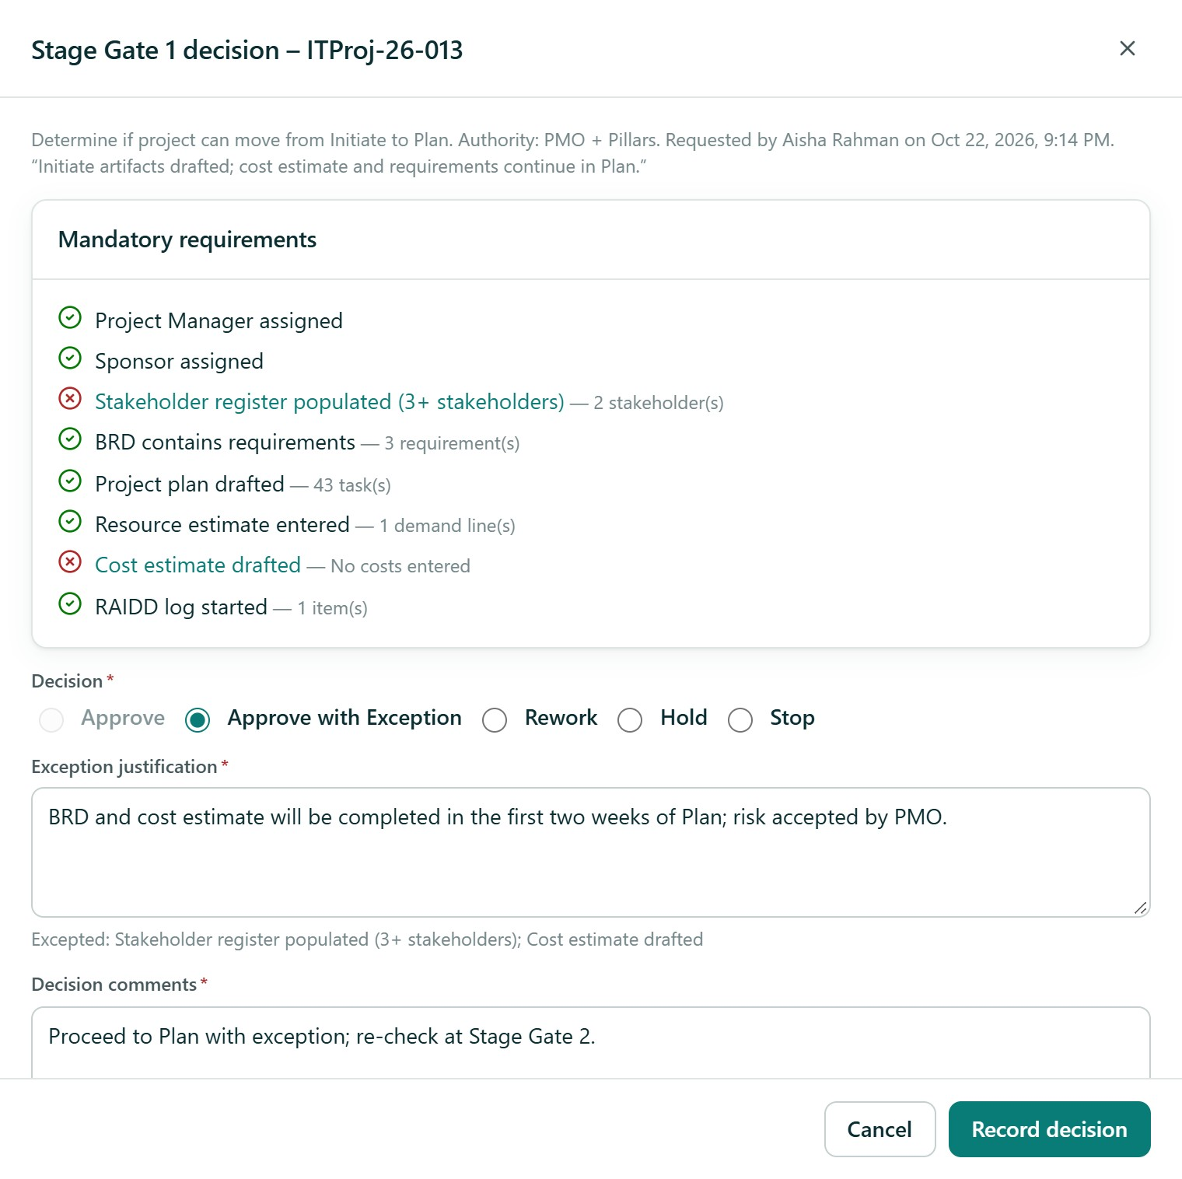
Stage Gate 1 with readiness checks
STEP 8 OF 14 · INITIATE · PM → PMO
BEFORE · IN SMARTSHEET
Readiness was a set of checklist columns on the 0.0a Project Record, such as BRD (S1), Project Plan (S1) and Cost Estimate Draft (S1).
NOW · IN CORDOVA PPM
Each gate has a configurable checklist, checked against the project's live data
Approve is blocked while mandatory items are open
Approve with Exception needs a written justification; the exception is recorded and auditable
BRD PPM‑FR‑030 · ART‑FR‑004 · PPM‑CN‑005 · AC‑006 · AC‑007
Notes:
Six of eight Stage Gate 1 checks are met; the stakeholder register needs a third stakeholder and the cost estimate is empty. Plain Approve is disabled, so the PMO Director approves with an exception and a justification. The exception is stored with the excepted items and appears in the exceptions report and audit trail (PPM-CN-005, AC-007). This is the same readiness the Smartsheet checklist columns tracked, now enforced.

Slide 21
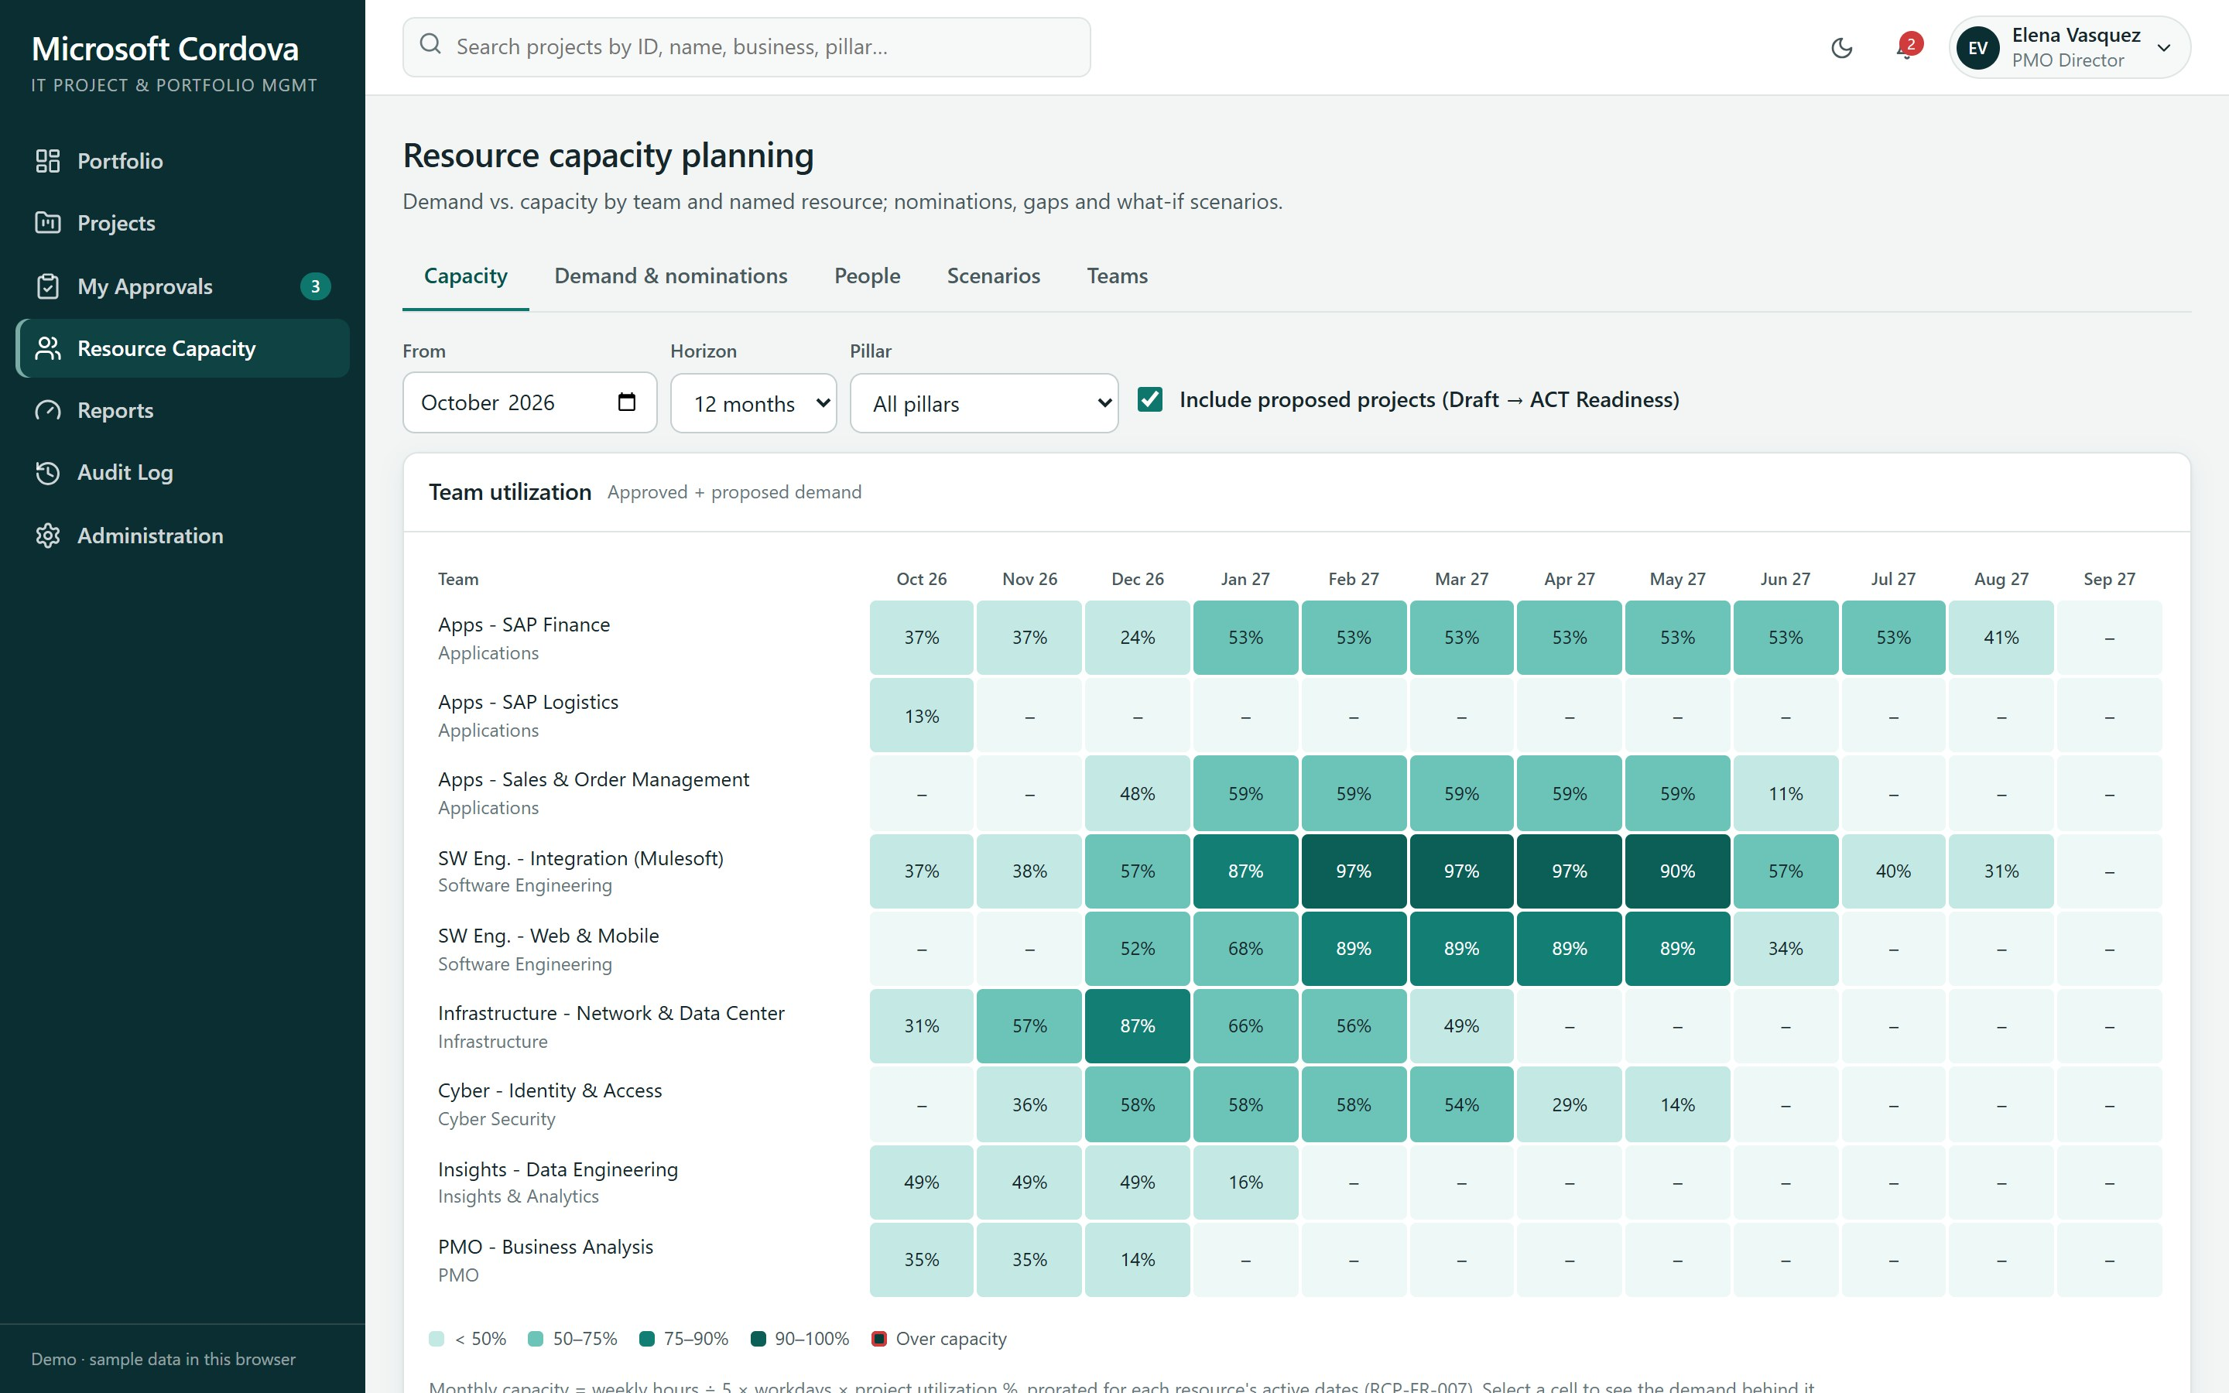
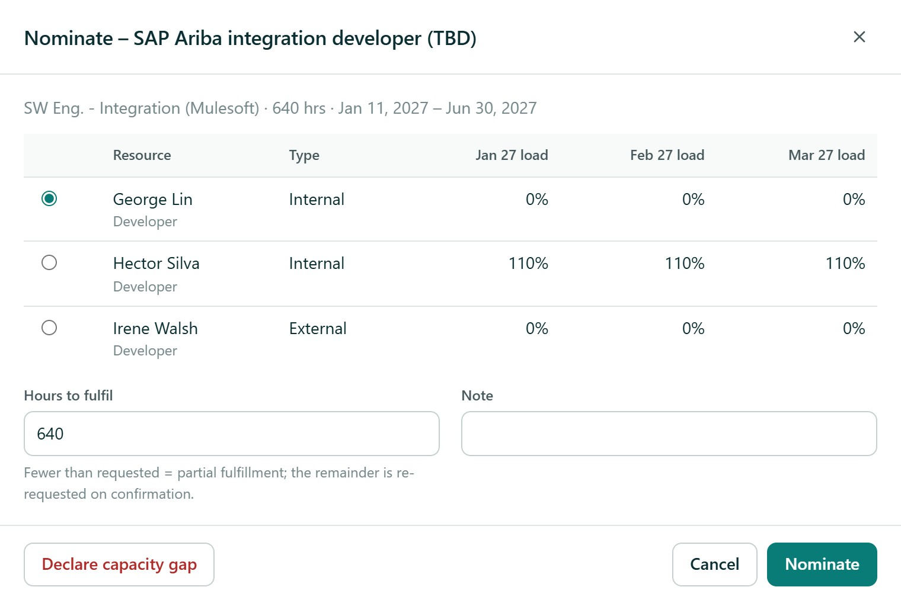
Plan: staff the work
STEP 9 OF 14 · PLAN & FUND · RTM / PM
BEFORE · IN SMARTSHEET
Capacity data lived in Smartsheet and fed a Power BI RCP report, using weekly hours, utilization % and workdays per month.
NOW · IN CORDOVA PPM
The same capacity calculation runs in the app; the heatmap shows demand against capacity
The RTM nominates a named resource or declares a gap; the PM confirms or rejects
Gaps escalate to the PMO and pillar leads; scenarios test start shifts and added capacity
BRD RCP‑FR‑005 · RCP‑FR‑007 · RCP‑FR‑008 · RCP‑FR‑009 · RCP‑FR‑011 · AC‑011
Notes:
Capacity uses the same inputs as the Smartsheet RCP process: weekly hours divided by five, times workdays in the month, times utilization percentage. With the new project's demand included, the Integration team runs over capacity from January to May, which shows in red. Nina Petrova, the Resource Team Manager, sees each candidate's load before nominating. If no one is available she declares a capacity gap, which can be escalated. Saved scenarios compare start shifts or added capacity against the official plan without changing it (RCP-FR-012).

Slide 22
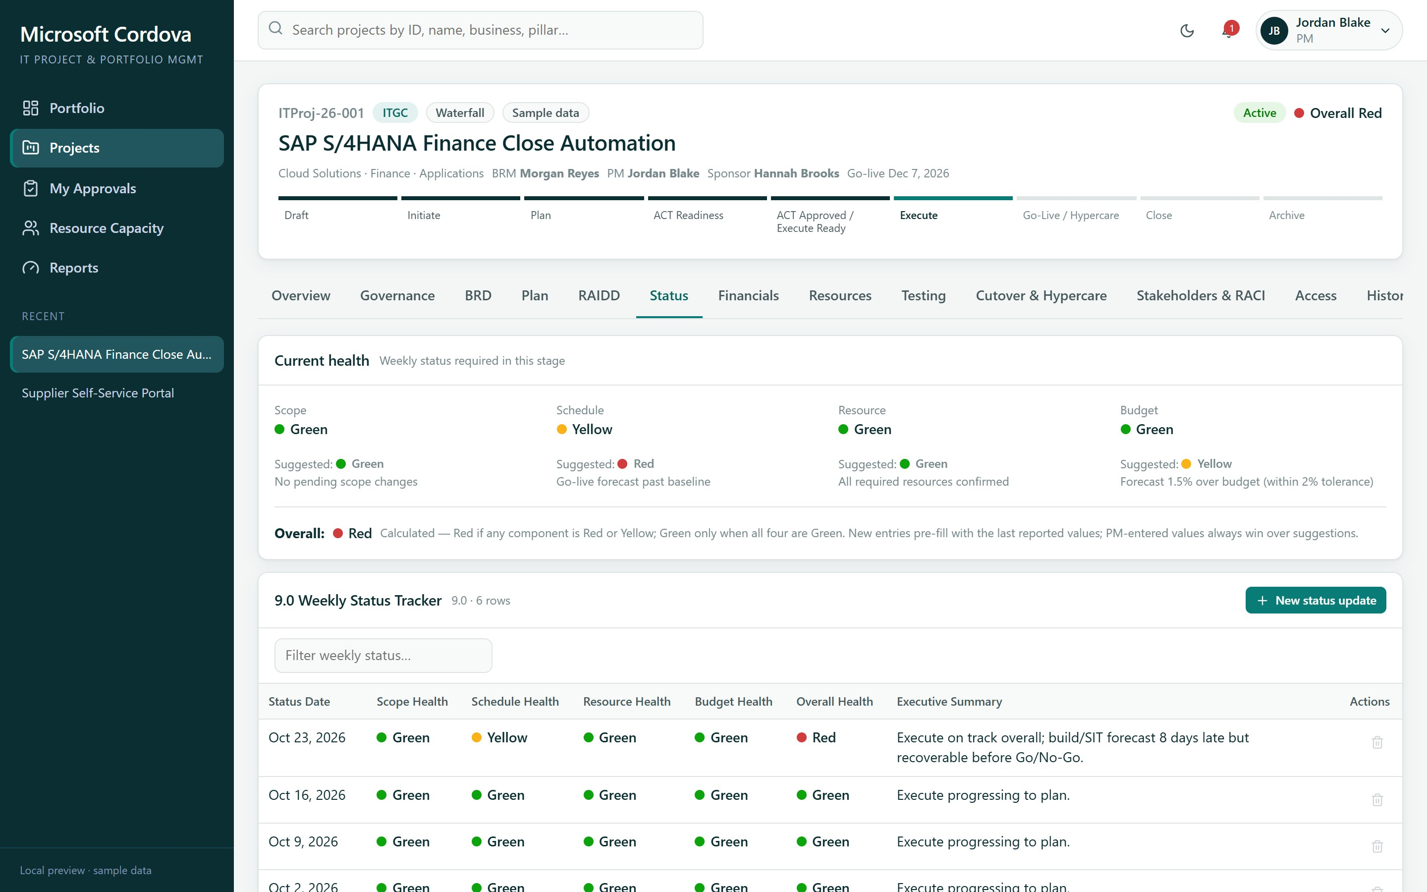
Weekly status and health
STEP 10 OF 14 · PLAN & FUND · PROJECT MANAGER
BEFORE · IN SMARTSHEET
The 9.0 Weekly Status Tracker sheet held scope, schedule, resource, budget and overall health, plus a path to green.
NOW · IN CORDOVA PPM
Weekly status is required from Plan through Hypercare
Overall health is calculated: Red if any of scope, schedule, resource or budget is Red or Yellow
Calculated suggestions sit beside PM-entered values; overdue updates trigger reminders
BRD STAT‑FR‑001…005 · DATA‑FR‑004 · AC‑008 · AC‑009
Notes:
This is a sample project in Execute. The fields are the ones the Weekly Status Tracker sheet had, but overall health is no longer typed: the PM reported schedule as Yellow, so overall health is Red, exactly as STAT-FR-004 specifies. The calculated suggestion flags schedule as Red because the go-live forecast is past baseline. Suggestions never overwrite what the PM entered (STAT-FR-005). Overdue weekly updates trigger reminders (NOT-FR-003).

Slide 23
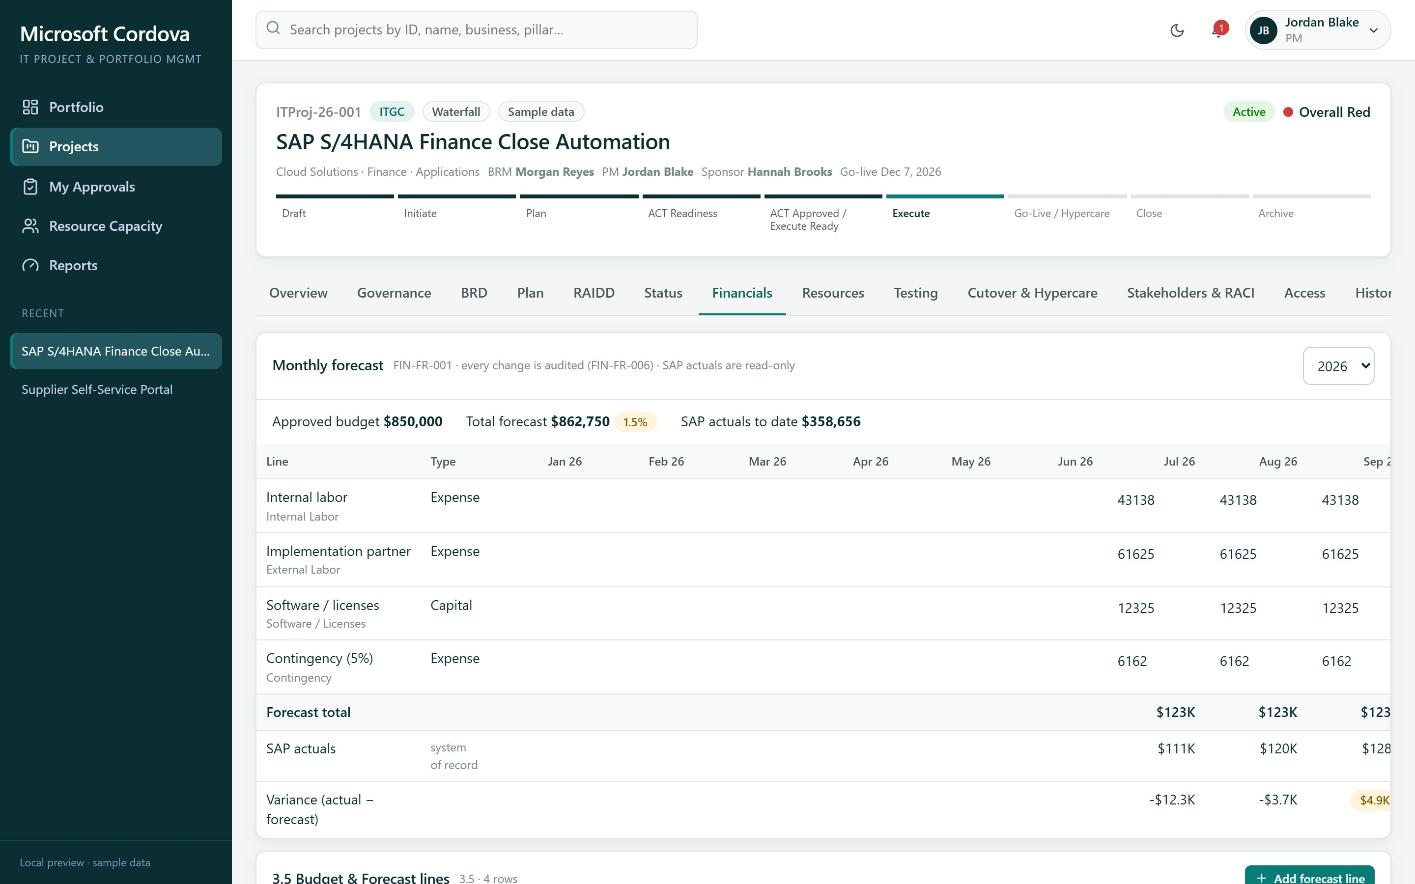
Stage Gates 2 and 3: ACT and funding
STEP 11 OF 14 · PLAN & FUND · PM / FINANCE
BEFORE · IN SMARTSHEET
The 3.5 Budget and Forecast sheet held the WBS element, spend type, approved budget and monthly columns; the estimate sat in 4.0 Cost Estimator.
NOW · IN CORDOVA PPM
SG2 confirms ACT readiness: BRD approved, plan baselined, resources feasible
SG3 records the ACT number and approval; WBS element and PO are captured after ACT
Monthly forecast per capital or expense line against approved budget; SAP actuals are read-only
BRD FIN‑FR‑001…006 · SEC‑FR‑006 · AC‑010
Notes:
The PM or Finance maintains the monthly forecast in Cordova PPM, in the same shape as the Smartsheet Budget and Forecast sheet. SAP remains the system of record for actuals, which are loaded read-only (PPM-AS-004). The budget health check uses the 2% tolerance from the BRD. WBS and PO fields stay locked until after ACT approval (FIN-FR-002), and each forecast cell change creates an audit entry (FIN-FR-006).

Slide 24
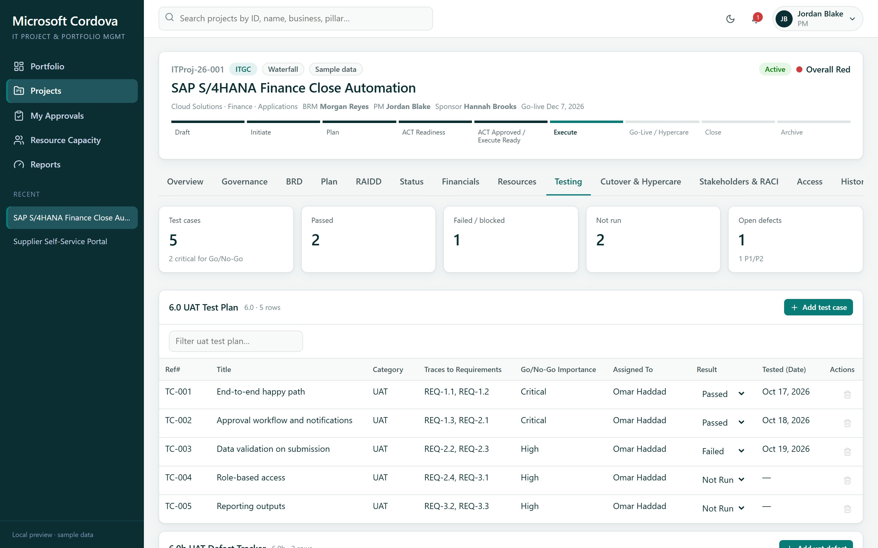
Execute: design, build and test
STEP 12 OF 14 · DELIVER & CLOSE · DELIVERY TEAM
BEFORE · IN SMARTSHEET
The 6.0 UAT Test Plan and 6.0b UAT Defect Tracker sheets, with a test plan reference typed on each defect.
NOW · IN CORDOVA PPM
Design Review and CRB run when risk or architecture impact requires them
Every UAT test case traces to BRD requirements; uncovered requirements are flagged
Open P1 or P2 UAT defects block Go/No-Go
BRD GOV‑FR‑001 · GOV‑FR‑002 · BRD‑FR‑003 · BRD‑FR‑005
Notes:
In Execute the delivery team works the UAT test plan. In Smartsheet, a defect pointed to its test by a typed reference; now each test case links to the BRD requirements it verifies, and the BRD tab shows which requirements still have no test coverage (BRD-FR-003, BRD-FR-005). Failed cases and open high-priority defects keep the Go/No-Go checklist from passing.

Slide 25
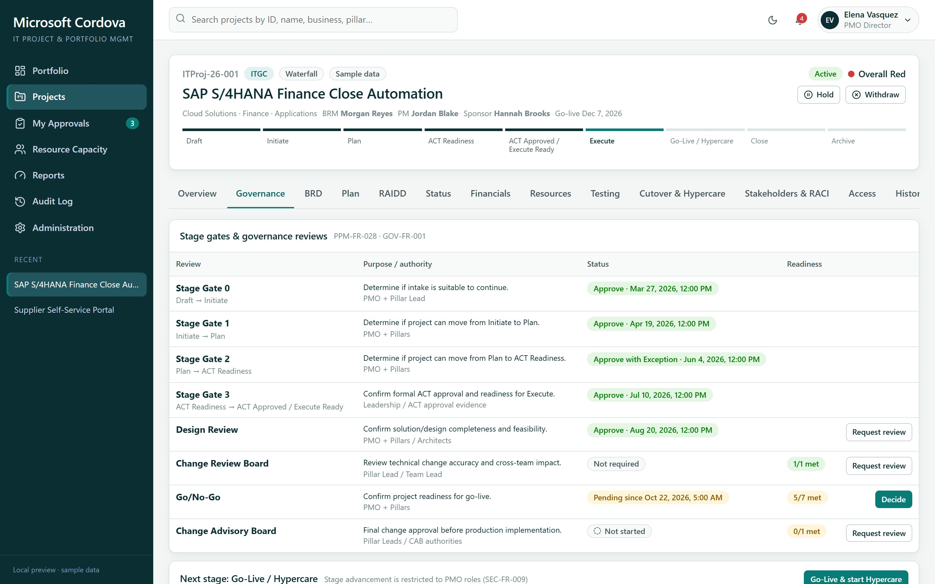
Go/No-Go, CAB and go-live
STEP 13 OF 14 · DELIVER & CLOSE · PMO / PILLARS
BEFORE · IN SMARTSHEET
The 7.0 Cutover Plan and 8.0 Hypercare Defect Tracker sheets.
NOW · IN CORDOVA PPM
Go/No-Go checks UAT, defects, the cutover plan and required reviews
CAB approves the production change; Go-Live moves the project to Hypercare
Cutover tasks and hypercare defects are tracked to closure
BRD GOV‑FR‑001 · GOV‑FR‑003 · NOT‑FR‑005 · AC‑006
Notes:
The sample SAP project has Stage Gates 0 to 3 and Design Review approved, with Go/No-Go pending. Upcoming Go/No-Go, CAB and go-live milestones raise alerts to PMO and pillar leadership (NOT-FR-005). Go-Live / Hypercare is an explicit stage, as BRD recommendation REC-002 suggests. The cutover plan and hypercare defect tracker are the same artifacts as the Smartsheet sheets, on the Cutover & Hypercare tab.

Slide 26
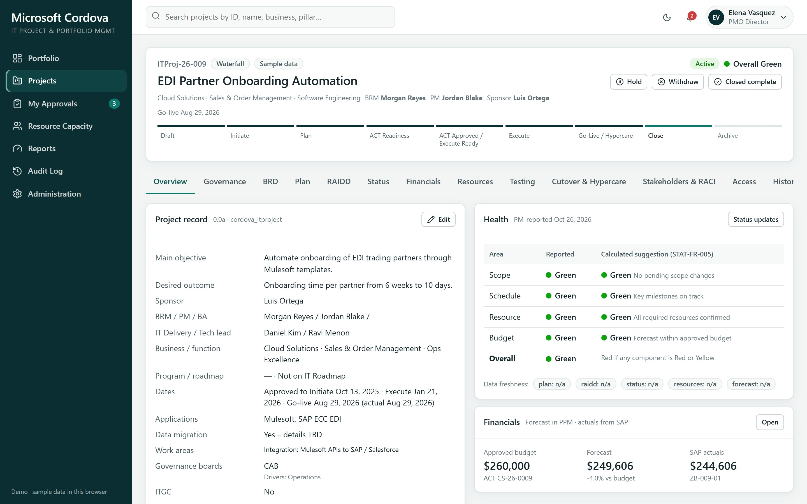
Close and archive
STEP 14 OF 14 · DELIVER & CLOSE · PMO
BEFORE · IN SMARTSHEET
Closure showed in the Workflow Status column; the sheets and dashboard stayed in the project's workspace.
NOW · IN CORDOVA PPM
Close needs hypercare defects closed and current status, or an approved exception
Lessons learned and benefits handoff are captured; status becomes Closed Complete
Archive is manual only; history and audit are kept
BRD PPM‑FR‑026 · PPM‑FR‑031 · NFR‑007
Notes:
The EDI sample project is in Close. The PMO marks it Closed Complete and later archives it by hand; nothing archives automatically (PPM-FR-031, REC-010). Archived projects stay available for historical reporting and audit (NFR-007), in the same tables as active projects rather than in a separate workspace.

Slide 27
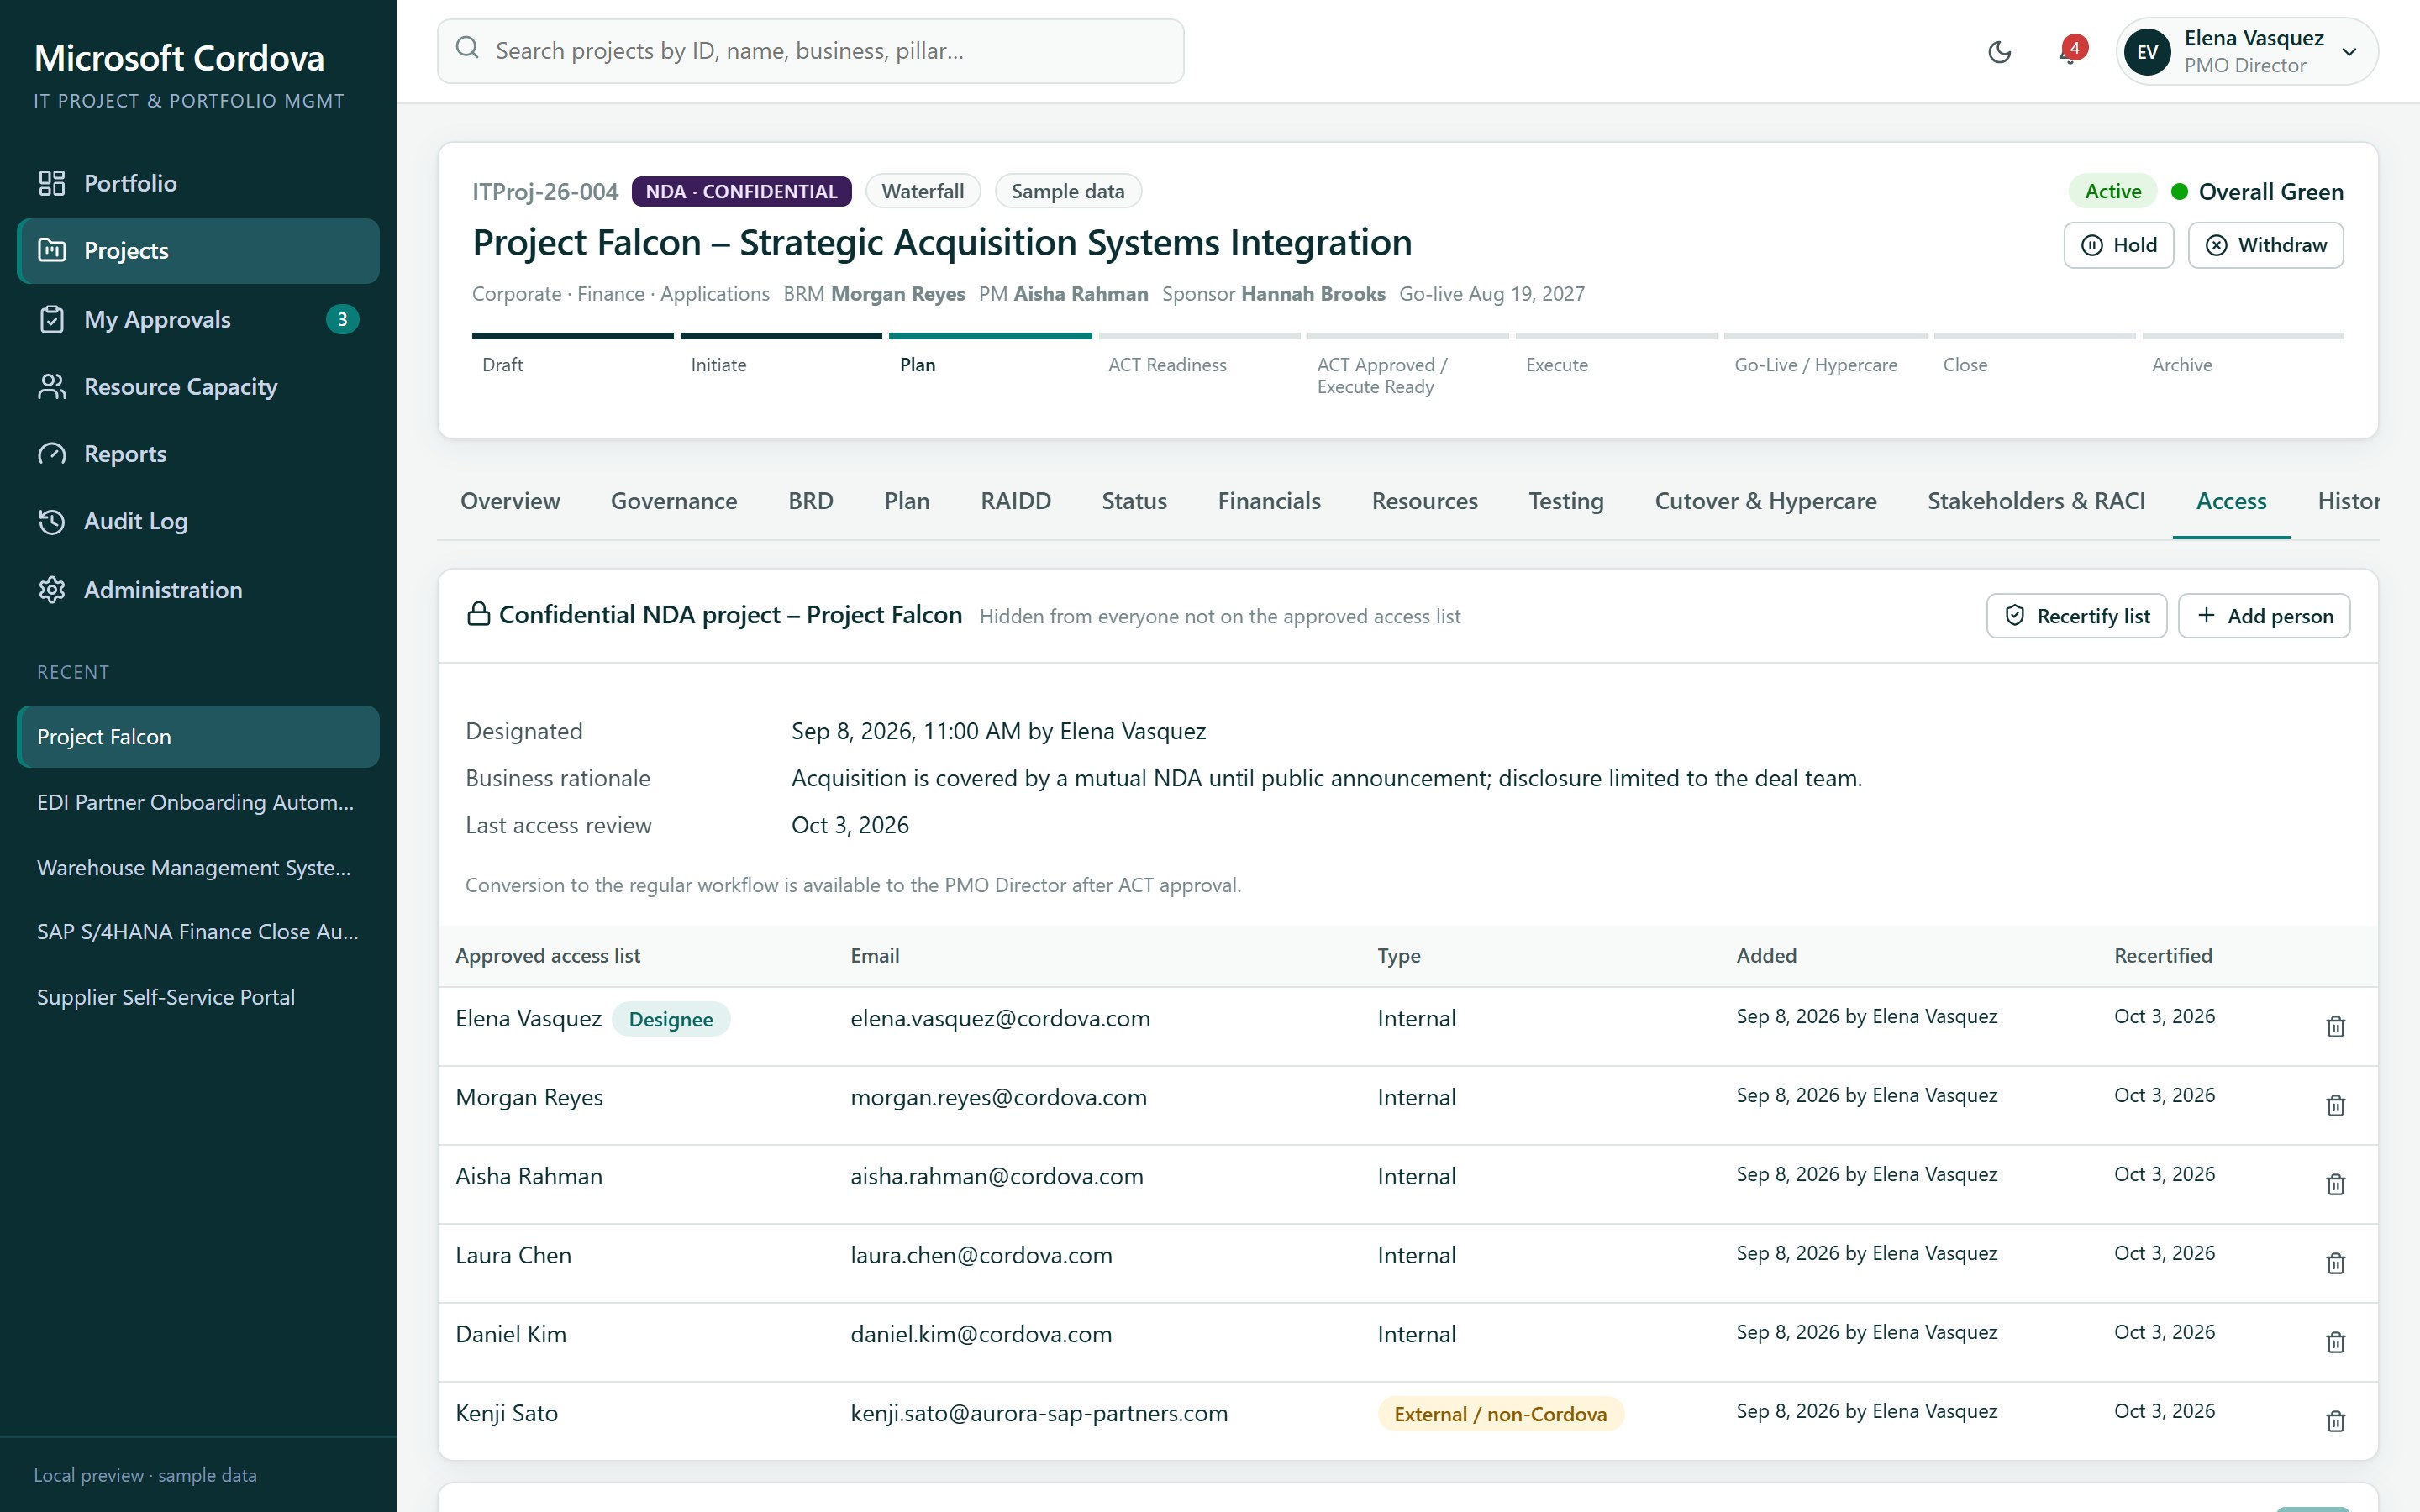
Confidential NDA projects
ACROSS EVERY STEP · BRD §17 CONFIDENTIAL WORKFLOW
BRD REQUIREMENT · PPM-CN-008
Only the PMO Director may designate an NDA project. It stays hidden from standard users, dashboards, reports, searches and notifications until converted.
NOW · IN CORDOVA PPM
The PMO Director designates the project and records the rationale
The approved access list can include internal and external people
Everyone else sees nothing: not in dashboards, reports, search, notifications or recent items
After ACT approval the Director converts it, keeping all history
BRD NDA‑FR‑001…011 · SEC‑FR‑011…013 · RPT‑FR‑005…007 · AC‑015…017
Notes:
Project Falcon is a sample NDA project. Its access list includes an external SAP partner. Signed in as the CIO, who is not on the list, the project list shows 11 projects and Falcon appears nowhere: not in dashboards, reports, search, notifications or recent items, which is what RPT-FR-007 requires. Before production, NDA row-level security in Dataverse is added so the restriction also holds for direct data access.

Slide 28
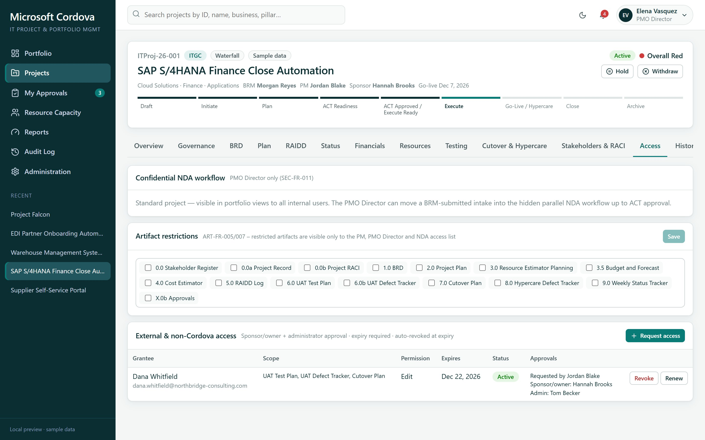
External collaborators
ACROSS EVERY STEP · BRD §17.4 EXTERNAL ACCESS
BRD REQUIREMENT · PPM-CN-009
External and non-Cordova access must be time-bound, explicitly approved, auditable and limited to authorized artifacts or workspaces.
NOW · IN CORDOVA PPM
Grant View or Edit per artifact or for the whole workspace
The sponsor or owner approves first, then an administrator
Expiry is mandatory; access is revoked automatically when it lapses
Renew, revoke and recertify are audited
BRD EXT‑FR‑001…010 · SEC‑FR‑014…016 · GOV‑FR‑008 · AC‑018
Notes:
A Northbridge consultant has Edit access to only the UAT plan, defect tracker and cutover plan on the SAP project, until a fixed date. Requests go to the sponsor or owner and then an administrator; the requester cannot approve their own request. Expiry warnings go out before access lapses (NOT-FR-008).

Slide 29
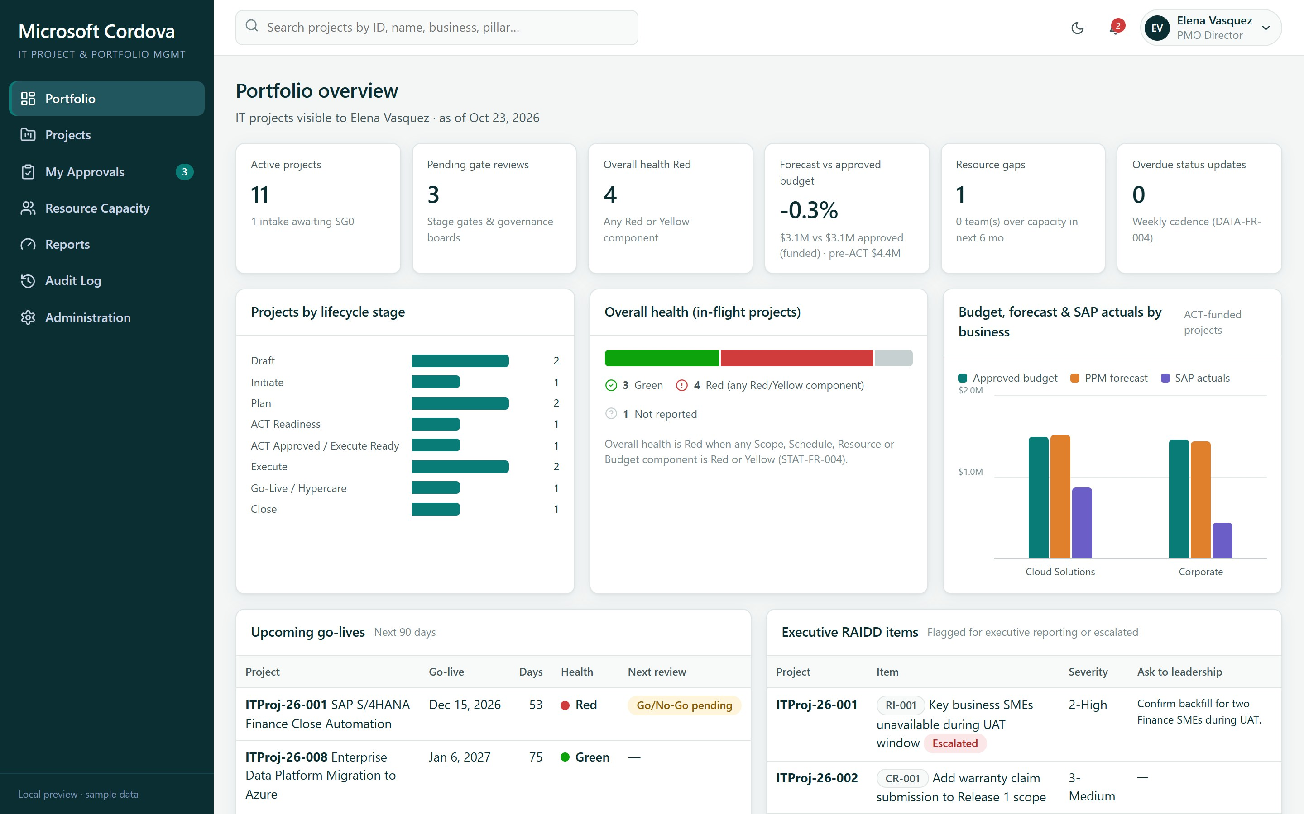
Portfolio view and reports
ACROSS EVERY STEP · BRD §11.2 REPORTING
BEFORE · IN SMARTSHEET
Power BI reports were built on Smartsheet data, including the RCP capacity report.
NOW · IN CORDOVA PPM
The executive dashboard shows stage, health, budget vs forecast vs SAP actuals, go-lives and executive RAIDD
Reports by business, function, pillar and stage; gate readiness; overdue updates; exceptions
Every view drills through to the project; Power BI can read the same tables
BRD RPT‑FR‑001…004 · PPM‑BO‑006 · DATA‑FR‑004 · AC‑012
Notes:
The portfolio dashboard is what executives and the PMO see first. Budget variance compares forecast with approved budget for funded projects only, so pre-ACT estimates do not distort it. Where Power BI used to read Smartsheet, it can now report from the same Dataverse tables the app uses (RPT-FR-004).

Slide 30
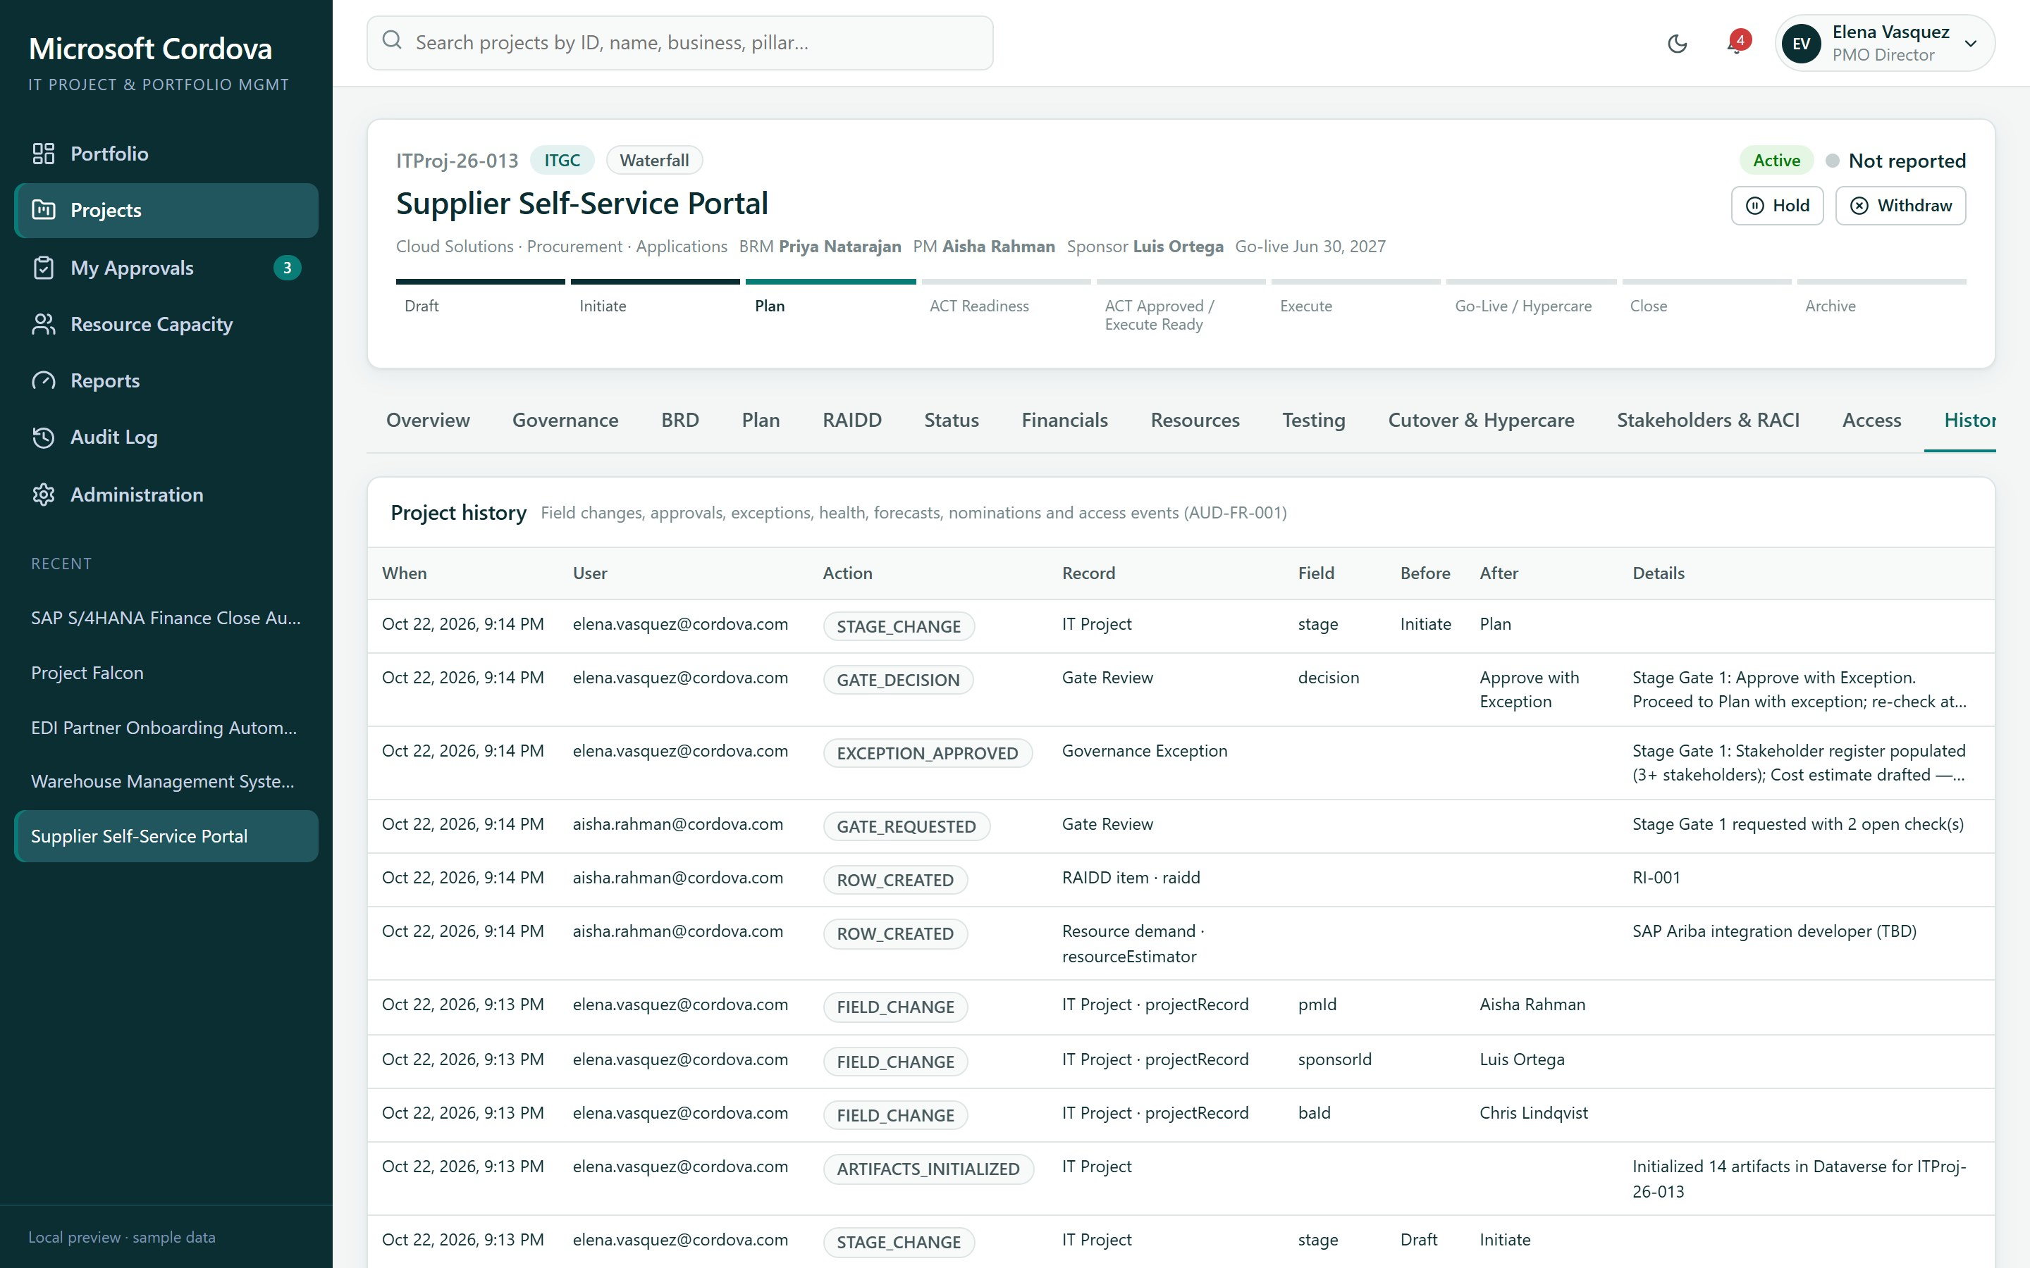
A complete audit trail
ACROSS EVERY STEP · BRD §11.6 AUDIT HISTORY
BEFORE · IN SMARTSHEET
Smartsheet kept activity and cell history sheet by sheet; approval evidence sat on the Approvals sheet.
NOW · IN CORDOVA PPM
Every field change, approval, exception, forecast, nomination and access event is recorded
Each entry has the user, time, previous and new value, and the record
Standard users cannot edit or delete audit entries; table auditing is on for all 30 tables
BRD AUD‑FR‑001…006 · GOV‑FR‑005 · PPM‑BO‑008 · AC‑013
Notes:
This is the history of the new Supplier Self-Service Portal project, from intake through the Stage Gate 1 exception, in one place rather than spread across sixteen sheets. The Cordova PPM User security role can create and read audit events but not edit or delete them (AUD-FR-004). The global audit log can be exported as evidence (NFR-004).

Slide 31
What changed, in numbers
THE RESULT
16 → 1
30
18 / 18
42
template sheets per project became one IT Project record with its artifacts as child rows
Dataverse tables and 2 security roles in the ITProject solution
BRD acceptance criteria traced to a step in this walkthrough
automated workflow checks, all passing, mapped to the acceptance criteria
Same stages, gates, artifacts and numbering the PMO already used, now with one data model, enforced rules and one audit trail.
Notes:
Four numbers sum up the move. The sixteen template sheets per project became one IT Project record with its artifacts as child rows. The ITProject solution has 30 Dataverse tables and two security roles. All eighteen acceptance criteria in BRD section 13 map to a step in this walkthrough. And 42 automated workflow checks, mapped to those criteria, pass against the current build.

Slide 32
Every acceptance criterion, traced
TRACEABILITY · BRD §13 ACCEPTANCE CRITERIA
ID | Acceptance criterion | Shown in
AC-001 | BRM creates, saves and submits a validated intake | Steps 1–2
AC-002 | Unique Project ID and Draft stage | Step 2
AC-003 | PMO notified on Ready for Review | Step 3
AC-004 | SG0 approval moves to Initiate, records date | Steps 4–5
AC-005 | Artifacts created on approval to Initiate | Step 5
AC-006 | Required stage gates and governance reviews | Steps 8, 12, 13
AC-007 | Advancement blocked unless exception approved | Step 8
AC-008 | Component health entered manually | Step 10
AC-009 | Overall health calculated automatically | Step 10
ID | Acceptance criterion | Shown in
AC-010 | Monthly forecast in PPM; SAP actuals | Step 11
AC-011 | Demand entered, nominated, confirmed, modeled | Step 9
AC-012 | Executive dashboards | Portfolio view
AC-013 | Full audit history | Audit trail
AC-014 | Role-based permissions | Steps 1, 4, 8
AC-015 | PMO Director designates NDA projects | NDA projects
AC-016 | NDA projects undiscoverable to others | NDA projects
AC-017 | NDA conversion after ACT keeps history | NDA projects
AC-018 | Time-bound, approved external access | External access
Notes:
All eighteen acceptance criteria in BRD section 13 map to a step or cross-cutting slide in this deck. The same behaviors are covered by the 42 automated workflow checks in the code repository.

Slide 33
From walkthrough to rollout
NEXT STEPS
1
Pilot
Run two or three real intakes through Cordova PPM with BRMs and PMs in the development environment.
2
Decide
Confirm the BRD open decisions: gate checklists (OD-006), schedule and resource thresholds (OD-004/005), data retention (OD-008).
3
Harden
Build the Power Automate flows and NDA row-level security before production.
4
Cut over
Start new intakes in Cordova PPM. Smartsheet data migration is out of scope, so decide how in-flight projects finish.
5
Train
Use this deck to onboard BRMs, PMs, Resource Team Managers and approvers.
Notes:
Suggested next steps. The pilot runs in the development environment where the ITProject Dataverse solution, security roles and the Cordova PPM app are installed. Hardening means the Power Automate flows for notifications, reminders, NDA team sync, external sharing and the SAP actuals load, plus NDA row-level security, as listed in the project README. Because the BRD keeps Smartsheet data migration out of scope, the cut-over is a decision: new intakes start in Cordova PPM, and the PMO decides whether in-flight projects finish in Smartsheet or are re-entered. One known nuance: Project IDs are sequential, so a hidden NDA project leaves a visible gap in the numbering; decide whether that is acceptable.

