Slide 1
Project 2 – Group 1
Jose DAvila
Diana De los Santos
Emilia Sanchez
Marc Huerta
Rae Ann Gregg

Slide 2
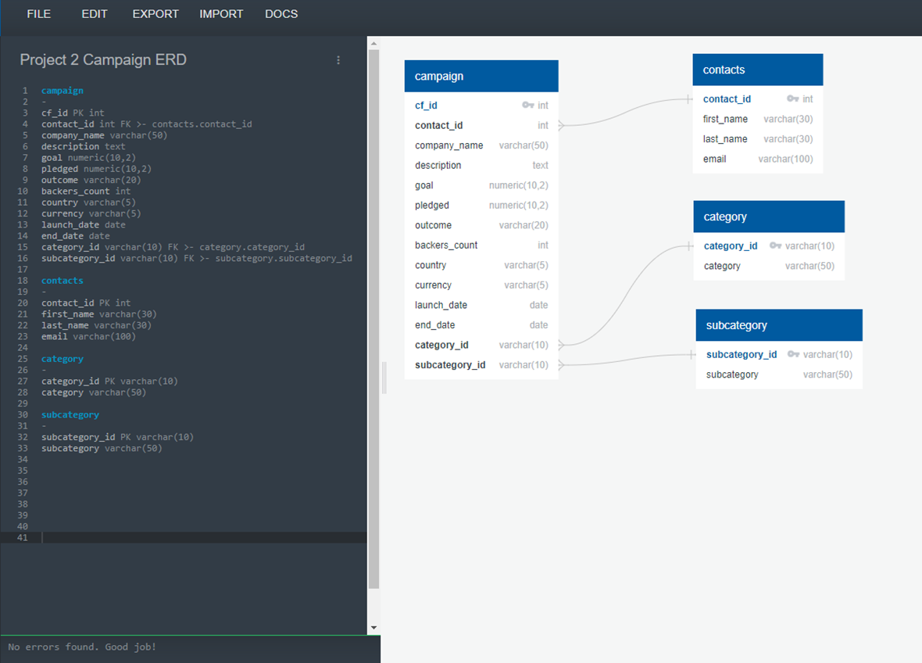
Crowdfunding ERD

Slide 3
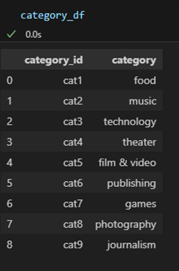
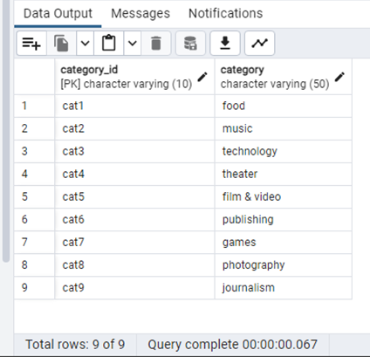
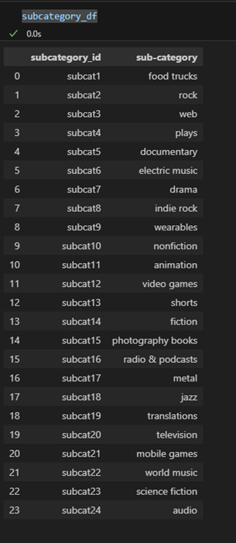
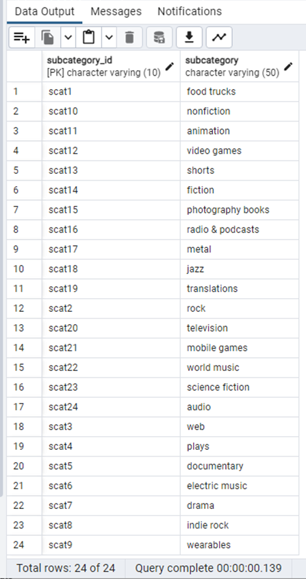
Category and Subcategory DataFrames

Slide 4
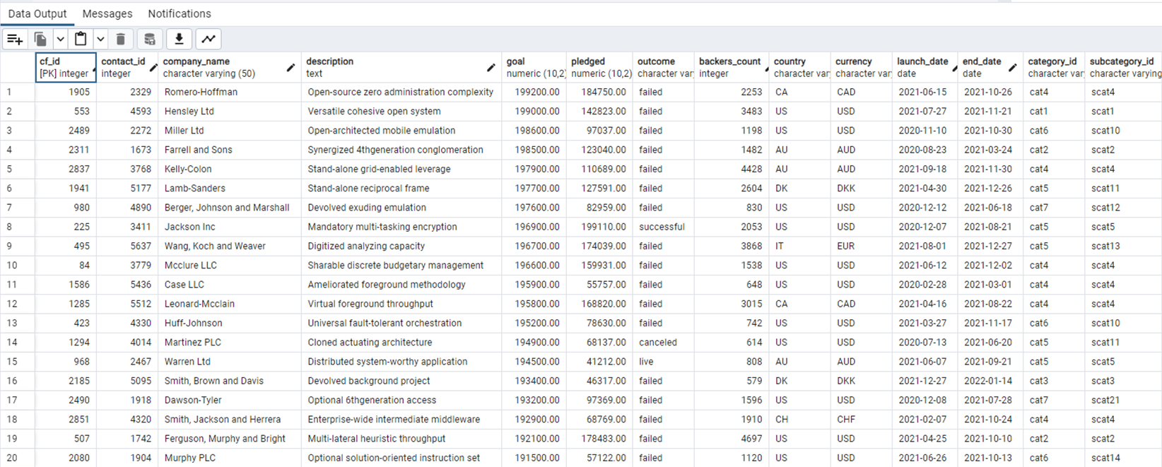
Campaign DataFrame

Slide 5
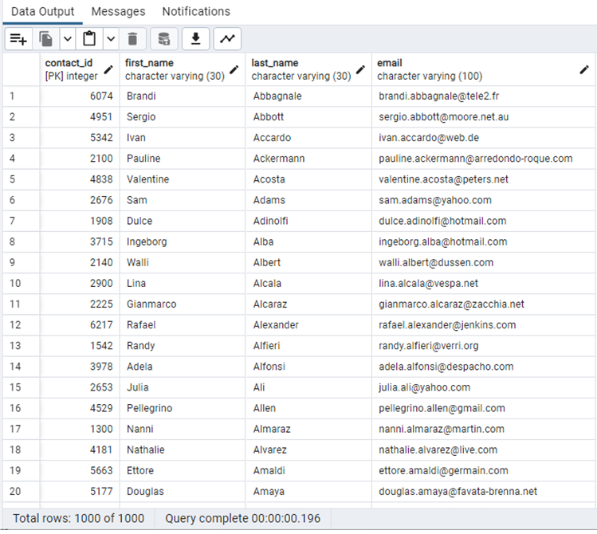
Contacts DataFrame

