Slide 1


BINUS UNIVERSITY
HYDROS
DRIP IRRIGATION
BY : MENGSKY TEAM

Slide 2
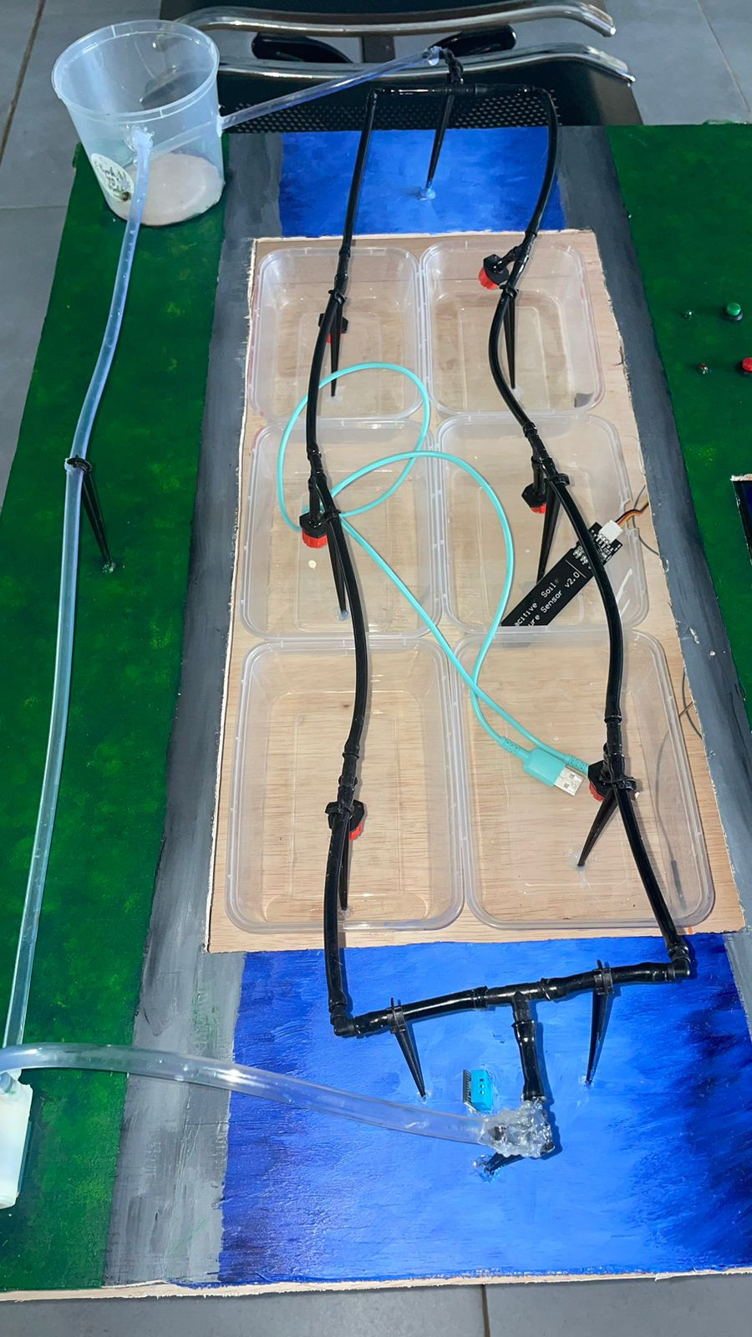
INTRODUCTION

Slide 3
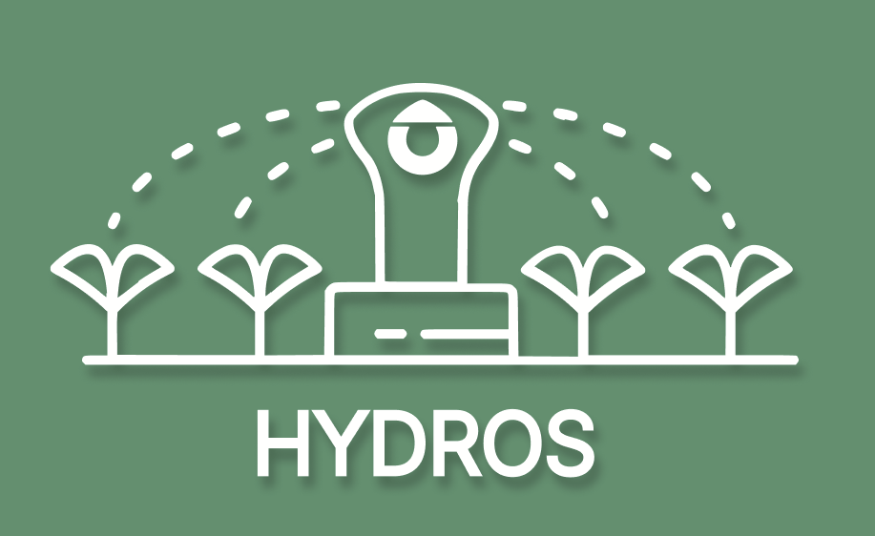

Slide 4

TIMELINE
Tanggal | Kegiatan
Research alat yang dibutuhkan untuk proyek | 14 Februari 2024 - 29 Februari 2024
Pembelian alat - alat untuk proyek | 25 Februari 2024 - 2 Maret 2024
Progress tahap 1: Membuat prototype arduino melalui Fritzing | 28 Februari 2024 - 1 Maret 2024
Progress tahap 2: Perakitan alat - alat secara langsung dan pengkodean arduino untuk uji coba semua alat yang dibeli | 2 Maret 2024 - 6 Maret 2024
Belajar cara penggunaan flutter dan bagaimana cara arduino bisa dikontrol melalui aplikasi | 7 Maret 2024 - 9 Maret 2024
Progress tahap 3: Pembuatan aplikasi mobile menggunakan flutter | 9 Maret 2024 - 26 April 2024
Progress tahap 4: Pengkodean backend pada arduino (dari arduino sampai ke firestore) | 28 April 2024 - 12 Mei 2024
Pengerjaan proyek selesai | 12 Mei 2024

Slide 5
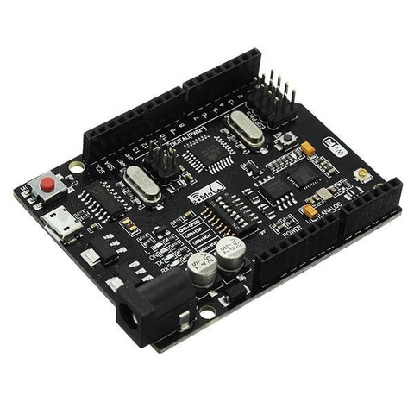
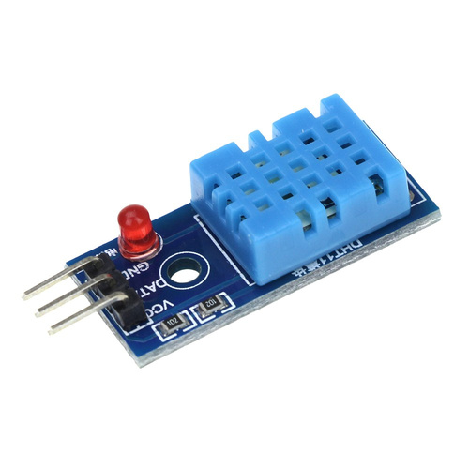
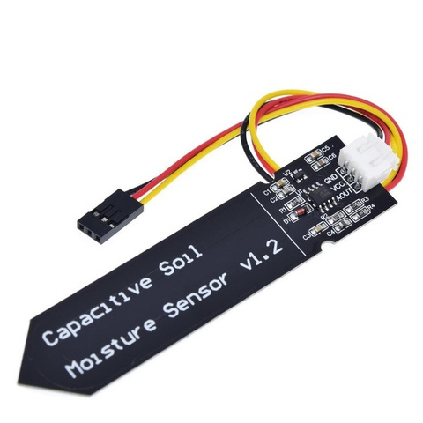
Komponen
Arduino Uno
Built In Wifi
DHT11
Soil Moisture

Slide 6



Komponen
Flutter
Firebase
ExpressJs

Slide 7
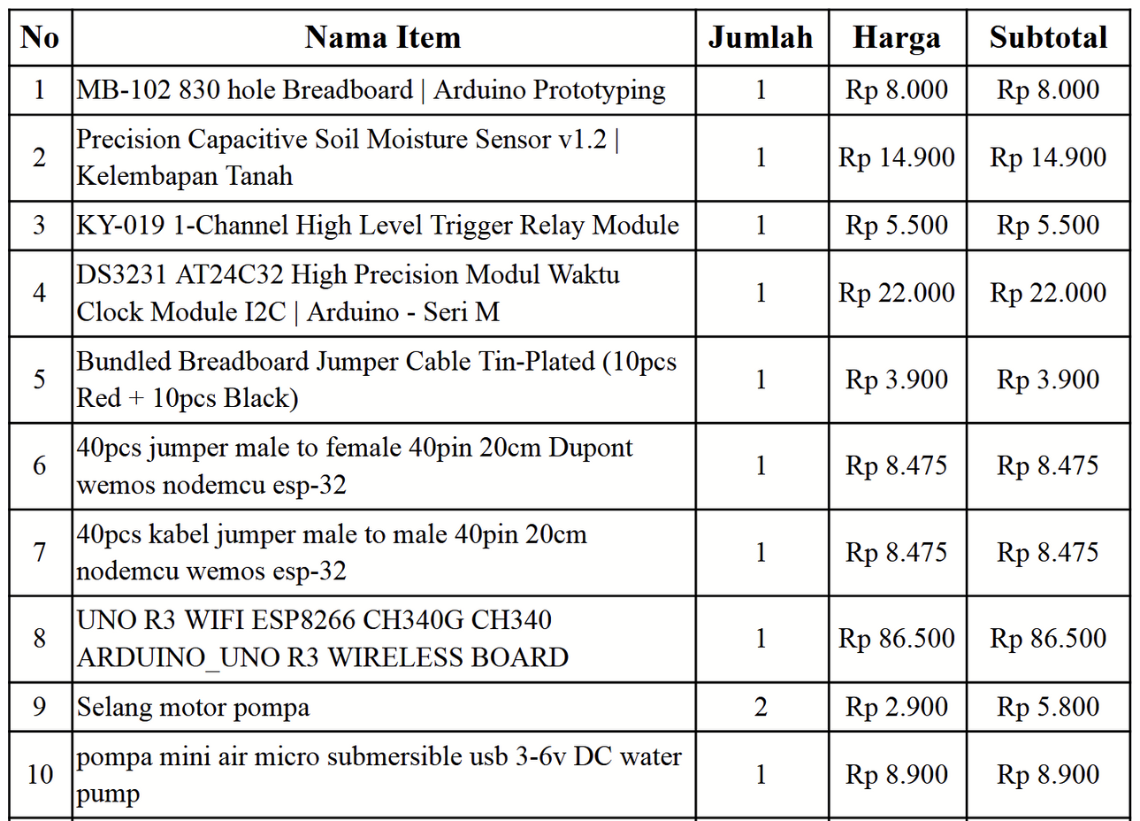
Anggaran

Slide 8
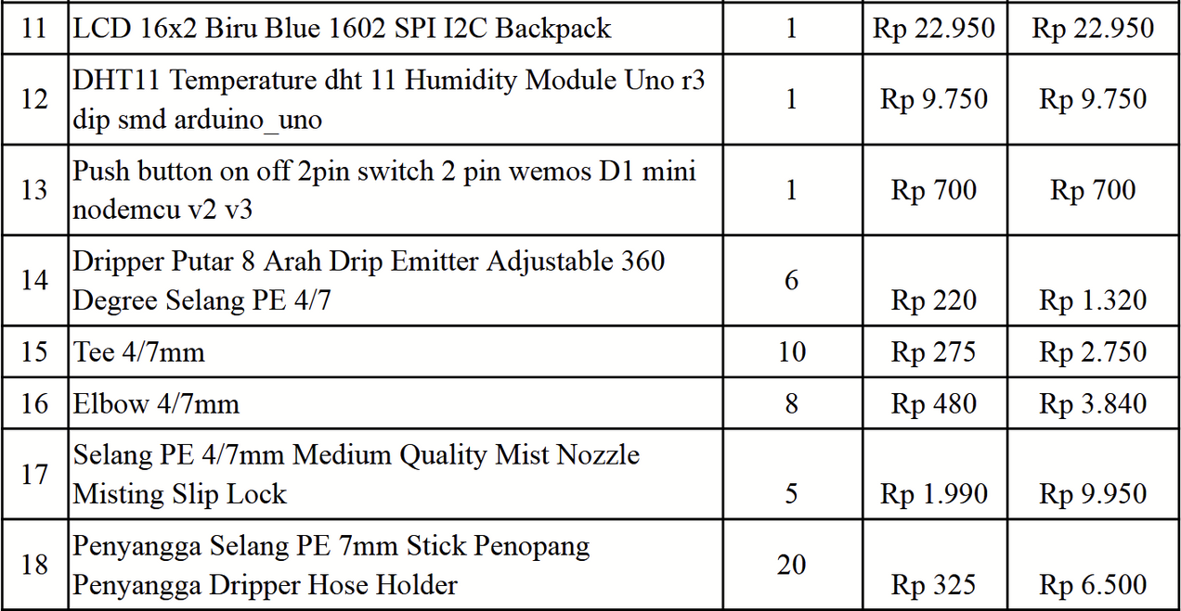
Anggaran

Slide 9
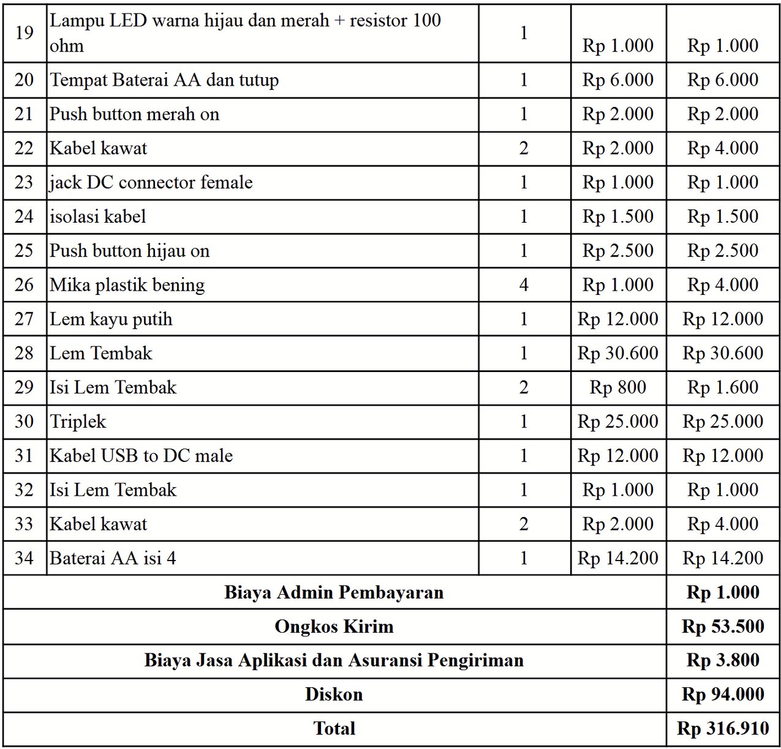

Slide 10

FITUR
Kontrol On/Off Pompa
Menampilkan Data Sensor
Kontrol Batas Kelembapan Tanah
Menampilkan Data Rata-rata
Menampilkan Jumlah Pompa Nyala
Menampilkan
History
Mengatur Waktu Pompa Nyala
Pair Device

Slide 11
Demo Time

Slide 12
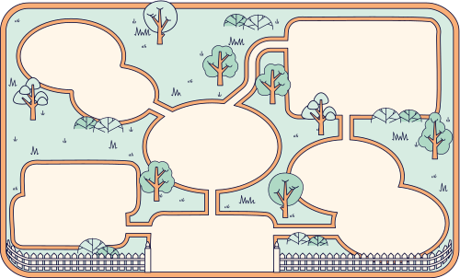
INFOGRAFIS
DRIP IRRIGATION
WATER SMARTER, NOT HARDER : INTRODUCING OUR SMART IRRIGATION SYSTEM
WATER CONSERVATION
Drip irrigation gets water and fertilizer directly to plant roots, everywhere they need it.
Drip irrigation can save up to 50% of water compared to traditional watering methods like hose watering or overhead irrigation. This is especially important in areas with limited water resources or during dry seasons.
FERTILIZATION FACILITATION
This feeds all the plants evenly, helping them grow better and potentially produce more.
ENHANCED PLANT GROWTH
Drip irrigation ensures plants receive the water they need consistently, which can lead to improved plant growth and crop yields.
Drip irrigation is a time-saving and labor-saving system, as there's no need for manual watering of plants.
SUPPRESSED WEEDS
Because water is only delivered to plant roots, weeds growing around the plants are deprived of as much water, hindering their growth.
SAVES TIME AND EFFORT
Traditional watering methods like hose watering or sprinklers often require frequent attention. With drip irrigation, water is delivered slowly and directly to the roots, reducing the need for constant monitoring and watering adjustments.
REDUCED PLANT DISEASES
Drip irrigation helps keep plant leaves dry, which can help reduce the risk of fungal and bacterial diseases.

Slide 13

DOKUMENTASI
https://bit.ly/dokumentasiHYDROS

Slide 14

QnA
Jangan tanya, berat, biar Pak Anang aja

Slide 15

Thank
You:)

