Slide 1
Getting Started with CSS

Slide 2
What’s CSS
Cascading
Style
Sheets
C S S

Slide 3

CSS Development
2012-06-19: Media Queries
2011-09-29: Namespaces
2011-09-29: Selectors Level 3
2011-06-07: Color
Candidate Recommendation (CR)：
css3-background
css3-box
css-cascade-3
css3-color
css3-content
css-fonts-3
css3-gcpm
css3-layout
css3-marquee
css3-mediaqueries
css3-page
css3-selectors
css3-ui
over fifty CSS modules published from the CSS Working Group
2012
CSS was first proposed by Håkon Wium Lie
1994
CSS 2 was developed by the W3C and published as a recommendation
CSS 4 ?
1998.05
1994
1996
1998
2011
2012
?
The CSS 1 specification was published
CSS 2.1 was was finally published as a W3C Recommendation
1996.11.17
Font properties
Color of text, backgrounds
Text attributes
Alignment of text, images, table
Margin, border, padding, and positioning
2011.06

Slide 4
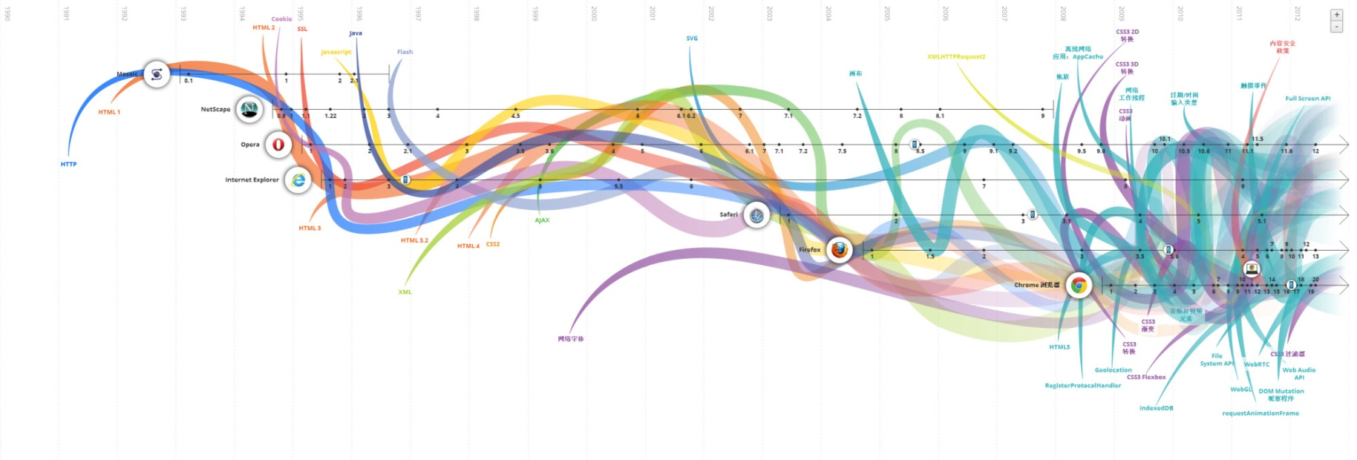
Evolution of the Web

Slide 5
CSS Syntax
Type Selector
Value
Property-value Pair
Property
div { color: #000000; font-size: 14px }
Declaration
CSS Rule

Slide 6




CSS Selectors
* #X
.X
X Y
X
X:visited
X:link
X + Y
X > Y
X ~ Y
X[title]
X[href=""]
X[href*=""]
X[href^="http"]
X[href$=".jpg"]
X[data-*=""]
X:checked
X:after
X:hover
X:not(selector)
X::first-letter
X:nth-child(n)
X:nth-last-child(n)
X:nth-of-type(n)
X:nth-last-of-type(n)
X:first-child
X:last-child
X:only-child
X:only-of-type
X:first-of-type
Applied to <a> tag
Applied to IE8
Applied to IE7
IE6
IE7
IE9
FF 3.5

Slide 7
References
Cascading Style Sheets :
http://en.wikipedia.org/wiki/Cascading_Style_Sheets
The 30 CSS Selectors you Must Memorize :
http://code.tutsplus.com/tutorials/the-30-css-selectors-you-must-memorize--net-16048
CSS selectors :
http://www.quirksmode.org/css/selectors/
网络的演变 :
http://www.evolutionoftheweb.com/?hl=zh-cn

Slide 8
F A Q

Slide 9
Thank you!

