Slide 1
CSS Background

Slide 2
Background property
background-color : transparent #111111
background-image: none url(http://......)
background-repeat: no-repeat repeat-x
background-attachment: scroll fixed
background-position-x: p(x) left center right
background-position-y: p(y) top center bottom

Slide 3
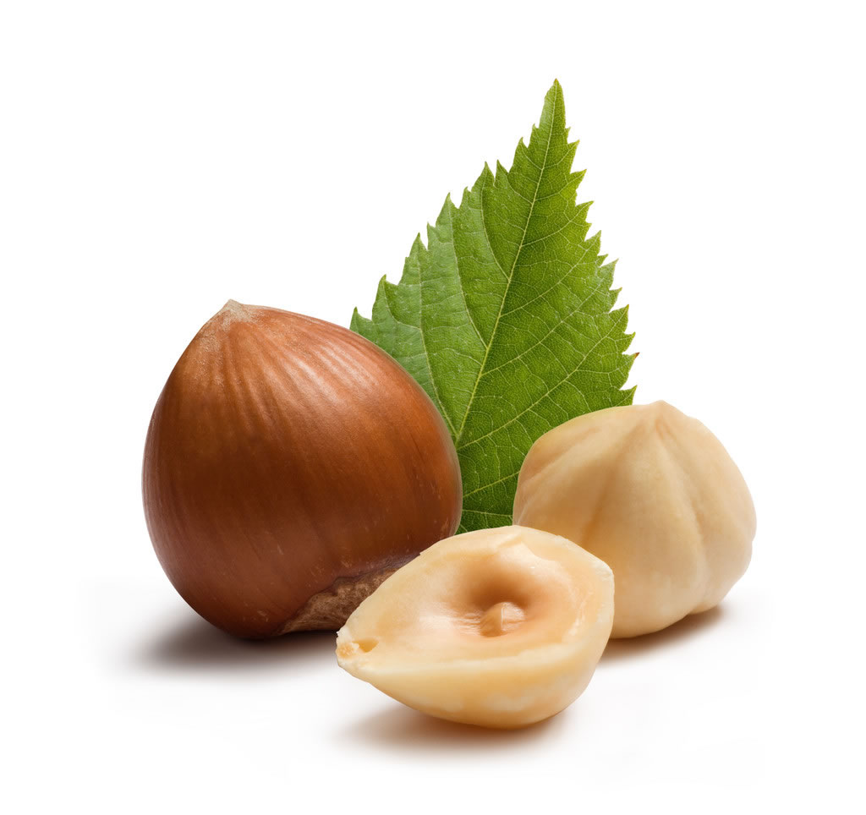
Time to Show!

Slide 4
Background style
div {
background-color : black /* 背景色为黑色 */
background-image : url(http://...) /* 背景图片地址 */
background-repeat : repeat-x /*背景水平平铺*/
background-attachment : fixed /*背景固定*/
background-position : 20px 20px /* 背景位置*/
}

Slide 5
Background demo
background-position-y
background-attachment
background-image
div {background: red url(…) repeat-y fixed 30px top}
background-position-x
background-color
background-repeat

Slide 6
References
Background :
https://developer.mozilla.org/zh-CN/docs/CSS/background
CSS2.0手册(苏沈小雨版) :
http://www.w3cn.org/resource/down/2004/73.html
图片来源 :
http://www.nipic.com/show/1/55/5171482k25dbbcd6.html
配色软件 ColorKey Xp 体验发布:
http://www.blueidea.com/download/product/2003/627_2.asp
中国传统色彩名录:
http://www.blueidea.com/design/doc/2003/1411.asp
Color Syntaxes:
http://www.w3.org/TR/SVG/types.html#ColorKeywords

Slide 7
F A Q

Slide 8
Thank you!

