Slide 1
CSS Positioning
Part ½ : Relative & Absolute

Slide 2
Position property
position: static relative absolute fixed inherit
left: auto 30% 50em 100px
top: auto 30% 50em 100px
right: auto 30% 50em 100px
bottom: auto 30% 50em 100px
z-index: auto range( 2³² )

Slide 3
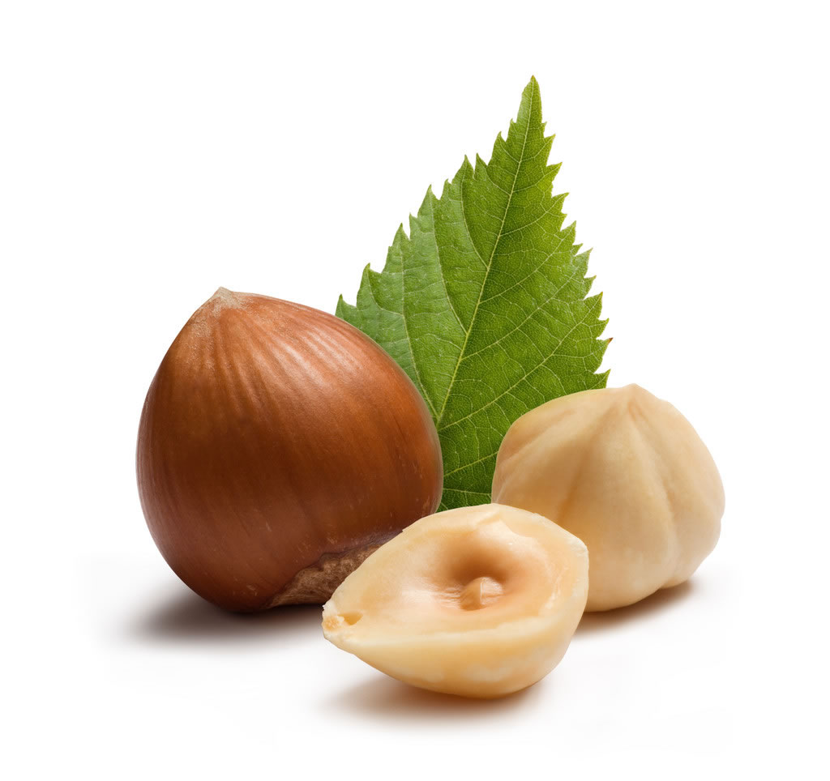
Time to Show!

Slide 4
Position style
#header {
position : absolute /* 绝对定位 */
left : 30px/* 向左偏移 30px */
top : 50px /* 向上偏移 50px */
z-index : 999 /* 层叠顺序为 999 */
}

Slide 5
References
CSS Positioning 101:
http://alistapart.com/article/css-positioning-101
BFC 神奇背后的原理:
https://github.com/melonHuang/blog/blob/master/docs/css/1formattingContext.md
HTML和CSS高级指南之二——定位详解:
http://www.w3cplus.com/css/advanced-html-css-lesson2-detailed-css-positioning.html

Slide 6
F A Q

Slide 7
Thank you!

